Slide 1


ALINA XIE/UI&UX DESIGN
ACADEMY OF ART UNIVERSITY
Hi! Figma Team!
This is a video from alina.
WENQIAN XIE
1

Slide 2

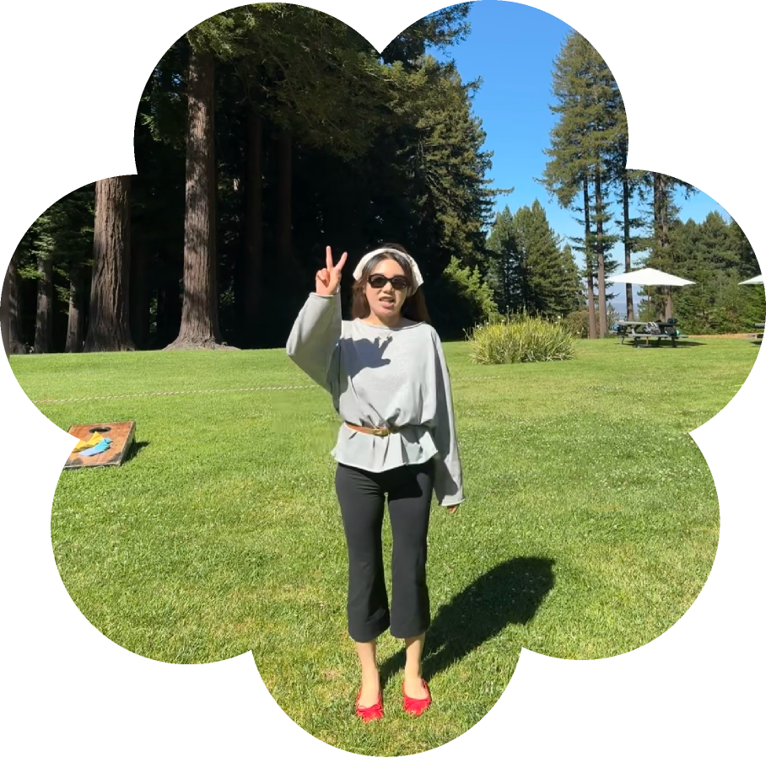
ALINA / WENQIAN XIE
who am I?
MY JOURNEY STARTS FROM....
BFA Communication Design #China
MFA Fine Art #Italy
Product Designer [Home Decor]
World Traveler & International Seller
MA UI/UX Design @ AAU
2

Slide 3

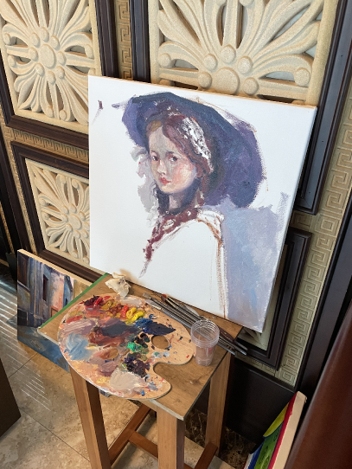
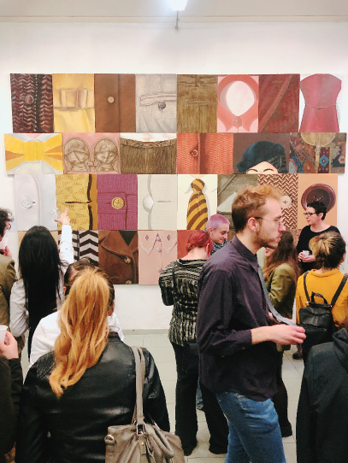
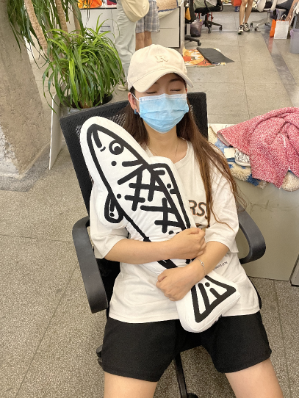
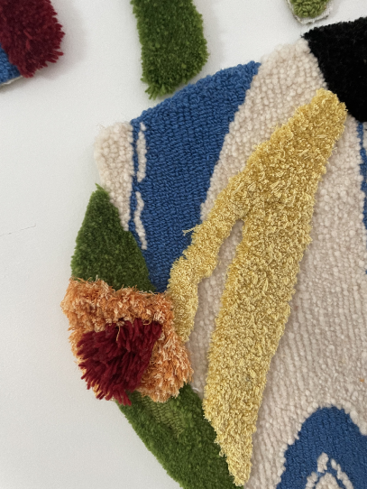
EXPERIENCE
studying as an artist
working as a product designer
home decor
passion: always want to create.
3

Slide 4

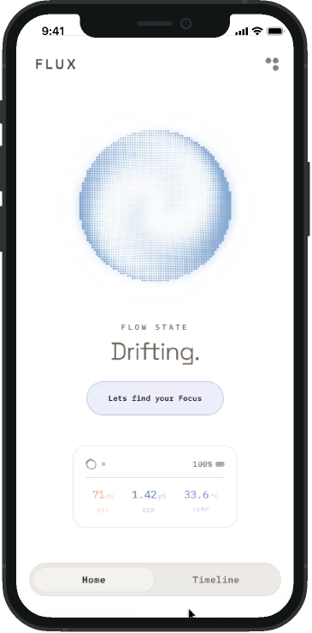


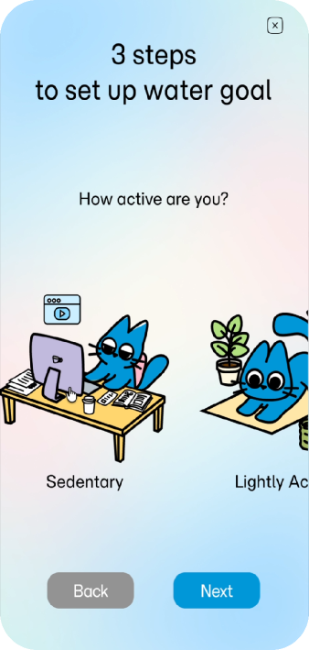

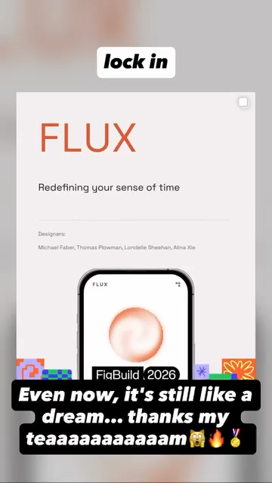

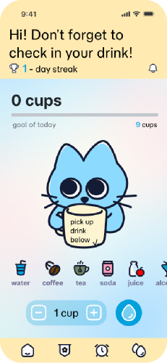

PROJECTS
Figma Build Hackthon 2026
user research, UI&motion design
Health Tracking
solo project
4

Slide 5
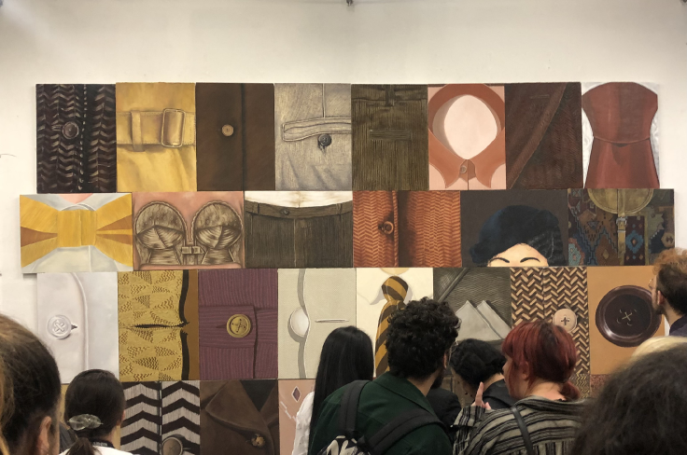
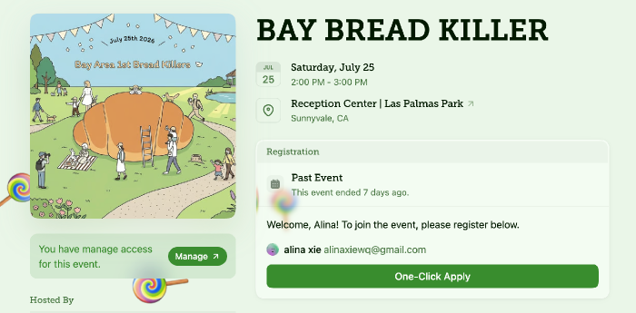
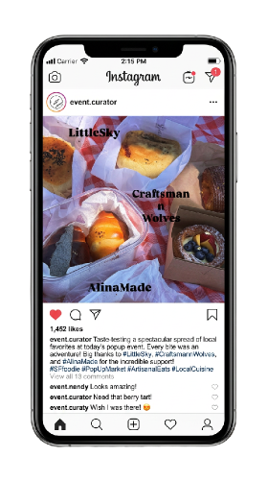
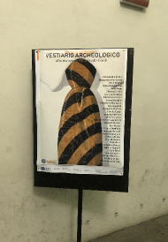
PAST EVENT
Alina_WQ_Xie
Alina_WQ_Xie
Alina_WQ_Xie
Alina_WQ_Xie
Alina_WQ_Xie
Alina_WQ_Xie
hoster
co-curator
bread and industry information sharing
display and visual for students exhibition
5

Slide 6



FUTURE EVENT
FigmaMake Mini Hackthon
+
The core objective of this event is to empower designers to customize AI-driven Figma Widgets and Plugins using natural language prompts.
By bridging the gap between product thinking and AI automation, this initiative will directly improve team productivity, eliminate repetitive operational friction and foster collaboration.
6

Slide 7
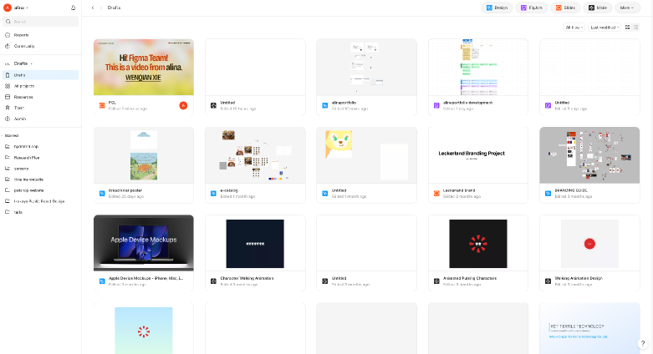
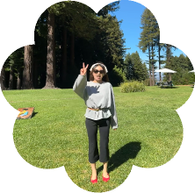


Thanks
For
Watching
Alina / Wenqian Xie
7

