Slide 1
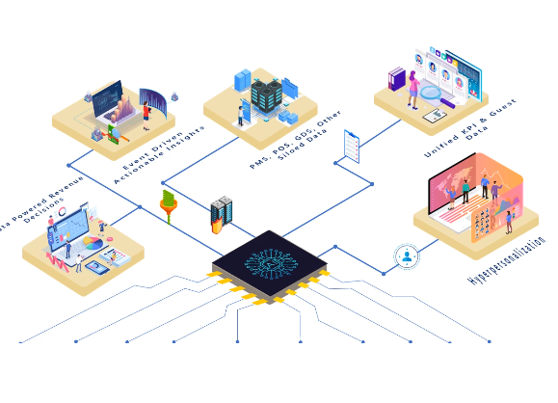



Slide 2

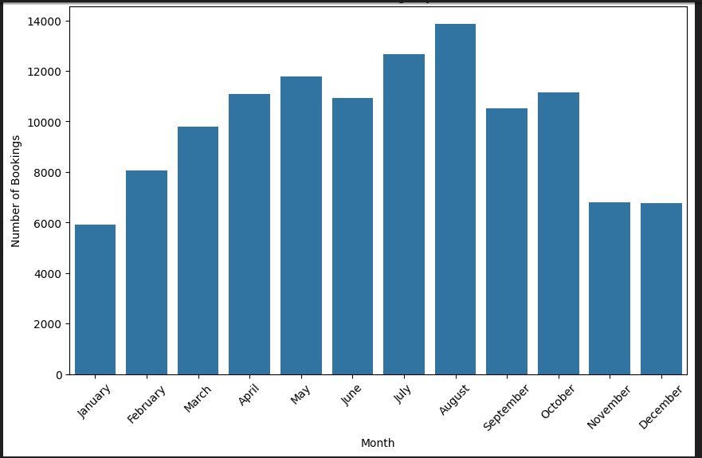
Booking Analysis graph by Months
This graph is shows that , the months of August is increasing the booking number and months of November and December is same booking is occurred.
Very less booking is occurred in the month of January.

Slide 3
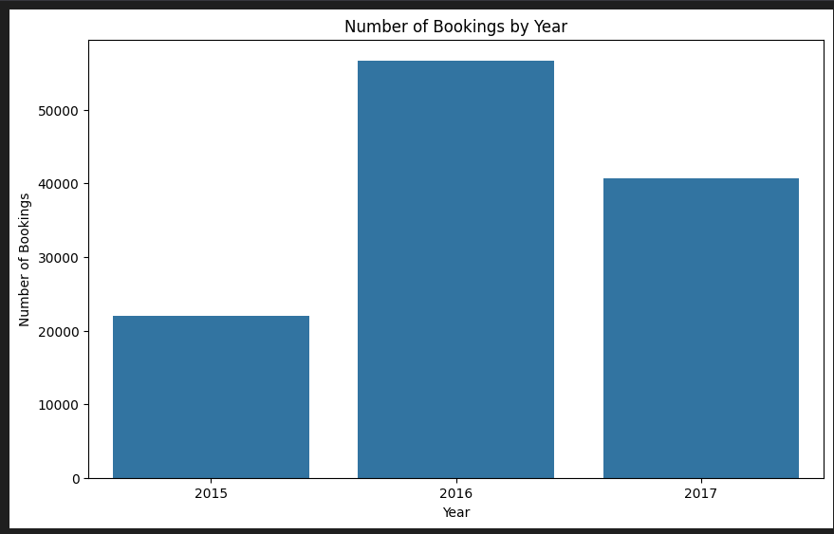
Booking Analysis graph by Years
This graph is shows that , the year of 2016 is increasing the booking number and year of 2017 slightly decrease as compared to 2016 .
2015 is very less booking confirmed.

Slide 4

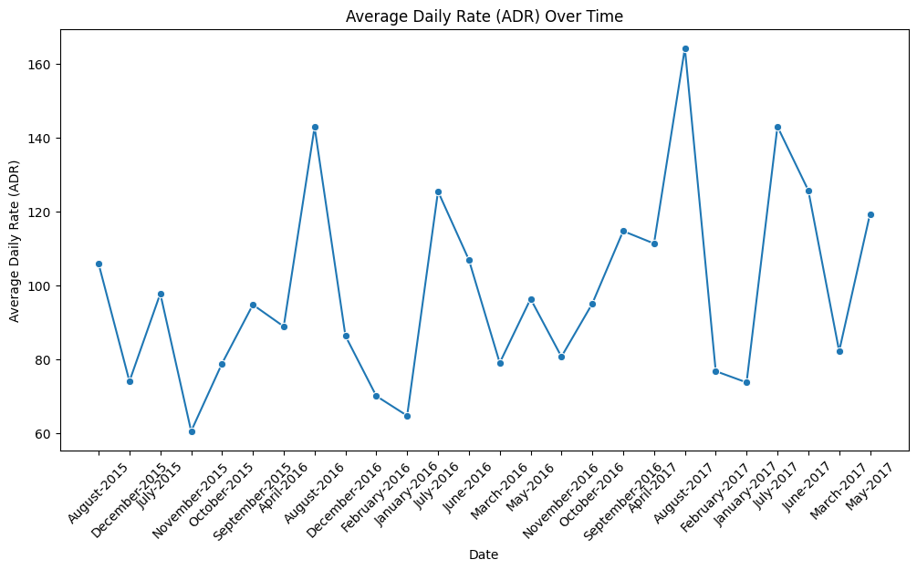
Average daily rate over time
In this graph shows the 2017 has more average daily rate over time

Slide 5
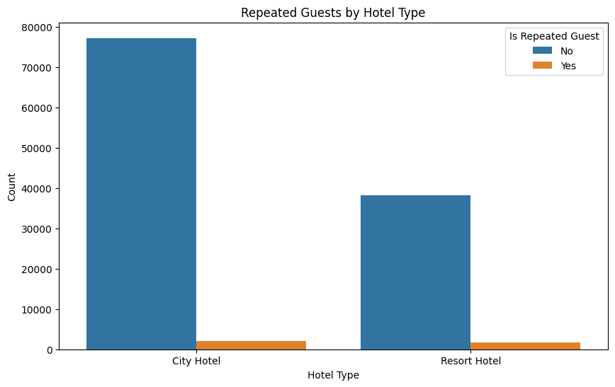
In the city repeated guest is come more as compared to resort.

Slide 6
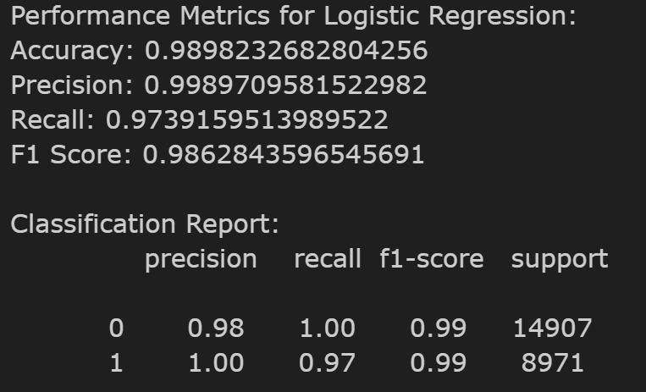
Logistic Regtression

Slide 7
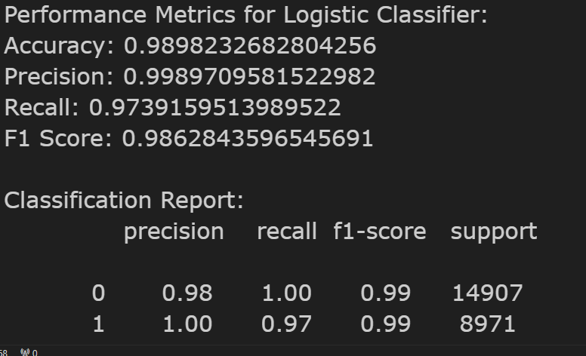
Logistic Classifier

Slide 8
Summery
Pricing Adjustments: Introduce flexible pricing to lower cancellations. Offer early-bird discounts for bookings with shorter lead times and provide added incentives, like free amenities, for reservations close to arrival. For longer stays, consider implementing tiered cancellation fees, as these often face higher cancellation rates.
Customer Targeting: Address high-cancellation segments with discounts on non-refundable bookings and flexible options. Foster guest loyalty by offering perks to repeat customers, who generally exhibit lower cancellation rates.

Slide 9
Marketing and Distribution Optimization: Boost direct bookings by providing unique benefits (such as complimentary breakfast) and flexible cancellation terms. Strategically partner with OTAs and negotiate terms to reduce cancellations.
Enhanced Customer Flexibility: Enable easy booking adjustments and offer flexible payment options to high-risk customers, helping to prevent cancellations.
Operational Efficiency: Leverage cancellation predictions to better align staffing and maintain room flexibility, reducing operational disruptions.

