Slide 1
IMPEDANCE-BASED BATTERY MANAGEMENT SYSTEM FOR SAFETY MONITORING OF LITHIUM-ION BATTERIES
Alin Anto
S7 EEE-A
Roll No: 16

Slide 2
INTRODUCTION: NEED FOR BMS
Controlling charge and discharge cycle
Preventing overheating
Maintaining cell matching for multi-cell battery
Terminal voltage match
SoC match
Load sharing profile
4. Detecting faulty cells in battery

Slide 3
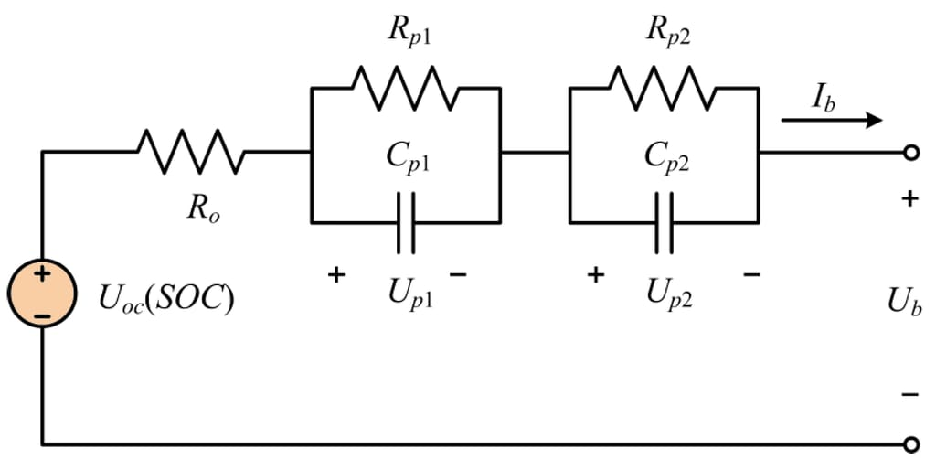
CONVENTIONAL BMS
Monitoring terminal voltage
Monitoring surface temperature
Control charge and discharging cycle
Indicate SoC
Even the most sophisticated BMS now available only has a single frequency impedance meter

Slide 4
TEST OF HYPOTHESIS
Hypothesis
“ In multi-cell Li-Ion battery, monitoring of E_{t} , T_{surf} & R_{s} alone is not sufficient to identify cell mismatch”
Factors affecting mismatch
Cycle life aging
Calendar aging
Over discharge
Over charge

Slide 5
TEST SETUP
New cells 5.3 Ah (swing 5300 model, Boston power, MA, USA)
Cycled twice (2.7V to 4.2 @ C/4 rate)
Brought to 50% SoC.
Stored at room temperature overnight.
3 cell battery is formed with is tested immediately.
6 cell battery is formed which is stored for 6 months to simulate calendar aging.
2 individual cells are reserved for overcharging and discharging tests.

Slide 6
CELL EMF MONITORING
Emf of the cell depends on:-
Activation at anode.
Diffusion at cathode.
Resistive drop across electrolyte.
Emf least depends on FOD.
Foreign object debris is formed in the electrolyte via permanent chemical changes brought by over discharging, cycle life aging, calendar aging.

Slide 7
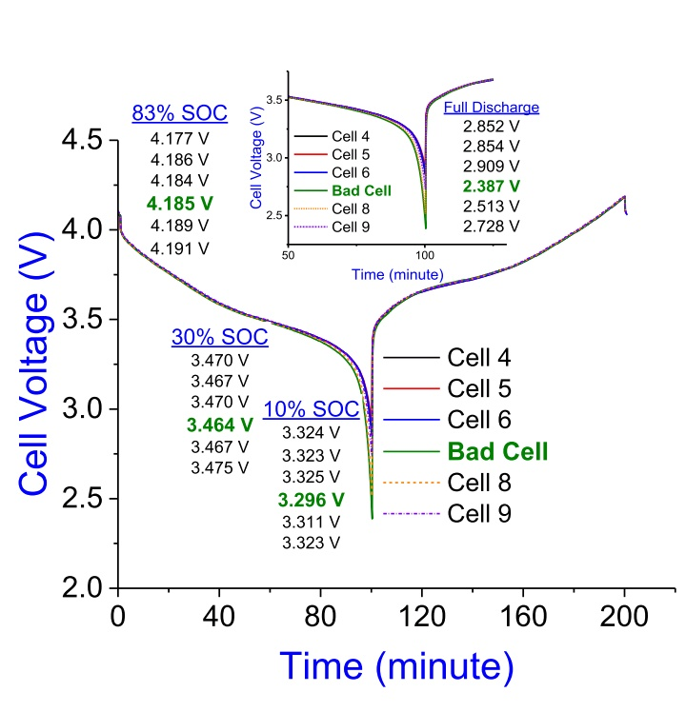
Voltage vs time graph(charge discharge cycle)
Cell discharge limit-2.7V
Battery discharge limit-16.2V
Battery made of 5 normal and 1 over discharged cell.
No deviation for Bad cell upto 30% SoC

Slide 8
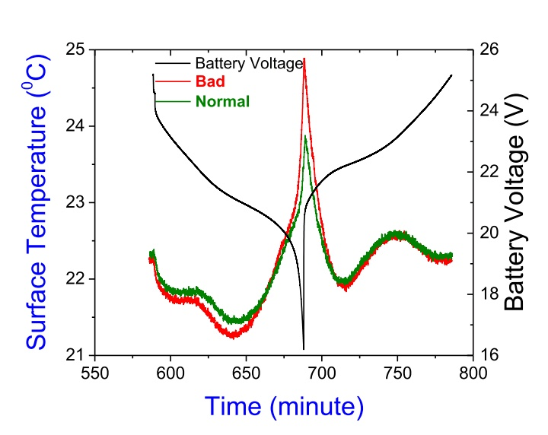
SURFACE TEMPERATURE MONITORING
Even when fully drained the deviation is not more than 1 degree.
The actual over discharge condition can only be indicated by internal temperature of cell
Battery made of 5 normal and 1 over discharged cell.

Slide 9
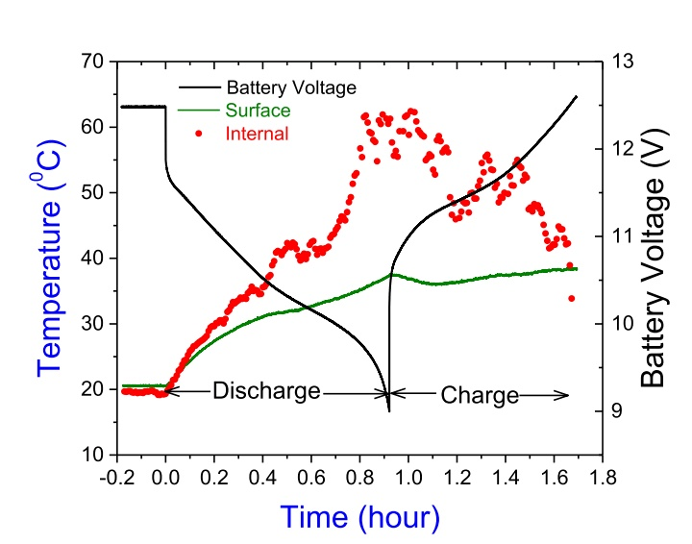
SURFACE TEMPERATURE MONITORING
There exists only weak relation between internal and surface temperature.

Slide 10
OBSERVATIONS
A cell voltage monitor in BMS is not always capable of identifying mismatched and over discharged cells and will miss bad cells discharging far below their limit, which might cause a battery fire.
Monitoring of surface temperature do not indicate damage to the interior of the cell and SoH.

Slide 11
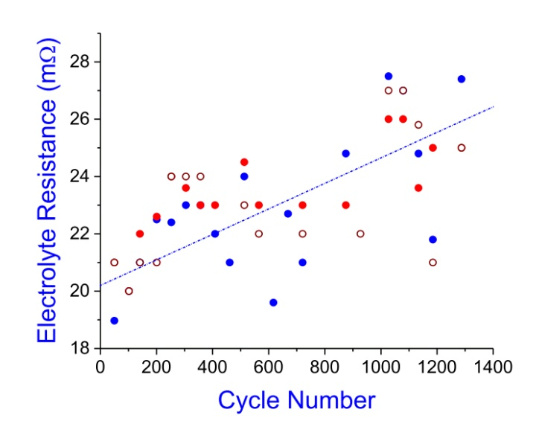
ELECTROLYTIC RESISTANCE MONITORING
The Electrolyte resistance depends on:-
Internal Temperature
Li+ concentration in electrolyte.
Aging & FOD.
Functions:-
To estimate aging.
To estimate internal temperature.
Limitations:-
Result valid only when cell is resting.
Otherwise the Li+ concentration varies and affects resistance of electrolyte.

Slide 12
PRINCIPLE OF IMPEDANCE BASED BMS
Li ion cell is a multi-component system consisting of anode, cathode and electroyte.
SEI is most sensitive to temperature and least sensitive to current and SoC.
Multi-frequency impedence measurement (phase and amplitude) can separate the effects of each component in Li-ion cell system

Slide 13
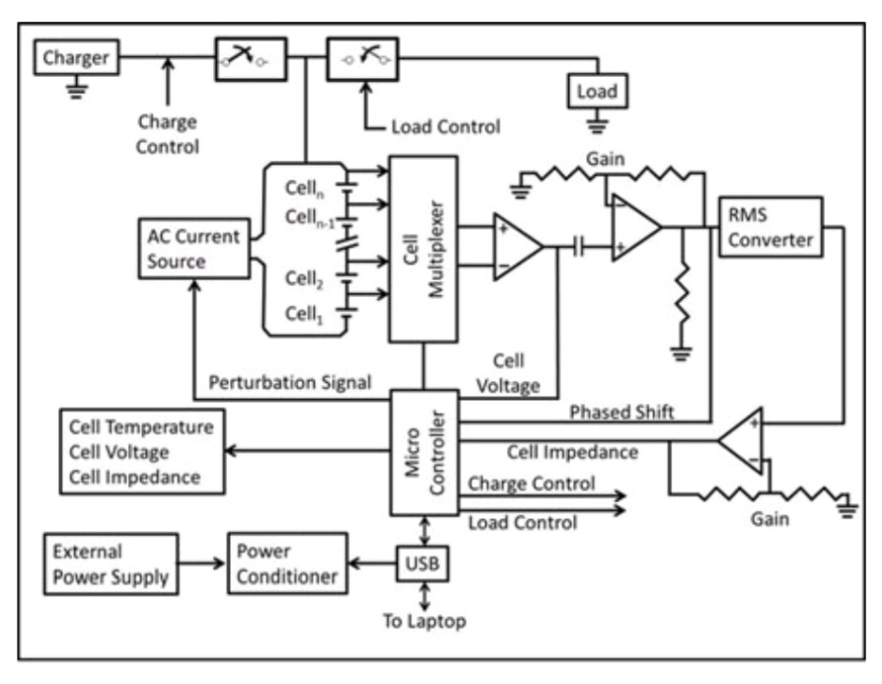
PROPOSED SYSTEM-BLOCK DIAGRAM

Slide 14
BITS-BMS OUTPUT
10Hz-Cathode Temperature
70Hz- Anode Temperature
400-1000Hz-Electrolyte resistance and SoH.
2Hz or DC- Terminal Voltage(SoC)
Measurement Technique
Small amplitude ac current (I) of fixed magnitude (typically 25 mA) is passed through battery at required frequency.
Response Voltage(V) of Each cell is measured.
V/I gives magnitude of impedance.
Phase shift between V and I gives impedance angle.

Slide 15
ADVANTAGES
Monitoring internal Temperature(preventing Thermal runaway.)
Identify Existing and Emerging mismatches.
Independent operation of state of battery(charging , discharging or idle.)
Monitoring SoH(Over-charged or Over-discharged)
DISADVANTAGE
Calibration is required.

Slide 16
CONCLUSIONS
Conventional BMS monitors only E_{t} & T_{surf} (some models measure R_{s} at single frequency)
BITS-BMS can measure anode, cathode and electrolyte impedance(amplitude and phase) separately.
It can also indirectly measure internal temperature.
Only disadvantage is the need to calibrate.

Slide 17
THANK YOU

Slide 18
REFERENCE
[1] Bliss G. Carkhuff, Plamen A. Demirev and Rengaswamy Srinivasan, “Impedance-Based Battery Management System for Safety Monitoring of Lithium-Ion Batteries.”, IEEE Trans. Ind. Electron. , vol. 65, no. 8, August 2018.

