Slide 1
U-Net:Convolutional Networks for Biomedical Image Segmentation
Review
Faculty of Computer Science
Data Science
Moscow 2024
Alina Prolygina

Slide 2
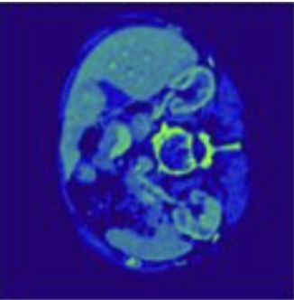
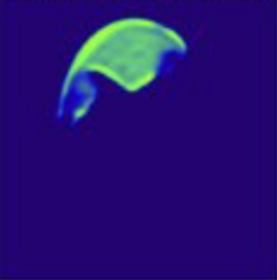
Problems
Solution
Faculty of Computer Science
U-Net:Convolutional Networks for Biomedical Image Segmentation
Introduction
Challenges in Biomedical Image Segmentation:
The need for precise pixel-wise classification.
Limited availability of annotated training data.
High complexity of biomedical images (overlapping structures, irregular shapes, or poor contrast).
Examples of Tasks:
Neuron segmentation in electron microscopy.
Cell segmentation in light microscopy.
U-Net architecture:
Symmetrical U-shaped structure.
Efficient combination of context and localization.
High accuracy with minimal data requirements.
Results:
Leading performance in ISBI challenges on electron and light microscopy image segmentation.
Applicability to a wide range of segmentation tasks.

Slide 3
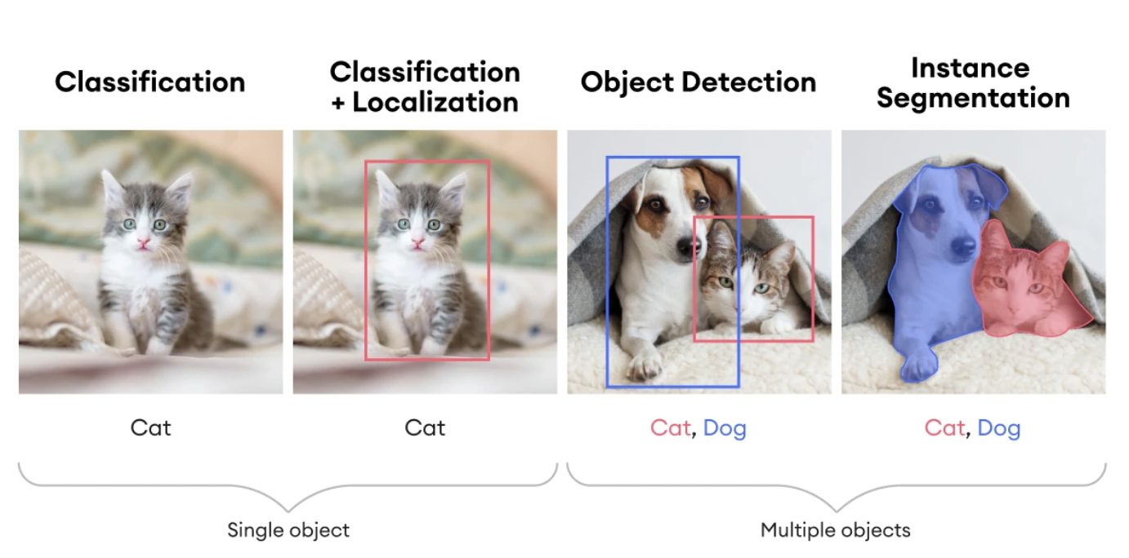
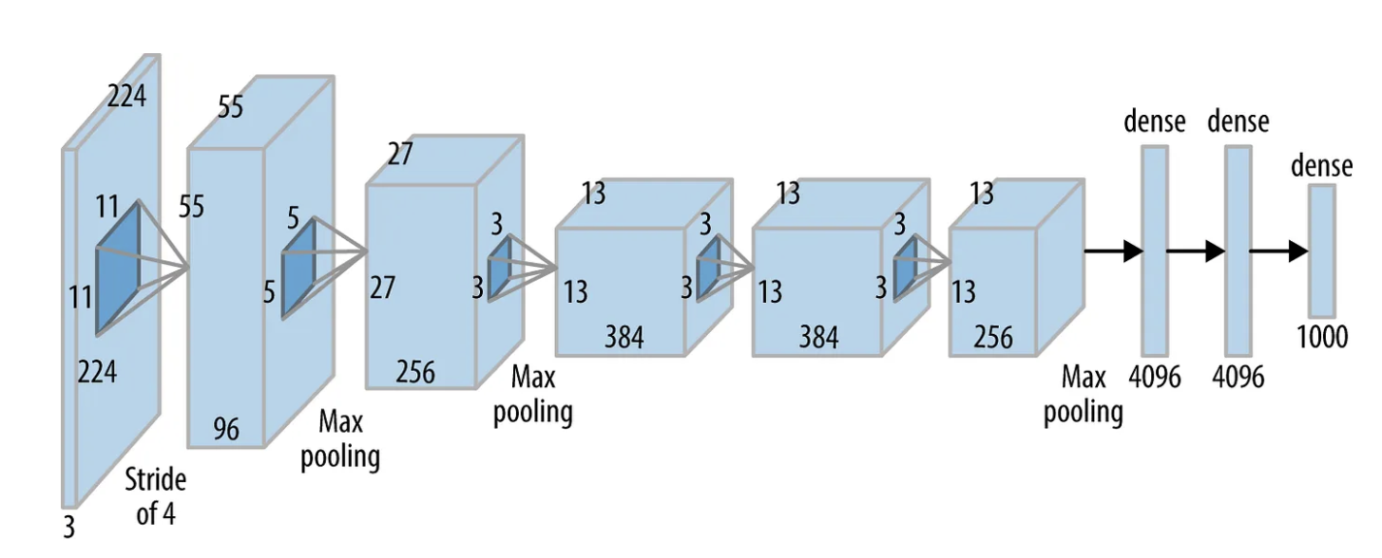
Role of Deep CNN in Image Processing
Contribution of Krizhevsky et al. (2012)
Shift from Classification to Segmentation
Faculty of Computer Science
U-Net:Convolutional Networks for Biomedical Image Segmentation
Convolutional Networks
Enable automatic feature extraction.
Set new standards of accuracy in classification and recognition tasks.
AlexNet architecture achieved outstanding results on ImageNet.
Utilized deep convolutional networks trained on a dataset of 1 million images.
Classification: assigning a single class label to an image.
Segmentation: assigning a class label to each pixel.
New challenges: ensuring localization accuracy and leveraging contextual information.

Slide 4
Sliding window method
Faculty of Computer Science
U-Net:Convolutional Networks for Biomedical Image Segmentation
Previous Approaches
Applies a small window to all parts of the image.
Each window is classified independently.
Drawbacks
Advantages
High computational cost: processing overlapping regions increases resource usage.
Limited context: small windows only capture local features.
Trade-off: larger windows provide more context but reduce localization accuracy.
Simple implementation.
Ability to localize objects.

Slide 5
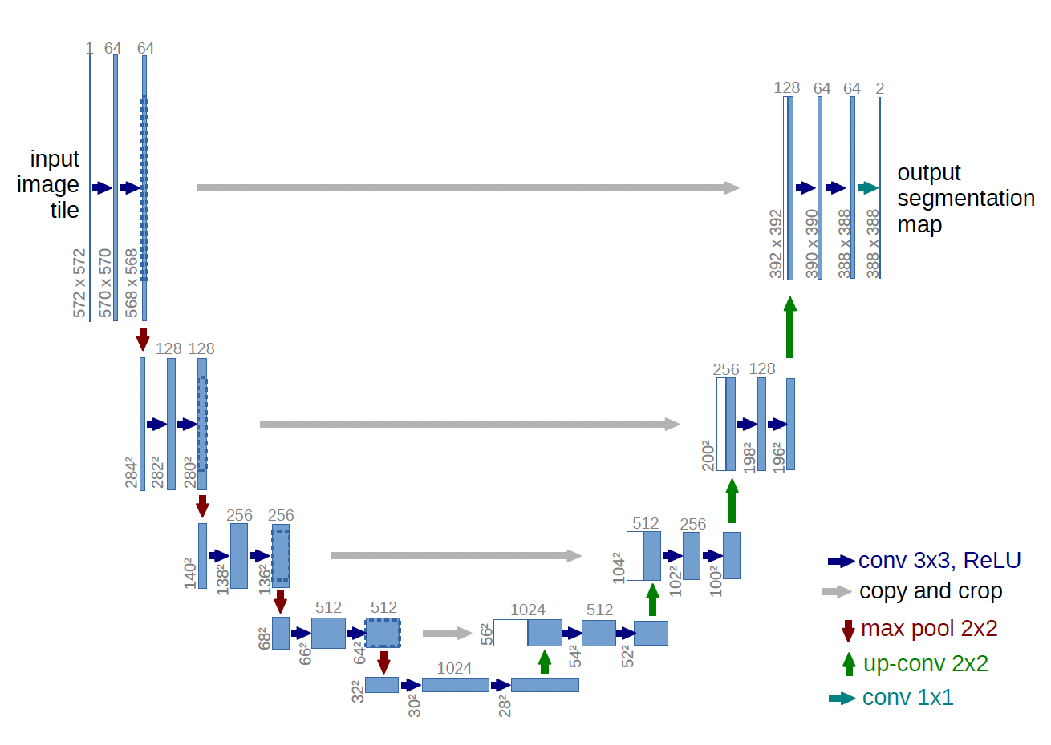
Faculty of Computer Science
U-Net:Convolutional Networks for Biomedical Image Segmentation
Architecture
U-Net Architecture
Core Concept:
U-Net is designed specifically for pixel-wise image segmentation.
The architecture combines two main paths:
Contracting path: captures global context by progressively reducing spatial dimensions.
Expanding path: restores resolution for precise localization while incorporating contextual information.
Key Characteristics:
Symmetrical, U-shaped structure.
Skip connections between corresponding layers in contracting and expanding paths.
Allows the network to integrate low-level spatial features with high-level semantic information.
Efficient for tasks with limited annotated data.

Slide 6
Faculty of Computer Science
U-Net:Convolutional Networks for Biomedical Image Segmentation
Contracting Path
Contracting Path
Process Description:
Step-by-step reduction of the spatial resolution of the image.
Several operations are applied:
3x3 Convolutions: Increase the depth of feature maps to extract complex characteristics.
ReLU (Rectified Linear Unit): Adds non-linearity to the network.
2x2 Max-Pooling: Reduces the spatial dimensions while preserving key features.
Role of the Contracting Path:
Captures global context.
Extracts high-level features required for understanding the overall structure of the image.
Key Features:
The number of feature maps doubles at each level.
Reducing spatial dimensions increases computational efficiency.

Slide 7
Faculty of Computer Science
U-Net:Convolutional Networks for Biomedical Image Segmentation
Expanding Path
Expanding Path
Process Description:
Gradual restoration of spatial resolution.
The following operations are applied:
Up-Convolution (2x2): Increases the size of feature maps.
Merging with skip connections: Combines high-level features with detailed data from the contracting path.
3x3 Convolutions and ReLU: Generates new feature maps with improved localization.
Role of the Expanding Path:
Restores image resolution for precise segmentation.
Integrates contextual data with local features.
Key Features:
Symmetry with the contracting path.
Use of skip connections for enhanced segmentation accuracy.

Slide 8
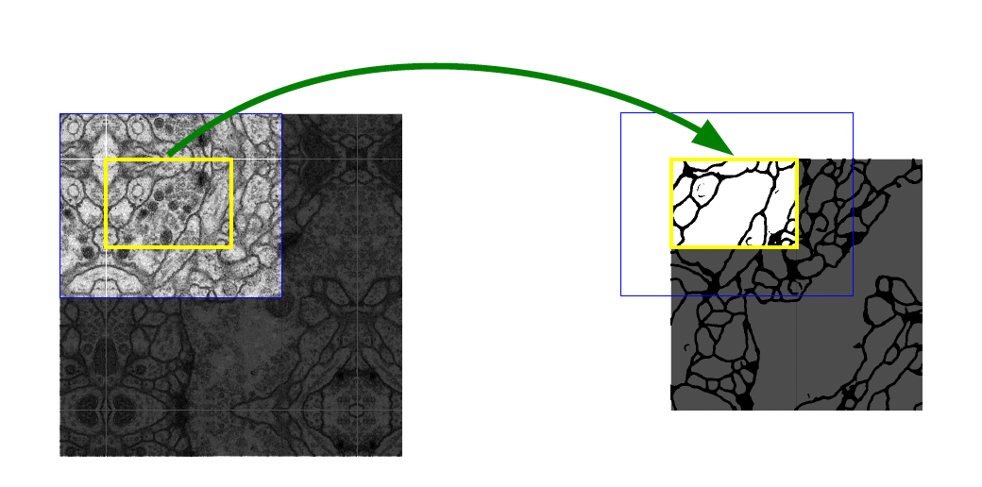
Faculty of Computer Science
U-Net:Convolutional Networks for Biomedical Image Segmentation
Key Modifications in U-Net
Key Modifications in U-Net
Core Innovations:
Skip Connections: Directly link layers from the contracting path to corresponding layers in the expanding path.
Enable the network to combine low-level spatial details with high-level semantic features.
Fully Convolutional Architecture:
Eliminates the need for fully connected layers.
Allows the network to process images of arbitrary sizes efficiently.
Modified Expanding Path:
Larger number of feature channels maintained throughout the expanding path.
Ensures propagation of contextual information to higher-resolution layers.
Segmentation Without Borders:
Uses only valid parts of convolutions to avoid artifacts at the edges.
Allows for seamless segmentation of large images via the overlap-tile strategy:
Missing context at the image borders is extrapolated using mirroring.
Data Augmentation:
Incorporates elastic deformations, making the network invariant to these transformations.

Slide 9
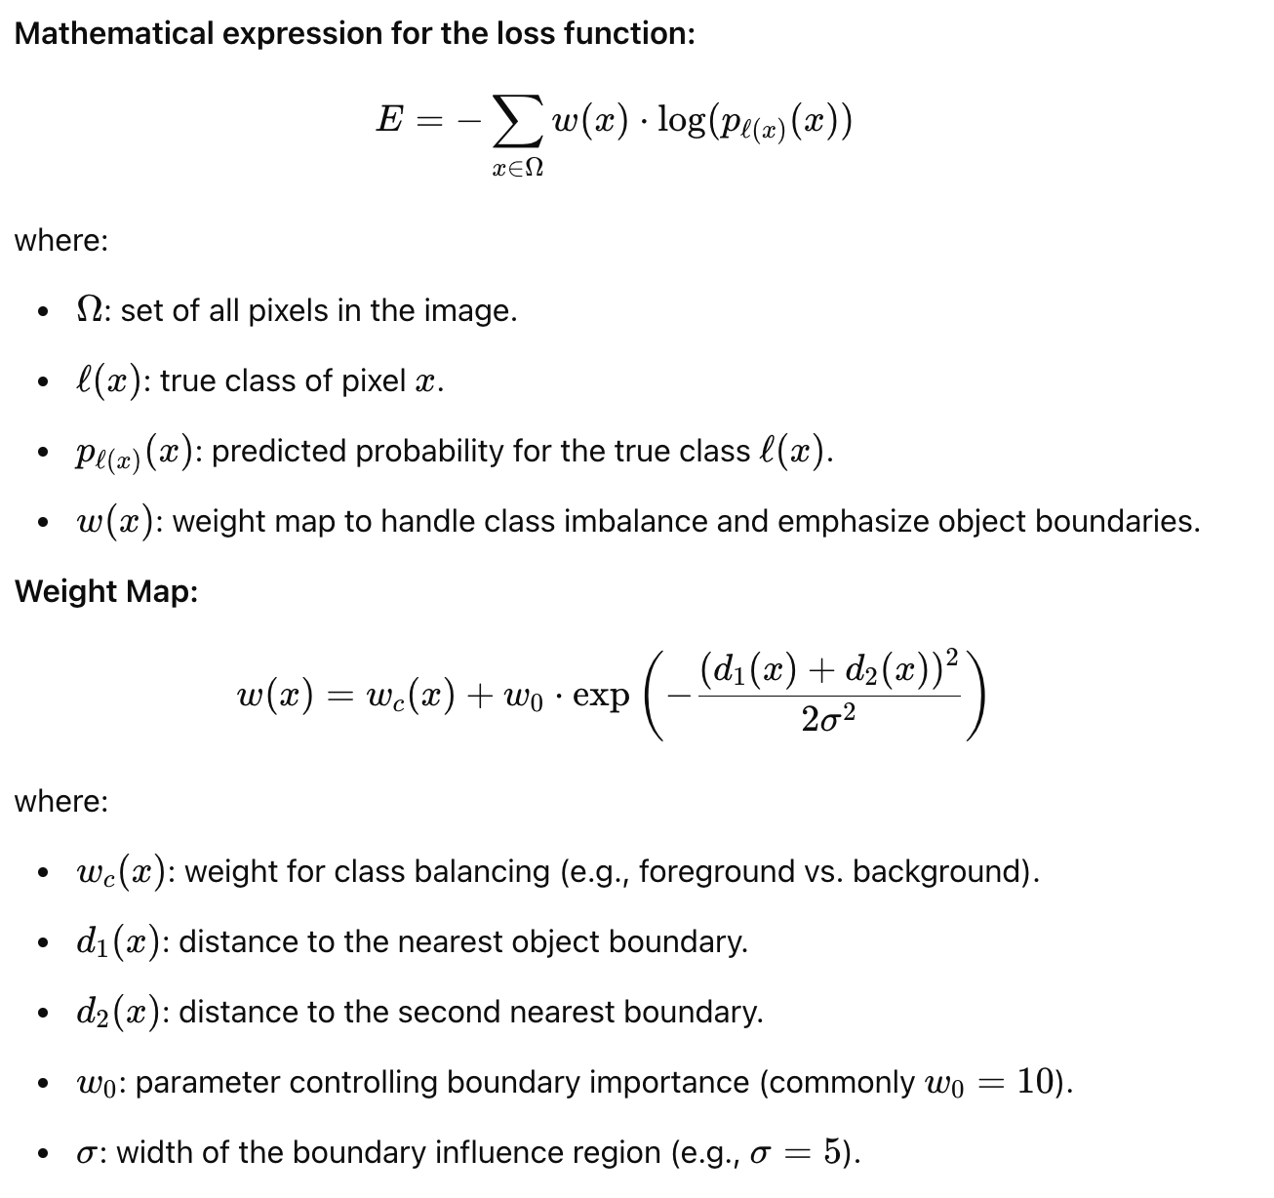
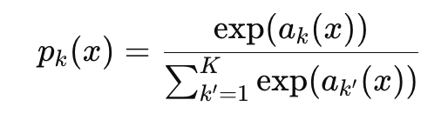
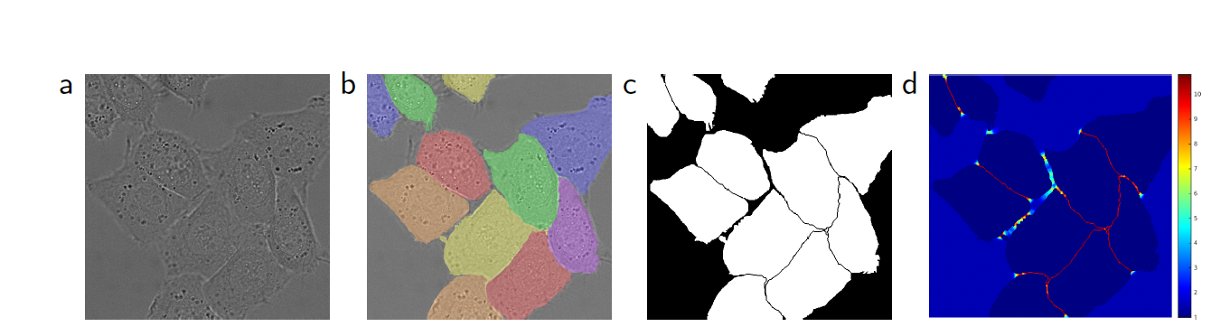
Faculty of Computer Science
U-Net:Convolutional Networks for Biomedical Image Segmentation
Training
Training
Training Challenges:
Limited amount of annotated training data, especially in biomedical tasks.
Importance of handling imbalances between foreground and background classes.
Key Training Strategies:
Loss Function:
Pixel-wise cross-entropy combined with a weighted loss.
Weights are assigned to balance class frequencies and emphasize separating boundaries between objects (e.g., touching cells).
Data Augmentation:
Elastic deformations to simulate realistic variations (e.g., tissue stretching).
Shifts, rotations, and intensity variations to improve generalization.
Optimization:
Stochastic Gradient Descent (SGD) with high momentum (0.99).
Large input tiles used instead of large batch sizes to maximize GPU memory usage.
Resulting Benefits:
Enhanced robustness to deformations and limited data availability.
Improved boundary precision for complex structures.

Slide 10
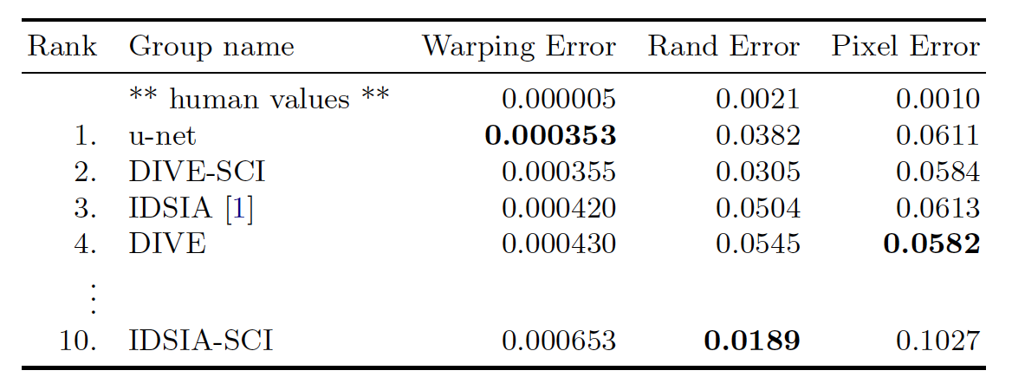
Faculty of Computer Science
U-Net:Convolutional Networks for Biomedical Image Segmentation
Results - Neuronal Segmentation (ISBI EM Challenge)
Results - Neuronal Segmentation (ISBI EM Challenge)
Dataset and Task:
ISBI Challenge for Electron Microscopy (EM) segmentation.
Task: Segment neuronal structures from EM stacks (30 images).
Performance Metrics:
Warping Error: 0.000353 (Best score in the competition).
Rand Error: 0.0382.
Significantly outperformed the sliding-window CNN approach (Warping Error = 0.000420).
Impact:
Accurate segmentation even with a small training set (30 annotated images).
Demonstrates U-Net’s ability to handle large, high-resolution images using the overlap-tile strategy.
Segmentation of a 512x512 pixel image takes less than 1 second on a modern GPU.

Slide 11
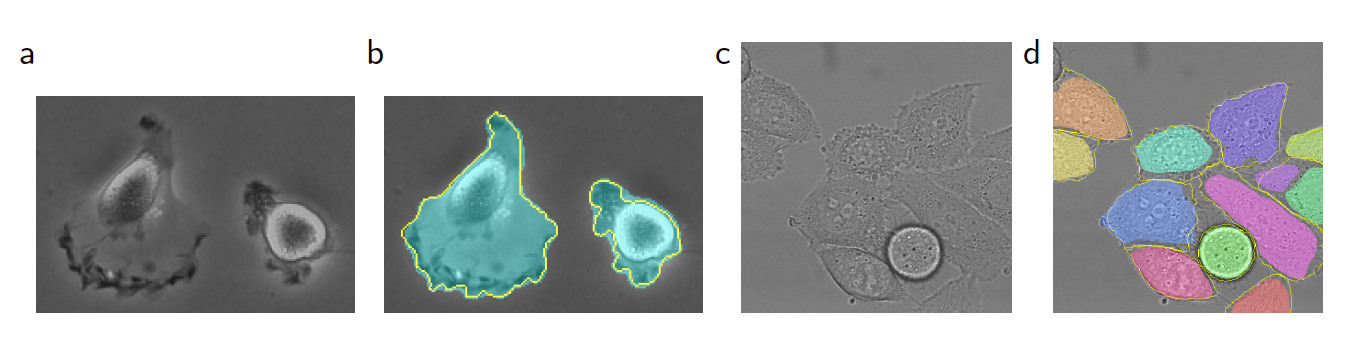
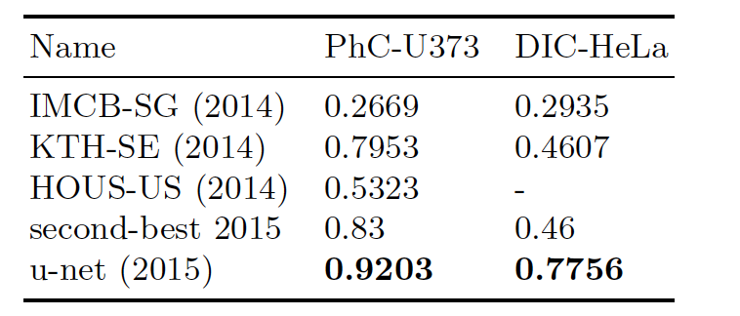
Faculty of Computer Science
U-Net:Convolutional Networks for Biomedical Image Segmentation
Results - Neuronal Segmentation (ISBI EM Challenge)
Results - Cell Segmentation (ISBI Cell Tracking Challenge 2015)
Datasets:
PhC-U373 (Phase Contrast Microscopy): Glioblastoma-astrocytoma U373 cells on polyacrylamide substrate (35 images).
IoU: 92.03% (significantly better than the second-best method at 83%).
DIC-HeLa (Differential Interference Contrast Microscopy): HeLa cells on flat glass (20 images).
IoU: 77.56% (second-best method achieved only 46%).
Impact:
Demonstrates U-Net’s ability to handle diverse imaging modalities.
Accurately segments touching and overlapping cells, solving a critical challenge in cell tracking.

Slide 12
Advantages
Limitations
Faculty of Computer Science
U-Net:Convolutional Networks for Biomedical Image Segmentation
Advantages and Limitations
High Accuracy with Limited Data:
U-Net is specifically designed to work effectively with small, annotated datasets, making it ideal for biomedical applications.
Precise Localization:
Skip connections allow for a combination of global context and pixel-level precision.
Robustness to Variations:
Elastic deformations and other augmentations make U-Net resilient to image distortions and real-world variabilities.
Versatility Across Domains:
Effective for diverse segmentation tasks, including biomedical imaging, satellite data analysis, and autonomous driving.
Efficient Architecture:
Fully convolutional design enables processing of arbitrarily large images using the overlap-tile strategy.
High Computational Requirements:
Large input tiles and the need to process feature-rich images demand significant GPU memory.
Sensitivity to Annotations:
U-Net relies heavily on high-quality, accurate labels; noisy or incorrect annotations can degrade performance.
Challenges with Complex Datasets:
For datasets with drastically different characteristics, extensive fine-tuning or retraining may be required.

Slide 13
Conclusion
Faculty of Computer Science
U-Net:Convolutional Networks for Biomedical Image Segmentation
Conclusion
Key Takeaways:
U-Net has revolutionized image segmentation, particularly in biomedical imaging.
The U-shaped architecture with skip connections balances localization accuracy and contextual understanding.
Robust data augmentation strategies enable high performance even with limited annotated datasets.
Impact in Biomedical Applications:
Set new benchmarks in segmentation challenges, such as ISBI EM and Cell Tracking.
Addressed critical challenges like overlapping cells and thin boundaries in biomedical images.
Future Directions:
Optimization for 3D and Volumetric Data:
Expanding U-Net’s architecture for segmentation in 3D biomedical imaging.
Scaling for Ultra-High-Resolution Data:
Reducing computational requirements to handle large-scale images more efficiently.
Exploration Beyond Biomedical Applications:
Applying U-Net to satellite imagery, autonomous driving, and other domains.

