Slide 1

Architectural Styles
Software Architecture
Lecture 5

Slide 2
Object-Oriented Style
Components are objects
  Data and associated operations
Connectors are messages and method invocations
Style invariants
  Objects are responsible for their internal representation integrity
  Internal representation is hidden from other objects
Advantages
  “Infinite malleability” of object internals
  System decomposition into sets of interacting agents
Disadvantages
  Objects must know identities of servers
  Side effects in object method invocations

Slide 3
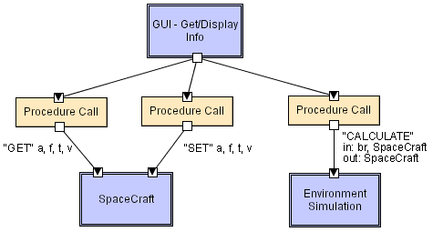
Object-Oriented LL
Software Architecture: Foundations, Theory, and Practice; Richard N. Taylor, Nenad Medvidovic, and Eric M. Dashofy; © 2008 John Wiley & Sons, Inc. Reprinted with permission.

Slide 4
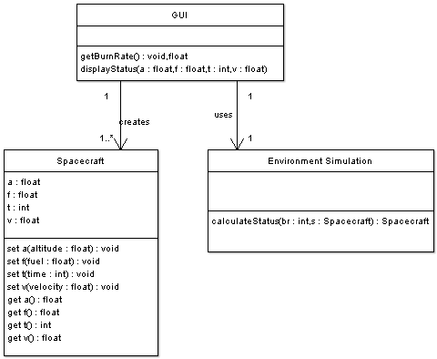
OO/LL in UML
Software Architecture: Foundations, Theory, and Practice; Richard N. Taylor, Nenad Medvidovic, and Eric M. Dashofy; © 2008 John Wiley & Sons, Inc. Reprinted with permission.

Slide 5
Layered Style
Hierarchical system organization
  “Multi-level client-server”
  Each layer exposes an interface (API) to be used by above layers
Each layer acts as a
  Server: service provider to layers “above”
  Client: service consumer of layer(s) “below”
Connectors are protocols of layer interaction
Example: operating systems
Virtual machine style results from fully opaque layers

Slide 6
Layered Style (cont’d)
Advantages
  Increasing abstraction levels
  Evolvability
  Changes in a layer affect at most the adjacent two layers
    Reuse
  Different implementations of layer are allowed as long as interface is preserved
  Standardized layer interfaces for libraries and frameworks

Slide 7
Layered Style (cont’d)
Disadvantages
  Not universally applicable
  Performance
Layers may have to be skipped
  Determining the correct abstraction level

Slide 8
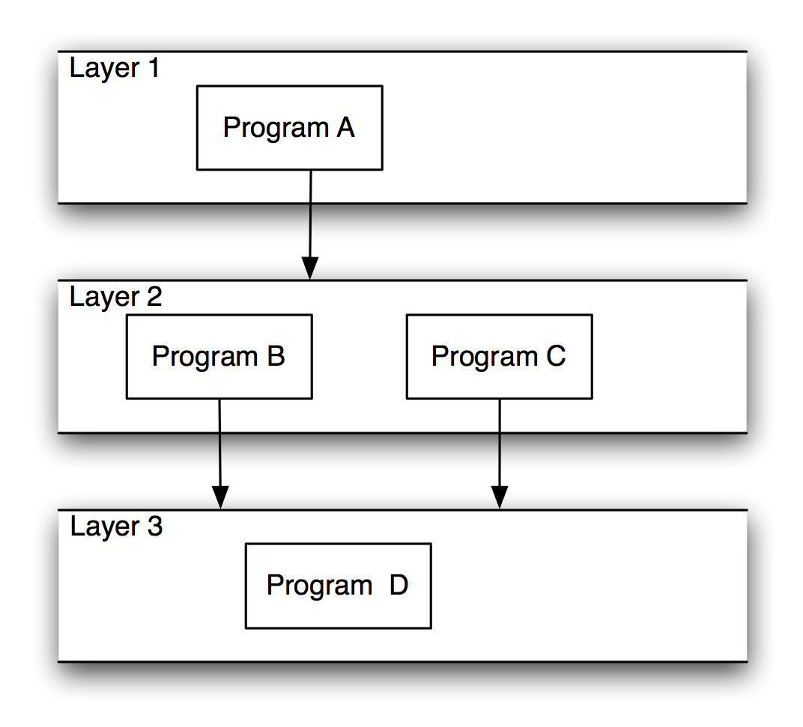
Layered Systems/Virtual Machines
Software Architecture: Foundations, Theory, and Practice; Richard N. Taylor, Nenad Medvidovic, and Eric M. Dashofy; © 2008 John Wiley & Sons, Inc. Reprinted with permission.

Slide 9
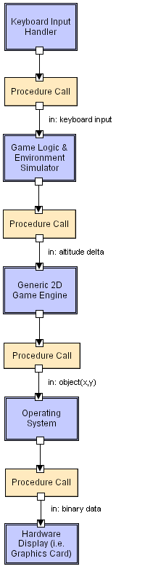
Layered LL
Software Architecture: Foundations, Theory, and Practice; Richard N. Taylor, Nenad Medvidovic, and Eric M. Dashofy; © 2008 John Wiley & Sons, Inc. Reprinted with permission.

Slide 10
Client-Server Style
Components are clients and servers
Servers do not know number or identities of clients
Clients know server’s identity
Connectors are RPC-based network interaction protocols

Slide 11
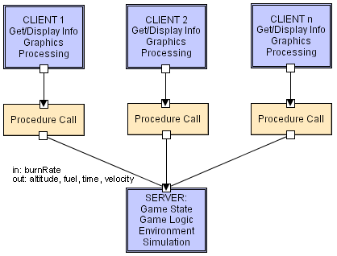
Client-Server LL
Software Architecture: Foundations, Theory, and Practice; Richard N. Taylor, Nenad Medvidovic, and Eric M. Dashofy; © 2008 John Wiley & Sons, Inc. Reprinted with permission.

Slide 12
Data-Flow Styles
Batch Sequential
  Separate programs are executed in order; data is passed as an aggregate from one program to the next.
  Connectors: “The human hand” carrying tapes between the programs, a.k.a. “sneaker-net ”
  Data Elements: Explicit, aggregate elements passed from one component to the next upon completion of the producing program’s execution.
Typical uses: Transaction processing in financial systems. “The Granddaddy of Styles”

Slide 13
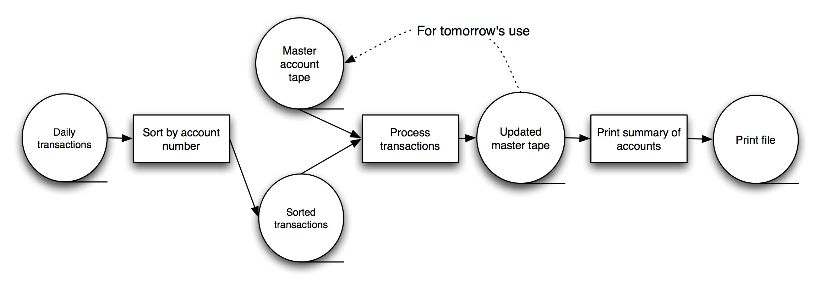
Batch-Sequential: A Financial Application
Software Architecture: Foundations, Theory, and Practice; Richard N. Taylor, Nenad Medvidovic, and Eric M. Dashofy; © 2008 John Wiley & Sons, Inc. Reprinted with permission.

Slide 14
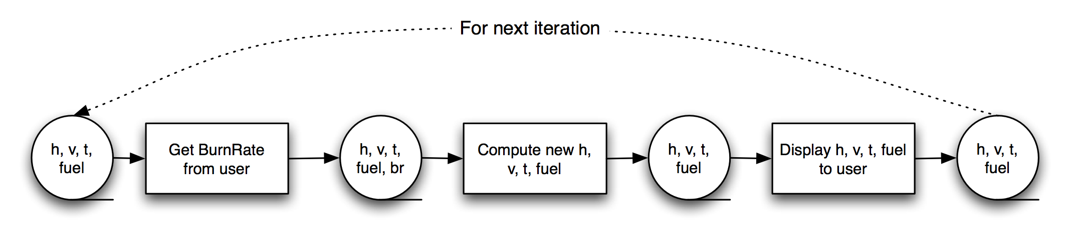
Batch-Sequential LL
Not a recipe for a successful lunar mission!
Software Architecture: Foundations, Theory, and Practice; Richard N. Taylor, Nenad Medvidovic, and Eric M. Dashofy; © 2008 John Wiley & Sons, Inc. Reprinted with permission.

Slide 15
Pipe and Filter Style
Components are filters
  Transform input data streams into output data streams
  Possibly incremental production of output
Connectors are pipes
  Conduits for data streams
Style invariants
  Filters are independent (no shared state)
  Filter has no knowledge of up- or down-stream filters
Examples
  UNIX shell signal processing
  Distributed systems parallel programming
Example: ls invoices | grep -e August | sort

Slide 16
Pipe and Filter (cont’d)
Variations
  Pipelines — linear sequences of filters
  Bounded pipes — limited amount of data on a pipe
  Typed pipes — data strongly typed
Advantages
  System behavior is a succession of component behaviors
  Filter addition, replacement, and reuse
    Possible to hook any two filters together
  Certain analyses
    Throughput, latency, deadlock
  Concurrent execution

Slide 17
Pipe and Filter (cont’d)
Disadvantages
  Batch organization of processing
  Interactive applications
  Lowest common denominator on data transmission

Slide 18

Pipe and Filter LL
Software Architecture: Foundations, Theory, and Practice; Richard N. Taylor, Nenad Medvidovic, and Eric M. Dashofy; © 2008 John Wiley & Sons, Inc. Reprinted with permission.
Notes:
GetBurnRate runs continuously on its own, prompting the user for a new burn rate.
In this design the “compute new values” determines how much time has passed. Could alternatively do that in the GetBurnRate filter. Would change semantics a bit.

Slide 19
Blackboard Style
Two kinds of components
  Central data structure — blackboard
  Components operating on the blackboard
System control is entirely driven by the blackboard state
Examples
  Typically used for AI systems
  Integrated software environments (e.g., Interlisp)
  Compiler architecture

Slide 20
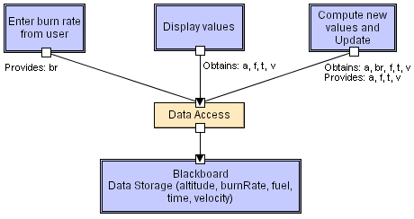
Blackboard LL
Software Architecture: Foundations, Theory, and Practice; Richard N. Taylor, Nenad Medvidovic, and Eric M. Dashofy; © 2008 John Wiley & Sons, Inc. Reprinted with permission.

Slide 21
Rule-Based Style
Inference engine parses user input and determines whether it is a fact/rule or a query. If it is a fact/rule, it adds this entry to the knowledge base. Otherwise, it queries the knowledge base for applicable rules and attempts to resolve the query.

Slide 22
Rule-Based Style (cont’d)
Components: User interface, inference engine, knowledge base
Connectors: Components are tightly interconnected, with direct procedure calls and/or shared memory.
Data Elements: Facts and queries
Behavior of the application can be very easily modified through addition or deletion of rules from the knowledge base.
Caution: When a large number of rules are involved understanding the interactions between multiple rules affected by the same facts can become very difficult.

Slide 23
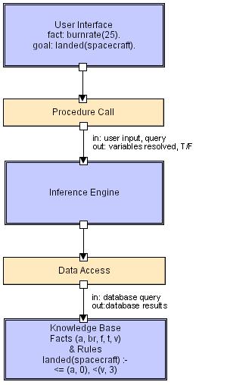
Rule Based LL
Software Architecture: Foundations, Theory, and Practice; Richard N. Taylor, Nenad Medvidovic, and Eric M. Dashofy; © 2008 John Wiley & Sons, Inc. Reprinted with permission.

Slide 24
Interpreter Style
Interpreter parses and executes input commands, updating the state maintained by the interpreter
Components: Command interpreter, program/interpreter state, user interface.
Connectors: Typically very closely bound with direct procedure calls and shared state.
Highly dynamic behavior possible, where the set of commands is dynamically modified. System architecture may remain constant while new capabilities are created based upon existing primitives.
Superb for end-user programmability; supports dynamically changing set of capabilities
Lisp and Scheme

Slide 25
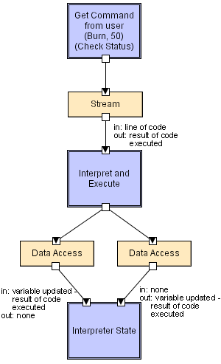
Interpreter LL
Software Architecture: Foundations, Theory, and Practice; Richard N. Taylor, Nenad Medvidovic, and Eric M. Dashofy; © 2008 John Wiley & Sons, Inc. Reprinted with permission.

Slide 26
Mobile-Code Style
Summary: a data element (some representation of a program) is dynamically transformed into a data processing component.
Components: “Execution dock”, which handles receipt of code and state; code compiler/interpreter
Connectors: Network protocols and elements for packaging code and data for transmission.
Data Elements: Representations of code as data; program state; data
Variants: Code-on-demand, remote evaluation, and mobile agent.

Slide 27
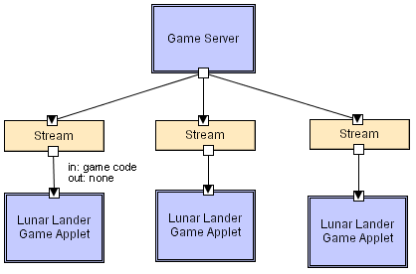
Mobile Code LL
Scripting languages (i.e. JavaScript,
VBScript), ActiveX control,
embedded Word/Excel macros.
Software Architecture: Foundations, Theory, and Practice; Richard N. Taylor, Nenad Medvidovic, and Eric M. Dashofy; © 2008 John Wiley & Sons, Inc. Reprinted with permission.

Slide 28
Implicit Invocation Style
Event announcement instead of method invocation
  “Listeners” register interest in and associate methods with events
  System invokes all registered methods implicitly
Component interfaces are methods and events
Two types of connectors
  Invocation is either explicit or implicit in response to events
Style invariants
  “Announcers” are unaware of their events’ effects
  No assumption about processing in response to events

Slide 29
Implicit Invocation (cont’d)
Advantages
  Component reuse
  System evolution
    Both at system construction-time & run-time
Disadvantages
  Counter-intuitive system structure
  Components relinquish computation control to the system
  No knowledge of what components will respond to event
  No knowledge of order of responses

Slide 30
Publish-Subscribe
Subscribers register/deregister to receive specific messages or specific content. Publishers broadcast messages to subscribers either synchronously or asynchronously.

Slide 31
Publish-Subscribe (cont’d)
Components: Publishers, subscribers, proxies for managing distribution
Connectors: Typically a network protocol is required. Content-based subscription requires sophisticated connectors.
Data Elements: Subscriptions, notifications, published information
Topology: Subscribers connect to publishers either directly or may receive notifications via a network protocol from intermediaries
Qualities yielded: Highly efficient one-way dissemination of information with very low-coupling of components

Slide 32
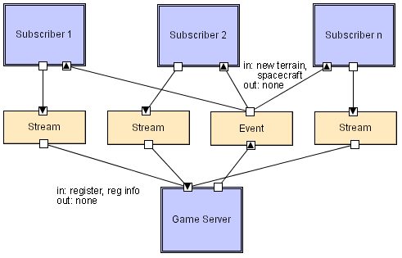
Pub-Sub LL
Software Architecture: Foundations, Theory, and Practice; Richard N. Taylor, Nenad Medvidovic, and Eric M. Dashofy; © 2008 John Wiley & Sons, Inc. Reprinted with permission.

Slide 33
Event-Based Style
Independent components asynchronously emit and receive events communicated over event buses
Components: Independent, concurrent event generators and/or consumers
Connectors: Event buses (at least one)
Data Elements: Events – data sent as a first-class entity over the event bus
Topology: Components communicate with the event buses, not directly to each other.
Variants: Component communication with the event bus may either be push or pull based.
Highly scalable, easy to evolve, effective for highly distributed applications.

Slide 34
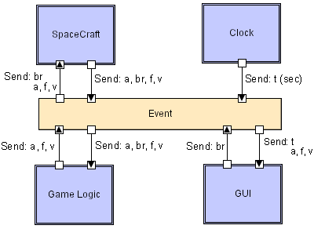
Event-based LL
Software Architecture: Foundations, Theory, and Practice; Richard N. Taylor, Nenad Medvidovic, and Eric M. Dashofy; © 2008 John Wiley & Sons, Inc. Reprinted with permission.

Slide 35
Peer-to-Peer Style
State and behavior are distributed among peers which can act as either clients or servers.
Peers: independent components, having their own state and control thread.
Connectors: Network protocols, often custom.
Data Elements: Network messages

Slide 36
Peer-to-Peer Style (cont’d)
Topology: Network (may have redundant connections between peers); can vary arbitrarily and dynamically
Supports decentralized computing with flow of control and resources distributed among peers.
Highly robust in the face of failure of any given node.
Scalable in terms of access to resources and computing power.
  But caution on the protocol!

Slide 37
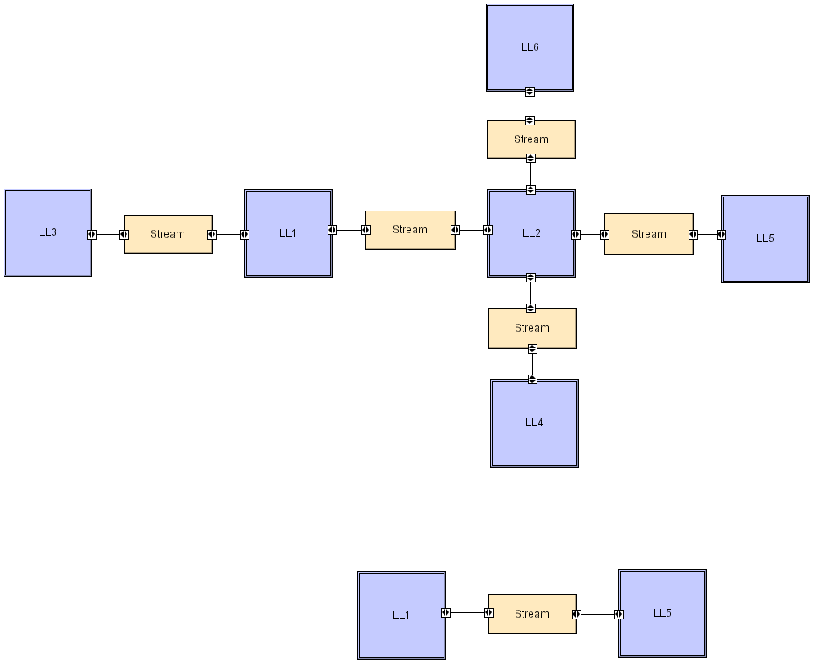
Peer-to-Peer LL
Software Architecture: Foundations, Theory, and Practice; Richard N. Taylor, Nenad Medvidovic, and Eric M. Dashofy; © 2008 John Wiley & Sons, Inc. Reprinted with permission.

