Slide 1

Analysis of Google Play
Store apps
By Alina Hohryakova

Slide 2
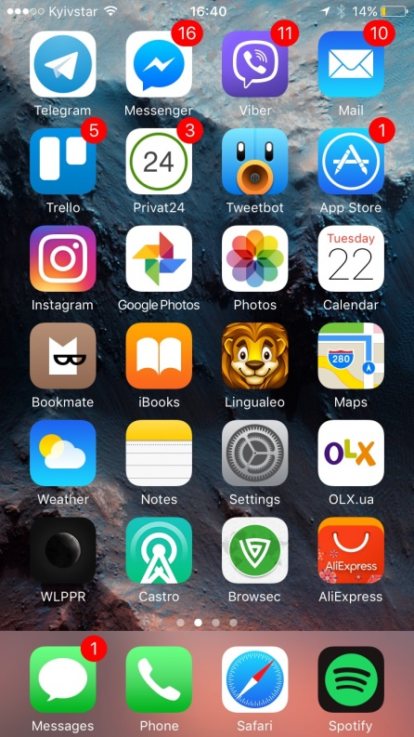
Evaluation parameters are app's average number of reactions (count of rating scores assigned) and / or number installs, and correlation between rating and the percentage of rating count to installs.
Relevance of the topic
Which applications in today's market have the most relevance perspective;
Which apps characteristics are better perceived by the market.

Slide 3


Data sources

Slide 4
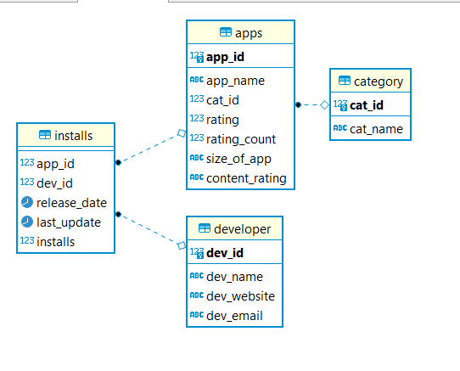
DATABASE SCHEMA
SNOWFLAKE
4 TABLES
1 FACT TABLE
3 DIMENSION TABLES
CLICK HERE

Slide 5
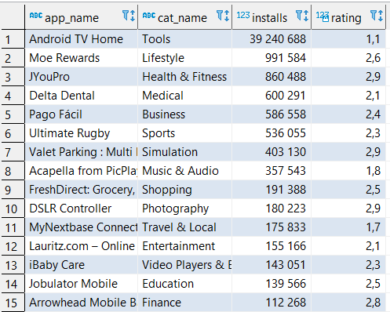
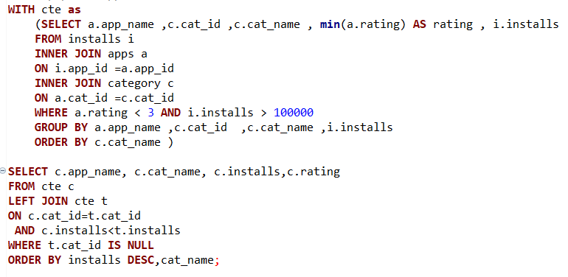
Popular apps with bad realization
Surprisingly, the most downloaded app came out with the lowest rating, and this app is from the category of tools. Thus, we learned about the prospect of developing a quality application from the category of tools.

Slide 6
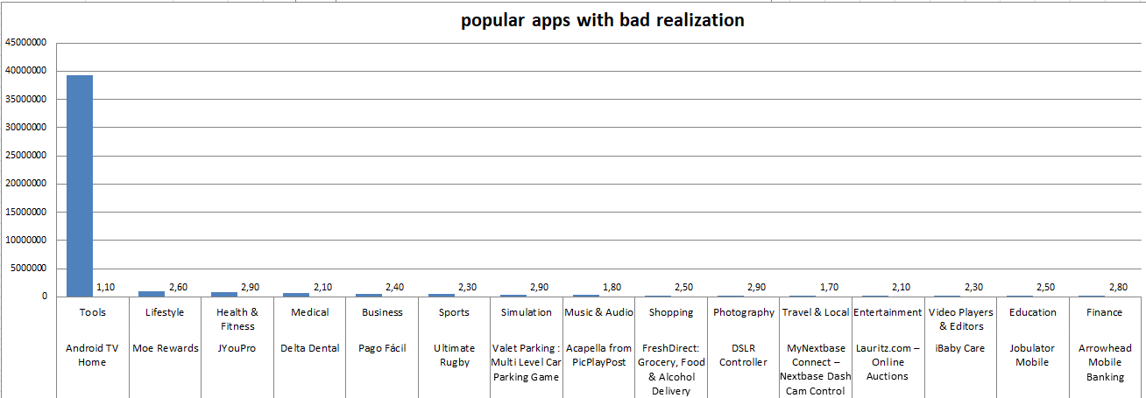
Popular apps with bad realization

Slide 7
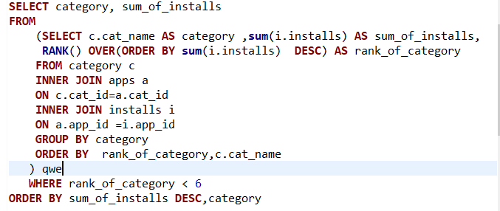
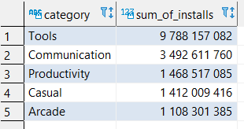
5 the most popular apps category by the amount of its installed
Productivity
Communication
Casual
Tools

Slide 8
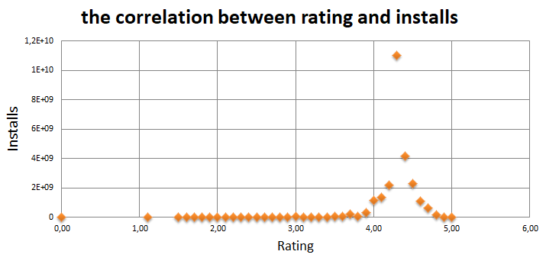
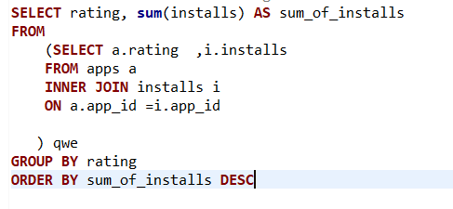
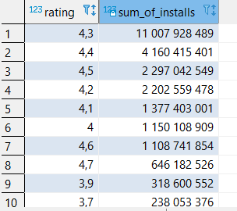
The correlation between rating and installs
In this query we can see that the most installed apps have pretty high rating.

Slide 9
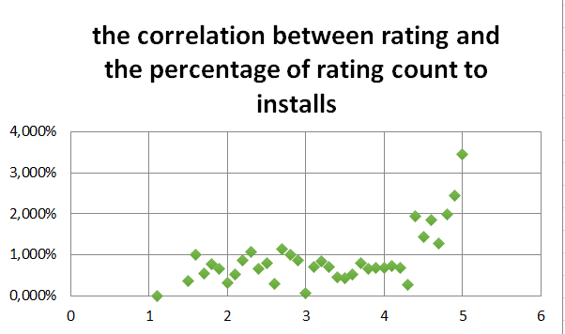
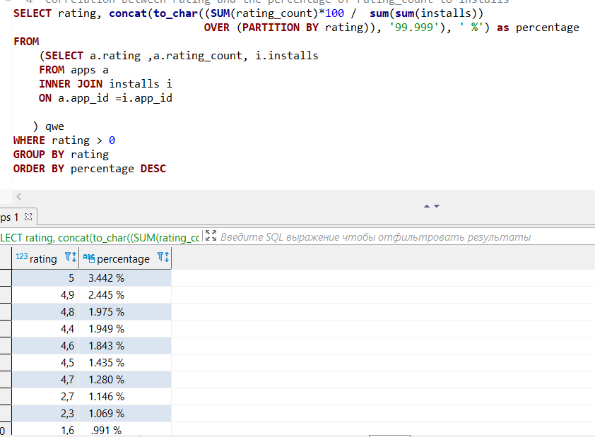
The correlation between rating and the percentage of rating count to installs
In conclusion, we can note that the highest rated apps have the highest percentage of feedback, but the number of people who have rated the app is still very small relative to the number of installs.

Slide 10

THANK YOU
FOR
ATTENTION

