Slide 1

Energy Surplus Forecasting Project
Wind & Solar Energy Forecasting & Decision Optimization
Showcase Presentation

Slide 2
CONTENTS
Data Visualization
Preprocessing
Feature Engineering
Duplicate Records
Missing Records
Handling Missing values
Stationary
Assumptions
Feature Scaling
Modelling
Energy Surface
Introduction

Slide 3

Introduction
• Predicts regional energy surplus 24 hours in advance using meteorological forecasts.
• Scope expanded to include both Wind and Solar Energy generation, optimizing green power utilization.
• Refactored pipeline supports both Brighton and Colchester locations to validate the pilot service portfolio.

Slide 4
Data Visualization
• Loaded historical hourly weather files for Brighton (128 files) and Colchester (196 files) from 2010 to 2024.
• Chronological train/test split (80% train, 20% test) applied upfront to prevent target lookahead leakage.
• Conducted EDA on regional wind speed profiles, solar irradiance levels, and daily/monthly consumer demand cycles.

Slide 5
Feature Engineering
Year
Quarter
Month
Week
Day
Extracting time-based features are crucial for capturing seasonality trends and improving model predictions. These features help in analyzing seasonal effects, managing anomalies, and enhancing model accuracy by providing context that identifies cyclical and non-linear relationships inherent in temporal data.

Slide 6
Duplicate & Missing Data *
• Duplicates are identified by index and cleaned, keeping the first chronological record.
• df = df[~df.index.duplicated(keep='first')]
• Preprocessing pipeline identifies and removes duplicate timestamps, keeping the first chronological record.
• The system reindexes to a complete hourly grid, creating NaN placeholders for missing hours.
• Linear interpolation is then applied to smoothly fill gaps, preserving physical continuity.

Slide 7
Handling Missing Data
• Replaced missing value fills (0, mean, ffill) with robust linear interpolation on weather features to preserve physical continuity.
• Applied night constraints: set solar radiation and UV index to 0.0 between 8 PM and 6 AM, preventing unrealistic nighttime solar generation.
• Replaced missing value fills (0, mean, ffill) with robust linear interpolation on weather features to preserve physical continuity.
• Applied night constraints: set solar radiation and UV index to 0.0 between 8 PM and 6 AM, preventing unrealistic nighttime solar generation.

Slide 8
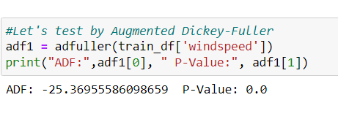
Stationary
visual (plotting mean and standard deviation)
statistical methods (Augmented Dickey-Fuller test) were employed. The Augmented Dickey-Fuller test provided a p-value of 0.0, rejects the null hypothesis of a unit root and confirming that the series is stationary.

Slide 9
Assumptions
• Wind Generation: 20 Horizontal Axis Wind Turbines (HAWT), blade length L=59.8m, sweep area A=11,234.4 m^2.
Ew = 0.5 * rho * A * (windspeed * 0.27778)^3 * 20 / 1000 kW (where rho = 1.225 kg/m^3)
• Solar Generation: Solar park with 5000 m^2 panel surface, 18% average efficiency.
Es = A_solar * eta * solarradiation / 1000 kW
• Power Requirement: Diurnal consumer demand cycle is loaded from requirement.csv.

Slide 10
Normalize Data
Data normalization was performed using MinMaxScaler, separately fitting `X_train` for feature scaling and `y_train` for target variable scaling to ensure all data values were proportionally scaled between 0 and 1.
X_scaler = MinMaxScaler()
X_scaler.fit(X_train)
y_scaler = MinMaxScaler()
y_scaler.fit(y_train)

Slide 11
LSTM
• LSTM Model structured as a correctly-dimensioned temporal sequence model.
• Formats weather and energy features into 3D tensors: (batch_size, lookback_window=24, n_features=18) to predict next hour's output.
• Model structure: LSTM layer (64 units, tanh activation), 20% Dropout, Dense hidden layer (32 units), Dense output layer (1 unit).

Slide 12
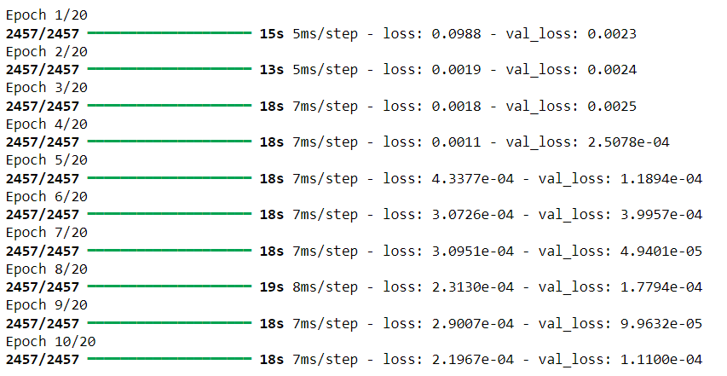
Model Comparison & Results
• We evaluate model performance for 24h Ahead Lagged Forecasting on the test set:
- Brighton: Persistence MAE 25,338.6 kW | XGBoost MAE 22,864.4 kW | LSTM MAE 22,845.3 kW
- Colchester: Persistence MAE 17,281.6 kW | XGBoost MAE 16,635.5 kW | LSTM MAE 16,105.1 kW
• The correctly dimensioned LSTM sequence model out-performs both the baseline persistence model and XGBoost, successfully capturing historical sequence temporal dependencies.

Slide 13
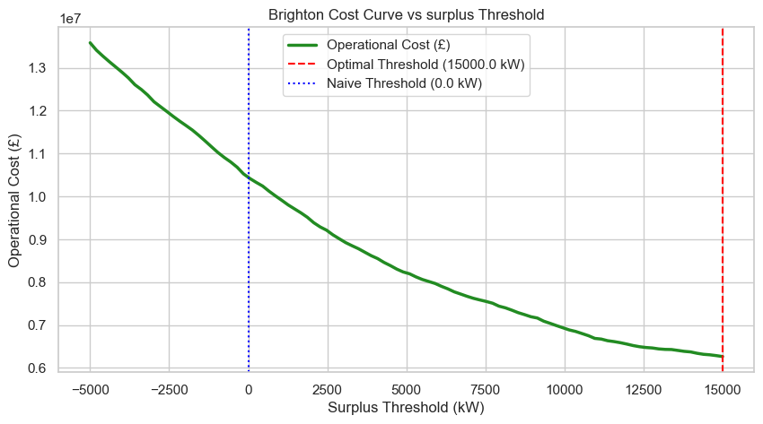
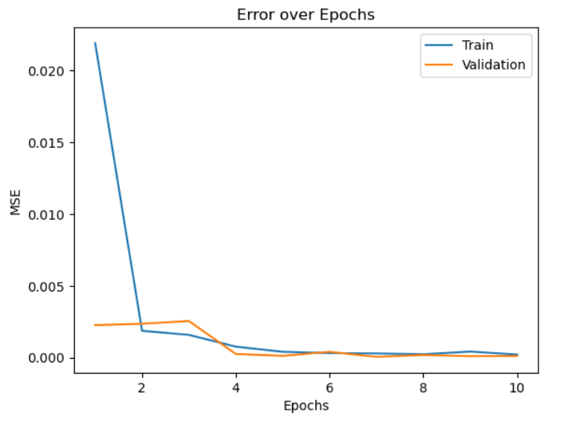
Cost-Optimized Decisions (Brighton)
• Business cost model: FP Deficit Cost = £0.20/kWh (spot price premium); FN Opportunity Cost = £0.02/kWh.
• A naive threshold (0.0 kW surplus) is highly unprofitable due to the massive cost of false positives.
• Brighton Optimal Threshold: 15.0 MW (15,000 kW) predicted surplus. This safety margin reduces operational losses by 40.0% (saving £4.18M).

Slide 14
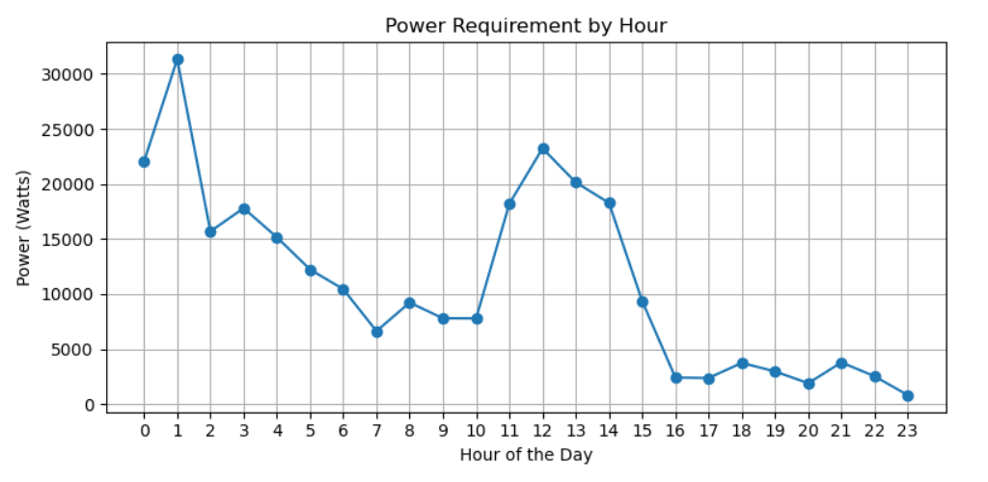
Required Power for the Next 24 hours

Slide 15
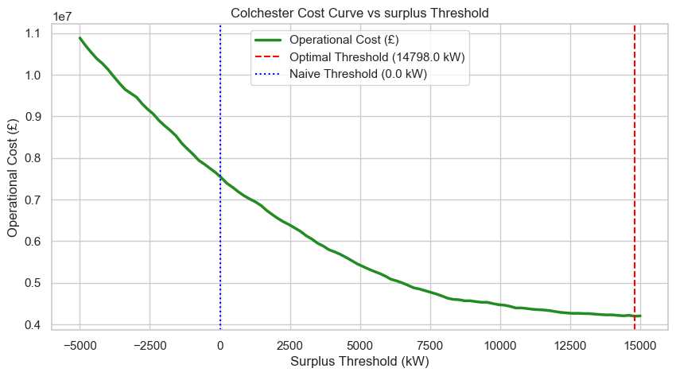
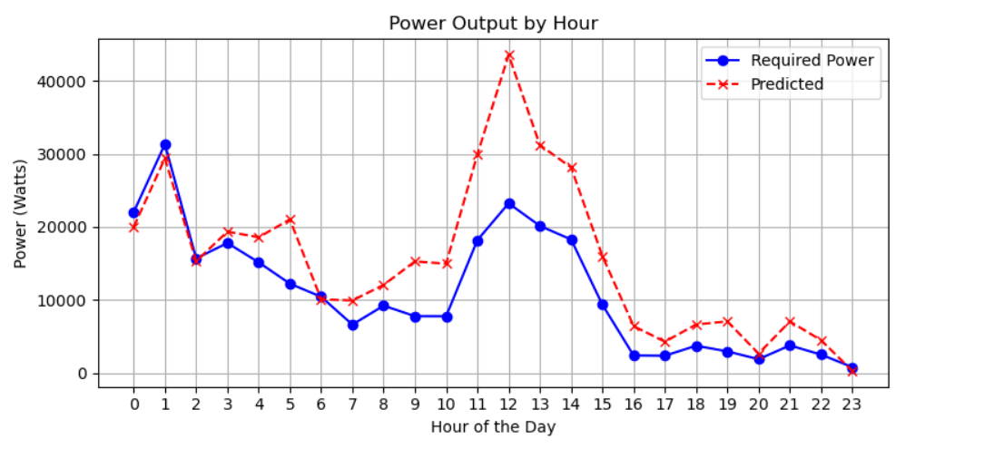
Operational Decisions (Colchester)
• Colchester Cost Optimization: Optimal surplus threshold is 14.8 MW (14,798 kW), reducing losses by 44.5% (saving £3.36M).
• Model Readiness: The LSTM sequence model is prepared for production deployment in energy management systems.
• Strategic Value: Integrating both wind and solar generation stabilizes regional supply, offering consistent free slots.

Slide 16
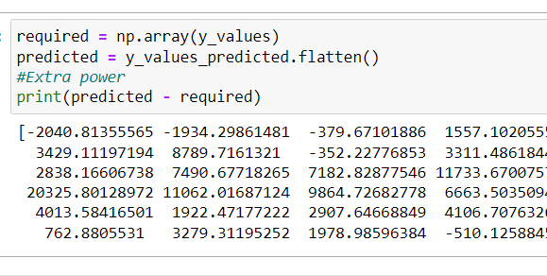

Slide 17

THANK YOU!

