Slide 1
Threat modeling
Introduction.

Slide 2
What and WHY
What: Hacking the application while it is designed.
Why: Create a secure design of a future application or API
Improve security posture of the software product
Reduce number of possible issue found on later stages
Save time and money on possible remakes and fixes
Improve integrity

Slide 3
What is your Threat Model?
To determine what we are worried about.
Few examples:
A thief who could steal money or sensitive information
An untrusted network
A company stakeholder who access sensitive documents and are not trusted

Slide 4
When and HOW
Threat modeling as process
Threat modeling as a living document
Threat modeling as a team exercise
Four key questions:
What are we building?
What can go wrong?
What should we do about those things that can go wrong?
Did we do a decent job analysis?

Slide 5
What we analyze
Assets. Resources we own. DB, servers, people etc.
Threats. Possible attacks.
System. The software as a system. Dataflow, trust boundaries (anywhere the privileges are different), etc.

Slide 6
Techniques
There is no right way to threat model.
There is no correct threat model.
Threat model should be useful.
STRIDE as a one, the most popular “tool” to find out what could go wrong
Spoofing, Tampering, Repudiation, Information Disclosure, Denial of Service, and Elevation of Privilege.

Slide 7
STRIDE
Spoofing – Pretending to be something or someone you are not.
Tampering – is modifying something you’re not suppose to modify. Including packets on the network, bits in disk or memory, etc.
Repudiation – claiming you didn’t do something.
Information Disclosure – exposing information to those who are not authorized to see it.
Denial of Service – prevent a system from providing service.
Elevation of Privilege – when program or user is able to do things that they’re not supposed to do.
Tool to use: Elevation of privilege card game.

Slide 8
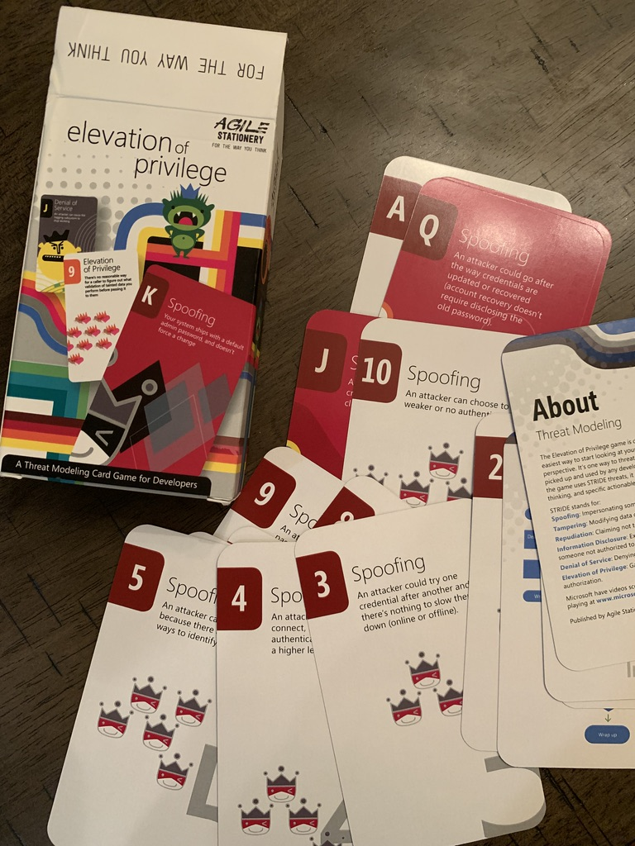
Elevation of Privilege (EoP) game

Slide 9
Ways to apply STRIDE
STRIDE-per-Element
STRIDE-per-Interaction

Slide 10
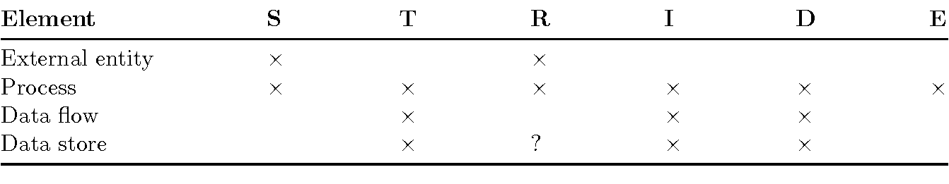
STRIDE-per-element

Slide 11
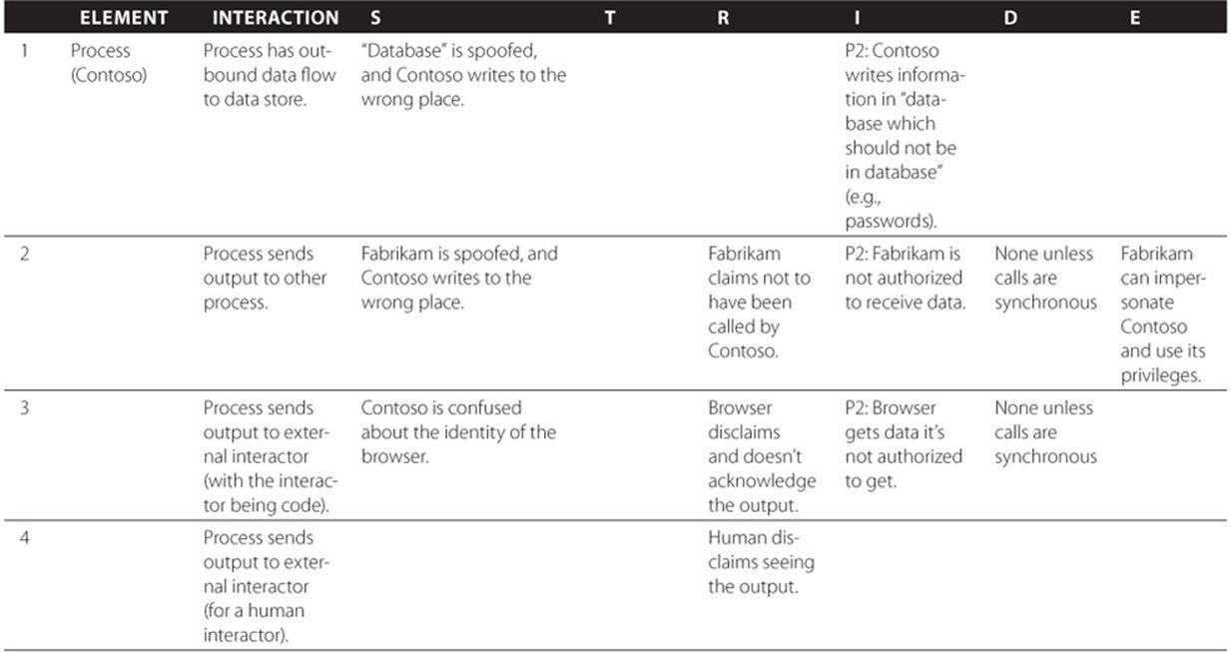
Stride-per-interaction

Slide 12
Other approaches
DESIST (Dispute, Elevation of Privilege, Spoofing, Information disclosure, Service denial and Tempering) a variant of STRIDE
PASTA (Process to Attack Simulation and Threat Analysis)
Attack tree
…

Slide 13
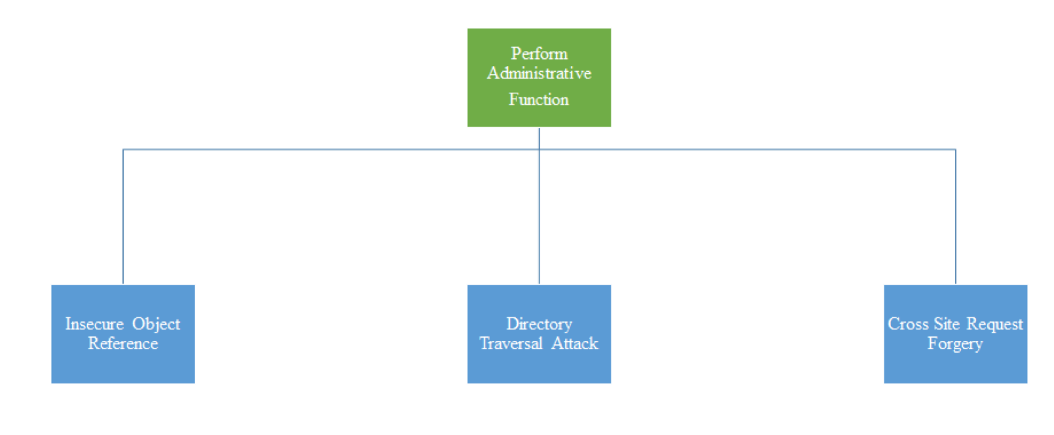
Attack tree examples

Slide 14
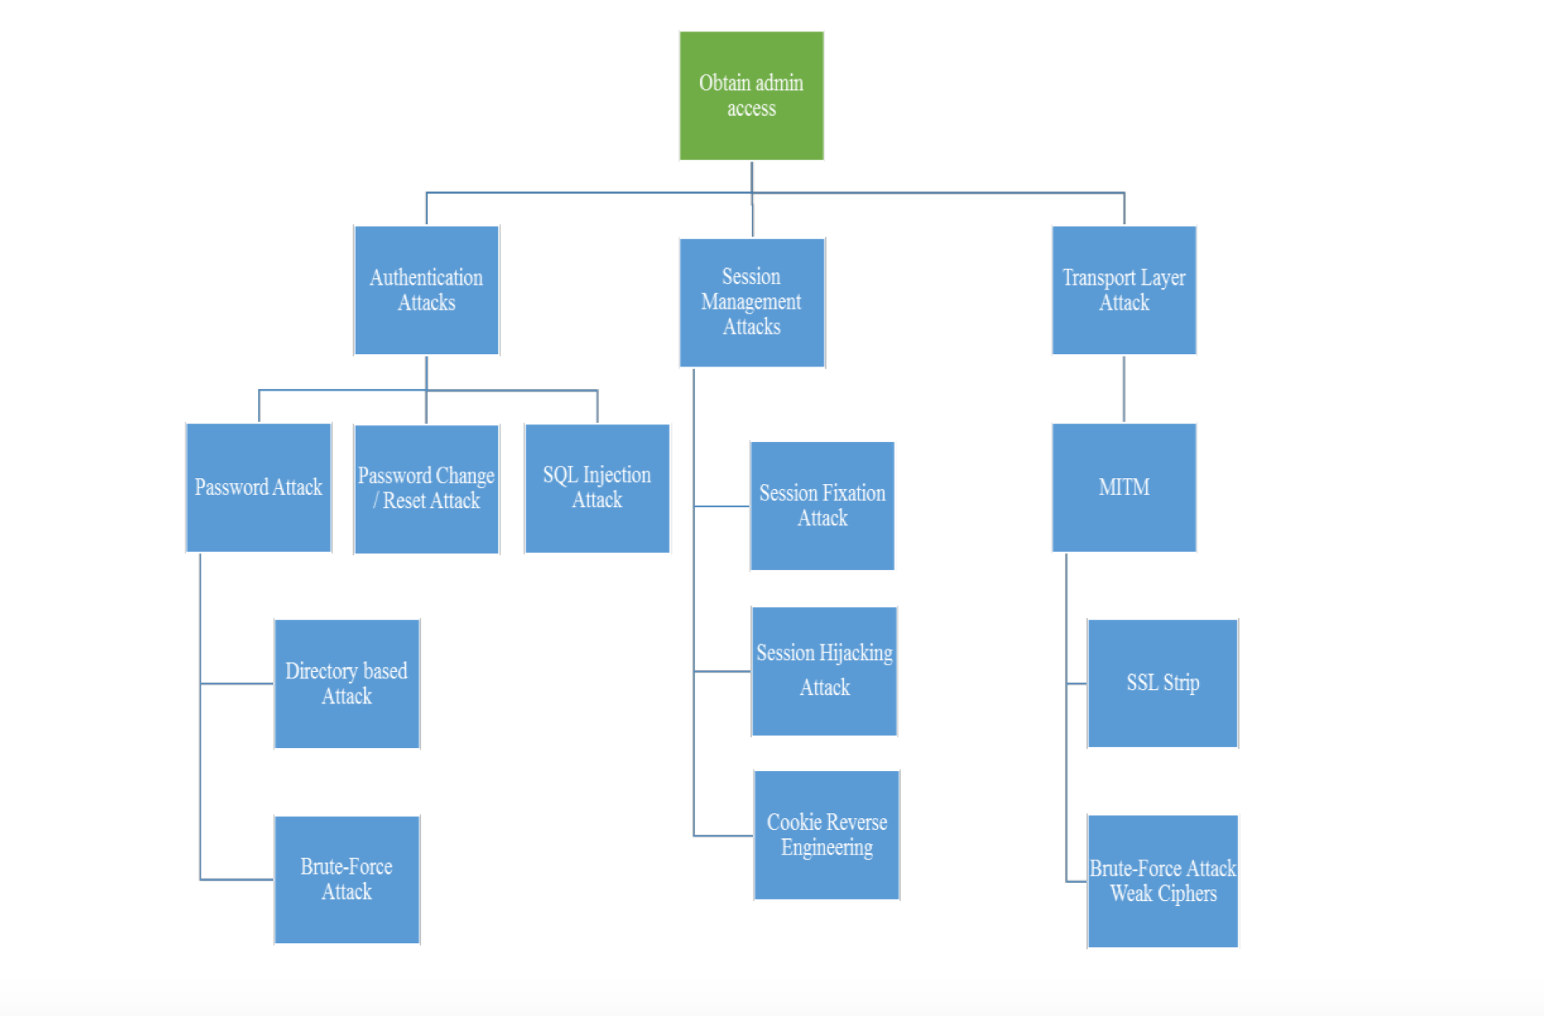

Slide 15
Diagraming
There are different types of diagram could be used to threat model.
The classic is Data flow diagram.
Some questions to ask out loud:
1. Can we tell a story without changing the diagram?
2. Can we tell a story without using words such as “sometimes” or “also”?
3. Can we see on the diagram where software will make a security decision?
4. Does the diagram shows all trust boundaries? Do we cover all app roles and network interfaces?
5. Does it reflect the current or planned reality of the software?

Slide 16
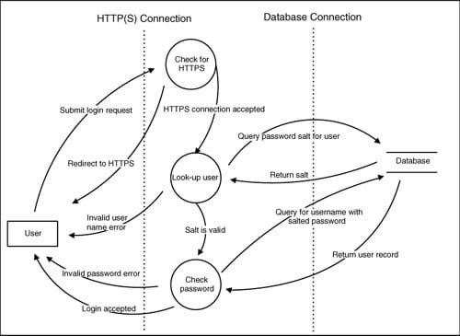
Diagram example

Slide 17
Tool for Diagramming
There are many different tools that can be used to create and keep our Threat Models.
Choosing the right one is to think about what should be threat modeled, how many details we want to include, and what would be comfortable to use.
Mostly it’s matter of preference.
Some examples:
MS Visio
PyTM
OWASP Threat Dragon

Slide 18
Checking the model
Is it complete?
Is it accurate?
Does it cover all security decisions we made?
Can we start next version with this diagram without any changes?

Slide 19
What to do with the findings
Mitigation Strategy
Mitigation and Elimination techniques
Creating controls
Tracking the issues
Example of mitigation strategy and technique for Spoofing a person threat:
Strategy: Identification and authentication.
Technique: Usernames, real names, or other identifiers.
Passwords, Tokens, Biometrics.
Enrollment, maintenance, expiry.

Slide 20
Validation of threats
1. Have we written down or filed a bug for each threat?
2. Is there a planned or implemented way to address each threat?
3. Do we have a test case per threat?
4. Has the software passed the test?

Slide 21
Number of different approaches
Threat model should be useful, thought there is no one right way to do it.
Continuous Threat Modeling (CTM). Threat model every user story according to Agile process
Rapid Threat Model Prototyping (RTMP)
…
Come up with something that works for the specific project.

Slide 22
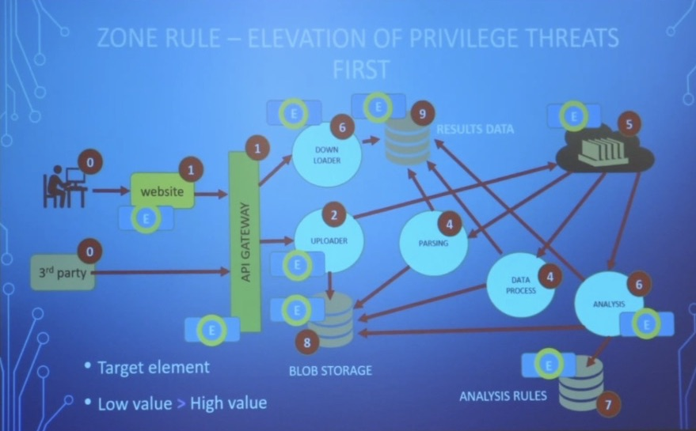
RTPM example

Slide 23
?

Slide 24
Materials used
…and useful resources to dig into
Threat modeling. Designing for security. By Adam Shostack.
SAFECode
OWASP (including video recordings from the conferences)
Elevation of Privilege card game by Microsoft.

