Slide 1
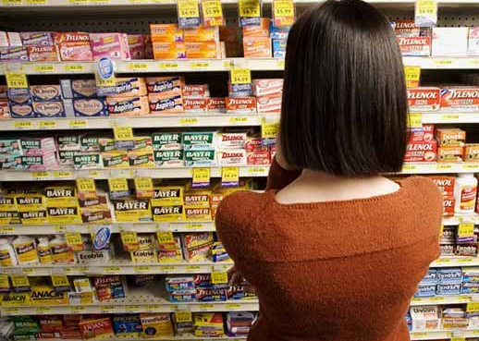
OptiMeds DI project proposal
Ali Mehdizadeh
Aug 13, 2020
https://globalpharmaupdate.com/

Slide 2
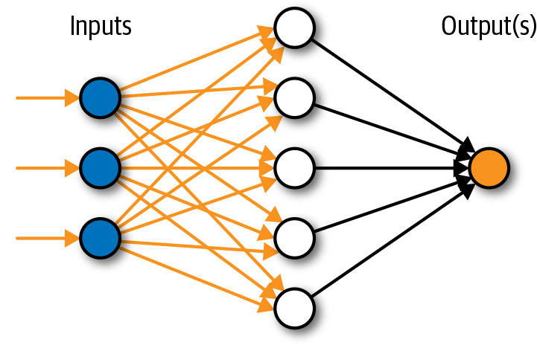
Idea
Design and application that helps user find the best medicine based on their symptoms, preferences and other information
User symptoms
OptiMed model
Best hit
Cold
Fever
Pain
….
Drug X
https://www.innoarchitech.com/

Slide 3
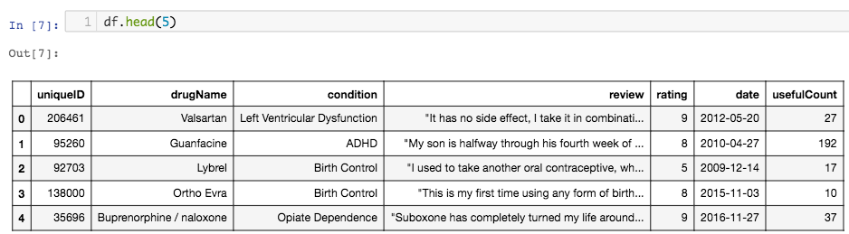
How it started?
Looking for different datasets for the project, trying to find a meaningful project, I came across this dataset:
https://github.com/alineu/ml-projects/blob/master/drug-DI/drug_optimizer.ipynb

Slide 4
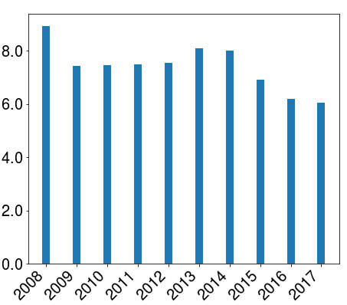
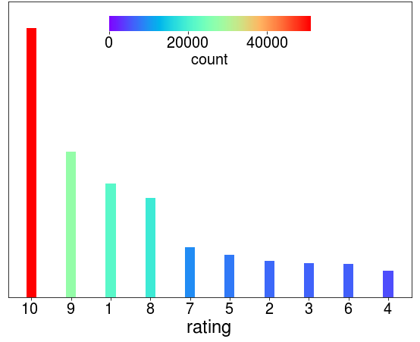
Data Exploration
User rating distribution
Mean rating over a decade
https://github.com/alineu/ml-projects/blob/master/drug-DI/drug_optimizer.ipynb
Notes:
https://www.wsj.com/

Slide 5
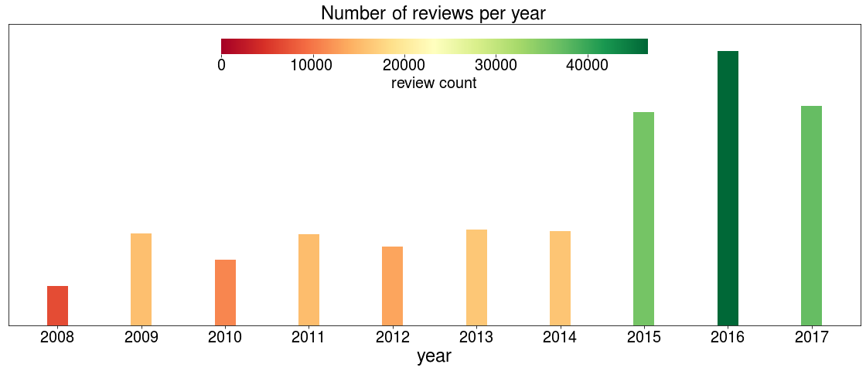
Data Exploration
Reviews per year
https://github.com/alineu/ml-projects/blob/master/drug-DI/drug_optimizer.ipynb
Notes:
https://www.wsj.com/

Slide 6
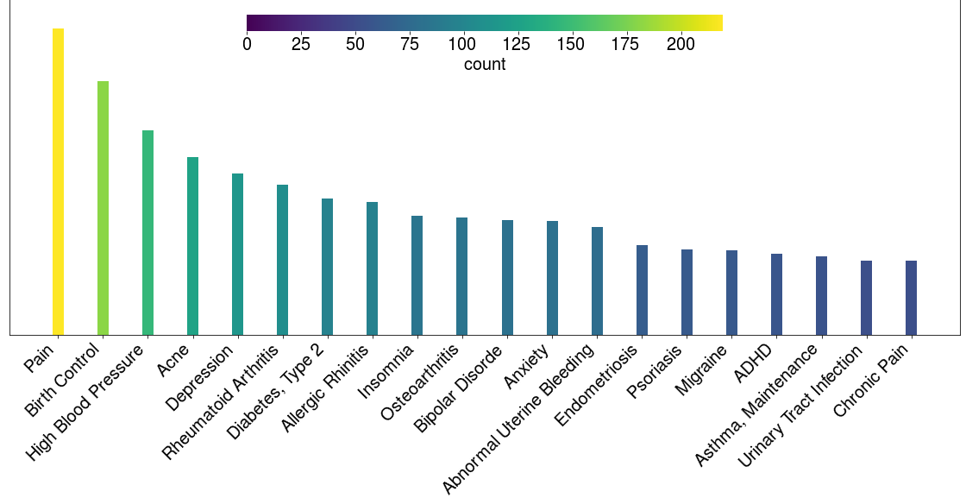
Data Exploration
Most frequent conditions that are aimed to be treated by drugs
https://github.com/alineu/ml-projects/blob/master/drug-DI/drug_optimizer.ipynb
Notes:
https://www.wsj.com/

Slide 7
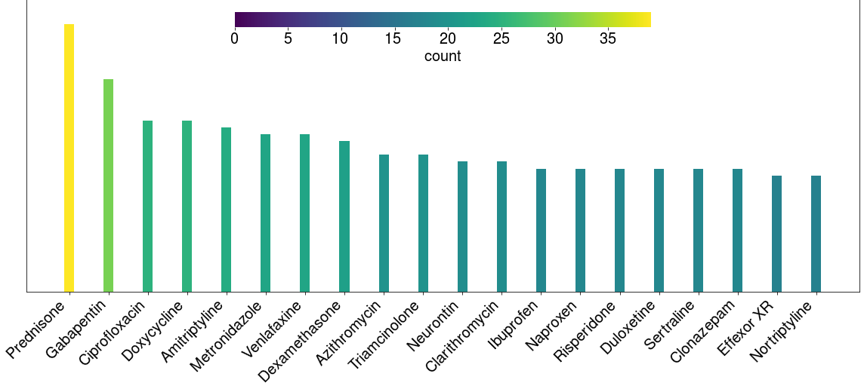
Data Exploration
Drugs with the highest number of induced effects
https://github.com/alineu/ml-projects/blob/master/drug-DI/drug_optimizer.ipynb
Notes:
https://www.wsj.com/

Slide 8
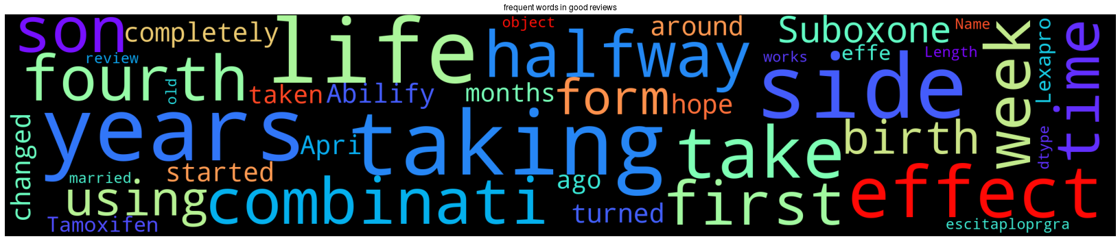
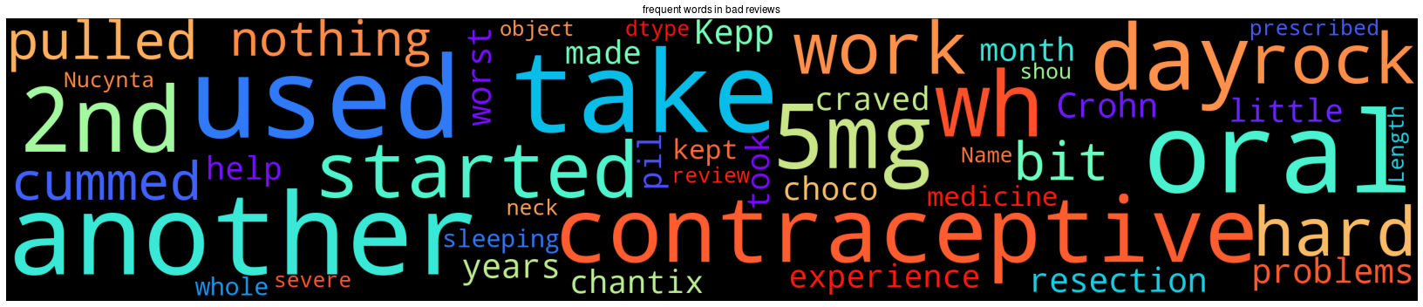
Data Exploration
Good
Bad
https://github.com/alineu/ml-projects/blob/master/drug-DI/drug_optimizer.ipynb
Notes:
https://www.wsj.com/

Slide 9
Goals
Current
Build a language model to recommend the right medicine according to the user condition
Future
Use other resources such as DrugBank to make the model more robust by considering potential drug interactions, side effects etc.
Use other APIs such as GoodRx to build a real-time model that considers other user-defined factors such as user location, price-range, and distance-to-pharmacy to make a more robust decision.
Expand the usefulness of the app to medical professionals so that they can offer patients customized solutions.

Slide 10
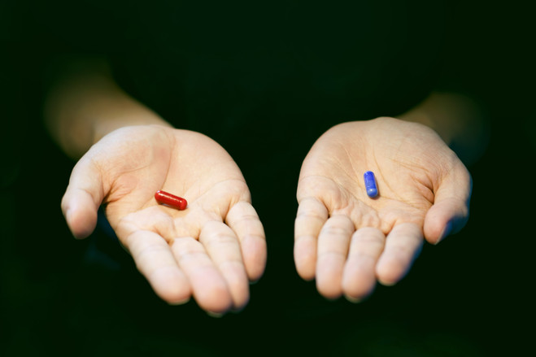
OptiMeds
Choose the right one

