Slide 1
Every international student in France
has a senior who helped them.
Notes:
Slow. Let it land. Do not rush into slide 2.

Slide 2
That advice is generous.
It's specific.
And it's usually from last year.
Notes:
Pause after "It's specific." before delivering the last line. The pause is the hook.

Slide 3
CHECKED AGAINST SOURCE
· WITH THE DATE ·
HEARSAY
Checks the paperwork advice international students pass around against dated official French sources — and tells you exactly what changed.

Slide 4
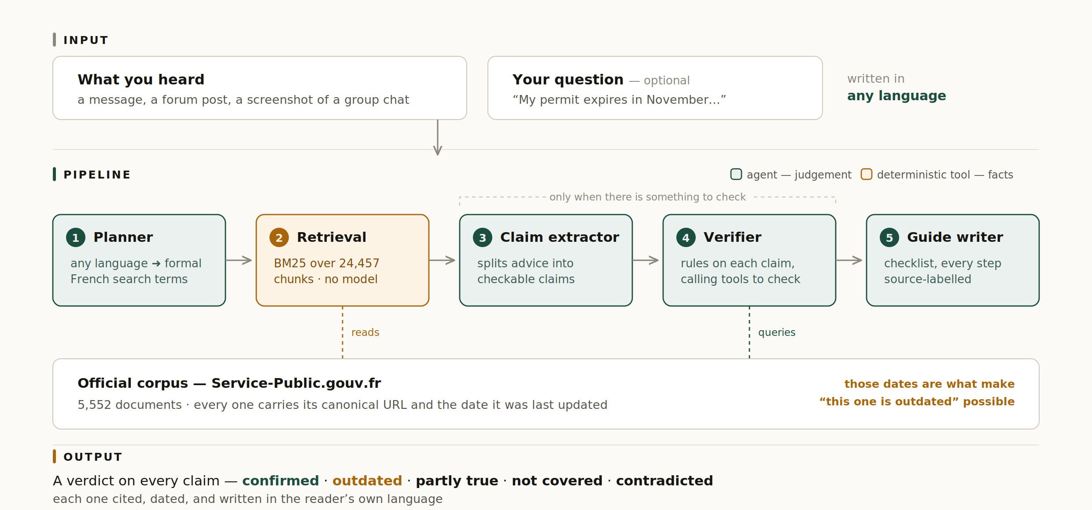
Green — agents make judgements. Amber — deterministic code supplies facts.

Slide 5
445,000
international students in France, 2024–25
Almost all of them get through this
on
hearsay.
Notes:
"hearsay" here is the ordinary word, not the product. That double meaning is the point.

Slide 6
HEARSAY
github.com/alineyyy/Hearsay
MIT licence · built with AWS Strands Agents on Amazon Bedrock
Official data: Service-Public.gouv.fr / DILA · Licence Ouverte 2.0 (Etalab)

