Slide 1
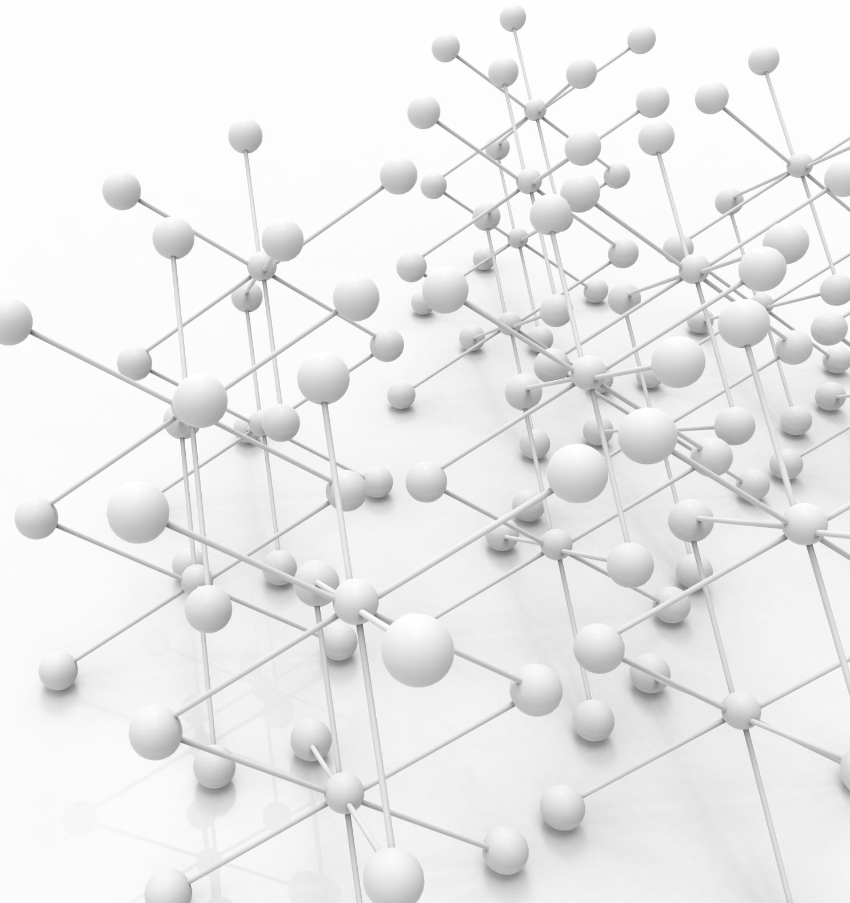

Www Lifecycle Explained

Slide 2
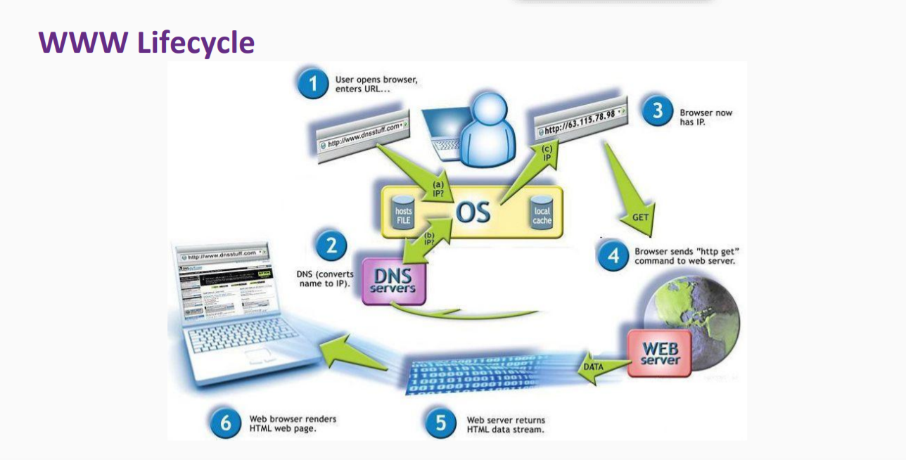

The image describes the process based on request (client) and response (server), structured in a multi-layer architecture.

Slide 3

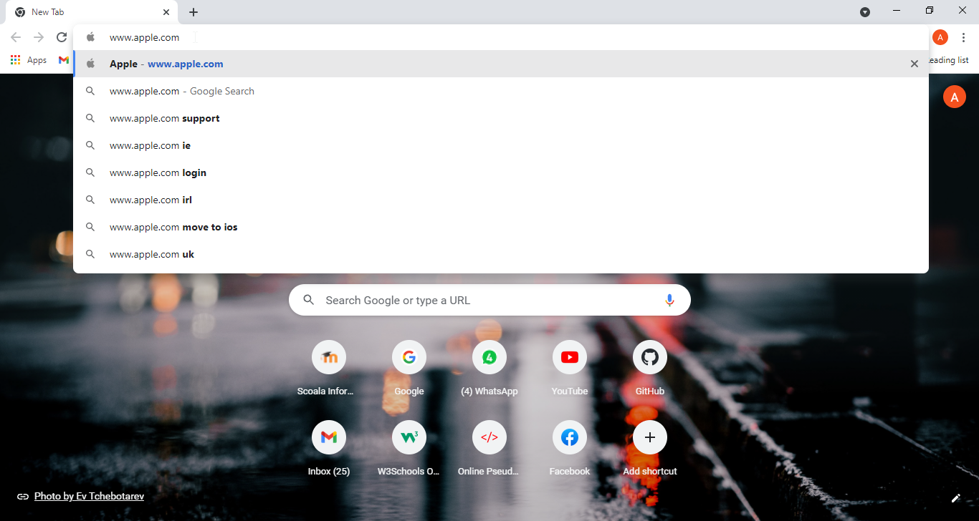
First step describes the user's interaction with the browser.
The user opens the browser, enters the web adress - https://apple.com and sent a HTTP (Hyper Text Transfer Protocol) request to the server in order to fetch the resource he is looking for.
The request is made in the presentation layer, which is the application's topmost level. This layer can be directly accessed by the user, displays informations from others layers and communicate only with the business layer.

Slide 4

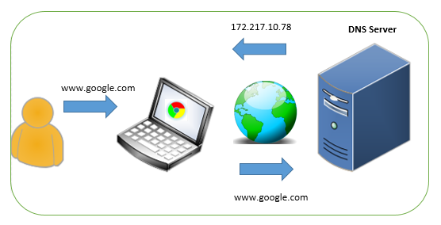
Step 2 The URL introduced contains a domain name - www.apple.com - that is recognized by DNS (Domain Name Server). Also called the internet's phone book, DNS is able to convert the name of the website you entered, into IP (Internet Protocol) adress.

Slide 5


Next step consist of having an IP adress now, instead of having the initial adress www.apple.com. HTTP GET request travels through business layer to web server.

Slide 6
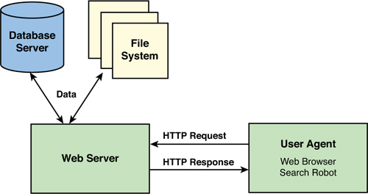
Receiving the command GET, the web server reads/processes the request and provide the information.
The database server is accesed in this step and the process is the equivalent of data layer.

Slide 7


Web server sends the data retrieved from data server to the user, using again business layer.
The format now, is html.

Slide 8


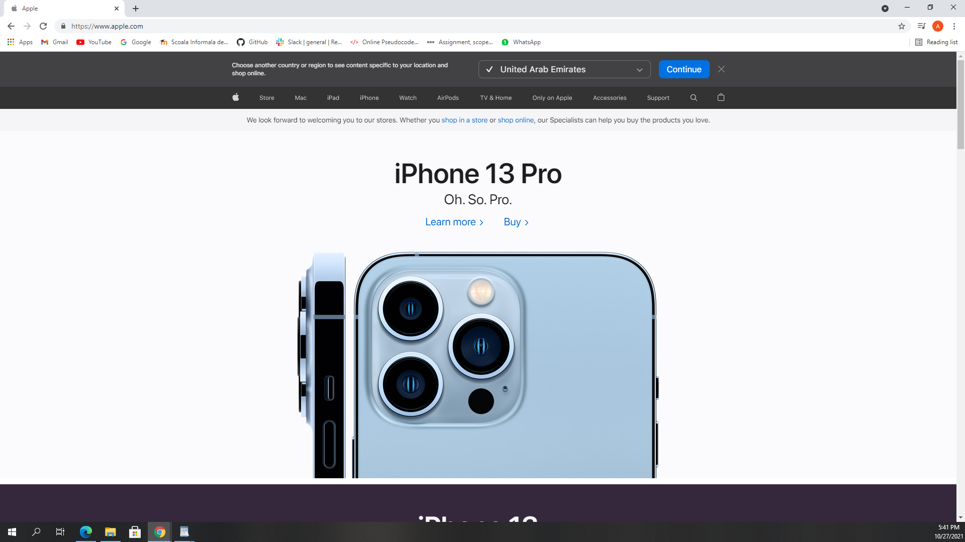
On the user's browser, the page displays now the request response, in a HTML (Hyper Text Markup Language) format, containing pictures and text.
The page is loaded now.

