Slide 1
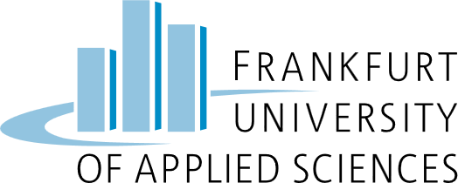
What is the Model Context Protocol (MCP)?
Ali M. Nekoh
HIS: Intro to Statistics
Frankfurt University of Applied Sciences
Dr. Prof. Marouf
November 2025

Slide 2
MCP (Model Context Protocol) is an open-source standard for connecting AI applications to external systems.
Using MCP, AI applications like Claude or ChatGPT can connect to data sources (e.g. local files, databases), tools (e.g. search engines, calculators) and workflows (e.g. specialized prompts)—enabling them to access key information and perform tasks.

Slide 3
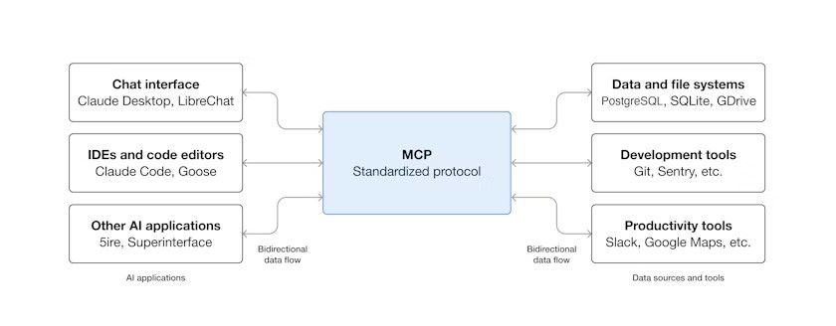

Slide 4
What can MCP enable?
Agents can integrate with Google Calendar and Notion for personalized assistance.
Claude Code can build full web apps directly from Figma designs.
Enterprise chatbots can access multiple databases for data analysis via chat.
AI models can design 3D models in Blender and send them for 3D printing.

Slide 5
Why does MCP matter?
MCP offers benefits across the ecosystem.
  Developers: Reduces build time and complexity.
  AI apps/agents: Gains access to rich data, tools, and apps.
  End-users: Get smarter AIs that can access data and take actions.

Slide 6
Start Building !
Build Server:
Create MCP servers to expose your data and tools
Build clients:
Develop applications that connect to MCP servers

Slide 7
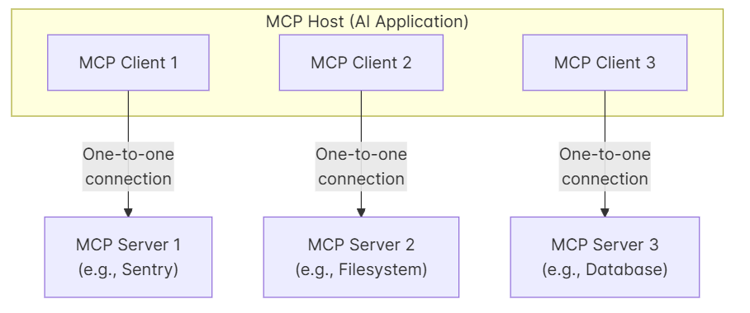
Architecture overview
MCP: follows a client-server architecture

