Slide 1

Update 1 | 27 Mar 2019
Block diagram
Parts
Tools
Workflow
//TODO

Slide 2
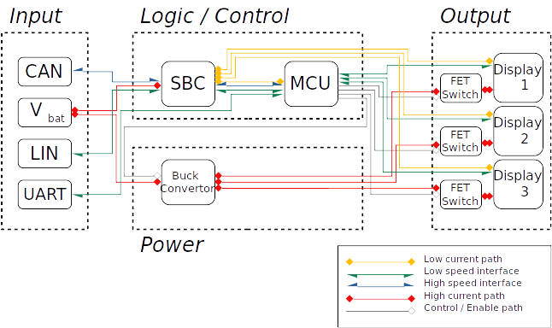
Block diagram
!!! CONTROL BUTTONS !!!
!!! RPM LEDS !!!

Slide 3
Block diagram – Input
3 pin connector
  CANH + CANL + LIN
2 pin connector
  V_{bat} + GND
2 pin connector
  UART

Slide 4
Block diagram – Logic
MCU
  STM32F378CCT6
  ARM MCU, 1.8V Operation, STM32 Family STM32F3 Series Microcontrollers, ARM Cortex-M4, 32bit, 72 MHz, 48 pins
SBC
  TLE9262
  Two integrated Low-Drop Voltage Regulators, 1 high-speed CAN transceiver, LIN transceiver, high-side outputs

Slide 5
Block diagram – Power
Buck converter
  LM46002-Q1
  3.5-V to 60-V, 2-A, Synchronous step-down voltage converter

Slide 6
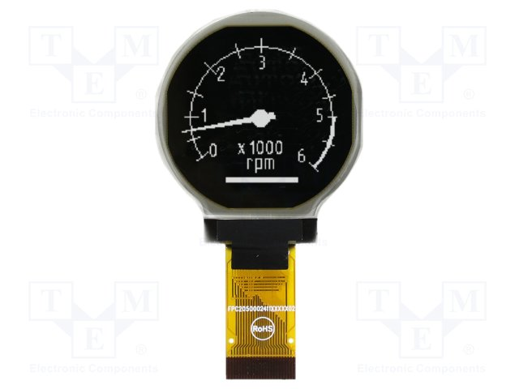
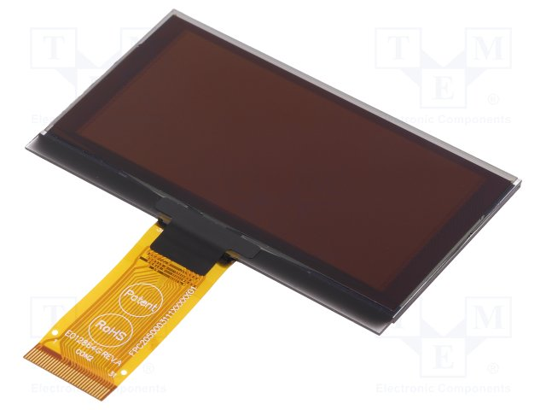
Block diagram – Output
Display 1 / 2
  EA W128128-XRLW
  1.2” Low-Power OLED, SPI, I²C, 8-Bit Interface, 37mm diameter
Display 3
  DEP 128064R-W
  128x64; 73x41,86x2,15mm, Monochrome (White)

Slide 7
Parts – MCU
STM32
  STM32F378CCT6
STM8
Renesas
  R7FS5D37A3A01CNB
  R7FS3A6783A01CNE
Microchip
  dsPIC33EV64GM004
Atmel
  at90can32

Slide 8
Tools – software
Compile / Debug
  arm-none-eabi-gcc
  arm-none-eabi-gdb
Build
  Make
Interface
  OpenOCD
  ST-Link/V2
Graphic
  LittlevGL
Configure
  STM32cubeMX
Middleware
  FreeRTOS

Slide 9

Tools - hardware
Schematic design
  KiCAD
PCB design
  KiCAD
SPICE simulator
  ngspice

Slide 10

Tools - LittlevGL
Hardware independent to use with any microcontroller or display
Scalable to operate with little memory (80 kB Flash, 10 kB RAM)
Simulator to start embedded GUI design on PC without embedded hardware
Free and open-source under MIT licence
Organised and buildable using Makefiles

Slide 11
Workflow – Arch Linux
Until now
Vim / Emacs
Make
OpenOCD
arm-*-gdb
Now: Visual Studio Code
  Code syntax highlight + autocompletion + IntelliSence
  JSON config files
  GDB integration
  Task automation
  Marketplace / Extensions

Slide 12
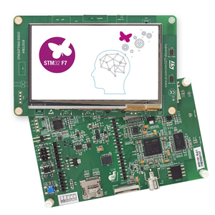
// TODO
Port project to 32F746GDISCOVERY on 24bit parallel interface
Cofigure basic interface on Dev Board
Finish work on schematic parts and component footprints
Start work schematic
? WCCA for Buck regulator, snubber circuits, discrete components

