Slide 1


Insights from Young Adults (Aged 18-26 Years) in Riyadh: Exploring Respiratory Health Symptoms in the Vaping Era
Basmah Alanazi
Master of Public Health, Biostatistics and Epidemiology Track
Advisor: Dr. Noara AlHusseini
Committee Members: [add names]
Alfaisal University · 2026

Slide 2
Acknowledgements
To my advisor, Dr. Noara AlHusseini, for her guidance and patience at every stage of this work
To the Department of Public Health at Alfaisal University, and to my colleague Murhaf Al Anan
To the 208 young people who answered my questionnaire honestly and gave this study its data
To my family and friends, who kept me going when the work was hardest

Slide 3
Overview
Introduction
Literature Review
Research Questions
Aims and Objectives
Methodology
Results
Discussion
Conclusion
Recommendations
References

Slide 4
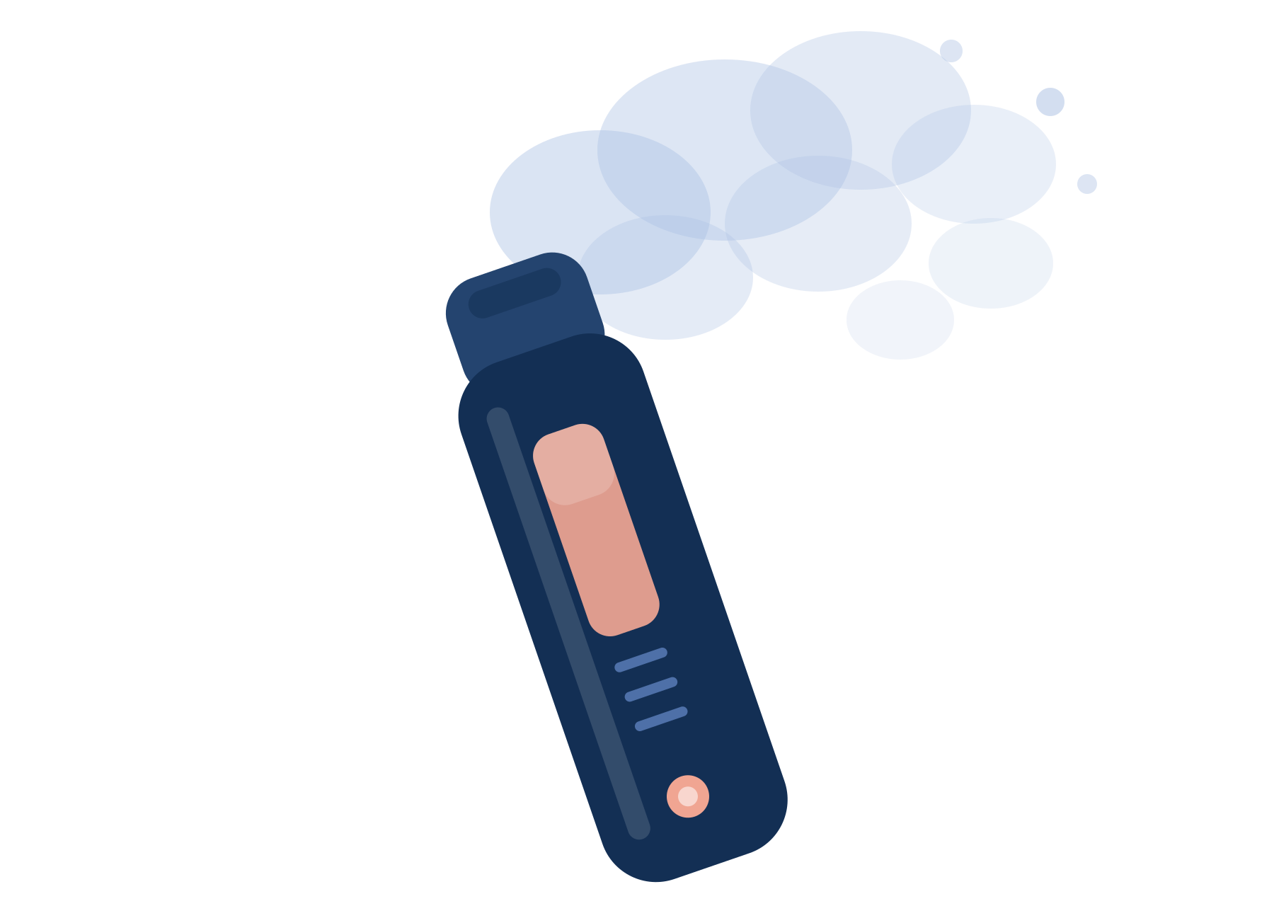
Introduction
A vape heats liquid into an aerosol. It is not harmless water vapor (CDC, 2024)
US adult use climbed from 4.5% in 2019 to 6.5% in 2023 (Vahratian et al., 2025)
The sharpest rise, 15.5%, was among those aged 21 to 24
By January 2020, EVALI had put 2,688 people in hospital (Krishnasamy et al., 2020)

Slide 5

Introduction (cont…)
Across 15 Saudi studies from 2021 to 2024, 30.5% of those surveyed were vaping (Alaboodi et al., 2025)
Until the 2025 retail limits, sales here were barely regulated (Tobacco Reporter, 2025)
Devices come in many shapes, flavors and nicotine strengths (Collins et al., 2018)
Most studies look at teenagers, or at all adults over 18, not at young adults aged 18 to 26

Slide 6
Literature Review
Table 1. Reported Prevalence of Current Vaping Among Youth and Young Adults
Setting | Population | Current use
USA (Kelsh et al., 2023) | College students, 19 to 22 yrs | 23.2%
Europe, 32 countries (Ollila et al., 2023) | Students, 15 to 16 yrs | 12.4%
Saudi Arabia (AlDukhail et al., 2025) | Adolescents, national | 5.3%
Riyadh (AlHumaidan et al., 2024) | Young adults, 18 to 25 yrs | 10.5%
Taibah University (Alzahrani et al., 2023) | University students | 24.0%
Wherever it has been measured, a large share of young people are already vaping.

Slide 7
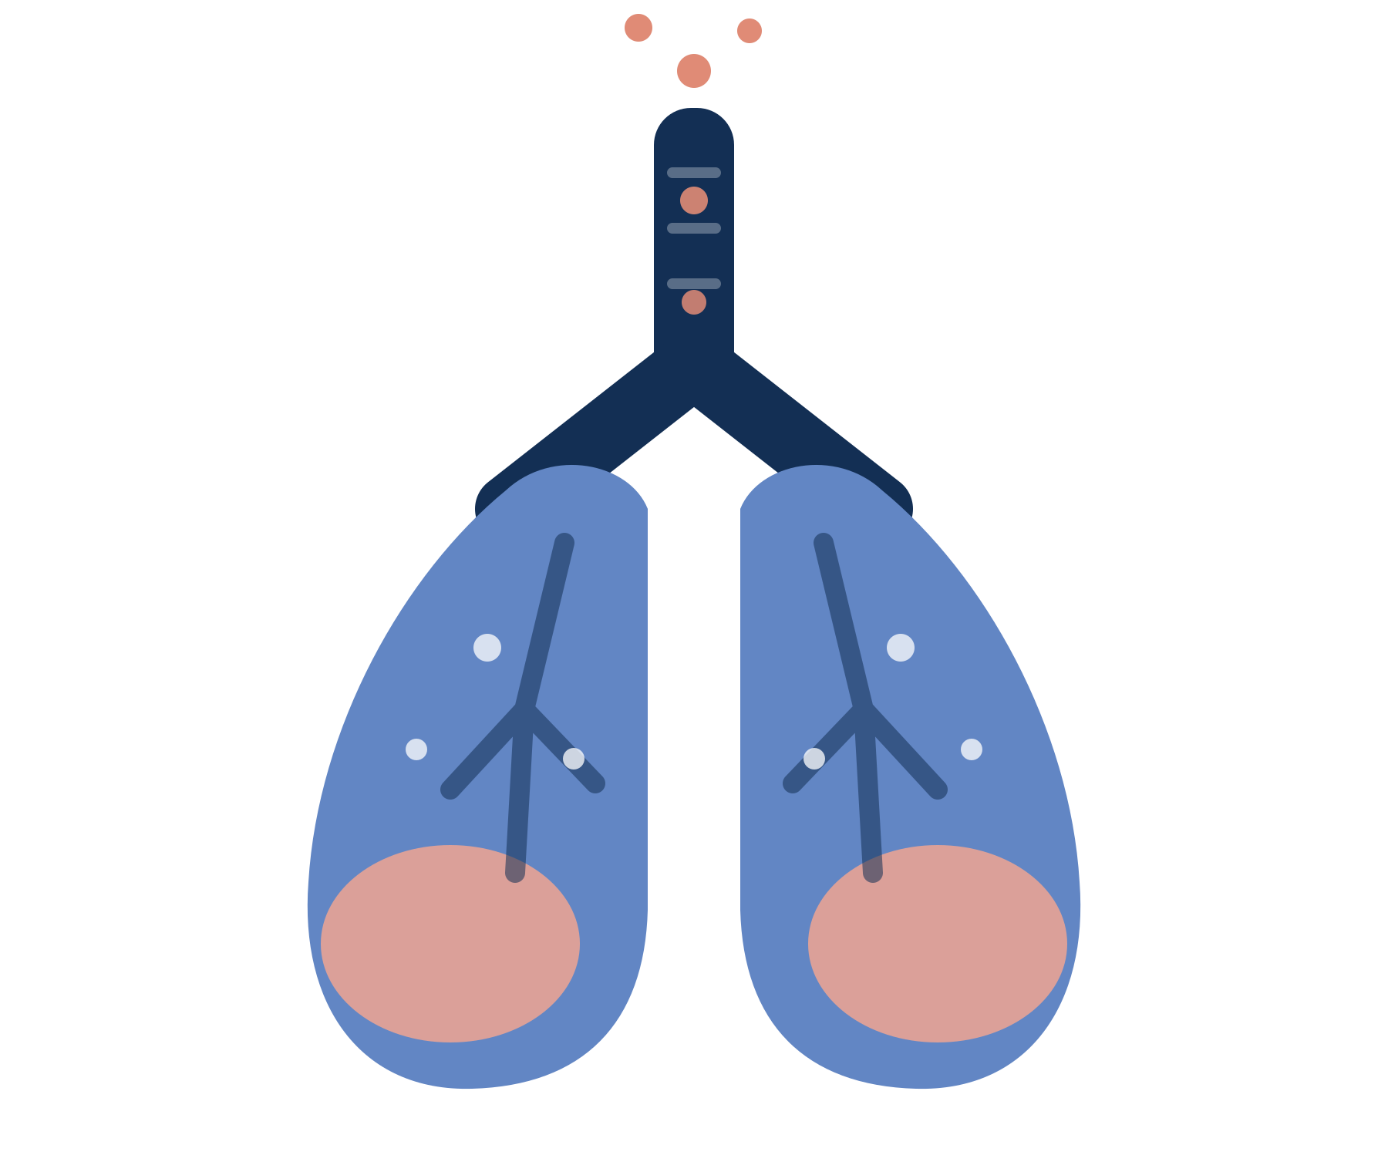
Literature Review (cont…)
Acrolein, formaldehyde and acetaldehyde in the aerosol can damage the lungs for good (American Lung Association, 2025)
More than half of the patients who develop EVALI end up in intensive care
There is moderate evidence that vaping brings on cough, wheezing and worse asthma (NAM, 2018)
Yet 17% of young adults in Riyadh think vapes are harmless, or safer than cigarettes (AlHumaidan et al., 2024)

Slide 8
Research Question
What makes young adults aged 18 to 26 in Riyadh take up vaping?
How much do they really know about what vaping does to their lungs?
  Main outcome: their score on the Perspective of Vape Use questionnaire
  Also examined: which personal and behavioral factors shift that score

Slide 9
Aims and Objectives
My aim was to find out how much young adults in Riyadh know about the respiratory risks of vaping, and how their background shapes the way they see it
First, I set out to describe how they vape and to measure their Perspective of Vape Use score
Second, I tested which personal and behavioral factors were linked to that score

Slide 10
Methodology
I ran a cross-sectional survey, using an online questionnaire that people filled in themselves
It was open to 18 to 26 year olds living in Riyadh, male and female, Saudi and non-Saudi
Anyone who had never vaped, or who did not consent, was excluded
The calculation called for 167 responses at 95% confidence and a 5% margin of error
I collected 208 through convenient sampling, between March and December 2024

Slide 11
Methodology (cont…)
The tool was the validated Youth E-cigarette Smokers’ Perspective of Vape Use scale: 20 Likert items scored out of 100 (Dowd et al., 2019)
It held together well here, with a Cronbach’s alpha of 0.89, and the Arabic version was checked by back-translation
I analyzed the data in SPSS v27 (t-tests, ANOVA, correlation and multiple linear regression), taking p < 0.05 as significant
The study was approved under IRB-20274; taking part was voluntary and no one was identifiable

Slide 12
Results
Table 4.1. Descriptive Characteristics of Young Adult Vape Users in Riyadh (N = 208)
Variable | Category | n (%)
Age (mean ± SD) | 23.11 ± 2.64 years | —
Gender | Male | 120 (57.7)
 | Female | 88 (42.3)
Marital status | Single | 165 (79.3)
Residential area | Central Riyadh | 119 (57.2)
Employment status | Employed | 114 (50.2)
Education level | Bachelor’s degree | 105 (50.5)
The largest category is shown for each variable.

Slide 13
Results (cont…)
Table 4.2. Vaping Behavior of the Study Participants (N = 208)
Variable | Category | n (%)
How often do you vape? | Daily | 156 (75.0)
 | Weekly | 31 (14.9)
 | Socially | 21 (10.1)
Duration of vaping | 1 to 2 years | 81 (38.9)
Ever smoked cigarettes | Yes | 162 (77.9)
Respiratory condition | Yes (asthma, allergy, pneumonia) | 68 (32.7)
Three out of four participants were vaping every day.

Slide 14
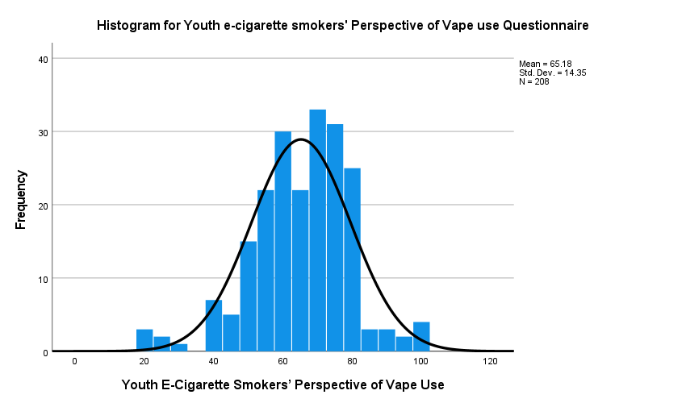
Results (cont…)
Figure 4.1. Distribution of the Youth E-cigarette Smokers’ Perspective of Vape Use Score (N = 208)
Mean score
65.18
± 14.35 out of 100
Awareness sat in the middle of the range. Most people scored between 55 and 80.

Slide 15
Results (cont…)
Table 4.3. Association Between Demographic Characteristics and the Vape Use Score (N = 208)
Variable | Category | Mean ± SD | 95% CI | p-value
Gender | Male | 63.33 ± 15.26 | 61.26 to 65.40 | 0.03*
 | Female | 67.70 ± 12.66 | 65.98 to 69.42
Marital status | Single vs married | 65.20 vs 65.12 | — | 0.97
Residential area | Five areas of Riyadh | 61.38 to 69.94 | — | 0.18
Education level | School to bachelor’s | 64.30 to 65.50 | — | 0.88
Monthly income | No income to >20,000 SAR | 61.00 to 66.40 | — | 0.70
* p < 0.05. Of everything I tested here, gender was the only demographic factor that made a real difference.

Slide 16
Results (cont…)
Table 4.4. Association Between Vaping Behavior and the Vape Use Score (N = 208)
Variable | Category | Mean ± SD | 95% CI | p-value
How often do you vape? | Daily | 65.66 ± 14.10 | 63.43 to 67.89 | 0.03*
 | Weekly | 67.87 ± 14.29 | 62.63 to 73.11
 | Socially | 57.67 ± 14.53 | 51.05 to 64.28
Respiratory condition | No | 63.00 ± 13.52 | 61.16 to 64.84 | <0.001*
 | Yes | 69.68 ± 15.06 | 67.63 to 71.73
Duration / past smoking | Not significant | — | — | >0.05
* p < 0.05. Social vapers scored lowest, and anyone with a respiratory condition scored highest.

Slide 17
Results (cont…)
Table 4.5. Multiple Linear Regression: Significant Predictors of the Vape Use Score (N = 208)
Variable | B (95% CI) | p-value
Western area of Riyadh (vs East) | −9.28 (−17.81, −0.75) | 0.033*
Income 10,001 to 20,000 SAR (vs none) | −10.18 (−20.18, −0.18) | 0.046*
Social vaping (vs daily) | −8.77 (−15.85, −1.70) | 0.015*
Respiratory health condition (vs none) | +6.04 (1.73, 10.36) | 0.006*
* p < 0.05. Age, gender, marital status, education, employment, how long someone had vaped and past cigarette use all dropped out once the rest was accounted for.

Slide 18
Discussion
Table 5.1. How These Findings Compare with Previous Global and Local Studies
What I found | Studies that agree | Studies that differ
Awareness was moderate (mean 65.2 / 100) | Hall et al., 2025; Alduraywish et al., 2023; AlHumaidan et al., 2024 | Gupta et al., 2020, where awareness across six countries was low
Women were more aware than men | Alam & Silveyra, 2023; AlSayyad et al., 2024 (Bahrain) | Khalid et al., 2021 and Piñeiro et al., 2016, where men scored higher
Daily and weekly vapers beat social vapers | Mayorga et al., 2019, where daily users knew the risks better | Kozlowski et al., 2017, where daily users thought vaping was safer
A respiratory condition raised awareness | Alsaedi & Al-Zalabani, 2025: symptoms are commoner in current users | Nothing I found contradicts this

Slide 19
Discussion (cont…)
The questionnaire was already validated, it held up well here, and the regression let me adjust for confounders
Because I recruited online, people chose themselves into the study, so this may not hold for every young adult in Riyadh
Everything was self-reported, including how often people said they vape
The uncomfortable finding is that awareness was reasonable while three in four still vaped every day

Slide 20
Conclusion
Awareness of the respiratory risks was moderate, 65.2 out of 100, yet three quarters of the group vaped daily
Women, and anyone already living with a respiratory condition, knew more
Social vapers, higher earners and people in western Riyadh knew less
If knowing the risk were enough, this group would be vaping far less. Campaigns have to speak to each group in its own terms

Slide 21
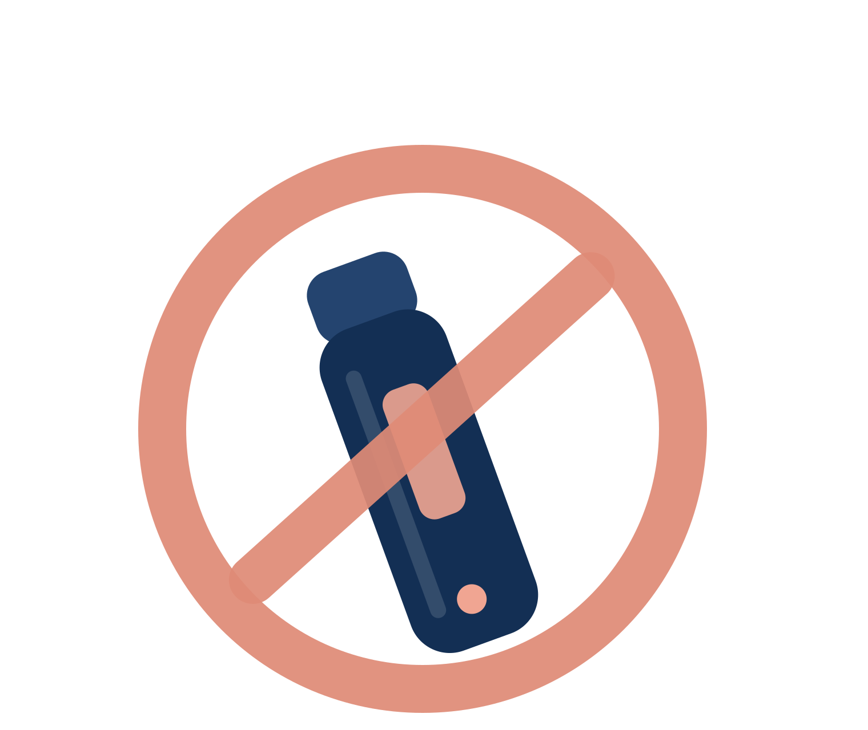
Recommendations
Aim awareness campaigns at young people, with different messages for men and women
Tax vapes the way tobacco is taxed, and ban their use in public places
Control advertising, and keep sales to licensed shops with an 18+ age limit
Put pictorial warnings on the packaging, and say plainly that vapes are not the safer option
Follow this up with focus groups, to hear in their own words why young adults start

Slide 22
References
Alaboodi, T., et al. (2025). Epidemiology of using electronic cigarettes in Saudi Arabia: A systematic review. Cureus, 17(3).
Alam, F., & Silveyra, P. (2023). Sex differences in e-cigarette use and related health effects. IJERPH, 20(22), 7079.
AlDukhail, S. K., et al. (2025). Electronic cigarette use among adolescents in Saudi Arabia: A national study. Tobacco Induced Diseases, 23.
Alduraywish, S. A., et al. (2023). Knowledge and attitude toward e-cigarettes among first year university students in Riyadh. Healthcare, 11(4), 502.
AlHumaidan, N. I., et al. (2024). Prevalence, perception and attitude regarding e-cigarette usage among young adults in Riyadh. Saudi Medical Journal, 45(8), 857–861.
Alsaedi, M. Q., & Al-Zalabani, A. H. (2025). E-cigarette use and respiratory symptoms among university students. Tobacco Induced Diseases, 23.
AlSayyad, A. S., et al. (2024). Gender differences in e-cigarette knowledge, attitudes and practice in Bahrain. Discover Public Health, 21, 116.
American Lung Association. (2025). The impact of e-cigarettes on the lung.
Dowd, A. N., Motschman, C. A., & Tiffany, S. T. (2019). Development and validation of the questionnaire of vaping craving. Nicotine & Tobacco Research, 21(1), 63–70.
Gupta, V., et al. (2020). Assessment of knowledge of use of electronic cigarette and its harmful effects among young adults. Open Medicine, 15(1), 796–804.
Kelsh, S., et al. (2023). Young adults’ electronic cigarette use and perceptions of risk. Tobacco Use Insights, 16.
Khalid, A. S., et al. (2021). Awareness and attitude of vape users in the Saudi community. Pakistan Journal of Medical Sciences, 15, 1111–1114.
Krishnasamy, V. P., et al. (2020). Update: Characteristics of a nationwide outbreak of EVALI, United States. MMWR, 69(3), 90–94.
Mayorga, N. A., Garey, L., & Zvolensky, M. J. (2019). Differences in perceptions of e-cigarettes across daily and non-daily users. Addictive Behaviors, 90, 415–420.
Ollila, H., et al. (2024). Exclusive and dual use of electronic cigarettes among European youth in 32 countries. Tobacco Control, 33(5), 622–627.
Piñeiro, B., et al. (2016). Gender differences in use and expectancies of e-cigarettes. Addictive Behaviors, 52, 91–97.
Vahratian, A., et al. (2025). Electronic cigarette use among adults in the United States, 2019–2023. NCHS Data Brief, 524.

Slide 23
Thank You
I am happy to take your questions

