Slide 1
Exploring YouTube Video Trends and Predictive Insights
Alinzon Simon
Adv. Programming Techniques
School of Professional Studies
May 2025

Slide 2
Abstract
This study explores YouTube’s top trending videos to understand content popularity, user engagement, and sentiment. Using machine learning and sentiment analysis, it investigates how region, category, and emotional tone influence likes, views, and comments.

Slide 3
Research Questions
1. What are the most popular YouTube video categories across countries?
2. How does video category correlate with like counts?
3. Can we predict likes/views using description, category, region?
4. How does sentiment in descriptions relate to engagement?

Slide 4
Dataset Overview
Video Metadata:
title, description, video_id, etc.
Categorical: category_name, region_name
Engagement Metrics: views, likes, comments, favorites

Slide 5
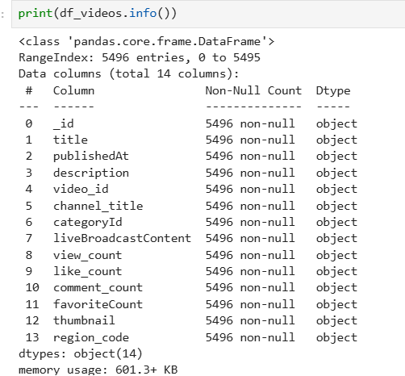
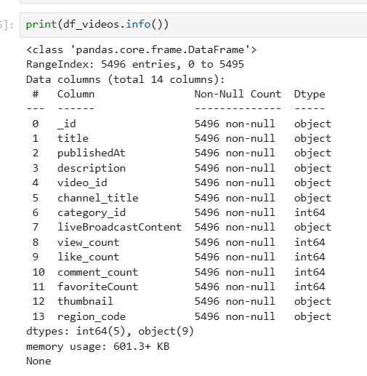
Data Wrangling

Slide 6
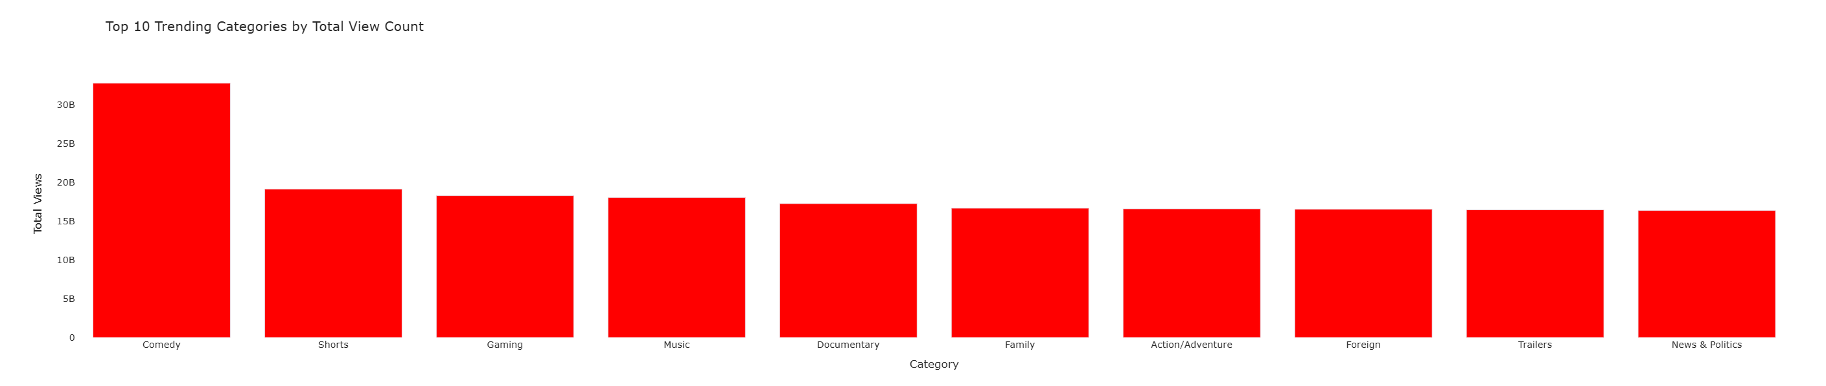
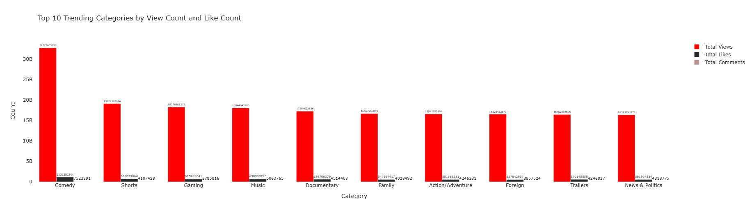
Exploratory Data Analysis

Slide 7
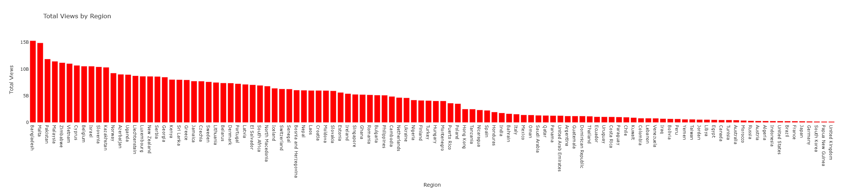
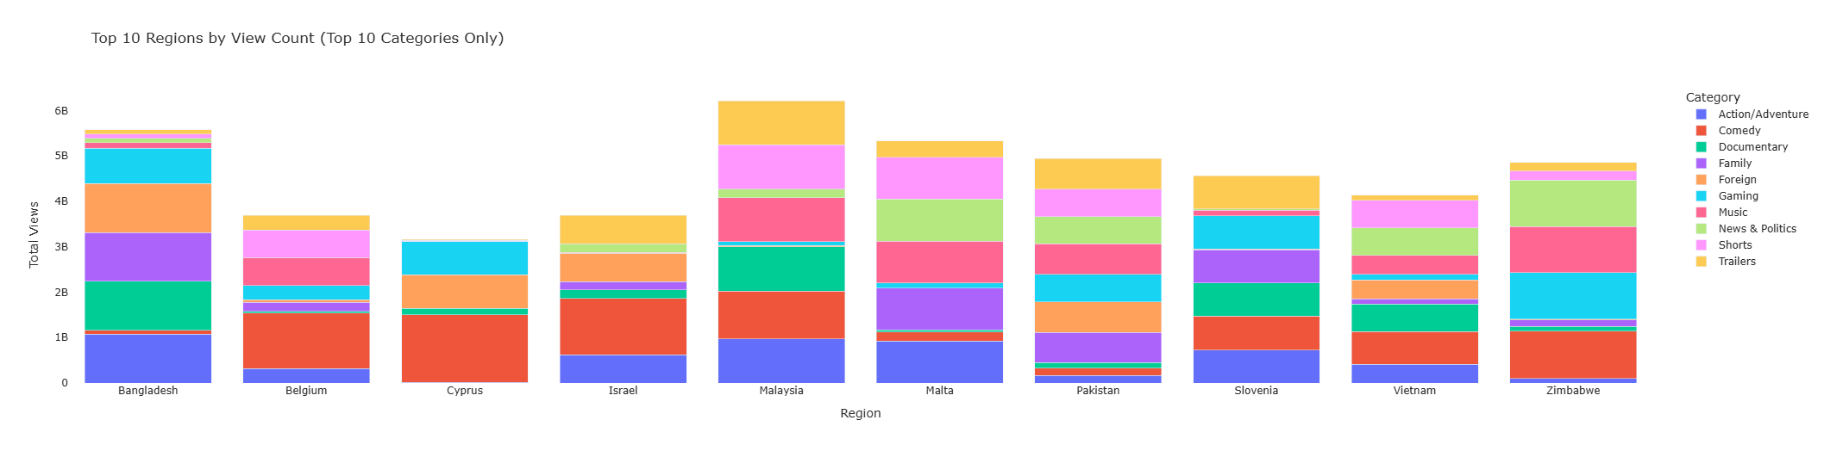
Exploratory Data Analysis

Slide 8
Q1: Regional Preferences in Video Categories
Action/Adventure is globally dominant.
Anime/Animation and Autos & Vehicles have regional appeal.
Documentary, Drama, and Education thrive in culturally interested regions.

Slide 9
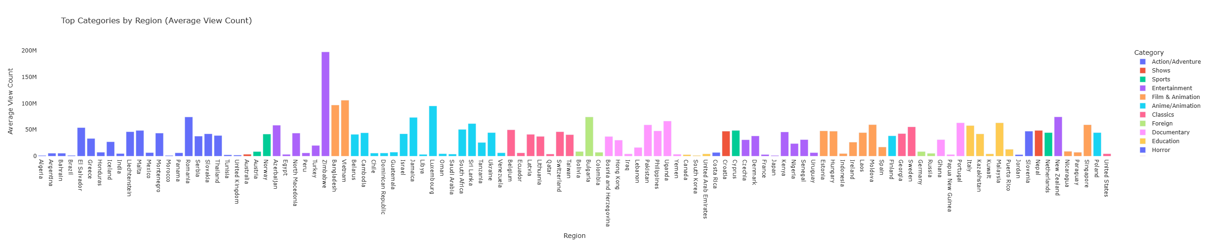
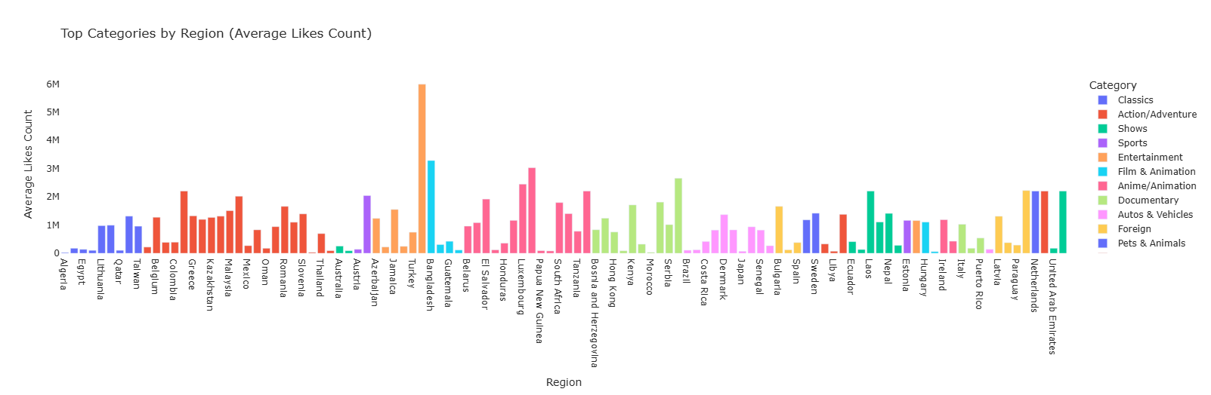

Slide 10
Q2: Certain categories receive consistently higher like counts than informational categories
ANOVA shows no significant difference in likes across categories (p=0.0831).
Gaming, Comedy, Shorts, and Music show weak positive correlations with likes.
Category alone has limited predictive power.

Slide 11
Q3: Can we predict the number of likes or views a video will receive based on its description, category, or region?
Random Forest model achieved R² = 0.78 for predicting likes.
Region, category, and description content are strong predictors.
Model captures 78% of variation in engagement metrics.

Slide 12
Q4: Descriptions expressing positive emotions correlate with higher user engagement, especially in the form of likes and comments.
Positive sentiment in video descriptions correlates with higher likes, views, and comments.
Sentiment analysis categorized content into Positive, Neutral, and Negative.
Positive tone boosts user engagement.

Slide 13
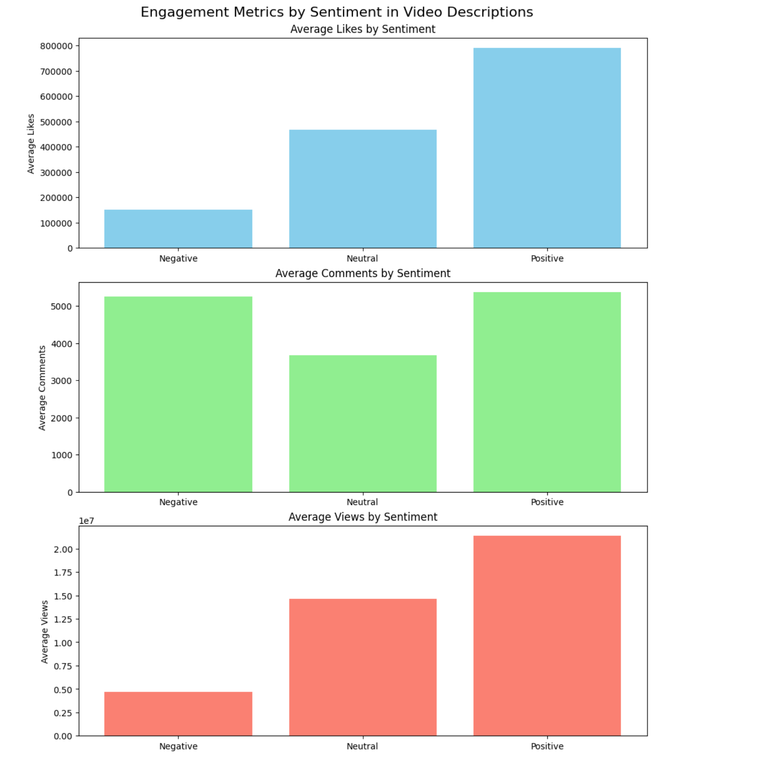

Slide 14
Conclusion
Regional Popularity : Action/Adventure leads globally; Anime/Animation and Autos & Vehicles engage diverse regions.
Category & Likes : Higher engagement in Gaming, Comedy, Shorts, and Music, but no significant correlation (p = 0.0831).
Predicting Engagement : Machine learning (Random Forest, R² = 0.78) effectively predicts likes and views using content, region, and category.
Emotional Tone & Engagement : Positive sentiment boosts likes, comments, and views, shaping audience response.

