Slide 1
Lecture 14
Consistency and Availability Tradeoffs

Slide 2
Overview
Bayou – always available replicated storage
  always disconnected operation, even when connected
  application specific conflict, resolution
  replication
Porcupine – self-adapting, self-tuning mail systems
  lock free, eventual consistency
  manageability, scalability and performance tradeoffs
Notes:
*

Slide 3
Bayou: System Goals
Always available system
  read and write regardless of network/system state
Automatic conflict resolution
Eventual consistency
  no instantaneous consistency guarantees, but always merges to a consistent state
  1 copy serializable equivalence
Based on pair-wise communication
  no central services to fail or limit availability
Notes:
*

Slide 4
Bayou: Example Applications
Non-real-time, collaborative applications
  shared calendars, mail, document editing, program development
Applications implemented
  Meeting room scheduler: degenerate calendar
    form based reservation
    tentative (gray) and committed (black) reservations
  Bibliography database
    keyed entries
    automatic merging of same item with different keys
Applications have well defined conflict and resolution semantics
  application specific, but automatic resolution
  Bayou does not generalize to block storage
Notes:
*

Slide 5
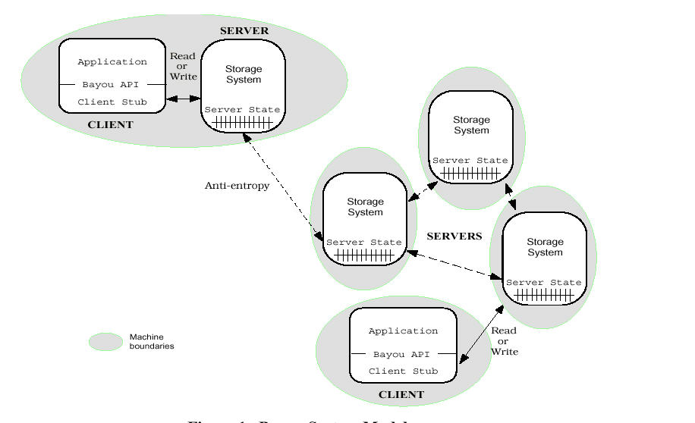
Bayou: System Architecture
Notes:
*

Slide 6
Bayou: System Architecture
Servers may be
  distinguished
  collocated
RPC interface
  read/write only
  sessions
Data collections replicated in full
  weak consistency
  update any copy, read any copy
Notes:
*

Slide 7
Bayou: System Architecture
Server state
  log of writes
Each write has a global ID
  assigned by accepting server
Anti-entropy sessions
  pair-wise conflict resolution
  reduce disorder
  apply locally accepted writes to other replicas
Epidemic algorithms
  pair-wise between many sites converge to a consistent state
Notes:
*

Slide 8
Bayou: Conflict Resolution
Application specific conflict resolution
Fine-grained
  record level, individual meeting room entries
Automatic resolution
  merging of bibliographic entries
Two constructs to implement conflict detection and resolution
  dependency checks (application defined)
  merge procedures
Notes:
*

Slide 9
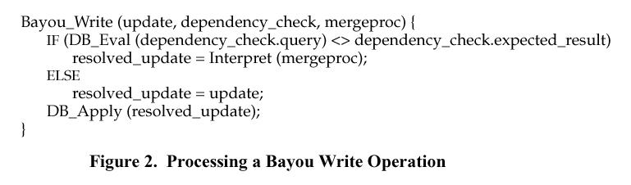
Bayou: Write Operation
Dependency check is a DB query
  passes if query gets the expected result
Failed dependency checks invoke a merge procedure
  results in a resolved update
Notes:
*

Slide 10
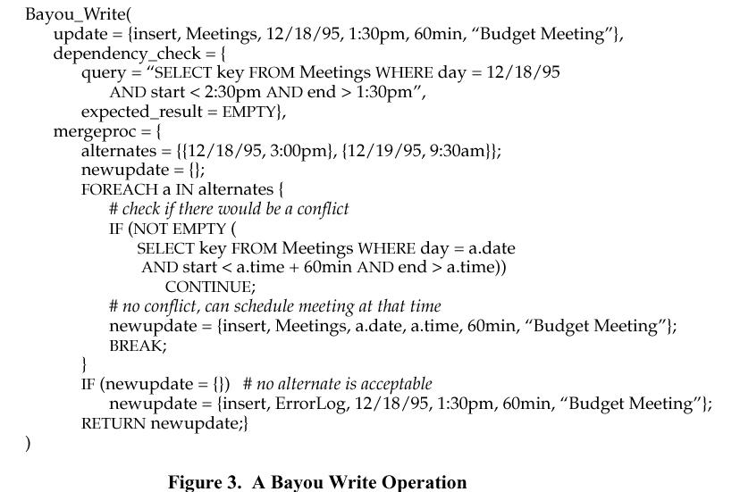
Bayou: Write Example
Notes:
*

Slide 11
Bayou: Anti-Entropy Merging
To merge a set of tentative replicas with another site
  perform the tentative writes at the new site
  for writes that conflict, use the resolution procedure defined as part of the write
  rollback the log as necessary to undo tentative writes
Update ordering
  each server defines its own update order
  when merging two sites, define an update order over both servers
  transitive property gives a global ordering over all sites
Vector clocks
  for k replicas, each server maintains a k^{th} order vector clock
  list of applied, forgotten and tentative updates at each server
Notes:
*

Slide 12
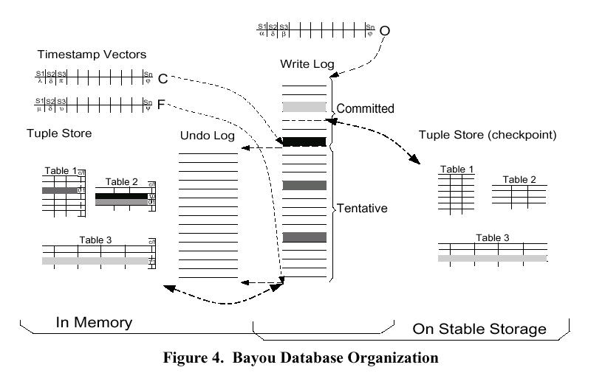
Bayou: Database Structure
Notes:
*

Slide 13
Bayou: Timestamp Vectors
O vector – omitted and committed writes, no longer in log
C vector – committed writes, known to be stable
F vector – full state, tentative writes
Notes:
*

Slide 14
Bayou: DB Views
In-memory – full view of all tentative writes
  tenative writes are stable in the log
On disk – only committed writes
Notes:
*

Slide 15
Bayou: In conclusion
Non-transparency
Application specific resolver, achieve automation
Tentative and stable resolutions
Partial and multi-object updates
  sessions, which we did not talk about
Impressively rich and available storage for applications that can stand tentative updates
  writes may change long after they have been performed
Notes:
*

Slide 16
Porcupine: Goals
Scalable mail server
  “dynamic load balancing, automatic configuration, and graceful degradation in the presence of failures.”
  “Key to the system’s manageability, availability, and performance is that sessions, data, and underlying services are distributed homogeneously and dynamically across nodes in a cluster.”
Tradeoffs between manageability, scalability, and performance
Notes:
*

Slide 17
Porcupine: Requirements
Management
  self-configuring, self-healing: no runtime interaction
  management task is to add/remove resources (disk, computer)
  resource serve in different roles over time, transparently
Availabiltiy
  service to all users at all times
Performance
  single node performance competitive with other single-node systems
  scale linearly to thousands of machines
Notes:
*

Slide 18
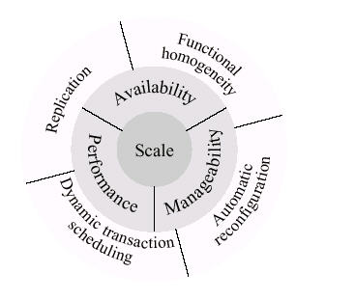
Porcupine: Requirements
Central goal
System requirement
Method of achievement
Notes:
*

Slide 19
Porcupine: What’s what.
Functional homogeneity: any node can perform any function.
  increases availability because a single node can run the whole system, no idependent failure of different functions
  manageability: all nodes are identical in software and configuration
Notes:
*

Slide 20
Porcupine: What’s what.
Automatic reconfiguration
  no management tasks beyond installing software
Notes:
*

Slide 21
Porcupine: What’s what.
Replication
  availability: sites failing does not make data unavailable
  performance: updates can go to closest replica, least loaded replica, or several replicas in parallel
  replication performance is predicated on weak consistency
Notes:
*

Slide 22
Porcupine: What’s what.
Dynamic transaction scheduling: dynamic distribution of load to less busy machines
  no configuration for load balance
Notes:
*

Slide 23
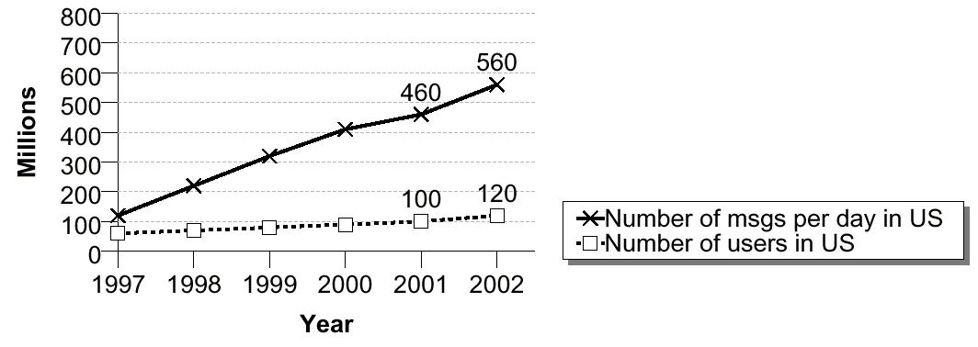
Porcupine: Uses
Why mail? (can be configured as a Web or Usenet Server)
  need: single corporations handle more than 10⁸ messages per day, goal is to scale to 10⁹ messages per day
  write-intensive: Web-services have been shown to be highly scalable, so pick a more interesting workload
  consistency: requirements for consistency are weak enough to justify extensive replication
Notes:
*

Slide 24
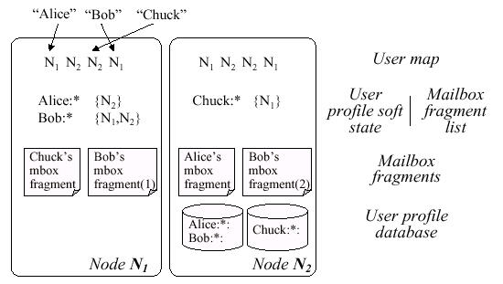
Porcupine: Data Structures
Notes:
*

Slide 25
Porcupine: Data Structures
Mailbox fragment: portion of some users mail
  a mailbox consists of the union of all replicas of all fragments for a user
Fragment list: list of all nodes that contain fragments
  soft state, not persistent or recoverable
Notes:
*

Slide 26
Porcupine: Data Structures
User profile database
  client population, user names, passwords, profiles, etc.
  hard (persistent state), changes infrequently
User profile
  soft state version of database, used for updates to user profile
  kept at one node in a system
Notes:
*

Slide 27
Porcupine: Data Structures
User map
  maps user to a node that is managing soft state and fragment list
  replicated at each node
  hash index
Notes:
*

Slide 28
Porcupine: Replication Tradeoff
Plusses: replication allows for:
  dynamic load balancing
  availability when nodes fail
Minuses: replication detracts from:
  delivery and retrieval, more complex, longer paths
  performance, compared with a statically load balanced system, performance is lower
Replication ethos:
  as wide as necessary, no wider
Notes:
*

Slide 29
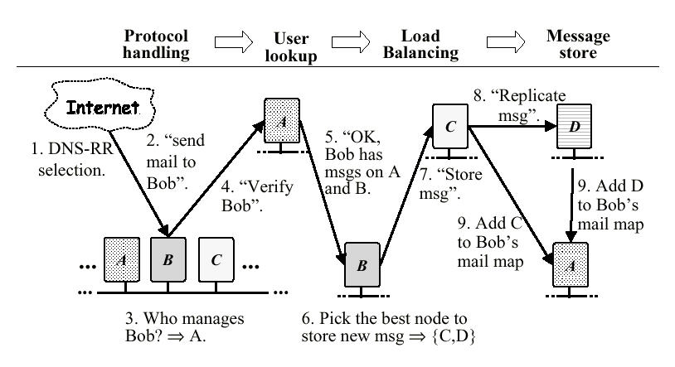
Porcupine: Control Flow (write/send)
Notes:
*

Slide 30
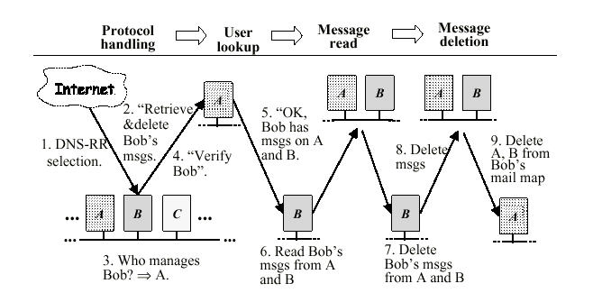
Porcupine: Control Flow (read/IMAP/POP)
Notes:
*

Slide 31
Porcupine: Replication Approach
Eventual consistency
Update anywhere
Total update
  changes to an object modify the entire object, invalidating the previous copy
  reasonable for mail, simplifies system
Lock free
  side-effect of update anywhere
Ordering by loosely synchronized clocks
  not vector based clocks
System is less sophisticated and flexible than Bayou
Notes:
*

Slide 32
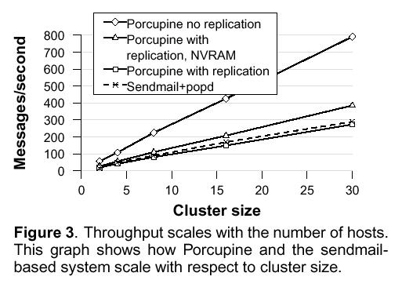
Porcupine: Scaling
Replication trades off availability for performance
Notes:
*

Slide 33
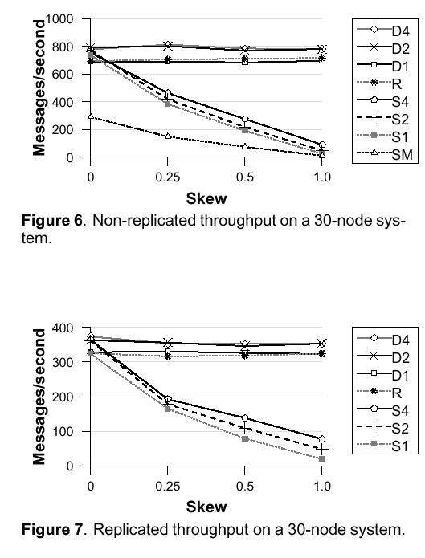
Porcupine: Handling Skew
Dyanmic load balancing helps deal with workload skew
  SX – static distribution on X nodes
  DX – dynamic distribution on X nodes
  SM – sendmail and pop
  R – random, unrealistic
Notes:
*

Slide 34
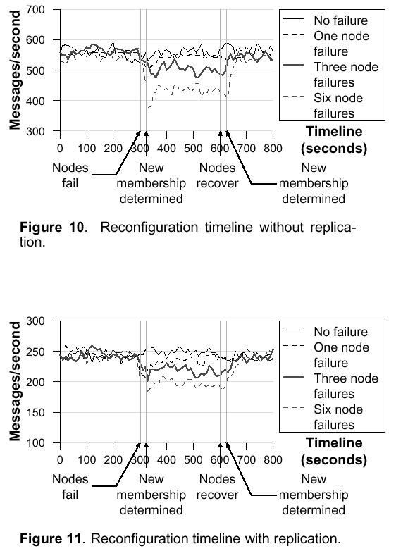
Porcupine: Handling Skew
Replication eases recovery from failures
Notes:
*

