Slide 1
From Viewstamped Replication to BFT
Barbara Liskov
MIT CSAIL
November 2007

Slide 2
Replication
Goal: provide reliability and availability by storing information at several nodes

Slide 3
Today’s talk
Viewstamped replication
  Failstop failures
BFT
  Byzantine failures
Characteristics:
  One-copy consistency
  State machine replication
  Runs on an asynchronous network

Slide 4
Failstop failures
Nodes fail by crashing
  A machine is either working correctly or it is doing nothing!
Requires 2f+1 replicas
  Operations must intersect at at least one replica
  In general want availability for both reads and writes
  Read and write quorums of f+1 nodes

Slide 5


Quorums
1. State:
…
2. State:
…
3. State:
…
Servers
X
write A
write A
write A
Clients

Slide 6
Quorums
1. State:
…
2. State:
…
3. State:
…
A
A
X
Servers
Clients

Slide 7
Quorums
1. State:
…
2. State:
…
3. State:
…
A
A
X
Servers
X
write B
write B
write B
Clients

Slide 8
Concurrent Operations
1. State:
…
2. State:
…
3. State:
…
A
B
A
B
B
A
Servers
write A
write B
write B
write A
write B
write A
Clients

Slide 9
Viewstamped Replication
Viewstamped replication: a new primary copy method to support highly available distributed systems, B. Oki and B. Liskov, PODC 1988
  Thesis, May 1988
Replication in the Harp file system, S. Ghemawat et. al, SOSP 1991
The part-time parliament, L. Lamport, TOCS 1998
Paxos made simple, L. Lamport, Nov. 2001

Slide 10
Ordering Operations
Replicas must execute operations in the same order
Implies replicas will have the same state, assuming
  replicas start in the same state
  operations are deterministic

Slide 11
Ordering Solution
Use a primary
  It orders the operations
  Other replicas obey this order

Slide 12
Views
System moves through a sequence of views
  Primary runs the protocol
  Replicas watch the primary and do a view change if it fails

Slide 13
Execution Model
Client
Server
Application
Viewstamp
Replication
Viewstamp
Replication
Application
operation
operation
result
result

Slide 14
Replica state
A replica id i (between 0 and N-1)
  Replica 0, replica 1, …
A view number v#, initially 0
Primary is the replica with id
  i = v# mod N
A log of <op, op#, status> entries
  Status = prepared or committed

Slide 15
Normal Case
View: 3
Primary: 0
Log:
replica 0
7
Q
committed
write A,3
client 1
View: 3
Primary: 0
Log:
replica 1
7
Q
committed
client 2
View: 3
Primary: 0
Log:
replica 2
7
Q
committed

Slide 16
Normal Case
View: 3
Primary: 0
Log:
replica 0
7
Q
committed
prepare A,8,3
8
A
prepared
client 1
View: 3
Primary: 0
Log:
X
replica 1
7
Q
committed
client 2
View: 3
Primary: 0
Log:
replica 2
7
Q
committed

Slide 17
Normal Case
View: 3
Primary: 0
Log:
replica 0
7
Q
committed
8
A
prepared
client 1
View: 3
Primary: 0
Log:
replica 1
7
Q
committed
client 2
ok A,8,3
View: 3
Primary: 0
Log:
replica 2
7
Q
committed
8
A
prepared

Slide 18
Normal Case
result
View: 3
Primary: 0
Log:
replica 0
7
Q
committed
commit A,8,3
8
A
committed
client 1
View: 3
Primary: 0
Log:
X
replica 1
7
Q
committed
client 2
View: 3
Primary: 0
Log:
replica 2
7
Q
committed
8
A
prepared

Slide 19
View Changes
Used to mask primary failures
Replicas monitor the primary
  Client sends request to all
Replica requests next primary to do a view change

Slide 20
Correctness Requirement
Operation order must be preserved by a view change
For operations that are visible
  executed by server
  client received result

Slide 21
Predicting Visibility
An operation could be visible if it prepared at f+1 replicas
  this is the commit point

Slide 22
View Change
View: 3
Primary: 0
Log:
replica 0
7
Q
committed
prepare A,8,3
8
A
prepared
client 1
View: 3
Primary: 0
Log:
X
replica 1
7
Q
committed
client 2
View: 3
Primary: 0
Log:
replica 2
7
Q
committed
8
A
prepared

Slide 23
View Change
X
View: 3
Primary: 0
Log:
replica 0
7
Q
committed
8
A
prepared
client 1
View: 3
Primary: 0
Log:
replica 1
7
Q
committed
client 2
View: 3
Primary: 0
Log:
replica 2
7
Q
committed
8
A
prepared

Slide 24
View Change
X
View: 3
Primary: 0
Log:
replica 0
7
Q
committed
8
A
prepared
client 1
View: 3
Primary: 0
Log:
do viewchange 4
replica 1
7
Q
committed
client 2
View: 3
Primary: 0
Log:
replica 2
7
Q
committed
8
A
prepared

Slide 25
View Change
X
View: 3
Primary: 0
Log:
X
replica 0
7
Q
committed
8
A
prepared
client 1
View: 4
Primary: 1
Log:
viewchange 4
replica 1
7
Q
committed
client 2
View: 3
Primary: 0
Log:
replica 2
7
Q
committed
8
A
prepared

Slide 26
View Change
X
View: 3
Primary: 0
Log:
replica 0
7
Q
committed
8
A
prepared
client 1
View: 4
Primary: 1
Log:
vc-ok 4,log
replica 1
7
Q
committed
client 2
View: 4
Primary: 1
Log:
replica 2
7
Q
committed
8
A
prepared

Slide 27
Double Booking
Sometimes more than one operation is assigned the same number
  In view 3, operation A is assigned 8
  In view 4, operation B is assigned 8

Slide 28
Double Booking
Sometimes more than one operation is assigned the same number
  In view 3, operation A is assigned 8
  In view 4, operation B is assigned 8
Viewstamps
  op number is <v#, seq#>

Slide 29
Scenario
X
View: 3
Primary: 0
Log:
replica 0
7
Q
committed
8
A
prepared
client 1
View: 4
Primary: 1
Log:
replica 1
7
Q
committed
client 2
View: 4
Primary: 1
Log:
replica 2
7
Q
committed

Slide 30
Scenario
View: 3
Primary: 0
Log:
replica 0
7
Q
committed
8
A
prepared
client 1
View: 4
Primary: 1
Log:
replica 1
7
Q
committed
write B,4
8
B
prepared
client 2
View: 4
Primary: 1
Log:
replica 2
7
Q
committed

Slide 31
Scenario
View: 3
Primary: 0
Log:
replica 0
7
Q
committed
8
A
prepared
client 1
View: 4
Primary: 1
Log:
prepare B,8,4
replica 1
7
Q
committed
8
B
prepared
client 2
View: 4
Primary: 1
Log:
replica 2
7
Q
committed
8
B
prepared

Slide 32
Additional Issues
State transfer
Garbage collection of the log
Selecting the primary

Slide 33
Improved Performance
Lower latency for writes (3 messages)
  Replicas respond at prepare
  client waits for f+1
Fast reads (one round trip)
  Client communicates just with primary
  Leases
Witnesses (preferred quorums)
  Use f+1 replicas in the normal case

Slide 34
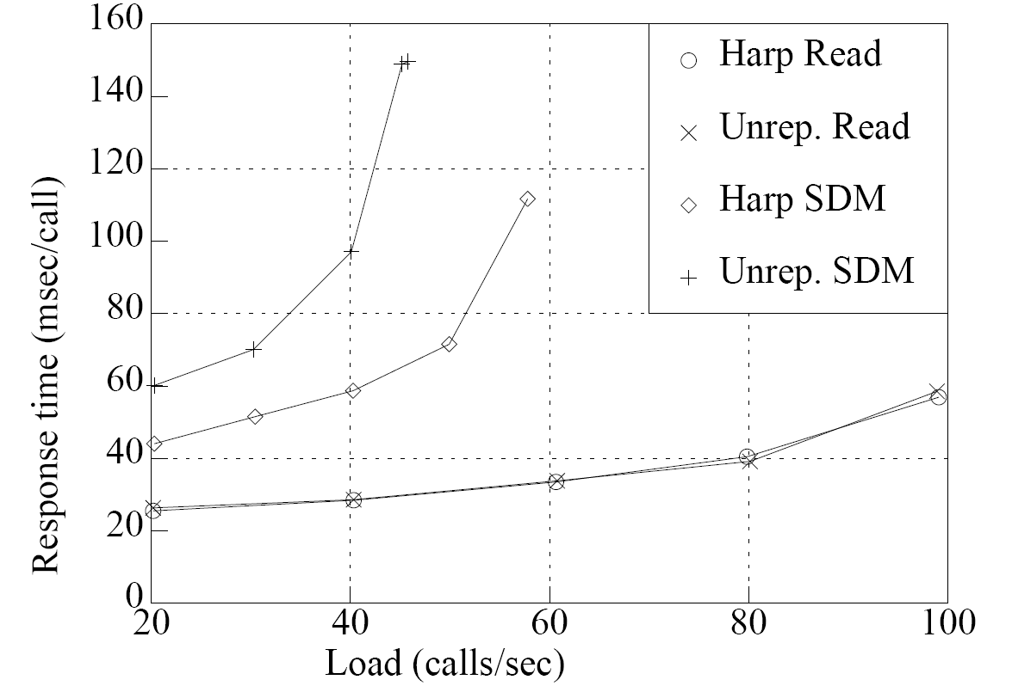
Performance
Figure 5-2: Nhfsstone Benchmark with One Group.
SDM is the Software Development Mix
B. Liskov, S. Ghemawat, et al., Replication in the Harp File System, SOSP 1991

Slide 35
BFT
Practical Byzantine Fault Tolerance, M. Castro and B. Liskov, SOSP 1999
Proactive Recovery in a Byzantine-Fault-Tolerant System, M. Castro and B. Liskov, OSDI 2000

Slide 36
Byzantine Failures
Nodes fail arbitrarily
  they lie
  they collude
Causes
  Malicious attacks
  Software errors

Slide 37
Quorums
3f+1 replicas are needed to survive f failures
2f+1 replicas is a quorum
  Ensures intersection at at least one honest replica
The minimum in an asynchronous network

Slide 38
Quorums
1. State:
…
2. State:
…
3. State:
…
4. State:
…
A
A
A
Servers
X
write A
write A
write A
write A
Clients

Slide 39
Quorums
1. State:
…
2. State:
…
3. State:
…
4. State:
…
A
A
B
B
B
Servers
X
write B
write B
write B
write B
Clients

Slide 40
Strategy
Primary runs the protocol in the normal case
Replicas watch the primary and do a view change if it fails
Key difference: replicas might lie

Slide 41
Execution Model
Client
Server
Application
BFT
BFT
Application
operation
operation
result
result

Slide 42
Replica state
A replica id i (between 0 and N-1)
  Replica 0, replica 1, …
A view number v#, initially 0
Primary is the replica with id
  i = v# mod N
A log of <op, op#, status> entries
  Status = pre-prepared or prepared or committed

Slide 43
Normal Case
Client sends request to primary
  or to all

Slide 44
Normal Case
Primary sends pre-prepare message to all
  Records operation in log as pre-prepared

Slide 45
Normal Case
Primary sends pre-prepare message to all
  Records operation in log as pre-prepared
  Why not a prepare message?
  Because primary might be malicious

Slide 46
Normal Case
Replicas check the pre-prepare and if it is ok:
  Record operation in log as pre-prepared
  Send prepare messages to all
All to all communication

Slide 47
Normal Case
Replicas wait for 2f+1 matching prepares
  Record operation in log as prepared
  Send commit message to all
Trust the group, not the individuals

Slide 48
Normal Case
Replicas wait for 2f+1 matching commits
  Record operation in log as committed
  Execute the operation
  Send result to the client

Slide 49
Normal Case
Client waits for f+1 matching replies

Slide 50
BFT
Request
Pre-Prepare
Prepare
Commit
Reply
Client
Primary
Replica 2
Replica 3
Replica 4

Slide 51
View Change
Replicas watch the primary
Request a view change
Commit point: when 2f+1 replicas have prepared

Slide 52
View Change
Replicas watch the primary
Request a view change
  send a do-viewchange request to all
  new primary requires f+1 requests
  sends new-view with this certificate
Rest is similar

Slide 53
Additional Issues
State transfer
Checkpoints (garbage collection of the log)
Selection of the primary
Timing of view changes

Slide 54
Improved Performance
Lower latency for writes (4 messages)
  Replicas respond at prepare
  Client waits for 2f+1 matching responses
Fast reads (one round trip)
  Client sends to all; they respond immediately
  Client waits for 2f+1 matching responses

Slide 55
BFT Performance
Phase | BFS-PK | BFS | NFS-sdt
1 | 25.4 | 0.7 | 0.6
2 | 1528.6 | 39.8 | 26.9
3 | 80.1 | 34.1 | 30.7
4 | 87.5 | 41.3 | 36.7
5 | 2935.1 | 265.4 | 237.1
total | 4656.7 | 381.3 | 332.0
Table 2: Andrew 100: elapsed time in seconds
M. Castro and B. Liskov, Proactive Recovery in a Byzantine-Fault-Tolerant System, OSDI 2000

Slide 56
Improvements
Batching
  Run protocol every K requests

Slide 57
Follow-on Work
  BASE: Using abstraction to improve fault tolerance, R. Rodrigo et al, SOSP 2001
  R.Kotla and M. Dahlin, High Throughput Byzantine Fault tolerance. DSN 2004
  J. Li and D. Mazieres, Beyond one-third faulty replicas in Byzantine fault tolerant systems, NSDI 07
  Abd-El-Malek et al, Fault-scalable Byzantine fault-tolerant services, SOSP 05
  J. Cowling et al, HQ replication: a hybrid quorum protocol for Byzantine Fault tolerance, OSDI 06

Slide 58
Papers in SOSP 07
Zyzzyva: Speculative Byzantine fault tolerance
Tolerating Byzantine faults in database systems using commit barrier scheduling
Low-overhead Byzantine fault-tolerant storage
Attested append-only memory: making adversaries stick to their word
PeerReview: practical accountability for distributed systems

Slide 59
Future Directions
Keeping less state
  at 2f+1 or even f+1 replicas
Reducing latency
Improving scalability

Slide 60
From Viewstamped Replication to BFT
Barbara Liskov
MIT CSAIL
November 2007

