Slide 1
On-Device Binary Classification with Federated Learning using the STM32
Yingshuo Xi, Ali Jahangiri
Department of Electrical and Information Technology,
Lund University, Sweden.
This research has been partially supported by the Wallenberg AI, Autonomous Systems and Software Program (WASP), the Swedish Research Council (VR), the ELLIIT Strategic Research Environment, European Union, and an unrestricted gift from Google.

Slide 2
Data Collection
CONTENTS
Data Collection
On-device Training
Federated Learning

Slide 3
Dataset - acoustic dataset of brushless DC motors
Dataset
(Data in Brief *)
Healthy
(class 0)
Healthy
Bearing
Propeller
Defect
(class 1)
8
8
6
7
6
8
Train set
Validation set
Test set
Not used
* Prieto Estacio, R. S., Bravo Montenegro, D. A., & Rengifo Rodas, C. F. (2023). Dataset of audio signals from brushless DC motors for predictive maintenance.
Data in Brief, 50, 109569. https://doi.org/10.1016/j.dib.2023.109569

Slide 4
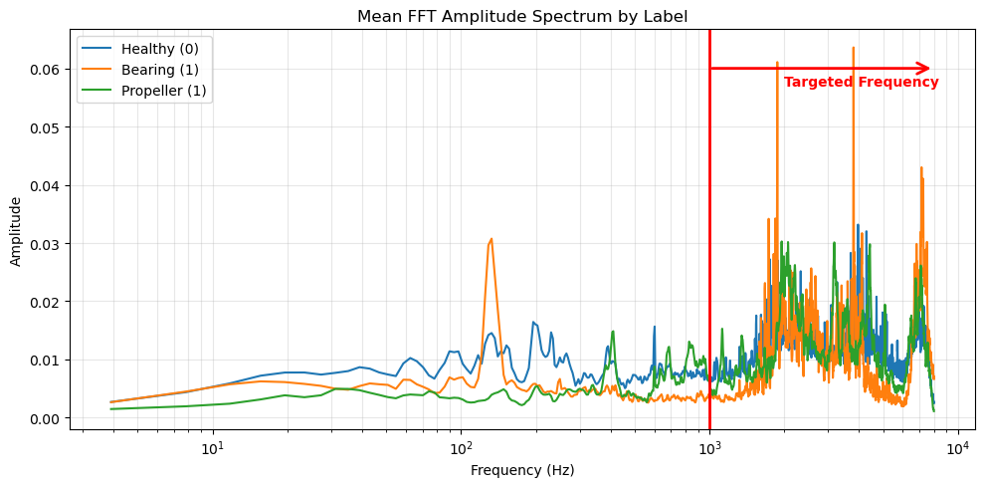
Fourier Transform
To capture enough cycles (5) of the frequency (1000 Hz) based on the sampling rate (16000 Hz),
the minimal data points per sample: 80.

Slide 5
Dataset - Overview
Samples Per Set
Label | Train | Validation | Test
0 | 14425 (46.80%) | 8236 (50.00%) | 8186 (49.94%)
1 | 16400 (53.20%) | 8236 (50.00%) | 8206 (50.06%)
total | 30825 | 16472 | 16392

Slide 6
On-device Training
CONTENTS
Data Collection
On-device Training
Federated Learning

Slide 7
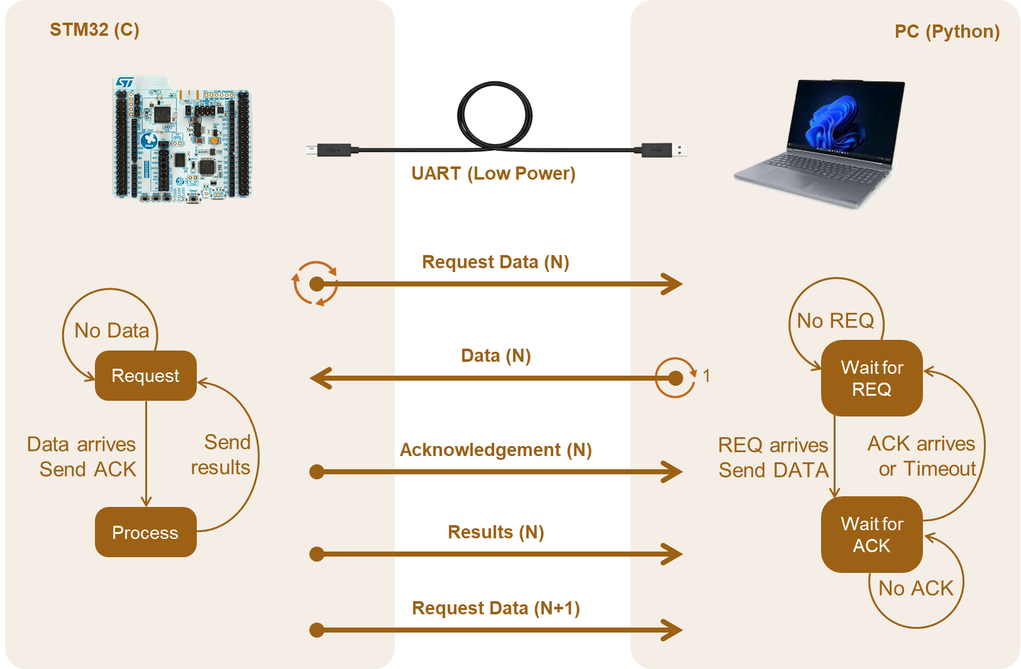
UART Communication

Slide 8
UART Protocal
start of frame
type
sequence
length
DATA
crc
2 bytes
1 bytes
2 bytes
2 bytes
length bytes
2 bytes
CODE | Meaning
0x01 | Request_train
0x02 | Data
0x03 | Ack
0x04 | Finish
0x05 | End
0x06 | Result_train
0x07 | Request_val
0x08 | Result_val
0x09 | Request_test
0x0A | Result_test
label
Data1(float)
data2
1 bytes
4 bytes

Slide 9
Process and Flash
[Load] (Train + Val [Save?]) + …… + (Train + Val [Save?]) + Test
NVM
FLASH
Start Code
Version
480K
Store
Program code
32K
Store
weights
Length
crc
Accuracy
Data
0x08000000
0x08078000

Slide 10
Model – Binary Forward-Forward
Correct Label
DATA
DATA
(label = 1)
positive
positive
DATA
FF Model
FF Model
Wrong Label
DATA
negative
DATA
(label = 0)
negative
Classical FF Model
Binary FF Model

Slide 11
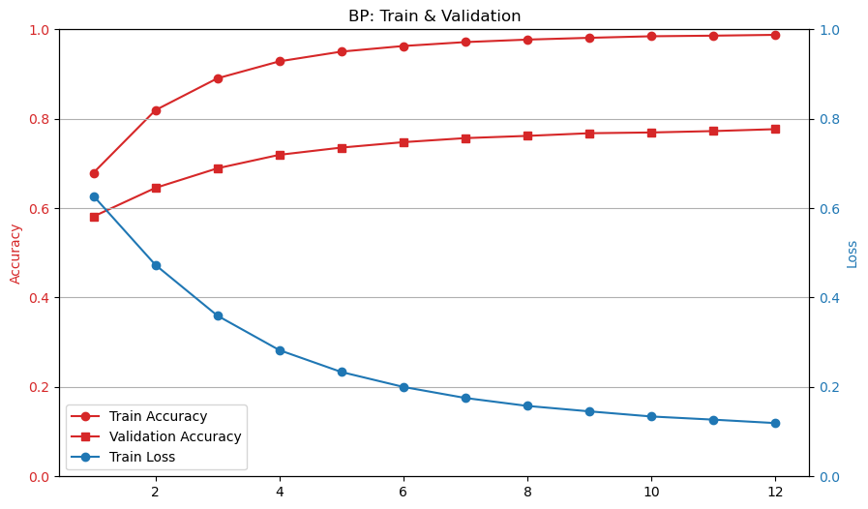
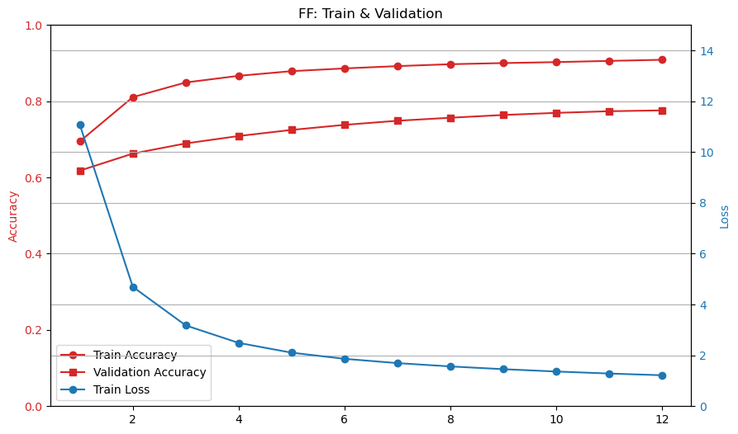
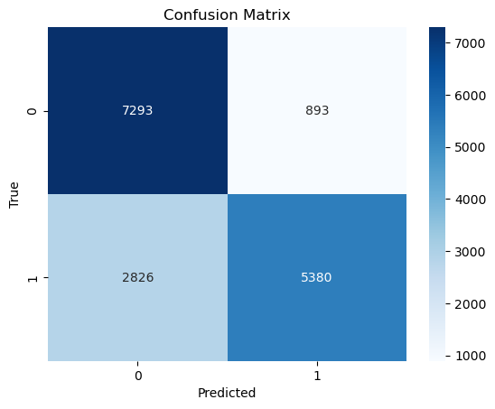
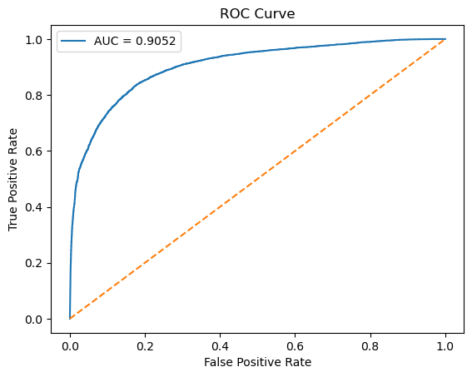
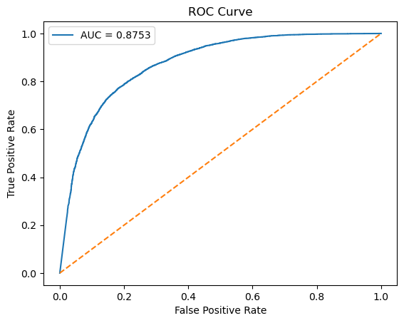
Results
Test acc: 0.8193
Test acc: 0.7731

Slide 12
Results
Model | Accuracy | F1 score | AUC | Flash (Static) | RAM (Static) | RAM (Fixed) | RAM (Train)
BP | 0.82 | 0.80 | 0.91 | 38.8KB | 50.8KB | 15.9KB | 0.5KB
FF | 0.77 | 0.74 | 0.88 | 40.7KB | 52.4KB | 17.5KB | 0.8KB

Slide 13
Federated Learning
CONTENTS
Data Collection
On-device Training
Federated Learning

Slide 14

Federated Averaging
$$w_{new}=Σ_{i=1}^{n}\frac{w_{i}}{n}=\frac{w_{client}+w_{server}}{2}$$
Implementation of FedAvg with two weights
Calculated on STM32 server module
After 2 epochs (i.e. 1 round), the weights are averaged and sent back to each board. For a total of 6 rounds

Slide 15
Dataset – FL Split
Samples Per Device
Board | Train | Validation | Test
COM16 | 250 (55.55%) | 100 (22.22%) | 100 (22.22%)
COM21 | 250 (55.55%) | 100 (22.22%) | 100 (22.22%)
total | 500 | 200 | 100
Shared global test set

Slide 16
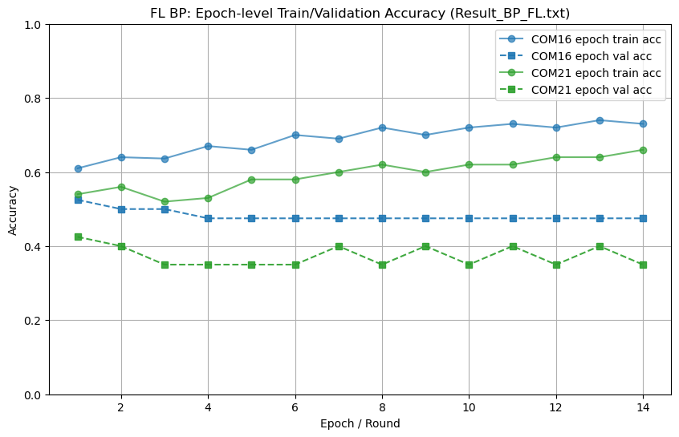
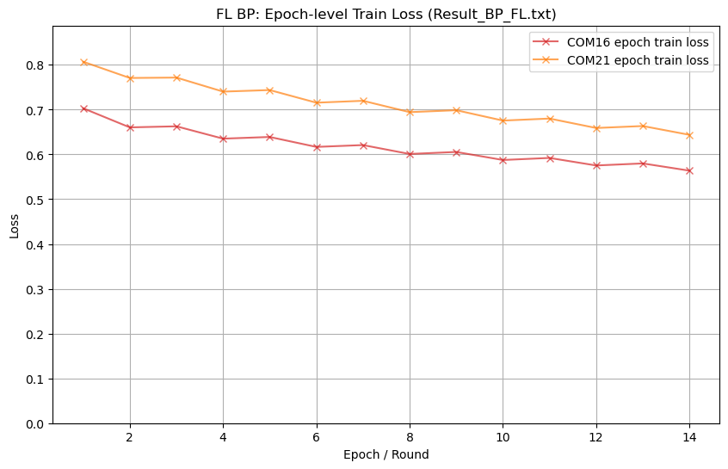
BP Results - Epochs

Slide 17
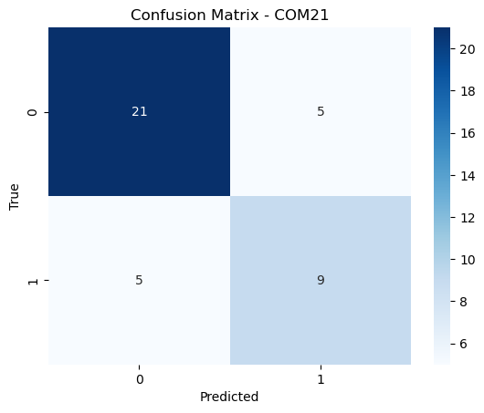
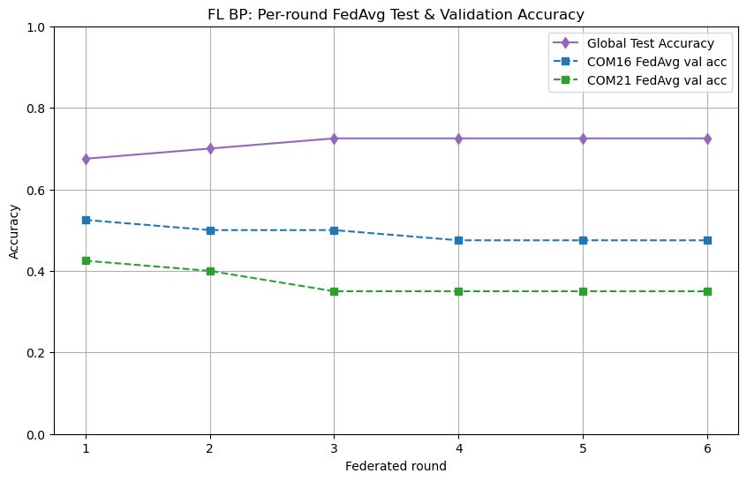
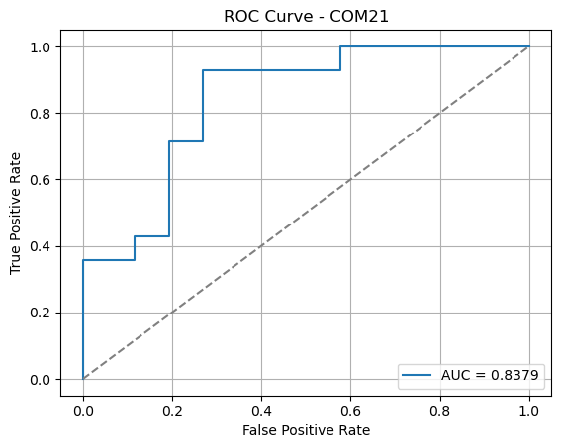
BP Results - Rounds

Slide 18
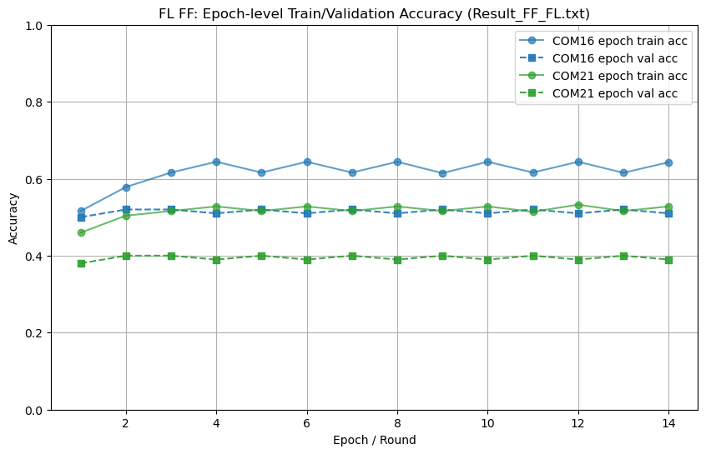
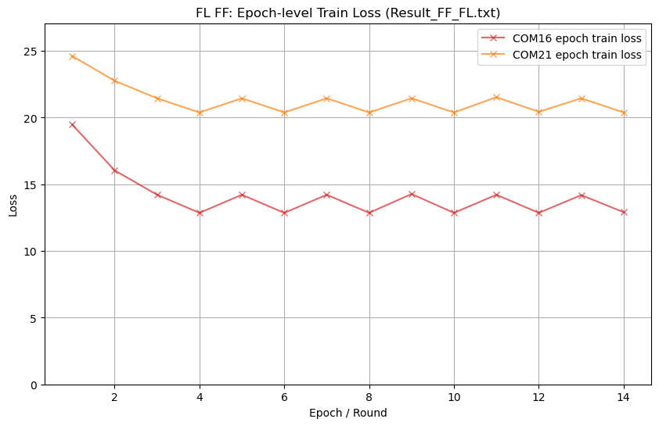
FF Results - Epochs

Slide 19
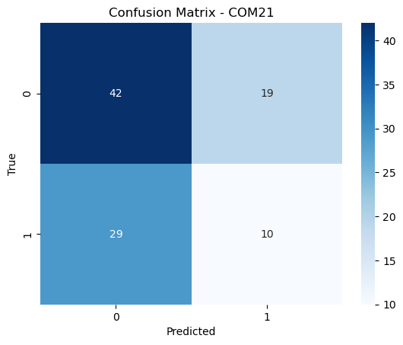
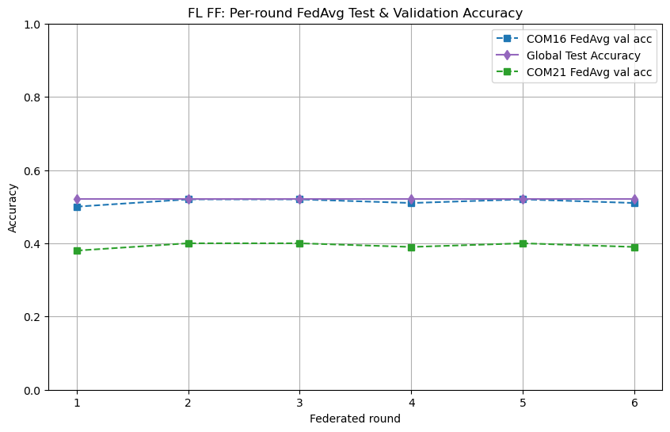
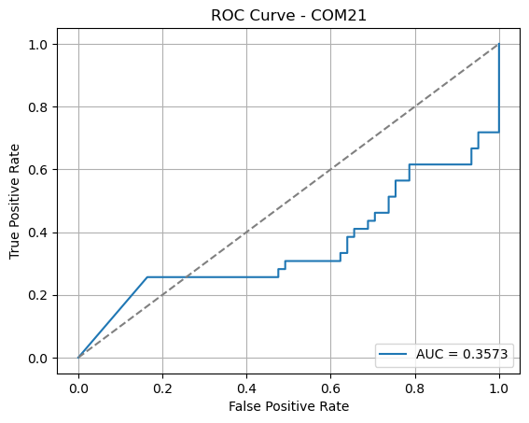
FF Results - Rounds

Slide 20
Results
On-device training
Federated learning*
Model | Accuracy | F1 score | AUC
BP | 0.82 | 0.80 | 0.91
FF | 0.77 | 0.74 | 0.88
Model | Accuracy | F1 score | AUC
BP | 0.72 | 0.64 | 0.83
FF | 0.54 | 0.32 | 0.36
* Subset of whole dataset used for federated learning due to time limits

Slide 21
Conclusion
On-device learning on the STM32 is possible, although slow (>1 day training)
A “simple” downsampling process can be used in lieu of FFT-based feature extraction
After 12 epochs, we can get 82% (BP) and 77% (FF) accuracy
After 6 rounds of 2 epochs, we can get accuracy of 72% (BP) and 54% (FF) via federated learning.
Setting up BLE on the STM32 remains a challenge, instead, weights are sent via UART
Increasing dataset should improve FF federated learning metrics

Slide 22

Questions?
Thank you!

Slide 23
