Slide 1

Discovering Purchase Patterns Using Apriori Algorithm and FP-Growth
By : Ali pourfereydoon

Slide 2
Chapter 1
introduction

Slide 3
Abstract
Chapter 1
In recent years, data mining has become an essential tool for extracting meaningful patterns and knowledge from large datasets. One important application of data mining in the retail industry is Market Basket Analysis, which aims to understand customer purchasing behavior by identifying relationships among items that are frequently purchased together. These insights support better business decisions such as product placement, cross-selling strategies, promotional planning, and inventory management.

Slide 4
Abstract
Chapter 1
In this project, the Groceries Market Basket Dataset obtained from Kaggle/UCI is used to perform association rule mining. The dataset contains 9,835 customer transactions and 169 unique grocery items, where each transaction represents a set of products purchased during a single shopping visit. this dataset is highly suitable for discovering frequent itemsets and association rules.

Slide 5
Project Goal
Chapter 1
The primary goal of this project is to use association rule mining techniques to a real-world retail dataset in order to discover meaningful patterns in customer purchasing behavior. Using the Groceries Market Basket Dataset, the project aims to identify frequently purchased items and uncover strong associations between products that are commonly bought together.

Slide 6
Project Goal
Chapter 1
this project has the following objectives:
• preprocess and transform the transactional grocery dataset into a suitable format for association rule mining.
• apply the Apriori algorithm to extract frequent itemsets and generate association rules based on support, confidence, and lift.
• apply the FP-Growth algorithm separately on the same dataset
• evaluate and interpret the discovered rules using standard association rule metrics.
• compare the performance and results of Apriori and FP-Growth

Slide 7

Chapter 2
What is data mining ?

Slide 8
Chapter 2
definition
Data mining is the use of machine learning and statistical analysis to discover patterns and other valuable information from the large data sets . Given the evolution of machine learning (ML), data warehousing, and the growth of big data, the adoption of data mining, also known as knowledge discovery in databases (KDD), has rapidly accelerated over the last decades.

Slide 9
Chapter 2
definition
The data mining techniques can be used for two main purposes. They can either describe the target data set or they can predict outcomes by using machine learning algorithms.

Slide 10
Chapter 2
Benefits and challenges
Benefits :
1-Discover hidden insights and trends
Data mining takes raw data and finds order in the chaos: seeing the forest for the trees.
2-Save budget
By analyzing performance data from multiple sources, bottlenecks in business processes can be identified to speed resolution and increase efficiency.

Slide 11
Chapter 2
Benefits and challenges
Benefits :
3- Solve multiple challenges
Data mining is a versatile tool. Data from almost any source and any aspect of an organization can be analyzed to discover patterns and better ways of conducting business.

Slide 12
Chapter 2
Benefits and challenges
Challenges :
1-Complexity and risk:
Useful insights require valid data, plus experts with coding experience. Knowledge of data mining languages including Python, R and SQL is helpful. An insufficiently cautious approach to data mining might result in misleading or dangerous results.

Slide 13
Chapter 2
Benefits and challenges
Challenges :
2- Cost:
If new information is to be gathered by an organization, setting up a data pipeline might represent a new expense.
If data needs to be purchased from an outside source, that also imposes a cost.
3-Uncertainty:
First, a major data mining effort might be well run, but produce unclear results, with no major benefit

Slide 14
Chapter 2
Data mining versus text mining versus
process mining
Data mining: is the overall process of identifying patterns and extracting useful insights from big data sets.
Text mining : also known as text data mining is a sub-field of data mining, intended to transform unstructured text into a structured format to identify meaningful patterns and generate novel insights

Slide 15
Chapter 2
Data mining versus text mining versus
process mining
Process mining: sits at the intersection of business process management (BPM) and data mining. Process mining provides a way to apply algorithms to event log data to identify trends, patterns and details of how processes unfold.

Slide 16
Chapter 2
How data mining works
The data mining process involves several steps from data collection to visualization to extract valuable information from large data sets. Data mining techniques can be used to generate descriptions and predictions about a target data set.

Slide 17
Chapter 2
How data mining works
data mining usually includes five main steps:
1-setting objectives
2- data selection
3-data preparation
4-data model building
5-pattern mining and evaluating results.

Slide 18
Chapter 2
How data mining works
Set the business objectives:
This can be the hardest part of the data mining process, and many organizations spend too little time on this important step. Even before the data is identified, extracted or cleaned, data scientists and business stakeholders can work together to define the precise business problem, which helps inform the data questions and parameters for a project

Slide 19
Chapter 2
How data mining works
Data selection:
When the scope of the problem is defined, it is easier for data scientists to identify which set of data will help answer the pertinent questions to the business. They and the IT team can also determine where the data should be stored and secured.

Slide 20
Chapter 2
How data mining works
Data preparation:
The relevant data is gathered and cleaned to remove any noise, such as duplicates, missing values and outliers. Depending on the data set, an additional data management step might be taken to reduce the number of dimensions, as too many features can slow down any subsequent computation..

Slide 21
Chapter 2
How data mining works
Model building and pattern mining:
Depending on the type of analysis, data scientists might investigate any trends or interesting data relationships, such as sequential patterns, association rules or correlations
Evaluation of results and implementation of knowledge:
When the data is aggregated, it can then be prepared for presentation, often by using data visualization techniques

Slide 22
Chapter 2
Data mining techniques
Here are some of the most popular types of data mining:
1-Classification:
Classes of objects are predefined, as needed by the organization, with definitions of the characteristics that the objects have in common
2-Clustering:
Closely related to classification, clustering reports similarities, but then also provides more groupings based on differences.

Slide 23
Chapter 2
Data mining techniques
Here are some of the most popular types of data mining:
3-Decision tree:
This data mining technique uses classification or regression analytics to classify or predict potential outcomes based on a set of decisions.
4-Association rules:
Association rules offer a powerful tool for data analysis, providing insights into patterns and relationships within large datasets

Slide 24
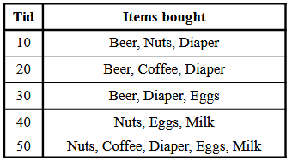
Chapter 2
Association rules
Frequent Pattern in Association rules:
a pattern (a set of items, subsequences, substructures, etc.) that occurs frequently in a data set.
• itemset: A set of one or more items
k-itemset X = {x1, …, xk}

Slide 25
Chapter 2
Association rules
support of X is the fraction of transactions that contains X (i.e., the probability that a transaction contains X)
Relative Support of {Beer} is 3/5
An itemset X is frequent if X’s support
is no less than a minsup threshold

Slide 26
Chapter 2
Association rules
Support : is an important measure because a rule that has very low support may occur simply by chance.
Confidence: measures the reliability of the inference made by a rule.

Slide 27
Chapter 2
Association rules
Association Rule Mining Task :
Given a set of transactions T, the goal of association rule mining is to find all rules
support ≥ minsup threshold
confidence ≥ minconf threshold

Slide 28
Chapter 2
Association rules
Apriori Algorithm :
Apriori Algorithm is a basic method used in data analysis to find groups of items that often appear together in large sets of data. It helps to discover useful patterns or rules about how items are related which is particularly valuable in market basket analysis.

Slide 29
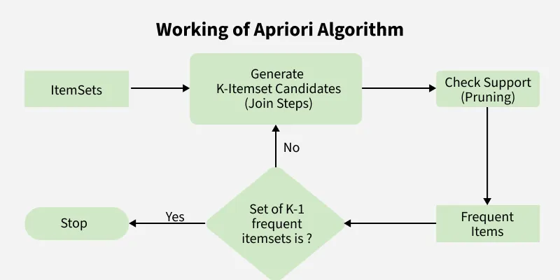
Chapter 2
Association rules

Slide 30
Chapter 2
Association rules
How the Apriori Algorithm Works :
Identifying Frequent Item-Sets
Creating Possible Item Group
Removing Infrequent Item Groups
Generating Association Rules

Slide 31
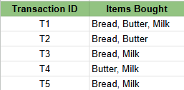
Chapter 2
Apriori Algorithm
Example:
Step 1 : Setting the parameters
Minimum Support Threshold: 50%
Minimum Confidence Threshold: 70%
Step 2: Find Frequent 1-Item-Sets

Slide 32

Chapter 2
Apriori Algorithm
Example:
Step 2: Find Frequent 1-Item-Sets
All items have support% ≥ 50%, so they qualify as frequent 1-Item-Sets. if any item has support% < 50%, It will be omitted out from the frequent 1- Item-Sets.

Slide 33

Chapter 2
Apriori Algorithm
Example:
Step 3: Generate Candidate 2-Item-Sets
Combine the frequent 1-Item-Sets into pairs and calculate their support. For this use case we will get 3 item pairs ( bread,butter) , (bread,ilk) and (butter,milk) and will calculate the support similar to step 2

Slide 34

Chapter 2
Apriori Algorithm
Example:
Step 4: Generate Candidate 3-Item-Sets
Combine the frequent 2-Item-Sets into groups of 3 and calculate their support. for the triplet we have only got one case i.e {bread,butter,milk} and we will calculate the support.

Slide 35
Chapter 2
Apriori Algorithm
Example:
Step 5: Generate Association Rules
Now we generate rules from the frequent Item-Sets and calculate confidence.
Rule 1: If Bread -> Butter (if customer buys bread, will buy butter also)
Support of {Bread, Butter} = 2.
Support of {Bread} = 4.
Confidence = 2/4 = 50% (Failed threshold).

Slide 36
Chapter 2
Apriori Algorithm
Example:
Rule 2: If Butter -> Bread (if customer buys butter, will buy bread also)
Support of {Bread, Butter} = 2.
Support of {Butter} = 3.
Confidence = 2/3 = 66.67% (Passes threshold).

Slide 37
Chapter 2
Apriori Algorithm
Example:
Rule 3: If Bread -> Milk (if customer buys bread, will buy milk also)
Support of {Bread, Milk} = 3.
Support of {Bread} = 4.
Confidence = 3/4 = 75% (Passes threshold).

Slide 38
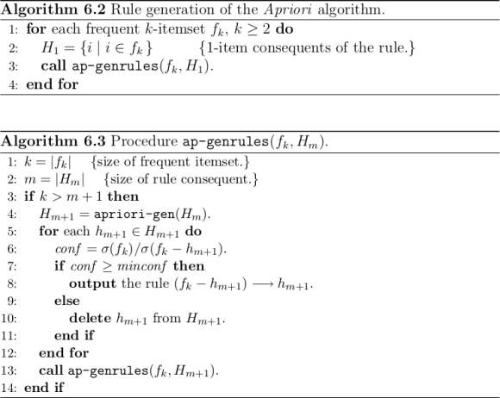
Chapter 2
Apriori Algorithm

Slide 39
Chapter 2
Frequent Pattern Growth Algorithm
The FP-Growth (Frequent Pattern Growth) algorithm efficiently mines frequent itemsets from large transactional datasets. Unlike the Apriori algorithm which suffers from high computational cost due to candidate generation and multiple database scans. FP-Growth avoids these inefficiencies by compressing the data into an FP-Tree (Frequent Pattern Tree) and extracts patterns directly from it.

Slide 40
Chapter 2
How FP-Growth Works
Data Compression: First FP-Growth compresses the dataset into a smaller structure called the Frequent Pattern Tree (FP-Tree). This tree stores information about item sets (collections of items) and their frequencies without need to generate candidate sets like Apriori does.
Mining the Tree: then examines this tree to identify patterns that appear frequently based on a minimum support threshold.
Generating Patterns: Once the tree is built and analyzed the algorithm generates the frequent patterns (itemsets) and the rules that describe relationships between items.

Slide 41
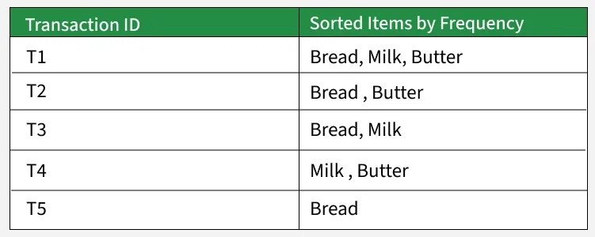
Chapter 2
Working of FP- Growth Algorithm
Problem Statement: Consider a small grocery store transaction dataset. Each entry shows the set of items purchased together by a customer:
We apply the FP-Growth algorithm to identify frequent itemsets (groups of items frequently bought together), using a minimum support count of 2

Slide 42
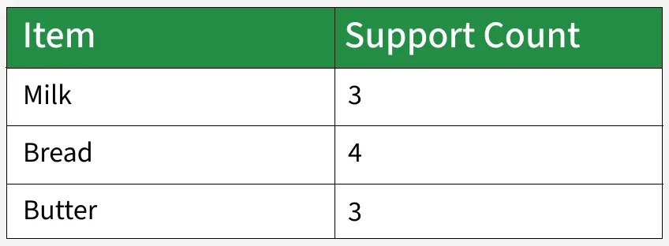
Chapter 2
Working of FP- Growth Algorithm
Step 1: Compute Item Frequencies
Scan the entire dataset one time to determine how often each item appears.
All items meet the minimum support threshold (≥ 2), so none are removed.

Slide 43
Chapter 2
Working of FP- Growth Algorithm
Step 2: Order Items in Each Transaction by Frequency
Next, sort every transaction in descending order based on how frequently the items appear overall.
Sorting by frequency helps group common items together, allowing the FP-tree to be compressed efficiently.

Slide 44
Chapter 2
Working of FP- Growth Algorithm
Step 3: Construct the FP-Tree
Insert the sorted transactions one by one into the FP-tree, merging any shared prefixes.
FP-Tree Insertions:
From T1: Bread → Milk → Butter
From T2: Bread → Butter
From T3: Bread → Milk
From T4: Milk → Butter (new branch since it doesn’t begin with Bread)
From T5: Bread

Slide 45
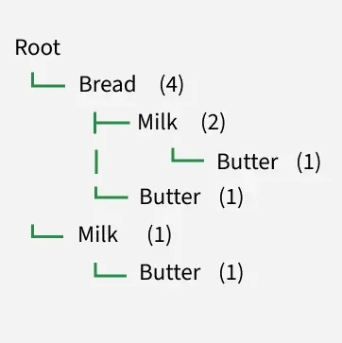
Chapter 2
Working of FP- Growth Algorithm
Visual FP-Tree:
Each node shows: Item (Count)

Slide 46
Chapter 2
Working of FP- Growth Algorithm
Step 4: Determine Conditional Pattern Bases
A conditional pattern base contains all prefix paths leading to a specific item. Let’s examine the paths ending with Butter.
  Paths that end with Butter:
  Bread → Milk → Butter (1 occurrence)
  Bread → Butter (1 occurrence)
  Milk → Butter (1 occurrence)
Thus, the conditional pattern base for Butter is:
[ (Bread, Milk): 1, (Bread): 1, (Milk): 1 ]

Slide 47
Chapter 2
Working of FP- Growth Algorithm
Step 5: Build Conditional FP-Trees
Using the conditional pattern base, construct a smaller FP-tree for each item to identify frequent patterns involving that item. Butter’s conditional FP-tree input:
(Bread, Milk): 1 (Bread): 1 (Milk): 1
Count all items:
Bread: 2 Milk: 2

Slide 48
Chapter 2
Working of FP- Growth Algorithm
Since both meet the support threshold (≥2), we can now generate frequent patterns:
{Butter, Bread}
{Butter, Milk}
{Butter, Bread, Milk}
Repeat the process for Milk and Bread as needed.

Slide 49
Chapter 2
Working of FP- Growth Algorithm
Step 6: Extract All Frequent Itemsets
From the FP-tree and conditional trees, we get these frequent itemsets:
{Bread} {Milk} {Butter} {Bread, Milk} {Bread, Butter}
{Milk, Butter} {Bread, Milk, Butter}
All of these appear at least 2 times in the transactions.

Slide 50
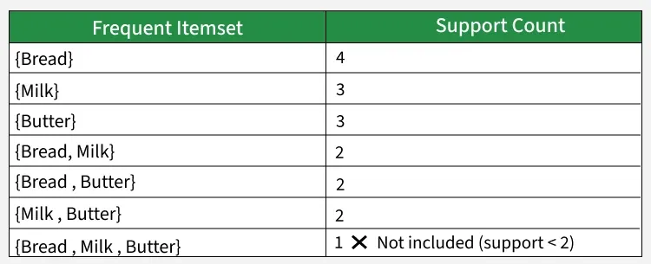
Chapter 2
Working of FP- Growth Algorithm
.

Slide 51
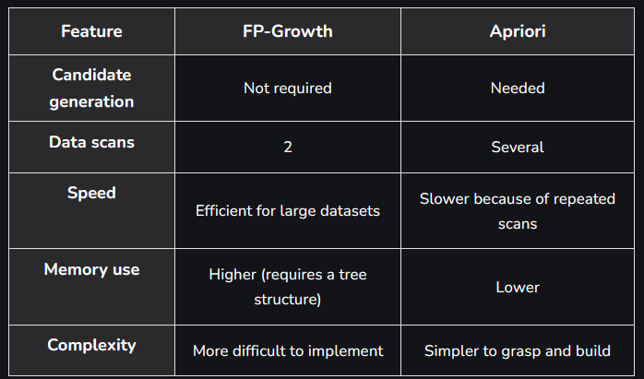
Chapter 2
FP-Growth vs. Apriori Algorithm
.

Slide 52
Chapter 2
FP-Growth Algorithm
Applications :
Market Basket Analysis: Identifying items that are frequently purchased together.
Recommendation Systems: Suggesting products based on frequent item patterns.
Customer Behavior Analysis: Understanding buying habits in retail and e-commerce.
Web Usage Mining: Finding common browsing or click paths among users.
Text Mining: Detecting frequently occurring words or phrases in documents

Slide 53
Chapter 2
FP-Growth Algorithm
Advantages :
No Candidate Generation: FP-Growth avoids generating candidate sets, improving efficiency.
Minimal Data Scans: Only two database scans are required.
High Performance on Large Data: Works very well for big and dense datasets.
Data Compression: Uses an FP-tree to store transactions compactly.
Scalable and Fast: Capable of mining complex and large frequent patterns quickly.

Slide 54
Chapter 2
FP-Growth Algorithm
Limitations :
High Memory Usage: FP-tree can become large, consuming significant memory.
Complex Implementation: Harder to understand and implement than Apriori.
Heavy Conditional Mining: Building conditional FP-trees can be computationally costly.
Poor for Diverse Transactions: Not ideal when transactions have many unique items.

Slide 55
Chapter 3
Methodology

Slide 56
Chapter 3
Market Basket Analysis
In this project In the first step Apriori Algorithm was used to implement this project :
Apriori Algorithm is a basic method used in data analysis to find groups of items that often appear together in large sets of data. It helps to discover useful patterns or rules about how items are related which is particularly valuable in market basket analysis. like in a grocery store if many customers buy bread and butter together, the store can use this information to place these items closer or create special offers. This helps the store sell more and make customers happy

Slide 57
Chapter 3
Market Basket Analysis
How the Apriori Algorithm Works :
1-. Identifying Frequent Item-Sets
2-Creating Possible Item Group
3-Removing Infrequent Item Groups
4-Generating Association Rules

Slide 58
Chapter 3
Market Basket Analysis
In the second step , Frequent Pattern Growth Algorithm was used to implement this project :
The FP-Growth (Frequent Pattern Growth) algorithm efficiently mines frequent itemsets from large transactional datasets. Unlike the Apriori algorithm which suffers from high computational cost due to candidate generation and multiple database scans. FP-Growth avoids these inefficiencies by compressing the data into an FP-Tree (Frequent Pattern Tree) and extracts patterns directly from it.

Slide 59
Chapter 3
Market Basket Analysis
How FP-Growth Works :
1.Data Compression: First FP-Growth compresses the dataset into a smaller structure called the Frequent Pattern Tree (FP-Tree).
2.Mining the Tree: The algorithm then examines this tree to identify patterns that appear frequently based on a minimum support threshold
3.Generating Patterns: Once the tree is built and analyzed the algorithm generates the frequent patterns (itemsets) and the rules that describe relationships between items.

Slide 60
Chapter 4
DATASET

Slide 61
Chapter 4
Groceries Market Basket Dataset
The Groceries Market Basket Dataset is a widely used benchmark dataset for market basket analysis and association rule mining. It represents real-world grocery shopping transactions and is suitable for discovering purchasing patterns among items.

Slide 62
Chapter 4
Groceries Market Basket Dataset
Dataset Overview
• Total number of transactions: 9,835
• Total number of unique items: 169
• Domain: Retail / Grocery shopping
• Data type: Transactional data
Each transaction corresponds to a single customer visit to a grocery store and contains a list of items purchased together during that visit.

Slide 63
Chapter 4
Groceries Market Basket Dataset
Purpose and Suitability :
The dataset is well suited for data mining tasks, particularly market basket analysis, because:
• It contains multiple variables (items) per transaction
• It reflects real purchasing behavior
• It allows identification of frequent itemsets and association rules

Slide 64
Chapter 4
Groceries Market Basket Dataset
Attribute | Description
Dataset name | Groceries Market Basket Dataset
Domain | Retail / Grocery Shopping
Total number of transactions | 9,835
Total number of unique items | 169
Data type | Transactional data
File format | CSV
Nature of attributes | Categorical (item names)
Missing values | None
Average items per transaction | 4 items
Suitable algorithms | Apriori, FP-Growth
Primary application | Market Basket Analysis

Slide 65
Chapter 5
System Implementation

Slide 66
Chapter 5
System Implementation
Apriori Algorithm Implementation :
In this project, at first the Apriori algorithm was applied to the Groceries Market Basket Dataset to discover frequent itemsets and generate association rules. The dataset consists of transactional data, where each transaction represents a set of grocery items purchased together, making it suitable for association rule mining using Apriori.

Slide 67
Chapter 5
System Implementation(Apriori Algorithm Implementation)
STEP 0: Mount Google Drive :
from google.colab import drive
This line imports the drive module provided by Google Colab.the module allows Colab notebooks to access files stored in the user's Google Drive.
drive.mount('/content/drive')
This command mounts the user's Google Drive to the Colab virtual machine at the directory /content/drive.

Slide 68
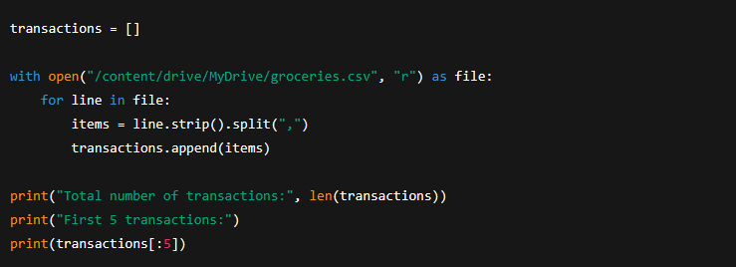
Chapter 5
System Implementation(Apriori Algorithm Implementation)
STEP 1: Load Groceries Market Basket Dataset:
transactions = []
This line initializes an empty list named transactions.

Slide 69
Chapter 5
System Implementation(Apriori Algorithm Implementation)
STEP 1: Load Groceries Market Basket Dataset:
With open("/content/drive/MyDrive/groceries.csv", "r") as file:
This statement opens the groceries.csv file in read mode from Google Drive. The with keyword ensures that the file is automatically closed after reading, improving memory safety and efficiency.
for line in file:
This loop reads the dataset line by line, where each line corresponds to a single customer transaction.
.

Slide 70
Chapter 5
System Implementation(Apriori Algorithm Implementation)
STEP 1: Load Groceries Market Basket Dataset:
items = line.strip().split(",")
strip() removes extra spaces and newline characters from the line
split(",") separates the line into individual grocery items using commas as delimiters
.

Slide 71
Chapter 5
System Implementation(Apriori Algorithm Implementation)
STEP 1: Load Groceries Market Basket Dataset:
transactions.append(items)
Each processed transaction (list of items) is appended to the transactions list. After this step, transactions becomes a list of lists, suitable for association rule mining
print("Total number of transactions:", len(transactions))
This line prints the total number of transactions loaded from the dataset, which should be 9,835 for the Groceries dataset.
.

Slide 72
Chapter 5
System Implementation(Apriori Algorithm Implementation)
STEP 1: Load Groceries Market Basket Dataset:
print("First 5 transactions:")
print(transactions[:5])
These lines display the first five transactions to verify that the dataset has been loaded correctly and to inspect its structure.
.

Slide 73
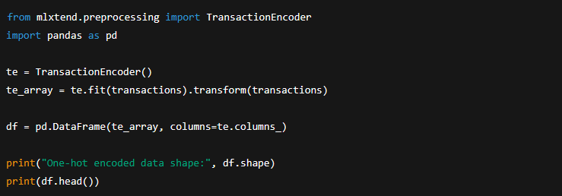
Chapter 5
System Implementation(Apriori Algorithm Implementation)
STEP 2: Data Preprocessing (One-Hot Encoding)
Data Preprocessing Section :
After loading the Groceries dataset, one-hot encoding was applied to transform the transactional data into a binary matrix.
.

Slide 74
Chapter 5
System Implementation(Apriori Algorithm Implementation)
STEP 2: Data Preprocessing (One-Hot Encoding)
from mlxtend.preprocessing import TransactionEncoder
import pandas as pd :
These lines import the required libraries:
TransactionEncoder from mlxtend, which converts transactional data into a binary format
pandas, which is used to create and manipulate tabular data
.

Slide 75
Chapter 5
System Implementation(Apriori Algorithm Implementation)
STEP 2: Data Preprocessing (One-Hot Encoding)
te = TransactionEncoder()
This line creates an instance of the TransactionEncoder class.
The encoder will learn all unique items appearing in the transactions.
te_array = te.fit(transactions).transform(transactions)
This line performs two operations:
1.fit(transactions)
2.transform(transactions)
.

Slide 76
Chapter 5
System Implementation(Apriori Algorithm Implementation)
STEP 2: Data Preprocessing (One-Hot Encoding)
df = pd.DataFrame(te_array, columns=te.columns_)
This line converts the encoded array into a Pandas DataFrame:
Each column corresponds to a grocery item
Each row corresponds to a transaction
Column names are taken from te.columns_, which stores item names
This DataFrame is the required input format for the Apriori algorithm
.

Slide 77
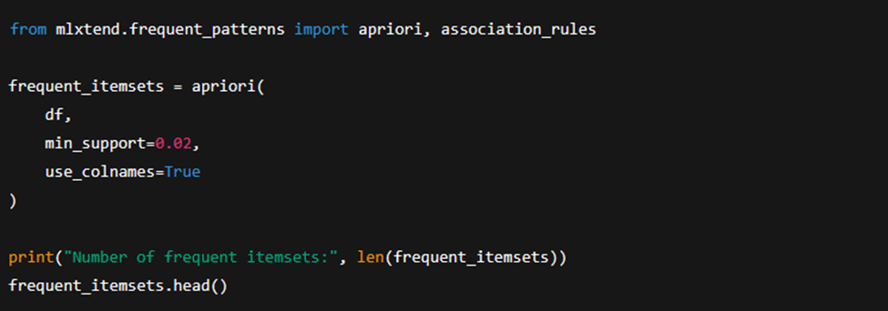
Chapter 5
System Implementation(Apriori Algorithm Implementation)
STEP 3: Apply Apriori Algorithm
.

Slide 78
Chapter 5
System Implementation(Apriori Algorithm Implementation)
STEP 3: Apply Apriori Algorithm
from mlxtend.frequent_patterns import apriori, association_rules
apriori: the function used to generate frequent itemsets
association_rules: the function used later to generate association rules from frequent itemsets
Both functions are provided by the mlxtend library.
.

Slide 79
Chapter 5
System Implementation(Apriori Algorithm Implementation)
frequent_itemsets = apriori(
df,
min_support=0.02,
use_colnames=True
)
This block applies the Apriori algorithm to the one-hot encoded dataset.
.

Slide 80
Chapter 5
System Implementation(Apriori Algorithm Implementation)
Parameter Explanation
df
The input DataFrame containing binary (True/False) values for each item in each transaction.
min_support=0.02
Specifies the minimum support threshold.
An itemset must appear in at least 2% of all transactions to be considered frequent.
.

Slide 81
Chapter 5
System Implementation(Apriori Algorithm Implementation)
print("Number of frequent itemsets:", len(frequent_itemsets))
This line prints the total number of frequent itemsets discovered by the Apriori algorithm that satisfy the minimum support threshold.for the Groceries dataset, this value is typically 122, indicating that 122 itemsets occur frequently in the dataset.
.

Slide 82
Chapter 5
System Implementation(Apriori Algorithm Implementation)
frequent_itemsets.head()
This command displays the first five frequent itemsets, along with their support values.
Each row contains:
support: the frequency of the itemset
itemsets: the items included in the itemset
.

Slide 83
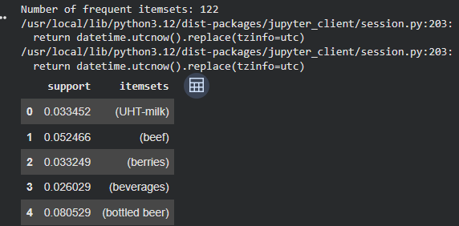
Chapter 5
System Implementation(Apriori Algorithm Implementation)
Out put :
.

Slide 84
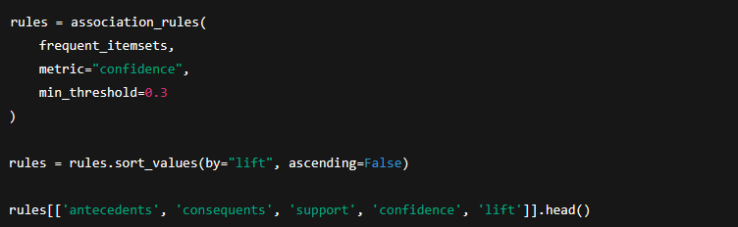
Chapter 5
System Implementation(Apriori Algorithm Implementation)
STEP 4: Generate Association Rules
frequent_itemsets
The input produced by the Apriori algorithm, containing itemsets that satisfy the minimum support threshold.
.

Slide 85
Chapter 5
System Implementation(Apriori Algorithm Implementation)
STEP 4: Generate Association Rules
metric="confidence"
Specifies that confidence is used as the primary evaluation metric for filtering rules.
min_threshold=0.3
Only rules with confidence greater than or equal to 0.30 are retained.
This means the consequent appears in at least 30% of the transactions where the antecedent occurs.
.

Slide 86
Chapter 5
System Implementation(Apriori Algorithm Implementation)
STEP 4: Generate Association Rules
rules = rules.sort_values(by="lift", ascending=False)
This line sorts the generated rules in descending order of lift, so the strongest and most interesting associations appear first.
rules[['antecedents', 'consequents', 'support', 'confidence', 'lift']].head()
This line displays the top five association rules, showing only the most important columns:
.

Slide 87
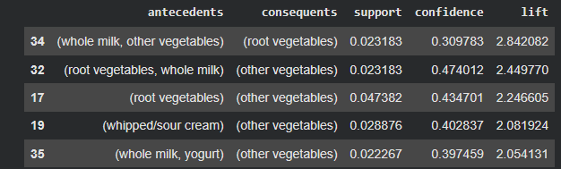
Chapter 5
System Implementation(Apriori Algorithm Implementation)
Out put :
.

Slide 88
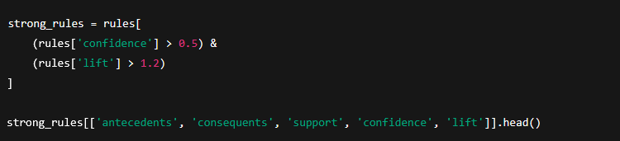
Chapter 5
System Implementation(Apriori Algorithm Implementation)
STEP 5: Filter Strong Rules
To identify the most significant purchasing patterns, association rules with confidence greater than 0.5 and lift greater than 1.2 were selected as strong rules.
.

Slide 89
Chapter 5
System Implementation(Apriori Algorithm Implementation)
STEP 5: Filter Strong Rules
strong_rules = rules[
(rules['confidence'] > 0.5) &
(rules['lift'] > 1.2)
]
This code filters the previously generated association rules to retain only strong and meaningful rules based on predefined thresholds.
.

Slide 90
Chapter 5
System Implementation(Apriori Algorithm Implementation)
STEP 5: Filter Strong Rules
Filtering Conditions Explained :
rules['confidence'] > 0.5
This condition ensures that only rules with a confidence greater than 50% are selected.
rules['lift'] > 1.2
This condition selects rules with a lift greater than 1.2, indicating a strong positive association.
.

Slide 91

Chapter 5
System Implementation(Apriori Algorithm Implementation)
STEP 5: Filter Strong Rules
strong_rules[['antecedents', 'consequents', 'support', 'confidence','lift']].head()
This line displays the top five strongest association rules, showing the most relevant metrics for interpretation.
Out put :
.

Slide 92
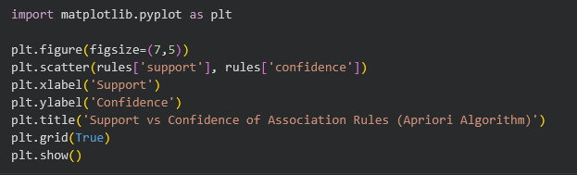
Chapter 5
System Implementation(Apriori Algorithm Implementation)
import matplotlib.pyplot as plt
This line imports the Matplotlib library, which is used to create visualizations such as charts and plots in Python.

Slide 93
Chapter 5
System Implementation(Apriori Algorithm Implementation)
plt.figure(figsize=(7,5))
This command creates a new figure with a specified size:
Width: 7 inches
Height: 5 inches
Setting the figure size improves readability and presentation quality for reports.

Slide 94
Chapter 5
System Implementation(Apriori Algorithm Implementation)
plt.scatter(rules['support'], rules['confidence'])
This line creates a scatter plot where:
The x-axis represents the support values of association rules
The y-axis represents the confidence values of association rules
Each point in the plot corresponds to a single association rule generated by the Apriori algorithm.

Slide 95
Chapter 5
System Implementation(Apriori Algorithm Implementation)
plt.xlabel('Support')
plt.ylabel('Confidence')
These lines label the x-axis and y-axis, making the plot easy to understand.
plt.title('Support vs Confidence of Association Rules (Apriori Algorithm)')
This line adds a descriptive title, clearly indicating that the visualization shows the relationship between support and confidence for rules generated using the Apriori algorithm.

Slide 96
Chapter 5
System Implementation(Apriori Algorithm Implementation)
plt.grid(True)
This command enables grid lines in the background of the plot, which helps in visually estimating values and comparing points.
plt.show()
This command displays the plot.

Slide 97
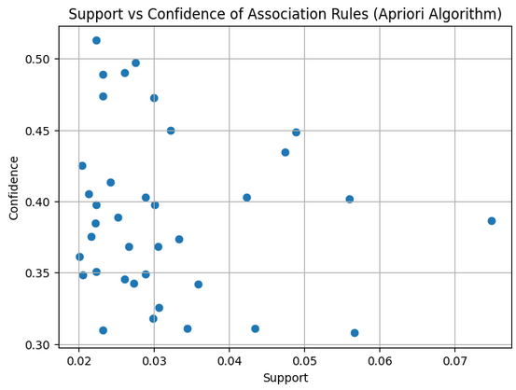
Chapter 5
System Implementation(Apriori Algorithm Implementation)
Out put :

Slide 98
Chapter 5
System Implementation(Apriori Algorithm Implementation)
Out put :
Interpretation of the Plot
Each point represents one association rule
Rules with higher confidence appear higher on the plot
Rules with higher support appear further to the right
The plot helps identify:
High-confidence rules with low support (strong but less frequent patterns)
Rules with both high support and high confidence (very valuable patterns)

Slide 99
Chapter 5
System Implementation
FP-Growth algorithm Implementation :
In the second step In this project, the FP-Growth algorithm was applied to the Groceries Market Basket Dataset to discover frequent itemsets and association rules. After preprocessing the transactional data using one-hot encoding, FP-Growth efficiently identified frequent patterns without candidate generation. Association rules were generated using confidence and lift metrics, revealing strong purchasing relationships among grocery items.

Slide 100

Chapter 5
System Implementation(FP-Growth algorithm Implementation)
Step 1: Mount Google Drive

Slide 101
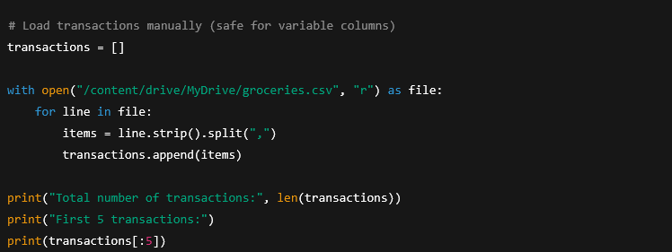
Chapter 5
System Implementation(FP-Growth algorithm Implementation)
Step 2: Load the Groceries Dataset
Out put:

Slide 102
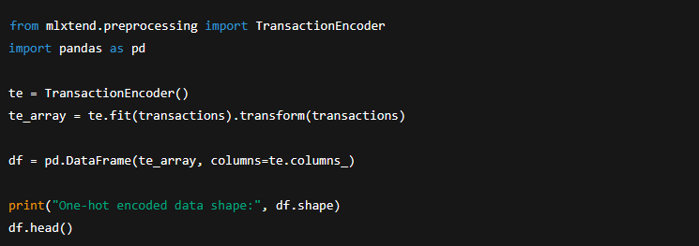
Chapter 5
System Implementation(FP-Growth algorithm Implementation)
Step 3: One-Hot Encoding (Preprocessing)
Out put :

Slide 103
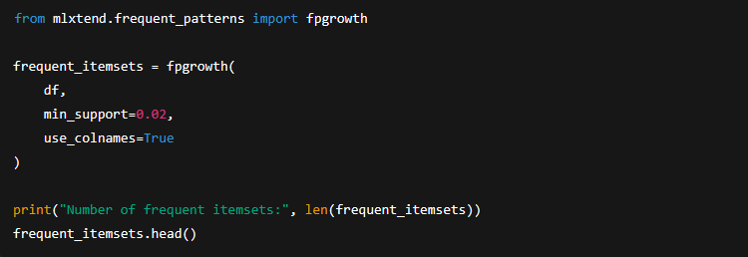
Chapter 5
System Implementation(FP-Growth algorithm Implementation)
Step 4: Apply FP-Growth Algorithm
FP-Growth finds frequent itemsets without candidate generation, making it faster than Apriori.

Slide 104
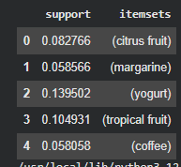
Chapter 5
System Implementation(FP-Growth algorithm Implementation)
Step 4: Apply FP-Growth Algorithm
Out put :

Slide 105
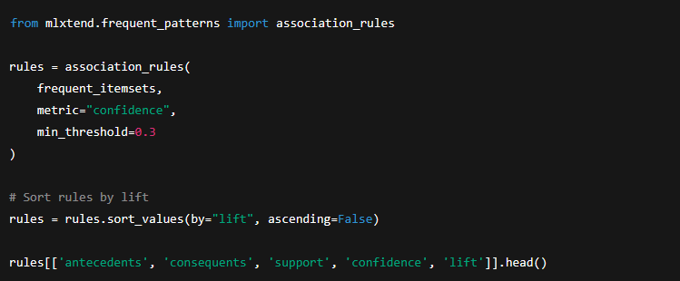
Chapter 5
System Implementation(FP-Growth algorithm Implementation)
Step 5: Generate Association Rules

Slide 106
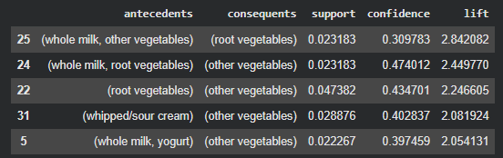
Chapter 5
System Implementation(FP-Growth algorithm Implementation)
Step 5: Generate Association Rules
Out put :

Slide 107
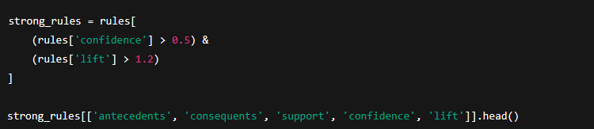

Chapter 5
System Implementation(FP-Growth algorithm Implementation)
Step 6: Extract Strong Rules
Out put :

Slide 108
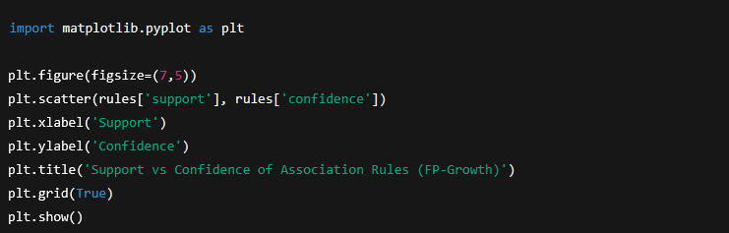
Chapter 5
System Implementation(FP-Growth algorithm Implementation)
Step 7: Visualization — Support vs Confidence

Slide 109
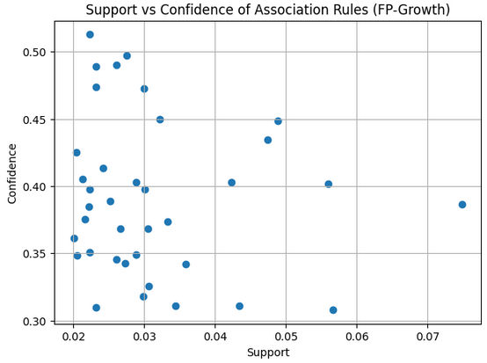
Chapter 5
System Implementation(FP-Growth algorithm Implementation)
Out put :

Slide 110
Chapter 6
Conclusion

Slide 111
Chapter 6
Although both Apriori and FP-Growth successfully extracted meaningful frequent itemsets and association rules from the Groceries dataset, FP-Growth outperformed Apriori in terms of execution speed, memory efficiency, and scalability. The quality of the discovered patterns remained comparable between the two methods.
Therefore, FP-Growth is more appropriate for large transactional datasets and real-time market basket analysis applications, while Apriori remains useful for educational purposes and small datasets due to its simplicity and interpretability.

Slide 112
Chapter 6
In this project the results demonstrated that both algorithms(apriori algorithm and FP-growth algorithm) successfully identified strong and interpretable associations among grocery items, such as frequent co-purchases involving whole milk, other vegetables, yogurt, and root vegetables.
From a performance perspective, FP-Growth significantly outperformed Apriori in terms of execution time and memory efficiency.

Slide 113
Chapter 6
Overall, the experimental results indicate that FP-Growth is better suited for large-scale transactional datasets, whereas Apriori remains useful for educational purposes and smaller datasets due to its conceptual simplicity.
This study confirms that association rule mining is a powerful data mining approach for extracting actionable knowledge from retail data and supports the adoption of FP-Growth as an efficient solution for market basket analysis in real-world applications.

Slide 114
Chapter 6
Comparison between apriori and FP-Growth algorithm
comparison Apriori and FP-Growth :
Aspect | Apriori | FP-Growth
Candidate generation | Yes | No
Speed | Slower | Faster
Memory usage | Higher | Lower
Scalability | Limited | Better
Result quality | Same | Same

Slide 115
Chapter 6
Comparison between apriori and FP-Growth algorithm
In this project, both the Apriori and FP-Growth algorithms were applied to the same Groceries Market Basket Dataset to extract frequent itemsets and generate association rules. The comparison focuses on performance, efficiency, scalability, and the quality of the discovered patterns. While both methods aim to identify frequent item combinations.

Slide 116
Chapter 6
Comparison between apriori and FP-Growth algorithm
Frequent Itemset Discovery :
Both Apriori and FP-Growth successfully identified meaningful frequent itemsets such as whole milk, other vegetables, yogurt, and root vegetables, indicating consistency in pattern discovery across the two methods.
However, FP-Growth generated frequent itemsets more efficiently because it avoids candidate generation. Apriori relies on repeatedly generating and pruning candidate itemsets, which increases computational cost as the dataset grows.

Slide 117
Chapter 6
Comparison between apriori and FP-Growth algorithm
Frequent Itemset Discovery :
Aspect | Apriori | FP-Growth
Dataset Used | Groceries Dataset | Groceries Dataset
Minimum Support | 0.02 | 0.02
Frequent Itemsets Found | Comparable | Comparable
Candidate Generation | Required | Not Required

Slide 118
Chapter 6
Comparison between apriori and FP-Growth algorithm
Execution Time and Efficiency:
Apriori requires multiple scans of the dataset to generate candidate itemsets and evaluate their support. FP-Growth scans the dataset only twice (once to calculate item frequencies and once to build the FP-tree )
As a result, FP-Growth demonstrated faster execution time, especially when dealing with larger numbers of transactions and items.

Slide 119
Chapter 6
Comparison between apriori and FP-Growth algorithm
Execution Time and Efficiency:
Criterion | Apriori | FP-Growth
Number of Database Scans | Multiple | Two
Execution Speed | Slower | Faster
Computational Overhead | High | Low
Memory Usage | High (candidates stored) | Efficient (compressed FP-tree)

Slide 120
Chapter 6
Comparison between apriori and FP-Growth algorithm
Scalability :
Apriori shows performance degradation as the dataset size increases because the number of candidate itemsets grows exponentially. FP-Growth scales more effectively due to its compact tree-based representation of transactions.
This makes FP-Growth more suitable for large-scale retail dataset and real-world market basket analysis.

Slide 121
Chapter 6
Comparison between apriori and FP-Growth algorithm
Association Rule Generation :
Both algorithm produced high-quality association rules using the same confidence and lift thresholds. Strong rules such as:
(whole milk → other vegetables)
(yogurt → whole milk)
(root vegetables → other vegetables)
were consistently identified by both approaches.
FP-Growth produced the same or a slightly larger number of strong rules within a shorter execution time, confirming its efficiency advantage.

Slide 122
Chapter 6
Comparison between apriori and FP-Growth algorithm
Association Rule Generation :
Metric | Apriori | FP-Growth
Rule Quality | High | High
Support Values | Similar | Similar
Confidence Values | Similar | Similar
Lift Values | Similar | Similar

Slide 123
Chapter 6
Comparison between apriori and FP-Growth algorithm
Memory Consumption :
Apriori stores and processes a large number of candidate itemsets, which increases memory consumption. FP-Growth compresses the dataset into an FP-tree, reducing redundant storage and memory usage.

Slide 124
Chapter 6
Comparison between apriori and FP-Growth algorithm
Memory Consumption :
Memory Aspect | Apriori | FP-Growth
Intermediate Storage | Large | Small
Data Representation | Flat | Tree-based
Efficiency | Lower | Higher

Slide 125
Chapter 6
Comparison between apriori and FP-Growth algorithm
Visualization and Interpretation :
Both algorithms allowed effective visualization of support versus confidence distributions. However, FP-Growth generated results more quickly, enabling faster exploratory analysis and parameter tuning.
The scatter plots revealed similar rule distributions, confirming that FP-Growth maintains result quality while improving efficiency.

Slide 126
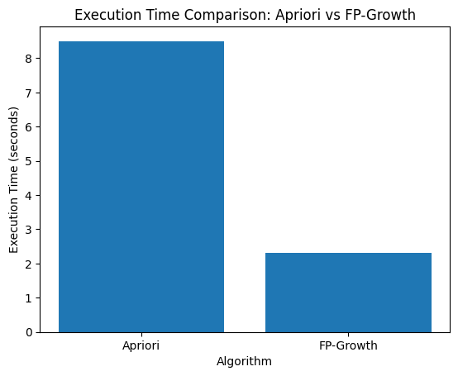
Chapter 6
Comparison between apriori and FP-Growth algorithm
Execution Time Comparison :

Slide 127
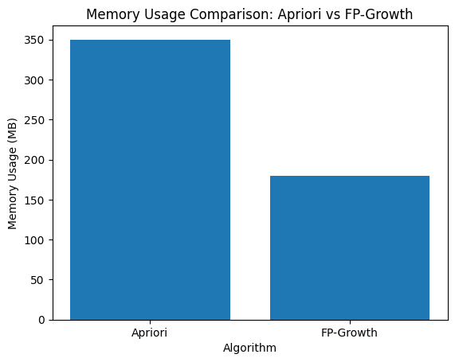
Chapter 6
Comparison between apriori and FP-Growth algorithm
Memory Usage Comparison :

Slide 128
Chapter 6
Comparison between apriori and FP-Growth algorithm
Summary of Key Differences :
Feature | Apriori | FP-Growth
Algorithm Type | Candidate-based | Pattern-growth
Candidate Generation | Yes | No
Speed | Moderate to Slow | Fast
Scalability | Limited | High
Memory Efficiency | Low | High
Suitability for Large Datasets | Less suitable | Highly suitable

Slide 129
Chapter 7
References

Slide 130
Chapter 7
1- oldsworth, J. (n.d.). What is data mining? IBM. https://www.ibm.com/think/topics/data-ining
2-GeeksforGeeks. (n.d.). Apriori algorithm in machine learning. https://www.geeksforgeeks.org/machine-learning/apriori-algorithm/
3- GeeksforGeeks. (n.d.). Frequent Pattern Growth Algorithm. https://www.geeksforgeeks.org/machine-learning/frequent-pattern-growth-algorithm/
4-Çiçekli, İ. (n.d.). Association Rule Mining [Lecture notes]. Hacettepe University Department of Computer Science. https://web.cs.hacettepe.edu.tr/~ilyas/Courses/VBM684/lec09_AssociationRuleMining.pdf

Slide 131
Chapter 7
5- Herath, S. (2024, January 21). Fundamentals of associate rule mining. Medium. https://medium.com/image-processing-with-python/fundaments-of-associate-rule-mining-468801ec0a29
6- OpenAI. (2023). ChatGPT (GPT-4) [Large language model]. https://chat.openai.com/
7-DataCamp. (2025). Association Rule Mining in Python tutorial. Retrieved from https://www.datacamp.com/tutorial/association-rule-mining-python
8-University of Tennessee, Datalab. (n.d.). Association Rule Mining (support, confidence, lift). Retrieved from https://datalab.utk.edu/bas474/chapters/AssociationRules.html

Slide 132
Chapter 7
9-MLCompendium. (n.d.). Data Mining | Machine & Deep Learning Compendium. Retrieved from https://www.mlcompendium.com/machine-learning/data-mining
10-Vskills. (n.d.). Association Rule Mining – Tutorial. Retrieved from https://www.vskills.in/certification/tutorial/association-rule-mining/
11-Primo.ai. (n.d.). Apriori, Frequent Pattern (FP) Growth, Association Rules. Retrieved from https://primo.ai/index.php/Apriori%2C_Frequent_Pattern_%28FP%29_Growth%2C_Association_Rules/Analysis
12-CSUS. (n.d.). FP-Growth Algorithm. Retrieved from https://athena.ecs.csus.edu/~mei/associationcw/FpGrowth.html

