Slide 1

Basic Concept of Classification (Data Mining)
Predicting Heart Disease Using Machine Learning
By : Ali pourfereydoon

Slide 2
Chapter 1
What is a Data Mining and classification:

Slide 3
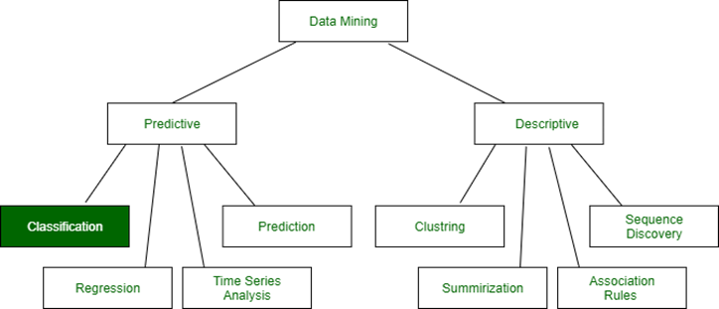
introduction
Chapter 1
Data mining in general terms means mining or digging deep into data that is in different forms to gain patterns, and to gain knowledge on that pattern. In the process of data mining, large data sets are first sorted, then patterns are identified and relationships are established to perform data analysis and solve problems.

Slide 4
introduction
Chapter 1
Classification:
Classification is a widely used technique in data mining and is applied in a variety of domains, such as email filtering, sentiment analysis, and medical diagnosis.
Classification is a task in data mining that involves assigning a class label to each instance in a dataset based on its features.
The goal of classification is to build a model that accurately predicts the class labels of new instances based on their features.

Slide 5
introduction
Chapter 1
There are two main types of classification:
binary classification and multi-class classification.
Binary classification involves classifying instances into two classes, such as "spam" or "not spam", while multi-class classification involves classifying instances into more than two classes.

Slide 6
introduction
Chapter 1
Binary: Possesses only two values i.e. True or False
Example: Suppose there is a survey evaluating some products. We need to check whether it’s useful or not
Nominal: When more than two outcomes are possible. It is in Alphabet form rather than being in Integer form.
Example: One needs to choose some material but of different colors. So, the color might be Yellow, Green, Black, Red.
Different Colors: Red, Green, Black, Yellow

Slide 7
introduction
Chapter 1
Ordinal: Values that must have some meaningful order.
Example: Suppose there are grade sheets of few students which might contain different grades as per their performance such as A, B, C, D
Continuous: May have an infinite number of values, it is in float type
Example: Measuring the weight of few Students in a sequence or orderly manner i.e. 50, 51, 52, 53
Weight: 50, 51, 52, 53
Discrete: Finite number of values.
Example: Marks of a Student in a few subjects: 65, 70, 75, 80, 90
Marks: 65, 70, 75, 80, 90

Slide 8
Chapter 2
The process of building a classification model typically involves the following steps:

Slide 9
Chapter 2
Data Collection:
The first step in building a classification model is data collection. In this step, the data relevant to the problem at hand is collected.
The data should be representative of the problem and should contain all the necessary attributes and labels needed for classification.
The data can be collected from various sources, such as surveys, questionnaires, websites, and databases.

Slide 10
Chapter 2
Data Preprocessing:
The second step in building a classification model is data preprocessing. The collected data needs to be preprocessed to ensure its quality.
This involves handling missing values, dealing with outliers, and transforming the data into a format suitable for analysis.
Data preprocessing also involves converting the data into numerical form, as most classification algorithms require numerical input.

Slide 11
Chapter 2
Data Preprocessing:
Handling Missing Values: Missing values in the dataset can be handled by replacing them with the mean, median, or mode of the corresponding feature or by removing the entire record.
Dealing with Outliers: Outliers in the dataset can be detected using various statistical techniques such as z-score analysis, boxplots, and scatterplots.
Outliers can be removed from the dataset or replaced with the mean, median, or mode of the corresponding feature.

Slide 12
Chapter 2
Data Preprocessing:
Data Transformation:
Data transformation involves scaling or normalizing the data to bring it into a common scale. This is done to ensure that all features have the same level of importance in the analysis.

Slide 13
Chapter 2
Feature Selection:
The third step in building a classification model is feature selection.
Feature selection involves identifying the most relevant attributes in the dataset for classification.
This can be done using various techniques, such as correlation analysis, information gain, and principal component analysis.

Slide 14
Chapter 2
Feature Selection:
Correlation Analysis: Correlation analysis involves identifying the correlation between the features in the dataset. Features that are highly correlated with each other can be removed as they do not provide additional information for classification.
Information Gain: Information gain is a measure of the amount of information that a feature provides for classification. Features with high information gain are selected for classification.

Slide 15
Chapter 2
Model Selection:
The fourth step in building a classification model is model selection. Model selection involves selecting the appropriate classification algorithm for the problem at hand. There are several algorithms available, such as :
Classifiers Of Machine Learning:
Decision Trees
Bayesian Classifiers
Neural Networks
K-Nearest Neighbour
Support Vector Machines
Linear Regression
Logistic Regressio

Slide 16
Chapter 2
Model Selection:
Classifiers can be categorized into two major types:
1.Discriminative
2. Generative:

Slide 17
Chapter 2
Model Selection:
Discriminative: It is a very basic classifier and determines just one class for each row of data. It tries to model just by depending on the observed data, depends heavily on the quality of data rather than on distributions.
Example: Logistic Regression
Generative: It models the distribution of individual classes and tries to learn the model that generates the data behind the scenes by estimating assumptions and distributions of the model. Used to predict the unseen data.

Slide 18
Chapter 2
Model Selection:
Example: Naive Bayes Classifier
Detecting Spam emails by looking at the previous data. Suppose 100 emails and that too divided in 1:4 i.e. Class A: 25%(Spam emails) and Class B: 75%(Non-Spam emails).
Now if a user wants to check that if an email contains the word cheap, then that may be termed as Spam. It seems to be that in Class A(i.e. in 25% of data), 20 out of 25 emails are spam and rest not.
And in Class B(i.e. in 75% of data), 70 out of 75 emails are not spam and rest are spam.
So, if the email contains the word cheap, what is the probability of it being spam ?? (= 80%).

Slide 19
Chapter 2
Model Selection:
Decision Trees: Decision trees are a simple yet powerful classification algorithm. They divide the dataset into smaller subsets based on the values of the features and construct a tree-like model that can be used for classification.

Slide 20
Chapter 2
Model Selection:
Support Vector Machines: Support Vector Machines (SVMs) are a popular classification algorithm used for both linear and nonlinear classification problems.
SVMs are based on the concept of maximum margin, which involves finding the hyperplane that maximizes the distance between the two classes.

Slide 21
Chapter 2
Model Selection:
Neural Networks:
Neural Networks are a powerful classification algorithm that can learn complex patterns in the data.
They are inspired by the structure of the human brain and consist of multiple layers of interconnected nodes

Slide 22
Chapter 2
Model Training:
The fifth step in building a classification model is model training.
Model training involves using the selected classification algorithm to learn the patterns in the data.
The data is divided into a training set and a validation set.
The model is trained using the training set, and its performance is evaluated on the validation set.

Slide 23
Chapter 2
Model Evaluation:
The sixth step in building a classification model is model evaluation.
Model evaluation involves assessing the performance of the trained model on a test set. This is done to ensure that the model generalizes well

Slide 24
Chapter 3
Real-Life Examples :

Slide 25
Chapter 3
Market Basket Analysis:
It is a modeling technique that has been associated with frequent transactions of buying some combination of items.
Example: Amazon and many other Retailers use this technique. While viewing some products, certain suggestions for the commodities are shown that some people have bought in the past.

Slide 26
Chapter 3
Weather Forecasting:
Changing Patterns in weather conditions needs to be observed based on parameters such as temperature, humidity, wind direction.
This keen observation also requires the use of previous records in order to predict it accurately.

Slide 27
Chapter 3
Predicting Heart Disease Using Machine Learning
Goal:To build a classification model that predicts whether a patient has heart disease based on medical attributes.
Why classification : The target variable (target) has two classes:
0 → No heart disease
1 → Heart disease
This makes it a binary classification problem.

Slide 28
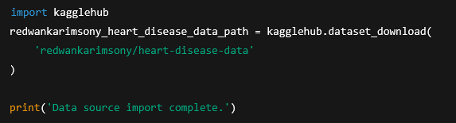
Chapter 3
Predicting Heart Disease Using Machine Learning
Step :1
STEP 1: Kaggle Dataset Import Setup

Slide 29
Chapter 3
Predicting Heart Disease Using Machine Learning
Step :1
STEP 1: Kaggle Dataset Import Setup
Explanation:
kagglehub is a library that allows downloading datasets directly from Kaggle.
The dataset heart-disease-data is downloaded from Kaggle.This ensures the dataset source is Kaggle.
The printed message confirms successful download.
Purpose:To legally and reproducibly import the dataset from Kaggle.

Slide 30

Chapter 3
Predicting Heart Disease Using Machine Learning
Step :2
STEP 2: Import Required Libraries
Explanation:
NumPy (np): used for numerical computations.
Pandas (pd): used for reading CSV files and handling tabular data.
Purpose:These libraries are fundamental for data preprocessing and analysis

Slide 31
Chapter 3
Predicting Heart Disease Using Machine Learning
Step :2
STEP 2: Import Required Libraries
NumPy (np):
NumPy is the fundamental package for scientific computing in Python. It is a Python library that provides a multidimensional array object, various derived objects (such as masked arrays and matrices), and an assortment of routines for fast operations on arrays, including mathematical, logical, shape manipulation, sorting, selecting, I/O, discrete Fourier transforms, basic linear algebra, basic statistical operations, random simulation and much more.

Slide 32
Chapter 3
Predicting Heart Disease Using Machine Learning
Step :2
STEP 2: Import Required Libraries
NumPy (np):
There are several important differences between NumPy arrays and the standard Python sequences:
NumPy arrays have a fixed size at creation, unlike Python lists (which can grow dynamically).
The elements in a NumPy array are all required to be of the same data type, and thus will be the same size in memory.

Slide 33
Chapter 3
Predicting Heart Disease Using Machine Learning
Step :2
STEP 2: Import Required Libraries
NumPy (np):
NumPy arrays facilitate advanced mathematical and other types of operations on large numbers of data. Typically, such operations are executed more efficiently and with less code than is possible using Python’s built-in sequences.
A growing plethora of scientific and mathematical Python-based packages are using NumPy arrays; though these typically support Python-sequence input, they convert such input to NumPy arrays prior to processing, and they often output NumPy arrays.

Slide 34
Chapter 3
Predicting Heart Disease Using Machine Learning
Step :2
STEP 2: Import Required Libraries
Pandas Introduction :
Pandas is an open-source Python library used for data manipulation, analysis and cleaning. It provides fast and flexible tools to work with tabular data, similar to spreadsheets or SQL tables.
Pandas is used in data science, machine learning, finance, analytics and automation because it integrates smoothly with other libraries such as:
NumPy: numerical operations
Matplotlib and Seaborn: data visualization
SciPy: statistical analysis
Scikit-learn: machine learning workflows

Slide 35


Chapter 3
Predicting Heart Disease Using Machine Learning
Step :2
STEP 2: Import Required Libraries
Pandas Introduction :
Installation: Before using Pandas, make sure it is installed
After the Pandas have been installed in the system we need to import the library. This module is imported using:
Note: pd is just an alias for Pandas. It’s not required but using it makes the code shorter when calling methods or properties.

Slide 36
Chapter 3
Predicting Heart Disease Using Machine Learning
Step :2
STEP 2: Import Required Libraries
Data Structures in Pandas:
Pandas provides two data structures for manipulating data which are as follows:
1. Pandas Series :
A Pandas Series is one-dimensional labeled array capable of holding data of any type (integer, string, float, Python objects etc.). The axis labels are collectively called indexes. Series is created by loading the datasets from existing storage which can be a SQL database, a CSV file or an Excel file.

Slide 37
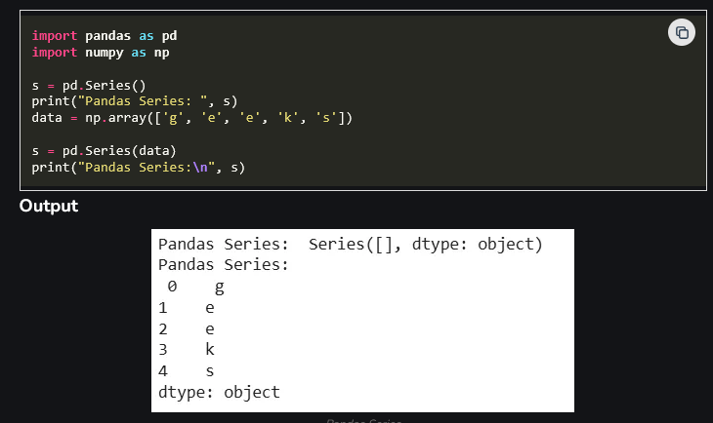
Chapter 3
Predicting Heart Disease Using Machine Learning
Step :2
STEP 2: Import Required Libraries
Data Structures in Pandas:

Slide 38
Chapter 3
Predicting Heart Disease Using Machine Learning
Step :2
STEP 2: Import Required Libraries
Data Structures in Pandas:
2. Pandas DataFrame:
Pandas DataFrame is a two-dimensional data structure with labeled axes (rows and columns). It is created by loading the datasets from existing storage which can be a SQL database, a CSV file or an Excel file. It can be created from lists, dictionaries, a list of dictionaries etc.

Slide 39
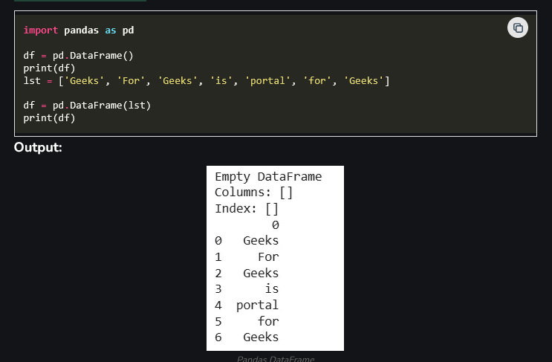
Chapter 3
Predicting Heart Disease Using Machine Learning
Step :2
STEP 2: Import Required Libraries
Data Structures in Pandas:
2. Pandas DataFrame:

Slide 40
Chapter 3
Predicting Heart Disease Using Machine Learning
Step :2
STEP 2: Import Required Libraries
Data Structures in Pandas:
Operations in Pandas:
Pandas provides essential operations for working with structured data efficiently. The sections below introduce the most commonly used functionalities with short explanations and simple examples.
1. Loading Data: This operation reads data from files such as CSV, Excel or JSON into a DataFrame.

Slide 41
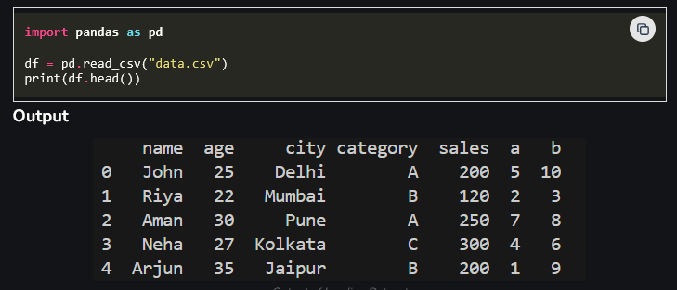
Chapter 3
Predicting Heart Disease Using Machine Learning
Step :2
STEP 2: Import Required Libraries
Data Structures in Pandas:
Operations in Pandas:
Explanation: pd.read_csv("data.csv") reads the CSV file and loads it into a DataFrame and df.head() shows the first 5 rows of the data.

Slide 42
Chapter 3
Predicting Heart Disease Using Machine Learning
Step :2
STEP 2: Import Required Libraries
Data Structures in Pandas:
Operations in Pandas:
2. Viewing and Exploring Data: After loading data, it is important to understand its structure and content. This methods allow you to inspect rows, summary statistics and metadata.

Slide 43
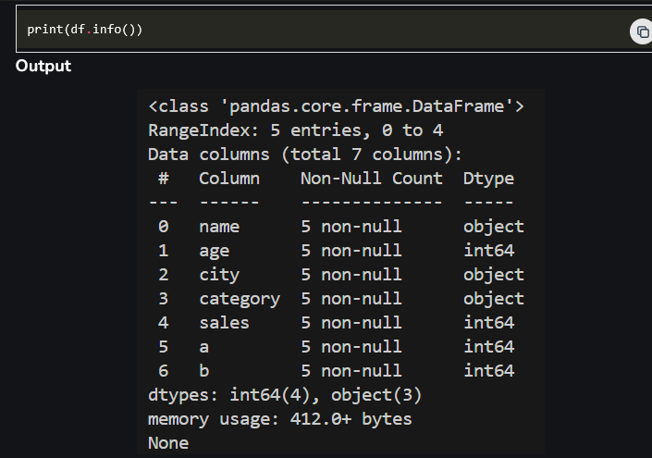
Chapter 3
Predicting Heart Disease Using Machine Learning
Step :2
STEP 2: Import Required Libraries
2. Viewing and
Exploring Data:

Slide 44
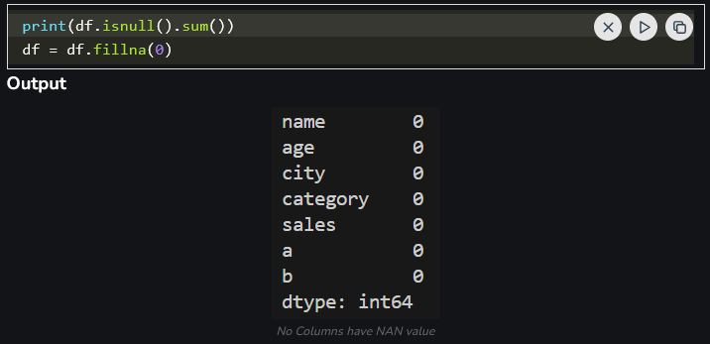
Chapter 3
Predicting Heart Disease Using Machine Learning
Step :2
STEP 2: Import Required Libraries
3. Handling Missing Data: Datasets often contain empty or missing values. Pandas provides functions to detect, remove or replace these values.
Explanation:
df.fillna(0)replaces missing
values with 0

Slide 45
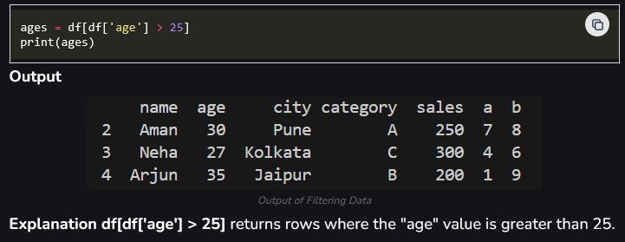
Chapter 3
Predicting Heart Disease Using Machine Learning
Step :2
STEP 2: Import Required Libraries
4. Selecting and Filtering Data: This operation retrieves specific columns, rows or records that match a condition. It allows precise extraction of required information.

Slide 46
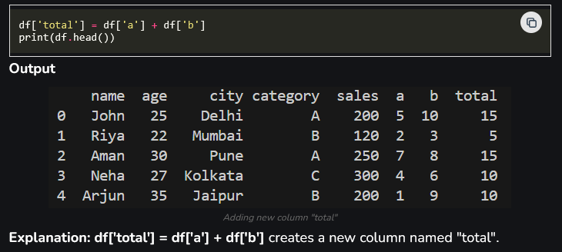
Chapter 3
Predicting Heart Disease Using Machine Learning
Step :2
STEP 2: Import Required Libraries
5. Adding and Removing Columns: You can create new columns based on existing ones or delete unwanted columns from the DataFrame

Slide 47
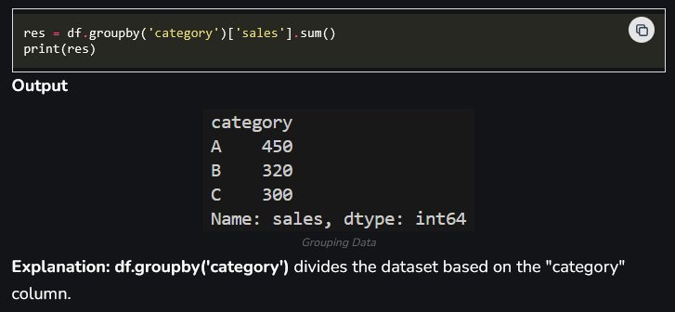
Chapter 3
Predicting Heart Disease Using Machine Learning
Step :2
STEP 2: Import Required Libraries
6. Grouping Data (GroupBy): Grouping allows you to organize data into categories and compute values for each group for example, sums, counts or averages.

Slide 48
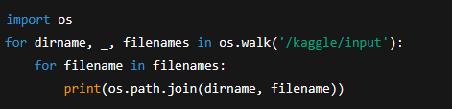
Chapter 3
Predicting Heart Disease Using Machine Learning
Step :3
STEP 3: Check Kaggle Input Directory
Explanation:
This code lists all files available in Kaggle’s /kaggle/input directory.It helps confirm the dataset file path and name.
Purpose:To verify that the dataset exists and identify its exact location.

Slide 49
Chapter 3
Predicting Heart Disease Using Machine Learning
Step :3
STEP 3: Check Kaggle Input Directory
What is os :
  The Python os module provides tools for using operating system-dependent functionality, like reading or writing to the file system. It allows you to interface with the underlying operating system in a portable way.
Key Features:
Interacts with the operating system
Manipulates file paths and directories
Provides access to environment variables
Facilitates process management

Slide 50
Chapter 3
Predicting Heart Disease Using Machine Learning
Step :3
STEP 3: Check Kaggle Input Directory
………………………………………………………………………………….
Object Type Description
os.path Module Provides common pathname manipulations
os.environ Mapping Gives access to environment variables
os.listdir() Function Lists directory contents
os.mkdir() Function Creates a directory
os.remove() Function Removes a file
os.rename() Function Renames a file or directory
os.walk() Function Generates file names in a directory tree

Slide 51
Chapter 3
Predicting Heart Disease Using Machine Learning
Step :3
STEP 3: Check Kaggle Input Directory
what is os :
Common Use Cases:
Navigating and manipulating the file system
Manipulating file and directory paths
Managing environment variables
Running shell commands from Python scripts
Iterating over files and directories

Slide 52
Chapter 3
Predicting Heart Disease Using Machine Learning
Step :4
STEP 4: Load the Dataset
Explanation:
The CSV file is loaded into a pandas DataFrame named df.df.head() displays the first five rows.
Purpose:To confirm the dataset structure and view sample records

Slide 53
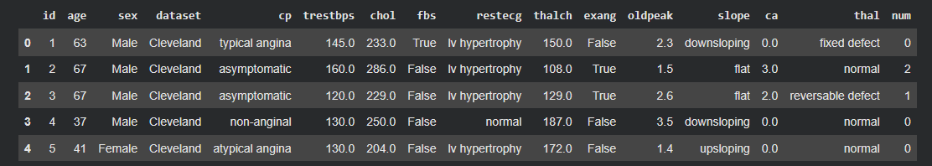
Chapter 3
Predicting Heart Disease Using Machine Learning
Step :4
STEP 4: Load the Dataset

Slide 54

Chapter 3
Predicting Heart Disease Using Machine Learning
Step :5
STEP 5: Dataset Structure Information
Explanation:
Displays:
Column names
Data types
Number of non-null values
Purpose:To understand which columns contain missing values and data types.

Slide 55
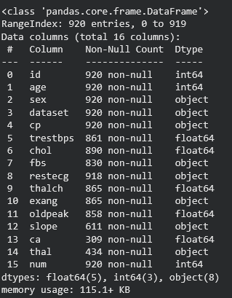
Chapter 3
Predicting Heart Disease Using Machine Learning
Step :5
STEP 5: Dataset Structure Information

Slide 56

Chapter 3
Predicting Heart Disease Using Machine Learning
Step :6
STEP 6: Statistical Summary
Explanation:
Provides descriptive statistics for numerical columns:
Mean
Standard deviation
Minimum and maximum
Purpose: To understand data distribution and detect anomalies.

Slide 57
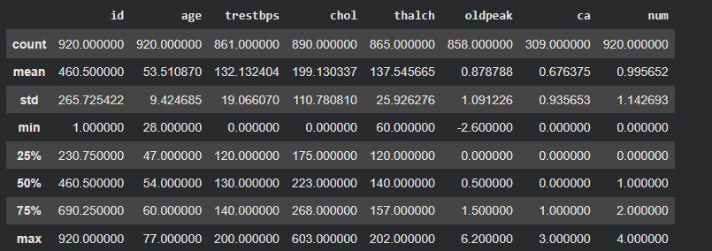
Chapter 3
Predicting Heart Disease Using Machine Learning
Step :6
STEP 6: Statistical Summary

Slide 58

Chapter 3
Predicting Heart Disease Using Machine Learning
Step :7
STEP 7: Categorical Summary
Explanation:
Shows statistics for categorical (object) columns.
Includes count, unique values, and most frequent values.
Purpose:To analyze non-numerical attributes.

Slide 59
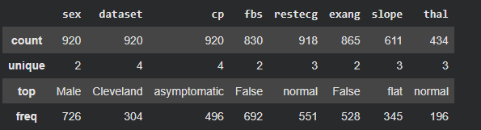
Chapter 3
Predicting Heart Disease Using Machine Learning
Step :7
STEP 7: Categorical Summary

Slide 60

Chapter 3
Predicting Heart Disease Using Machine Learning
Step :8
STEP 8: Missing Values and Duplicates
Explanation:
isnull().sum() counts missing values per column.
duplicated().sum() counts duplicate rows.
Purpose:To assess data quality before preprocessing.

Slide 61

Chapter 3
Predicting Heart Disease Using Machine Learning
Step :8
STEP 8: Missing Values and Duplicates

Slide 62

Chapter 3
Predicting Heart Disease Using Machine Learning
Step :9
STEP 9: Handling Missing Values (Numerical)
Explanation:
Missing values are filled using linear interpolation.
This estimates values based on neighboring data.
Purpose:
To preserve numerical trends without deleting data.

Slide 63
Chapter 3
Predicting Heart Disease Using Machine Learning
Step :9
STEP 9: Handling Missing Values (Numerical)
In medical datasets, missing values occur due to:
  Incomplete medical tests
  Data entry errors
  Patients skipping examinations
Problem:
  Machine learning models cannot handle missing values directly, so they must be treated before classification.

Slide 64
Chapter 3
Predicting Heart Disease Using Machine Learning
Step :9
STEP 9: Handling Missing Values (Numerical)
trestbps (Resting Blood Pressure):
  Represents the resting blood pressure of a patient measured in mm Hg
  Recorded when the patient is at rest
  High resting blood pressure is a major risk factor for heart disease
Medical meaning:
  Normal: ~120 mm Hg
  Elevated values increase cardiovascular risk
Role in classification:
  Helps the model distinguish between low-risk and high-risk patients

Slide 65
Chapter 3
Predicting Heart Disease Using Machine Learning
Step :9
STEP 9: Handling Missing Values (Numerical)
chol (Serum Cholesterol):
  Represents cholesterol level in the blood measured in mg/dL
  High cholesterol can lead to arterial blockage
Medical meaning:
  Normal: < 200 mg/dL
  High cholesterol increases risk of heart disease
Role in classification:
  Strong predictor for heart disease
  Used together with blood pressure, age, and heart rate

Slide 66
Chapter 3
Predicting Heart Disease Using Machine Learning
Step :9
STEP 9: Handling Missing Values (Numerical)
What Is interpolate:
Definition:
interpolate() is a method that estimates missing values based on existing data.Instead of removing rows, it fills missing values logically.

Slide 67

Chapter 3
Predicting Heart Disease Using Machine Learning
Step :10
STEP 10: Filling Missing Values Using Median
Explanation:
Median is used because it is robust to outliers.
Purpose:
To safely fill missing values without skewing data.

Slide 68
Chapter 3
Predicting Heart Disease Using Machine Learning
Step :10
STEP 10:
thalch (Maximum Heart Rate Achieved):
  Represents the maximum heart rate a patient reaches during a stress test
  Measured in beats per minute (bpm)
  Indicates how well the heart responds to physical exertion
Medical meaning:
  Higher values → better heart function
  Lower values → possible heart disease
Role in classification:
  Important predictor of heart disease
  Patients with heart disease often show reduced maximum heart rate

Slide 69
Chapter 3
Predicting Heart Disease Using Machine Learning
Step :10
STEP 10:
oldpeak (ST Depression Induced by Exercise):
  Measures depression of the ST segment during an ECG stress test
  Indicates reduced blood flow to the heart
  Measured in millimeters
Medical meaning:
  Higher values → greater ischemia (heart muscle oxygen shortage)
  Strong indicator of heart disease severity
Role in classification:
  One of the most important features in predicting heart disease
  Often ranked high in Random Forest feature importance

Slide 70
Chapter 3
Predicting Heart Disease Using Machine Learning
Step :10
STEP 10:
What Is fillna() :
Definition:
fillna() is a Pandas function used to replace missing (NaN) values in a dataset.
fillna(value)
It replaces missing values with a specified statistic or value.

Slide 71

Chapter 3
Predicting Heart Disease Using Machine Learning
Step :11
STEP 11: Rule-Based Imputation
Explanation:
If age > 50 → fasting blood sugar likely high.Uses domain knowledge.
Purpose:
To intelligently fill missing categorical values.

Slide 72

Chapter 3
Predicting Heart Disease Using Machine Learning
Step :12
STEP 12: More Rule-Based Filling
Explanation:
Lower heart rate suggests exercise-induced angina
Purpose:
To improve data accuracy using medical logic.

Slide 73
Chapter 3
Predicting Heart Disease Using Machine Learning
Step :12
STEP 12: More Rule-Based Filling
exang (Exercise-Induced Angina):
Indicates whether a patient experiences chest pain during physical exercise
Binary variable:
1 → Yes (exercise-induced angina present)
0 → No (no chest pain during exercise)
Medical significance:
  Chest pain during exercise is a strong indicator of heart diseaseOften caused by reduced blood flow to the heart muscles

Slide 74
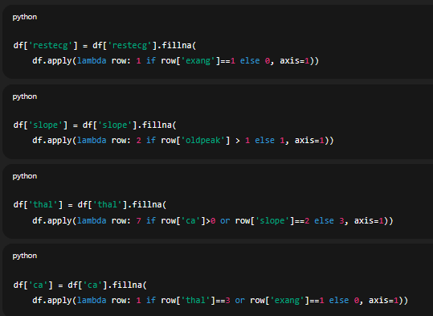
Chapter 3
Predicting Heart Disease Using Machine Learning
Step :13
STEP 13: Remaining Feature Imputation

Slide 75
Chapter 3
Predicting Heart Disease Using Machine Learning
Step :13
STEP 13: Remaining Feature Imputation
restecg (Resting Electrocardiographic Results)
Definition:
  Represents the results of an electrocardiogram (ECG) recorded while the patient is at rest.
  Indicates how the heart’s electrical activity behaves under normal conditions.
Typical values:
  0 → Normal
  1 → ST-T wave abnormality
  2 → Left ventricular hypertrophy

Slide 76
Chapter 3
Predicting Heart Disease Using Machine Learning
Step :13
STEP 13: Remaining Feature Imputation
slope (Slope of the Peak Exercise ST Segment)
Definition:
Describes the shape of the ST segment during peak exercise in an ECG test.
Typical values:
  1 → Upsloping (normal)
  2 → Flat (abnormal)
  3 → Downsloping (abnormal)
Medical significance:
  Flat or downsloping ST segments suggest ischemia.Indicates how the heart responds under physical stress.

Slide 77
Chapter 3
Predicting Heart Disease Using Machine Learning
Step :13
STEP 13: Remaining Feature Imputation
thal (Thalassemia / Stress Test Result)
Definition:
  Indicates results of a nuclear stress test related to blood flow in the heart.
Typical values:
  3 → Normal
  6 → Fixed defect (permanent damage)
  7 → Reversible defect (temporary ischemia)
Medical significance:
  Fixed and reversible defects indicate reduced blood supply to heart muscles.
  Strong indicator of coronary artery disease.

Slide 78
Chapter 3
Predicting Heart Disease Using Machine Learning
Step :13
STEP 13: Remaining Feature Imputation
ca (Number of Major Vessels Colored by Fluoroscopy)
Definition:
  Represents the number of major coronary arteries visible during fluoroscopy.
  Values range from 0 to 3.
Medical significance:
  Higher values indicate greater arterial blockage.
  Strongly associated with disease severity.

Slide 79
Chapter 3
Predicting Heart Disease Using Machine Learning
Step :13
STEP 13: Remaining Feature Imputation
Explanation:
Missing values are filled using logical conditions based on related features.
Purpose:
To maintain medical consistency across variables.

Slide 80

Chapter 3
Predicting Heart Disease Using Machine Learning
Step :14
STEP 14: Final Missing-Value Check
Explanation:
Confirms no missing values remain.

Slide 81

Chapter 3
Predicting Heart Disease Using Machine Learning
Step :14
STEP 14: These two lines import visualization libraries used to create graphs and plots.
Explanation:
Matplotlib is a Python library used to create basic graphs
Importing the plotting module pyplot
Giving it the short name plt (standard convention)

Slide 82
Chapter 3
Predicting Heart Disease Using Machine Learning
Step :14
STEP 14:
Matplotlib :Data visualization helps to understand complex datasets. The Matplotlib library in Python is a key tool for creating plots, and this guide walks you through installation and basic plotting.
Matplotlib is a popular plotting library in Python used for creating high-quality visualizations and graphs. It offers various tools to generate diverse plots, facilitating data analysis, exploration, and presentation. Matplotlib is flexible, supporting multiple plot types and customization options, making it valuable for scientific research, data analysis, and visual communication.

Slide 83

Chapter 3
Predicting Heart Disease Using Machine Learning
Step :14
STEP 14:
Installation of Matplotlib:
Let’s check how to set up the Matplotlib in Google Colab. Colab Notebooks are similar to Jupyter Notebooks except for running on the cloud. It is also connected to our Google Drive, making it much easier to access our Colab notebooks anytime, anywhere, and on any system. You can install Matplotlib by using the PIP command.

Slide 84

Chapter 3
Predicting Heart Disease Using Machine Learning
Step :14
STEP 14:
To verify the installation, you would have to write the following code chunk:
different categories of plots that Matplotlib provides.
Line plot
Histogram
Bar Chart
Scatter plot
Pie charts
Boxplot

Slide 85
Chapter 3
Predicting Heart Disease Using Machine Learning
Step :14
STEP 14:
Matplotlib is used to:
  Create figures
  Display plots
  Set titles, labels, axes
  Show graphs on screen
What is Seaborn:
  Seaborn is a Python library built on top of Matplotlib
It provides: More beautiful plots and Statistical visualizations and Less code for complex graphs

Slide 86
Chapter 3
Predicting Heart Disease Using Machine Learning
Step :14
Seaborn is used to:
  Plot distributions
  Create boxplots, histograms, heatmaps
  Visualize relationships between variables
In this project( heart disease ) these libraries are used to:
  Visualize age distribution
  Compare blood pressure vs blood sugar
  Show cholesterol vs heart rate
  Display correlation heatmap
These visualizations help:
  Understand data patterns
  Detect outliers
  Support modeling decisions

Slide 87

Chapter 3
Predicting Heart Disease Using Machine Learning
Step :15
STEP 15: Data Visualization (EDA) Age Distribution
plt.figure() creates a new, empty figure (plot window) where graphs will be drawn.
Why Do We Need plt.figure() :
  Without plt.figure():
  New plots may be drawn on top of old plots
  Graphs may overlap and become unclear
With plt.figure():
  Each plot is drawn separately
  Graphs are clean and readable

Slide 88
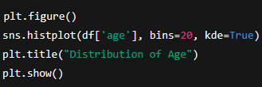
Chapter 3
Predicting Heart Disease Using Machine Learning
Step :15
STEP 15: Data Visualization (EDA) Age Distribution
plt.figure() → opens a new figure
sns.histplot() → draws the histogram
plt.title() → adds a title
plt.show() → displays the figure

Slide 89
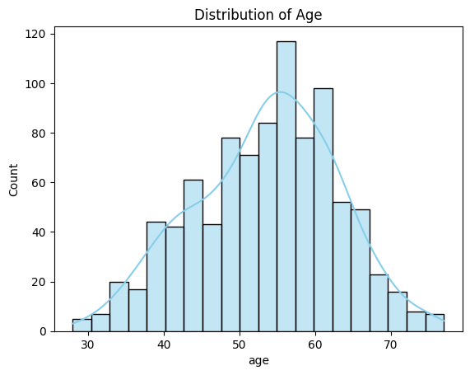
Chapter 3
Predicting Heart Disease Using Machine Learning
Step :15
STEP 15: Data Visualization (EDA) Age Distribution
This chart shows the distribution of patient ages in the heart disease dataset.
The histogram represents the frequency of patients within different age ranges, while the smooth curve (KDE) illustrates the overall age distribution trend.

Slide 90
Chapter 3
Predicting Heart Disease Using Machine Learning
Step :15
STEP 15: Data Visualization (EDA) Age Distribution
Key observations:
Most patients are between 45 and 65 years old.
The distribution is approximately normal (bell-shaped).
Very few patients are younger than 30 or older than 75.
Relevance to classification:
Age is an important feature in heart disease prediction, as the likelihood of heart disease generally increases with age. Understanding the age distribution helps ensure that the classification model is trained on a representative population and can learn meaningful patterns related to age

Slide 91

Chapter 3
Predicting Heart Disease Using Machine Learning
Step :15
STEP 15: Data Visualization (EDA)
Age Distribution
Shows age distribution and density.

Slide 92

Chapter 3
Predicting Heart Disease Using Machine Learning
Step :15
STEP 15: Data Visualization (EDA)
Blood Pressure vs FBS
Compares blood pressure by sugar level.

Slide 93
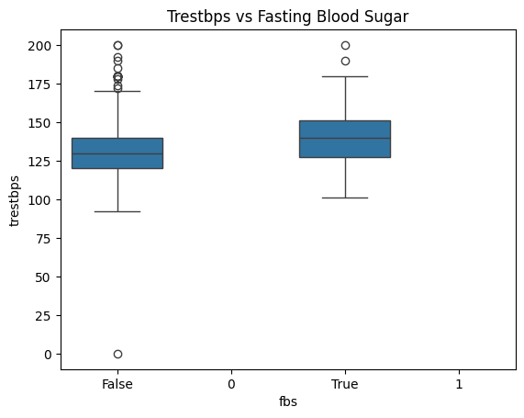
Chapter 3
Predicting Heart Disease Using Machine Learning
Step :15
STEP 15: Data Visualization (EDA)
Blood Pressure vs FBS
This box plot compares resting blood pressure (trestbps) between patients with normal fasting blood sugar and those with elevated fasting blood sugar (fbs).

Slide 94

Chapter 3
Predicting Heart Disease Using Machine Learning
Step :15
STEP 15: Data Visualization (EDA)
Blood Pressure vs FBS
Key observations:
Patients with high fasting blood sugar (fbs = True) tend to have a higher median resting blood pressure.
The blood pressure values for the high-FBS group show greater variability.
Outliers are present in both groups, indicating unusually high or low blood pressure readings.
Relevance to classification:
This visualization suggests a relationship between blood sugar levels and blood pressure, both of which are important risk factors for heart disease. Such patterns help the classification model learn how combinations of medical features contribute to the prediction of heart disease.

Slide 95
Chapter 3
Predicting Heart Disease Using Machine Learning
Step :15
STEP 15: Data Visualization (EDA)
Cholesterol vs Heart Rate
Visualizes relationship between cholesterol and heart rate.

Slide 96
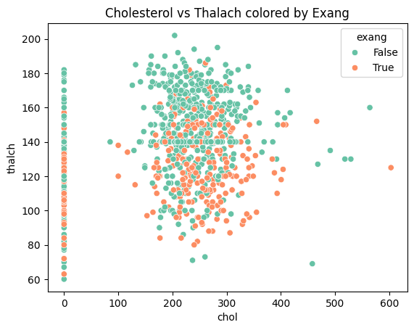
Chapter 3
Predicting Heart Disease Using Machine Learning
Step :15
STEP 15: Data Visualization (EDA)
This scatter plot shows the relationship between cholesterol level (chol) and maximum heart rate achieved (thalach), with points colored based on the presence of exercise-induced angina (exang).

Slide 97
Chapter 3
Predicting Heart Disease Using Machine Learning
Step :15
STEP 15: Data Visualization (EDA)
Key observations:
Patients without exercise-induced angina (exang = False) generally achieve higher maximum heart rates.
Patients with exercise-induced angina (exang = True) tend to have lower thalach values, even at similar cholesterol levels.
Cholesterol alone does not show a strong linear relationship with maximum heart rate, indicating that multiple features must be considered together.
Relevance to classification:
This visualization highlights how combinations of features (cholesterol, heart rate, and exercise-induced angina) help distinguish between different patient conditions. Such interactions are valuable for classification models like Random Forest, which can capture complex, non-linear relationships in medical data.

Slide 98

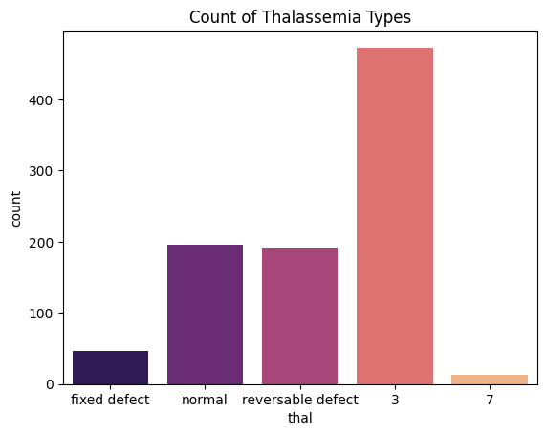
/tmp/ipython-input-659379015.py:2: FutureWarning: Passing `palette` without assigning `hue` is deprecated and will be removed in v0.14.0. Assign the `x` variable to `hue` and set `legend=False` for the same effect. sns.countplot(x='thal', palette='magma', data=df)
Chapter 3
Predicting Heart Disease Using Machine Learning
Step :15
STEP 15:

Slide 99
/tmp/ipython-input-659379015.py:2: FutureWarning: Passing `palette` without assigning `hue` is deprecated and will be removed in v0.14.0. Assign the `x` variable to `hue` and set `legend=False` for the same effect. sns.countplot(x='thal', palette='magma', data=df)
Chapter 3
Predicting Heart Disease Using Machine Learning
Step :15
STEP 15:Count of Thalassemia Types (Count Plot)
  This chart displays the frequency distribution of thalassemia (thal) categories in the heart disease dataset.
Key observations:
  The normal thalassemia category is the most frequent in the dataset.
  Reversible defect and fixed defect cases appear less frequently.
  A small number of cases fall into other categories, indicating class imbalance among thalassemia types.

Slide 100
/tmp/ipython-input-659379015.py:2: FutureWarning: Passing `palette` without assigning `hue` is deprecated and will be removed in v0.14.0. Assign the `x` variable to `hue` and set `legend=False` for the same effect. sns.countplot(x='thal', palette='magma', data=df)
Chapter 3
Predicting Heart Disease Using Machine Learning
Step :15
STEP 15: Count of Thalassemia Types (Count Plot)
Relevance to classification:
Thalassemia type is an important clinical feature related to heart disease risk.
Understanding its distribution helps the classification model learn how different thalassemia conditions contribute to heart disease prediction and highlights potential class imbalance that the model must handle.

Slide 101
Chapter 3
Predicting Heart Disease Using Machine Learning
Step :15
STEP 15:
sns.barplot() is a Seaborn function used to create a bar chart that shows the relationship between two variables:
  One categorical variable (x-axis)
  One numerical variable (y-axis)
By default, it shows the mean (average) of the numerical variable for each category.

Slide 102
Chapter 3
Predicting Heart Disease Using Machine Learning
Step :15
STEP 15:
x='fbs’
fbs = Fasting Blood SugarThis is a categorical variable:
  0 → Normal fasting blood sugar
  1 → High fasting blood sugar
These categories appear on the x-axis..

Slide 103
Chapter 3
Predicting Heart Disease Using Machine Learning
Step :15
STEP 15:
y='chol’
  chol = Serum cholesterol level
  This is a numerical variable
The average cholesterol is plotted on the y-axis.

Slide 104
Chapter 3
Predicting Heart Disease Using Machine Learning
Step :15
STEP 15:
data=df
  df is the pandas DataFrame containing the dataset
  Seaborn takes data directly from this table
No need to manually extract columns

Slide 105
Chapter 3
Predicting Heart Disease Using Machine Learning
Step :15
STEP 15:
palette='Set3’ :
  Defines the color theme of the bars
  Set3 is a predefined color palette in Seaborn
Improves visual clarity and aesthetics.
This bar plot shows:
  The average cholesterol level for each fasting blood sugar group (normal vs high).
  Each bar = one fbs category
  Height of bar = mean cholesterol value

Slide 106
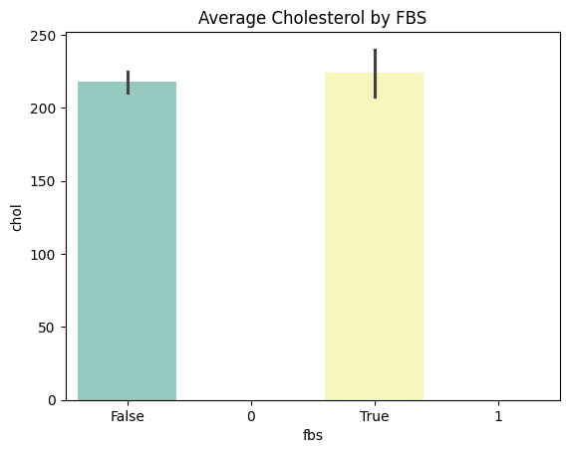
/tmp/ipython-input-1329050775.py:2: FutureWarning: Passing `palette` without assigning `hue` is deprecated and will be removed in v0.14.0. Assign the `x` variable to `hue` and set `legend=False` for the same effect. sns.barplot(x='fbs', y='chol', data=df, palette='Set3')
Chapter 3
Predicting Heart Disease Using Machine Learning
Step :15
STEP 15:
This bar chart illustrates the average cholesterol level (chol) of patients grouped by their fasting blood sugar status (fbs).
The fbs variable indicates whether a patient’s fasting blood sugar level is higher than the clinical threshold (typically >120 mg/dL).

Slide 107
/tmp/ipython-input-1329050775.py:2: FutureWarning: Passing `palette` without assigning `hue` is deprecated and will be removed in v0.14.0. Assign the `x` variable to `hue` and set `legend=False` for the same effect. sns.barplot(x='fbs', y='chol', data=df, palette='Set3')
Chapter 3
Predicting Heart Disease Using Machine Learning
Step :15
STEP 15:
Description of the Chart:
The x-axis represents fasting blood sugar categories:
  False (0) → Normal fasting blood sugar
  True (1) → Elevated fasting blood sugar
The y-axis shows the mean cholesterol level for each group.
The vertical black lines on each bar represent confidence intervals, indicating the variability of cholesterol values within each group.

Slide 108
/tmp/ipython-input-1329050775.py:2: FutureWarning: Passing `palette` without assigning `hue` is deprecated and will be removed in v0.14.0. Assign the `x` variable to `hue` and set `legend=False` for the same effect. sns.barplot(x='fbs', y='chol', data=df, palette='Set3')
Chapter 3
Predicting Heart Disease Using Machine Learning
Step :15
STEP 15:
Key Observations:
Patients with elevated fasting blood sugar (fbs = True) tend to have a slightly higher average cholesterol level compared to those with normal fasting blood sugar.
Although the difference is not extremely large, it suggests a positive association between high blood sugar and higher cholesterol levels.
The overlap in confidence intervals indicates that cholesterol alone may not fully separate the two groups.

Slide 109
/tmp/ipython-input-1329050775.py:2: FutureWarning: Passing `palette` without assigning `hue` is deprecated and will be removed in v0.14.0. Assign the `x` variable to `hue` and set `legend=False` for the same effect. sns.barplot(x='fbs', y='chol', data=df, palette='Set3')
Chapter 3
Predicting Heart Disease Using Machine Learning
Step :15
STEP 15:
Relevance to Classification:
This visualization highlights the relationship between fasting blood sugar and cholesterol, both of which are known cardiovascular risk factors. While neither feature alone may be sufficient to predict heart disease, their combined effect can improve the performance of a classification model such as Random Forest. This supports the use of multiple clinical features together to achieve more accurate heart disease prediction.

Slide 110

Chapter 3
Predicting Heart Disease Using Machine Learning
Step :16
STEP 16: Boolean to Numeric Conversion
Explanation:
Converts Boolean values to numeric form for ML models.

Slide 111
Chapter 3
Predicting Heart Disease Using Machine Learning
Step :16
STEP 16:
countplot shows the number of observations (counts) for each category.
It is used for categorical data only
thal represents thalassemia / stress test result:
  This is a categorical feature
  Values represent different test outcomes
Appears on the x-axi
.

Slide 112
Chapter 3
Predicting Heart Disease Using Machine Learning
Step :16
STEP 16:
hue='sex’ :
sex divides the data into subgroups:
  0 → Female
  1 → Male
Bars are split by sex, shown in different colors
data=df:
df is the DataFrame containing the dataset

Slide 113
Chapter 3
Predicting Heart Disease Using Machine Learning
Step :16
STEP 16:
palette='Set2’:
  Specifies the color scheme
  Improves readability and presentation quality

Slide 114
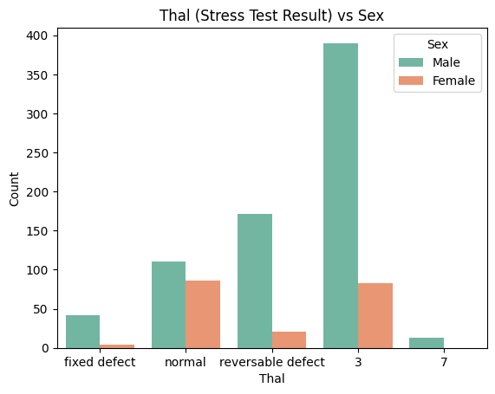
Chapter 3
Predicting Heart Disease Using Machine Learning
Step :16
STEP 16:

Slide 115

Chapter 3
Predicting Heart Disease Using Machine Learning
Step :16
STEP 16:
Adding a Title :
  Adds a descriptive title to the graph
  Clearly explains what the visualization represents
Titles are essential in academic plots

Slide 116

Chapter 3
Predicting Heart Disease Using Machine Learning
Step :16
STEP 16:
Labeling the Axes:
Explanation:
  X-axis → Thal categories
  Y-axis → Number of patients in each category
Axis labels improve interpretability.

Slide 117

Chapter 3
Predicting Heart Disease Using Machine Learning
Step :16
STEP 16:
Adding a Legend:
Explanation:
  Displays a legend showing:
  Male vs Female categories
Helps distinguish the colored bars

Slide 118

Chapter 3
Predicting Heart Disease Using Machine Learning
Step :16
STEP 16:
Displaying the Plot :
Explanation:
  Renders the plot on the screen
  Without this line, the graph may not appear

Slide 119
Chapter 3
Predicting Heart Disease Using Machine Learning
Step :17
STEP 17: Correlation Heatmap
.
Explanation:
Shows correlation between important numerical features.
Helps identify strong relationships.
Purpose:
Feature understanding before classification

Slide 120
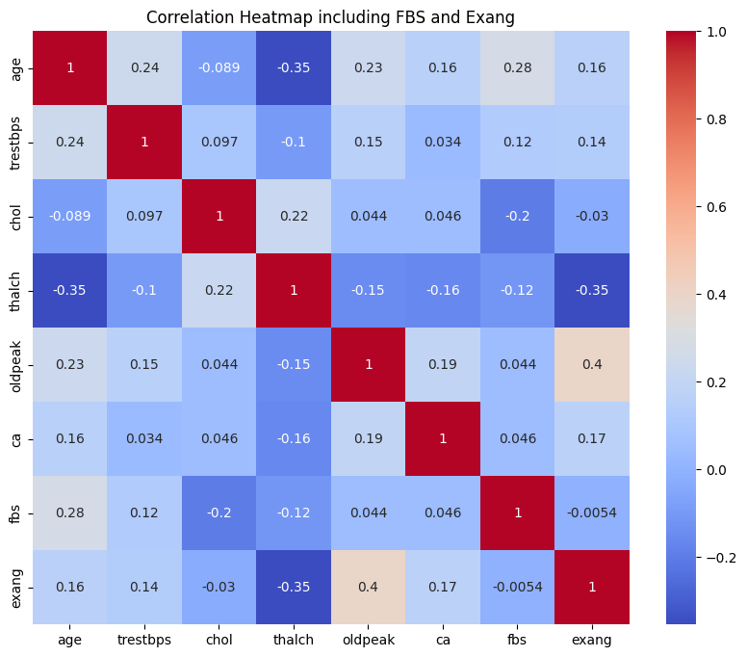
Chapter 3
Predicting Heart Disease Using Machine Learning
Step :17
STEP 17: Correlation Heatmap
.

Slide 121
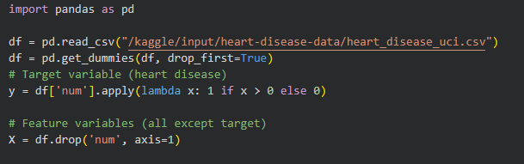
Chapter 3
Predicting Heart Disease Using Machine Learning
Step :18
STEP 18: STEP 18: Define Features and Target (Classification Setup)
What this considers:
y → class label (0 = no disease, 1 = disease)
X → medical features used for prediction

Slide 122
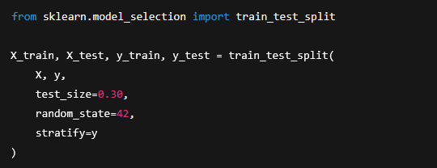
Chapter 3
Predicting Heart Disease Using Machine Learning
Step :18
STEP 19: Train–Test Split
What this considers:
70% training data
30% testing data
stratify=y keeps class balance
Purpose:To evaluate the model on unseen data

Slide 123
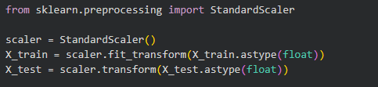
Chapter 3
Predicting Heart Disease Using Machine Learning
Step :20
STEP 20: Feature Scaling (Recommended)
What this considers:
Different feature scales (e.g., age vs cholesterol)
Improves model stability

Slide 124
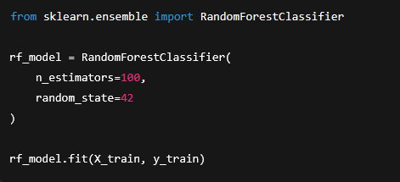
Chapter 3
Predicting Heart Disease Using Machine Learning
Step :21
STEP 21: Model Training (Random Forest Classifier)
What this considers:
Ensemble learning
Reduces overfitting
Suitable for medical classification
This is the actual classification model.

Slide 125

Chapter 3
Predicting Heart Disease Using Machine Learning
Step :22
STEP 22: Prediction
What this does:
Predicts heart disease class for test patients

Slide 126
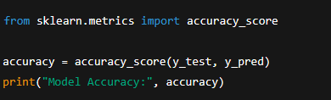
Chapter 3
Predicting Heart Disease Using Machine Learning
Step :22
STEP 23: Model Evaluation
Accuracy:
Accuracy shows how many predictions were correct
Model Accuracy: 0.8840579710144928

Slide 127
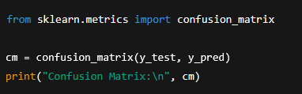
Chapter 3
Predicting Heart Disease Using Machine Learning
Step :22
STEP 23: Model Evaluation
Confusion Matrix:
Explains:
True Positives-True Negatives-False Positives-False Negatives

Slide 128
Chapter 3
Predicting Heart Disease Using Machine Learning
Step :22
STEP 23: Model Evaluation
Confusion Matrix:
Confusion Matrix: [[104 19]
[ 13 140]]

Slide 129

Chapter 3
Predicting Heart Disease Using Machine Learning
Step :22
STEP 23: Model Evaluation
Classification Report (Recommended)
Includes:
Precision
Recall
F1-score

Slide 130
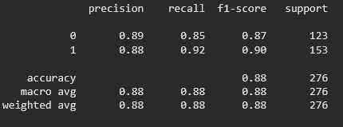
Chapter 3
Predicting Heart Disease Using Machine Learning
Step :22
STEP 23: Model Evaluation
Classification Report (Recommended)

Slide 131
Chapter 4
Summery,conclusions and
recommendations

Slide 132
Chapter 4
Advantages:
Mining Based Methods are cost-effective and efficient
Helps in identifying criminal suspects
Helps in predicting the risk of diseases
Helps Banks and Financial Institutions to identify defaulters so that they may approve Cards, Loan, etc.

Slide 133
Chapter 4
Disadvantages:
Privacy:
When the data is either are chances that a company may give some information about their customers to other vendors or use this information for their profit.
Accuracy Problem: Selection of Accurate model must be there in order to get the best accuracy and result.

Slide 134
Chapter 4
APPLICATIONS:
Marketing and Retailing
Manufacturing
Telecommunication Industry
Intrusion Detection
Education System
Fraud Detection

Slide 135
Chapter 5
References

Slide 136
Chapter 5
1.GeeksforGeeks. (n.d.). Classification in data mining. https://www.geeksforgeeks.org/machine-learning/classification-in-data-mining/
2. Waskom, M. L. (2021). Seaborn: Statistical data visualization. Journal of Open Source Software, 6(60), 3021.
https://doi.org/10.21105/joss.03021
3. Hunter, J. D. (2007). Matplotlib: A 2D graphics environment. Computing in Science & Engineering, 9(3), 90–95.
https://doi.org/10.1109/MCSE.2007.55
4. Kaggle. (2024). Kaggle: Your machine learning and data science community.
https://www.kaggle.com

Slide 137
Chapter 5
5. Redwan Karim Sony. (2020). Heart disease dataset [Data set]. Kaggle.
https://www.kaggle.com/datasets/redwankarimsony/heart-disease-data
6. OpenAI. (2023). ChatGPT (GPT-4 version) [Large language model]. https://chat.openai.com/
7. NumPy Developers. (n.d.). What is NumPy? NumPy documentation. https://numpy.org/doc/stable/user/whatisnumpy.html
8. GeeksforGeeks. (2025, December 5). Pandas introduction. GeeksforGeeks. https://www.geeksforgeeks.org/pandas/introduction-to-pandas-in-python

Slide 138
Chapter 5
9. Pozo Ramos, L. (2025, July 16). os | Python Standard Library (Reference). Real Python. https://realpython.com/ref/stdlib/os/
10. Agarwal, G. (2025, April 15). Introduction to Matplotlib using Python for beginners. Analytics Vidhya.
https://www.analyticsvidhya.com/blog/2021/10/introduction-to-matplotlib-using-python-for-beginners/ Analytics Vidhya

