Slide 1
HANDS-ON WORKSHOP - 3 DAYS
Power BI + Microsoft Fabric
From Tableau to a governed, AI-ready analytics estate
For the Schwab analytics team - learn by rebuilding a familiar analysis end to end
Highlights: Copilot in Power BI - GitHub Copilot + Power BI MCP servers - Fabric Data Agent

Slide 2
WELCOME
How these three days work
Teach, then do
Coached breakouts
Short teaching blocks in the room, then you build it yourself in a breakout. Every concept has a matching hands-on lab.
Small groups at each table with a Microsoft specialist coaching. Bring questions from your real Tableau work.
Built for Tableau users
One running example
No Power BI experience assumed. We map every idea back to what you already know in Tableau.
We rebuild a familiar public housing-market analysis (Redfin-style) end to end, so the skills transfer to your own reports.
10 to 30 people - conference room with breakout tables - laptops for the hands-on labs
Microsoft x Schwab | Power BI + Fabric workshop
02 / 29
Notes:
Set expectations: this is a learning session, not a pitch. We teach a concept, then you do it. Coaches float. The goal by end of day 3 is that you can migrate one of your own Tableau workbooks and see the value of Power BI + Fabric.

Slide 3
AGENDA
Three days, one journey
Day 1
Day 2
Day 3
Foundations & Best Practices
Hands-On Migration Lab
Showcase & Next Steps
From Tableau to Power BI: how it maps
Get the data into OneLake
GitHub Copilot + Power BI MCP servers
Data modeling: the star schema
Build the shared Direct Lake model
Ask your data: Fabric Data Agent
Visualization design best practices
Build reports faster with Copilot
Showcase & reusable patterns
Governance & migration approaches
Migrate a real workbook, end to end
Adoption roadmap & commitments
Microsoft x Schwab | Power BI + Fabric workshop
03 / 29

Slide 4
WHY NOW
The shift we are making together
Many extracts
->
One governed copy
Sources land once in OneLake; every report reads the same data. No more one .hyper per workbook.
Logic in each workbook
->
Measures defined once
Business logic lives in one shared semantic model, so every number agrees.
Refresh windows
->
Direct Lake, always current
No import and no scheduled refresh; reports read live from OneLake.
Opaque binaries
->
Git + CI/CD (PBIP)
Models and reports are plain text you can review, diff, and promote like code.
Manual authoring
->
Copilot + agents
Copilot builds visuals and DAX; the Data Agent and MCP servers answer questions on your model.
Microsoft x Schwab | Power BI + Fabric workshop
04 / 29
Notes:
This is the story arc of the whole workshop. Left is the Tableau-at-scale pain; right is where Fabric + Power BI take you. Each row maps to labs later in the three days.

Slide 5
YOU ALREADY KNOW MOST OF THIS
Your Tableau skills translate
In Tableau | In Power BI / Fabric | Note
Worksheet | Report visual | Same idea, one canvas holds many
Dashboard | Report page | A Power BI dashboard is a different Service feature
Published data source | Shared semantic model | Certify it once, reuse everywhere
Extract (.hyper) | Import or Direct Lake | Direct Lake needs no refresh
Calculated field / LOD | DAX measure with CALCULATE | Context instead of FIXED / INCLUDE
Tableau Prep | Dataflow Gen2 or notebook | Low-code or Spark, your choice
Row-level security | Power BI RLS | Carries through to Copilot and agents
Full mapping in reference/tableau-to-powerbi.md
Microsoft x Schwab | Power BI + Fabric workshop
05 / 29

Slide 6
DAY 1
Foundations & Best Practices
Architecture, data modeling, visualization design, governance, and migration approaches

Slide 7
DAY 1 - LAB 1
From Tableau to Power BI: the mindset
Model first, then visualize
Measures once, not per workbook
Tableau often starts at the sheet. Power BI is at its best when you shape a good model first, then reports come easily.
Define YoY, months of supply, and price metrics once in the shared model. Every report inherits them.
Report-based, not extract-based
A dashboard is not a dashboard
Thin reports connect live to one governed model. No copy of the data travels with each report.
A Tableau dashboard maps to a Power BI report page. Power BI 'dashboards' are a separate Service pin board.
Microsoft x Schwab | Power BI + Fabric workshop
07 / 29

Slide 8
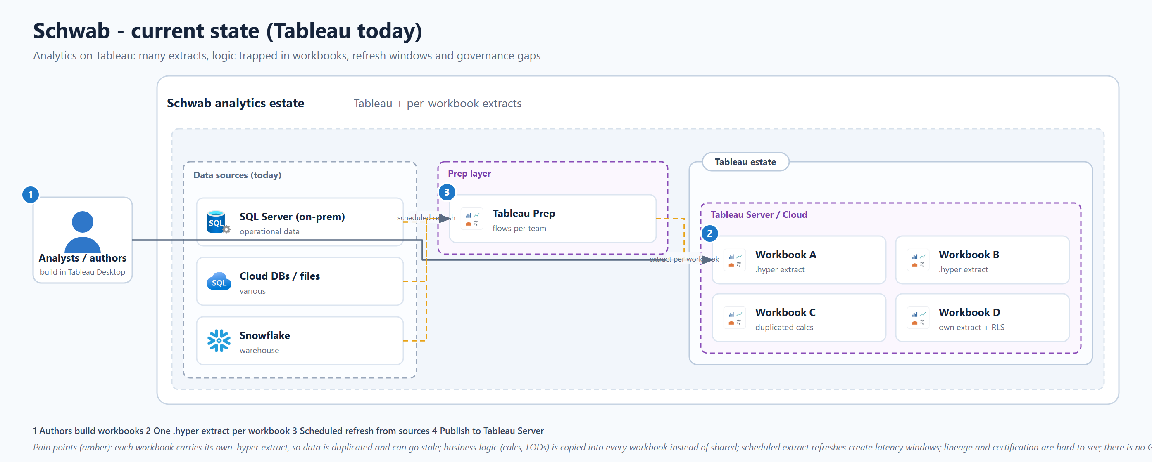
DAY 1 - WHERE A TABLEAU ESTATE IS TODAY
Current state: many extracts, scattered logic
Each workbook carries its own extract and its own copy of the logic. Freshness, storage, and 'which number is right' all get harder as you scale.
Microsoft x Schwab | Power BI + Fabric workshop
08 / 29

Slide 9
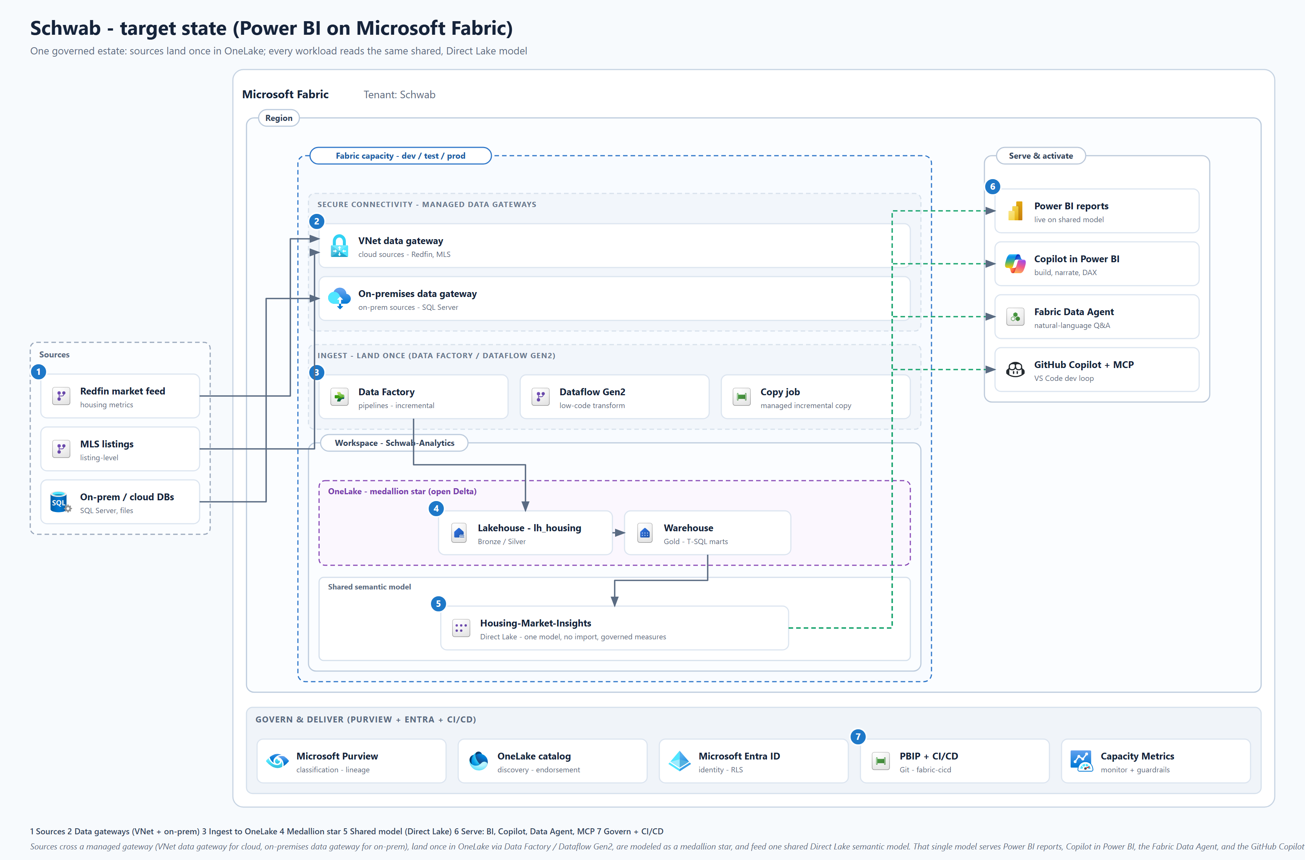
DAY 1 - WHERE WE ARE GOING
Target state: land once on OneLake, serve many
One shared Direct Lake model feeds Power BI, Copilot, the Data Agent, and the GitHub Copilot + MCP developer loop, all governed by Purview + Entra + CI/CD.
Microsoft x Schwab | Power BI + Fabric workshop
09 / 29
Notes:
This is the reference architecture for the whole workshop. Come back to it after each lab: Lab 5 builds the ingest arrows, Lab 6 the shared model, Lab 7 Copilot, Lab 9 the MCP loop, Lab 10 the Data Agent.

Slide 10
DAY 1 - LAB 2 - THE BIGGEST QUALITY LEVER
Data modeling: from a wide extract to a star
Tableau way: one wide extract
Power BI way: a star schema
dim_region
dim_date
market_tracker
(region, month, type, price, sales, inventory, ...)
all columns in one flat table
fact_home_sales
dim_property_type
Repeated values, ambiguous grain, slower and harder to keep consistent.
One fact, clean dimensions. Faster, self-explaining, and exactly what Copilot and the Data Agent need.
Microsoft x Schwab | Power BI + Fabric workshop
10 / 29
Notes:
The single highest-impact change for a Tableau team. A star schema is the shape Power BI, DAX, and AI features all expect. Reference: learn.microsoft.com/power-bi/guidance/star-schema.

Slide 11
DAY 1 - STORAGE MODES
Direct Lake: Import speed, live freshness
 | Import | DirectQuery | Direct Lake
Data copied into the model | Yes | No | No
Scheduled refresh needed | Yes | No | No
Speed | Fast | Depends on source | Fast (in-memory)
Freshness | As of last refresh | Live | Live from OneLake
Closest Tableau analog | Extract | Live connection | Best of both
Direct Lake loads OneLake Delta tables into memory on demand: no import, no refresh window. Reference: reference/direct-lake.md
Microsoft x Schwab | Power BI + Fabric workshop
11 / 29

Slide 12
DAY 1 - LAB 3
Visualization design that lands
Do
Avoid
+
Start from the question, not the chart
-
A wall of KPIs with no story
+
Fewer, clearer visuals per page
-
Ten colors competing for attention
+
Consistent theme and number formats
-
Dual axes that mislead
+
Small multiples over one busy chart
-
Recreating a print report pixel for pixel
+
Tooltips, drill-through, bookmarks for depth
-
Hard-coded values instead of measures
+
Design for accessibility from the start
Microsoft x Schwab | Power BI + Fabric workshop
12 / 29

Slide 13
DAY 1 - LAB 4
Governance you can actually run
Workspaces & roles
Admin, Member, Contributor, Viewer. Separate dev, test, and prod so an experiment never disturbs a live report.
Endorsement
Promote and then Certify the shared model so people find and trust the right one, instead of copying yet another.
Sensitivity labels
Microsoft Information Protection labels flow with the data into exports, so classification travels.
Deployment pipelines
Promote content dev to test to prod with rules, paired with PBIP + CI/CD for real change control.
Microsoft x Schwab | Power BI + Fabric workshop
13 / 29

Slide 14
DAY 1 - MIGRATION APPROACHES
How to migrate without boiling the ocean
1
2
3
4
5
Inventory
Prioritize
Decide
Prove it
Adopt
List the Tableau workbooks, owners, sources, and extracts.
->
Score value x complexity. Start where the payoff is high and the risk is low.
->
Rebuild the important ones well; re-platform simple ones fast. Model-based over report-based.
->
Run a scoped POC with clear success criteria and numbers that tie out.
->
Cut over, certify the model, and enable authors. Repeat by wave.
Worksheet in governance/migration-assessment-worksheet.md - approach in reference/migration-approaches.md
Microsoft x Schwab | Power BI + Fabric workshop
14 / 29

Slide 15
DAY 2
Hands-On Migration Lab
Guided exercises, real-world use cases, report development, and coaching from Microsoft specialists

Slide 16
DAY 2 - OUR RUNNING EXAMPLE
A familiar dataset: housing market (Redfin-style)
Tableau users know the public Redfin housing data well, so we rebuild it here. The sample is synthetic: 12 US metros, 24 months, 4 property types. You will model it, report on it, and ask it questions.
Workshop sample data (synthetic), homes sold by metro, latest month. Regenerate with data/generate_data.py
Microsoft x Schwab | Power BI + Fabric workshop
16 / 29

Slide 17
DAY 2 - LAB 5
Get the data into OneLake
Sources
Gateways
Ingest
Medallion
Redfin feed, MLS listings, on-prem SQL
->
VNet gateway for cloud, on-prem gateway for on-prem
->
Data Factory pipelines or Dataflow Gen2
->
Bronze raw, Silver star, Gold marts
Best practice: always cross a managed gateway. The VNet data gateway secures cloud sources; the on-premises data gateway secures on-prem. Land raw once, then transform in OneLake.
Microsoft x Schwab | Power BI + Fabric workshop
17 / 29

Slide 18
DAY 2 - LAB 6
One shared model, measures defined once
Housing-Market-Insights
Core measures (defined once)
Direct Lake on the gold tables. Star schema. Endorsed and reused by every report.
Homes Sold = SUM(fact[homes_sold])
Model as a star, mark the date table
Avg Median Sale Price = AVERAGE(...)
Hide keys, use friendly names
Months of Supply = DIVIDE([Inventory],[Homes Sold])
Prep for AI: schema, instructions, verified answers
Homes Sold YoY % = time intelligence
Promote, then Certify
Sold Above List % = AVERAGE(...)
Every report inherits these. No more redefining YoY in each workbook.
Microsoft x Schwab | Power BI + Fabric workshop
18 / 29

Slide 19
DAY 2 - LAB 7 - HIGHLIGHT
Copilot in Power BI
Build report pages
Narrate the data
Describe the page you want; Copilot lays out the visuals.
Generate a summary visual that explains what the numbers say.
Write DAX
Describe the model
Draft and explain DAX measures and queries in the DAX query view.
Auto-generate measure descriptions that also help humans.
The catch worth repeating: Copilot is only as good as your model. A clean star, friendly names, and measure descriptions are what make Copilot answers reliable.
Notes:
Demo live if possible. Emphasize the dependency on model quality, which ties back to Day 1 modeling. Reference: learn.microsoft.com/power-bi/create-reports/copilot-introduction.

Slide 20
DAY 2 - LAB 8 - COACHED BREAKOUT
Migrate a real workbook, end to end
Take a 3-sheet Tableau housing workbook (price trends, competitiveness, inventory), map the extract to the model, rebuild each sheet as a report visual, and check that the numbers tie out.
1
Map extract fields to model fields
2
Rebuild each sheet as a visual
3
Validate totals against the source
4
Add a second use case from MLS listings
Workshop sample data: median sale price trend, Seattle (rebuild of a Tableau sheet)
Microsoft x Schwab | Power BI + Fabric workshop
20 / 29

Slide 21
DAY 3
Showcase & Next Steps
Solution demonstrations, lessons learned, reusable patterns, and adoption recommendations

Slide 22
DAY 3 - LAB 9 - HIGHLIGHT
GitHub Copilot + Power BI MCP servers
MCP lets GitHub Copilot in VS Code talk to Power BI through tools. Host = VS Code, Client = Copilot, Server = Power BI. Two servers, in Public Preview:
Remote MCP server
Local MCP server
-
Fabric-hosted, no install
-
Runs in VS Code or Node 20+ (npx)
-
Entra ID or Service Principal auth
-
stdio transport
-
For querying + insights on existing models
-
For building + modifying models in code
-
Tools: Execute Query (DAX, honors RLS), Get Semantic Model Schema, Get Report Metadata
-
Tools: metadata read/write, query, database operations
Plus PBIP + Git + CI/CD (fabric-cicd): your model and reports become reviewable, promotable code. Apply least-privilege Fabric RBAC.
Notes:
This is the developer-experience wow moment for a technical audience. Remote = talk to data; Local = build the model in code. Reference: learn.microsoft.com/power-bi/developer/mcp/mcp-servers-overview.

Slide 23
DAY 3 - LAB 10 - HIGHLIGHT
Ask your data: the Fabric Data Agent
A natural-language agent grounded on your certified model
Try asking
"Which metros sold the most homes last month?"
Grounded on Housing-Market-Insights
Uses the Prep-for-AI metadata from Lab 6
"How did median price change year over year?"
Honors row-level security
"Where is inventory tightest right now?"
The natural next step from Tableau Ask Data
Microsoft x Schwab | Power BI + Fabric workshop
23 / 29

Slide 24
DAY 3 - LAB 11
What you take home: reusable patterns
Certified shared model
Measure library
Template report
One governed source of truth per subject area.
Business logic defined once, reused everywhere.
A themed starting point so new reports look right.
Deployment pipeline
MCP developer loop
AI-ready metadata
Dev to test to prod with PBIP + CI/CD.
GitHub Copilot builds and queries the model.
Prep-for-AI so Copilot and agents stay accurate.
Microsoft x Schwab | Power BI + Fabric workshop
24 / 29

Slide 25
DAY 3 - ADOPTION
A roadmap you can start on Monday
Crawl
Walk
Run
0 to 30 days
30 to 60 days
60 to 90 days
+
Stand up dev/test/prod workspaces
+
Onboard a first wave of authors
+
Scale by workbook wave
+
Migrate one high-value workbook
+
Set governance + naming standards
+
Enable Copilot + Data Agent broadly
+
Certify the first shared model
+
Turn on PBIP + CI/CD
+
Stand up a Center of Excellence
Microsoft x Schwab | Power BI + Fabric workshop
25 / 29

Slide 26
THE VALUE
Why Power BI + Microsoft Fabric
One governed truth
Lower total cost
Land once, model once, and every team reads the same certified numbers.
One capacity for BI and AI, Direct Lake instead of extract sprawl, no per-workbook refresh.
AI built in
Enterprise governance
Copilot, the Data Agent, and MCP work directly on your model, no bolt-on.
Purview lineage, Entra + RLS, sensitivity labels, and CI/CD as standard.
Faster delivery
Skills that transfer
Copilot drafts visuals and DAX; PBIP + pipelines ship changes safely.
Your Tableau instincts map cleanly; the team is productive quickly.

Slide 27
OVER TO YOU
One low-risk first step
Pick one high-value Tableau workbook and migrate it in a scoped POC. Two to three weeks, clear success criteria, numbers that tie out. We build it with you.
1
Scope
2
Build
3
Decide
Choose the workbook + success criteria together
Model, report, Copilot, and validate against source
Review results and plan the first migration wave
Microsoft x Schwab | Power BI + Fabric workshop
27 / 29

Slide 28
TAKE IT FURTHER
Resources and where things live
The lab repo
Every hands-on lab, the data generator, notebooks, and reference docs. Yours to keep and rerun.
reference/tableau-to-powerbi.md
The full concept mapping from Tableau.
reference/mcp-servers.md
The Power BI MCP servers, remote and local.
reference/direct-lake.md
Storage modes and when to use Direct Lake.
governance/adoption-roadmap.md
The 30-60-90 plan and Center of Excellence.
reference/sources.md
Every Microsoft Learn page this workshop grounds on.
Microsoft x Schwab | Power BI + Fabric workshop
28 / 29

Slide 29
Thank you
Let us build your first migration together.
Microsoft x Schwab - Power BI + Microsoft Fabric workshop

