Slide 1
ALIQ
Abstract Language Integrated Query

Slide 2
Write your logic once, use any system
Logic.dll
Future Systems
Local InMemory Back-End
Event-based Systems
Big-Data Systems
Hadoop
COSMOS
Write your own
Azure ALIQ System

Slide 3
Compare To LINQ
Late data binding
Describes logic on unordered multi-sets (IEnumerable, arrays, files, DB tables, events, etc.).
LINQ | ALIQ
IEnumerable<T> | Bag<T>
IQueryable<T>
IObservable<T>
…

Slide 4
1. Describing the business logic
Business logic does not care about the data provider
We are freed up to define the logic in advance with the presumption that all necessary methods will be implemented by data provider
Define and deploy! The joy!

Slide 5
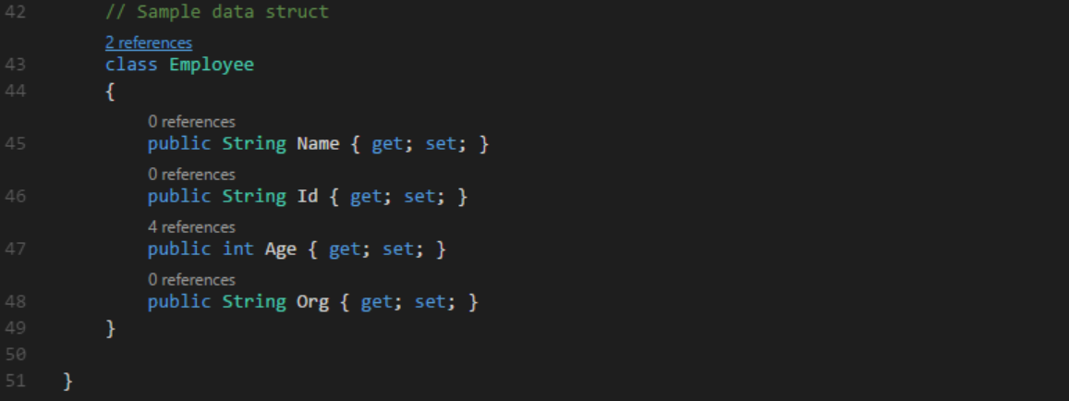
1. Describing the business logic

Slide 6
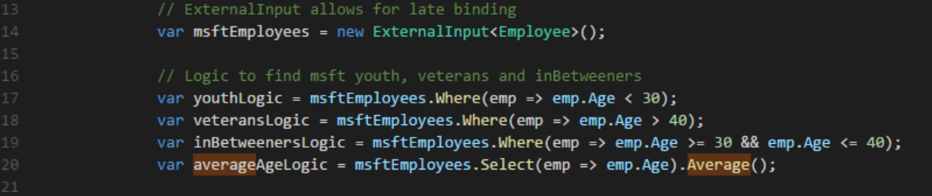
1. Describing business logic

Slide 7
2. Adapter layer
Transforms ALIQ operations to corresponding optimal data requests to different data providers/backends.
Adapter layers can service more than one type of data providers/backends if they in turn expose data via a common interface

Slide 8
2. Set up adapter layer

Slide 9
3. Data Binding
Finally, specify the data provider/backend
We can specify multiple sources of different kinds as long as the adapter can work with it

Slide 10
3. Binding data

Slide 11
4. Execute!
Just send the business logic to the adapter and get the results!

Slide 12

4. Execute!

