Slide 1


RoboMagic
Mobile Manipulator Engineering Report
ROBOTICS TEAM 2026

Slide 2






MULTI-DISCIPLINARY TEAM
Mechanical
Hardware
Software
Moemen Abdelmonem Haneen Mohamed
Mohamed Maghawry Saeed Ayman
Roaa Yasser Ali Rabia

Slide 3
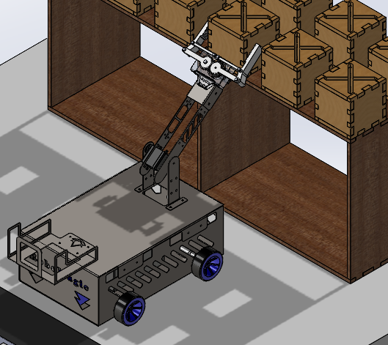

PROJECT EXECUTIVE SUMMARY
This report details the RoboMagic architecture—a high-performance mobile manipulator designed for autonomous navigation and manual handling tasks.
→
Rigid Chassis: 1mm Galvanized Steel Body.
→
Dual Control: Bluetooth + Autonomous Modes.
→
High Torque: Quad-DC Drivetrain ($8.8 \text{ kgf}\cdot\text{cm}$).
Design Priority
The platform prioritizes structural integrity and precise actuation, optimized for a total mass of ~4.7 kg and capable of traversing 20° inclines.
→
2-DOF Manipulation: Servo-driven arm and gripper.

Slide 4
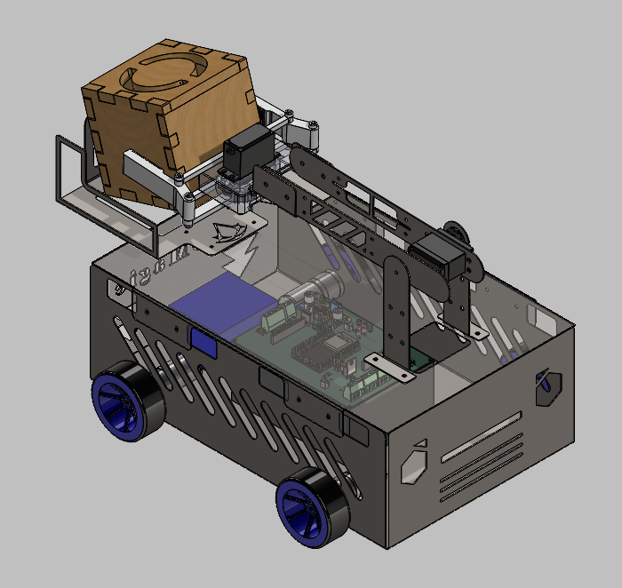
LOCOMOTION & DRIVETRAIN
High-Torque Performance
The robot utilizes a 4-Wheel Drive (4WD) tank configuration for maximum traction.
→
Motors: 4x JGA25-370 DC Motors.
→
Rated Speed: 250 RPM.
→
Stall Torque: 8.8 kgf.cm
→
Wheels: 65mm diameter coupled to shafts.
"Skid-steering logic allows for zero-radius turning capacity."

Slide 5
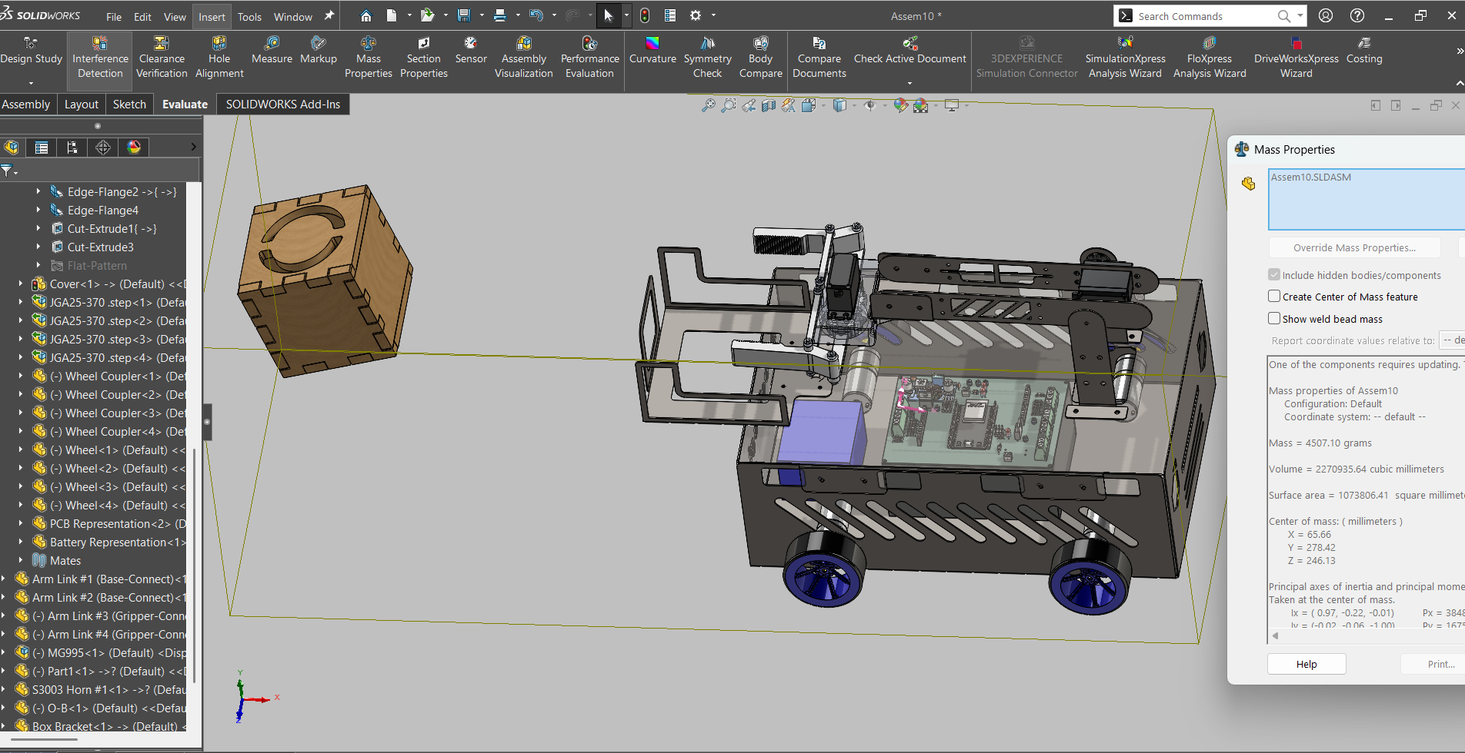
STRUCTURAL FRAMEWORK
Industrial Grade Body
The chassis serves as a robust shield, protecting internal electronics from environmental factors.
→
Material: 1mm Galvanized Steel Sheet.
→
Fabrication: Plasma cutting & bending.
→
Safety: Edges filleted to prevent wire chafing.
→
Rigidity: High torsional stiffness.

Slide 6
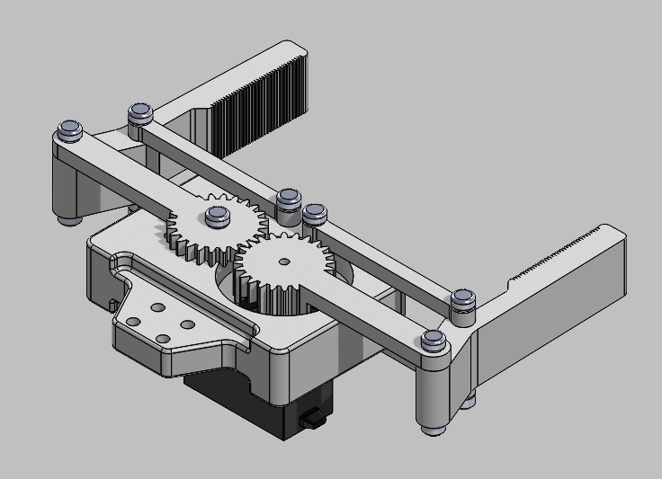

2-DOF MANIPULATOR DESIGN
Base Rotation & Grip
A modular attachment providing 360 degree sweep and parallel gripping capability.
Rotation: MG996R High-Torque Servo.
Gripper: S3003 Standard Servo.
Jaws are optimized with 3D-printed components (PLA/PETG) for weight savings at the end-effector.

Slide 7
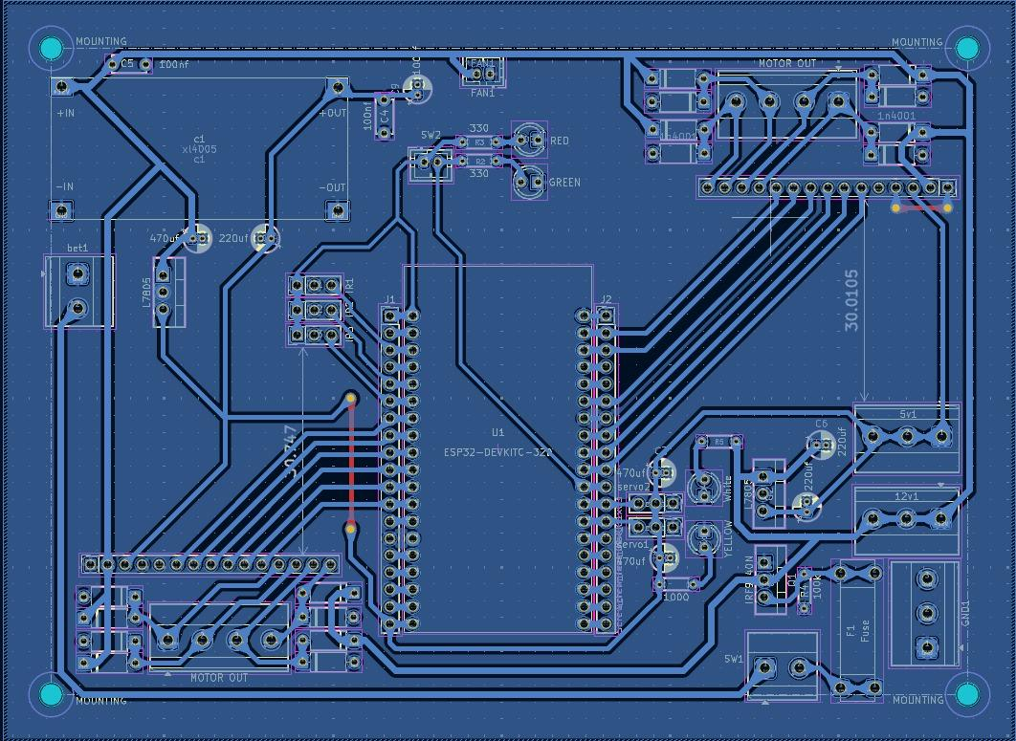
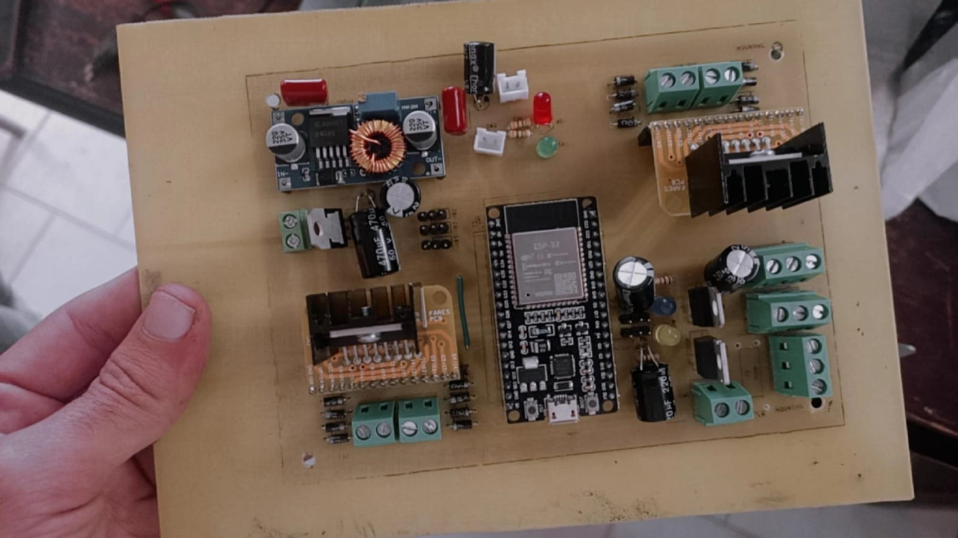
HARDWARE: POWER MANAGEMENT
→
Energy Reservoir: 12V 6000mAh Battery Pack providing 72Wh. Allows 1.5–3 hours of continuous uptime.
→
Dual-Rail Architecture: Segregated 12V rail for motor noise isolation and a regulated 5V rail for sensitive logic.
→
XL4005 Buck Converter: Step-down regulation rated at 5A to handle MG996R stall spikes ($2.5\text{A}$) without browning out the ESP32.
→
Safety Integration: 10A inline fuse and common ground bus bars for signal integrity.

Slide 8
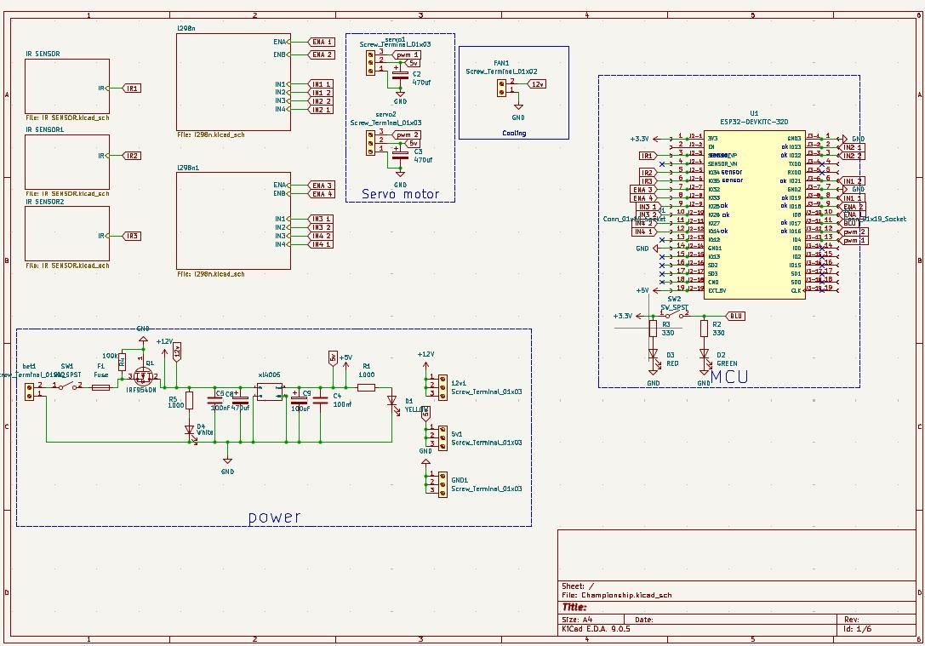

HARDWARE: ESP32 CONTROL CENTER
The Computational Brain
Utilizing the ESP32 (38-pin DIP) for high GPIO density and integrated wireless capabilities.
→
Actuation: Dual L298N H-Bridge modules for skid-steer control.
→
Signals: 6 PWM channels (4 for DC motors, 2 for Servos).
→
Thermals: Heat sinks thermally coupled to the steel chassis.

Slide 9






SOFTWARE: DUAL OPERATING MODES
Autonomous
Manual
Protection
Line following logic using 3x LM393 IR Sensors. Active-LOW path tracking.
RC Car Bluetooth Application Differential steering via Left RC Car Bluetooth App mapping.
Deadzone management and software-defined servo angle limits.

Slide 10

LINE FOLLOWING LOGIC
Line-Lost Recovery
Sensor States
When all sensors read HIGH, the robot activates "Memory Logic."
Middle LOW: Forward Drive.
Left LOW: Veering Right correction.
→
Stores last known turn direction.
Right LOW: Veering Left correction.
Two LOW: Sharp turn/Spin correction.
→
Initiates localized spin for a timed duration.
→
Auto-stop safety trigger if line is not re-acquired.

Slide 11
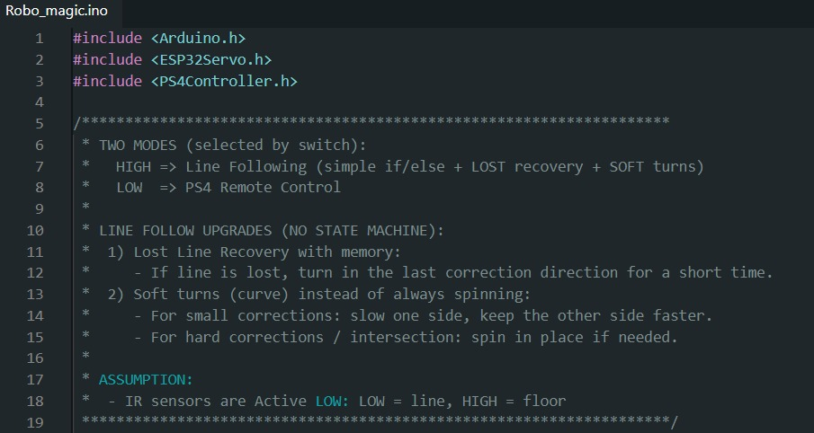

Slide 12
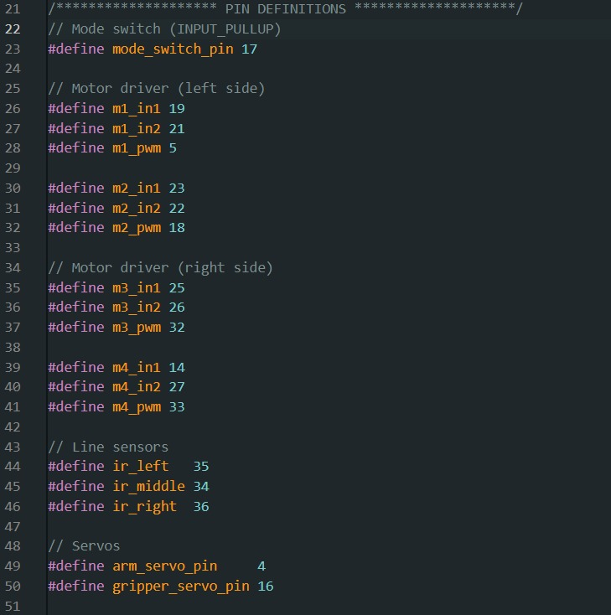

Slide 13
INVESTMENT & BILL OF MATERIALS
Component | Qty | Estimated Cost (LE)
DC Motors JGA25-370 | 4 | 1,200
Battery Pack 12V 6000mAh | 1 | 900
Sheet Metal Body (1mm Steel) | 1 | 550
ESP32 38-pin DIP | 1 | 350
GRAND TOTAL | -- | ~4,800 LE

