Slide 1
DNAdvise
Healthcare sector

Slide 2
STATISTICS
71%
80%
17.9 million annually
Deaths attributed to lifestyle disease
Cardiovascular
Diseases
(Most NCD deaths)
Source: WHO
Source: CDC

Slide 3
Introduction •
DNAdvise is a revolutionary concept merging genetic data and AI to offer personalized health advice. By analyzing saliva samples, it provides insights into disease risks and generates customized lifestyle recommendations for proactive well-being.

Slide 4
• Problem
Current healthcare approaches lack personalized guidance, leaving individuals without tailored strategies to manage their health proactively.
Individuals face challenges in understanding their unique genetic makeup and translating this information into actionable lifestyle changes.
There is a need for innovative solutions that bridge the gap in personalized healthcare, providing individuals with the tools and support they need to optimize their health and well-being.

Slide 5
• Work Route
Take Saliva samples
Data received from laboratory
Collect samples and variables
Data is received and sent to AI along with variables
Laboratory analysis
Result is Generated by AI as personalized lifestyle modifications

Slide 6
•Key Partnerships
Healthcare Providers
Insurance Companies
Partnering with clinics, hospitals, and healthcare professionals to offer GeneLifestyle AI as a value-added service to their patients.
Wellness Organizations
Research Institutions
Forming partnerships with companies and organizations focused on promoting health and wellness to reach new customer segments and expand market presence.

Slide 7
How much do you think (23 and me)’s net worth is ?

Slide 8
$ 6 Billion

Slide 9
Current healthcare approaches lack personalized guidance, leaving individuals without tailored strategies to manage their health proactively.
Individuals face challenges in understanding their unique genetic makeup and translating this information into actionable lifestyle changes.
There is a need for innovative solutions that bridge the gap in personalized healthcare, providing individuals with the tools and support they need to optimize their health and well-being.

Slide 10
• Revenue Model
01
02
03
04
Genetic Testing Kits
In App Advertisements
Subscription
Genetic Counseling Services

Slide 11
•Marketing and sales strategies
01
03
02
04
social media
partnerships
with healthcare professionals
digital channels
advertisements
Billboards, etc.

Slide 12
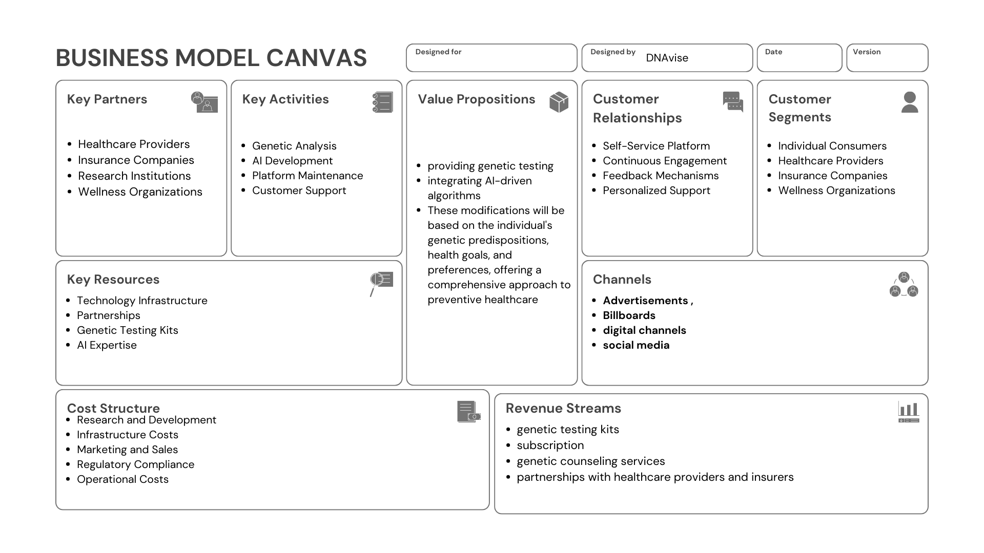

Slide 13
• Results analysis
Alzheimer's Disease:
Genetic Variants
APOE
TREM2
Lifestyle modification example:
Cognitive stimulation: Journaling, thought recording, Breathing techniques.
Healthy diet: rich in omega 3 and fatty acids.
PSEN1
Cytosine

Slide 14
DEMO

Slide 15
DEMO

Slide 16
UI Demo

Slide 17
• Our team
Ali Hamdan
Yara haddad
Khalid amoura
AI & Data Science
pharma-D
Network Engineering
Nahla bader
Hazim Musallam
Seba tamari
Data science and AI
Genetic engineer and researcher
Data science and AI

Slide 18
• Research resources
https://www.bing.com/search?pglt=41&q=un+healthy+life+style+deseade&cvid=62282ad6eed947eaad9fc44870fceba5&gs_lcrp=EgZjaHJvbWUyBggAEEUYOTIGCAEQABhAMgYIAhAAGEAyBggDEAAYQDIGCAQQABhAMgYIBRAAGEAyBggGEAAYQDIGCAcQABhAMgYICBAAGEDSAQkxNjE2NWowajGoAgCwAgA&FORM=ANNTA1&PC=U531
Lifestyle disease - Wikipedia
Factors Associated with an Unhealthy Lifestyle among Adults in Riyadh City, Saudi Arabia - PMC (nih.gov)

Slide 19
Thanks!

