Slide 1
A Computational Analysis of Doomerism

Slide 2
Motivation for Project
Youth Emotional Loneliness
  Multiple surveys and government statistics
    youth aged 15-24 are the loneliest demographic^{1, 2, 3}
  Loneliness ministers in the UK and Japan
[1] Statistics Canada. Canadian Social Survey: Loneliness in Canada. Survery. 2021.
[2] Christina R. Victor and Keming Yang. “The prevalence of loneliness among adults: A case
study of the united kingdom”. In: The Journal of Psychology 146.1-2 (2012), pp. 85–104.
[3] The Anatomy of Loneliness - Who feels lonely? the results of the world’s largest loneliness
Study. 2018.

Slide 3
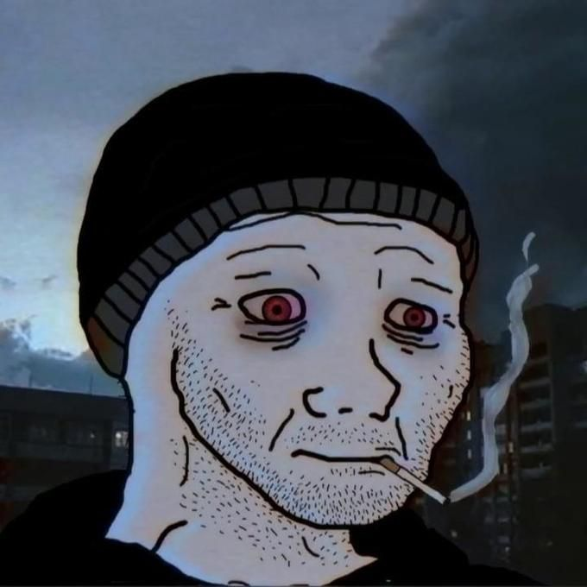
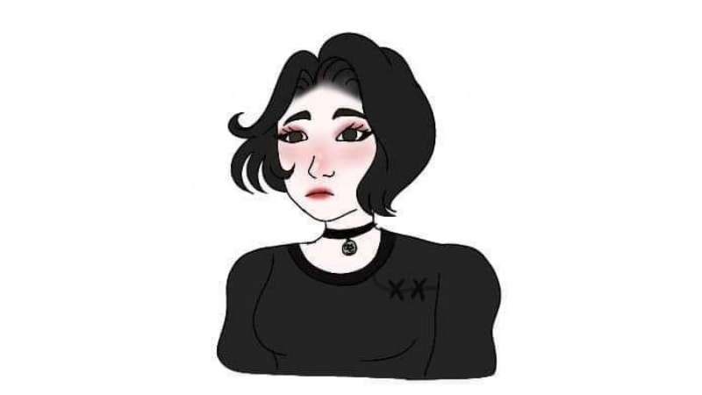
Cultural Icon Becoming Viral
Virality of a new doomer icon is culturally significant.
Young people are identifying with this archetype.
Dark, nihilistic, doomed existence, collapse, powerless¹
[1] Karel Němeček. “Internet memes as reservoirs of meaning: Interpreting the Doomer”. Bachelor’s Thesis. Masaryk University, 2020.

Slide 4
Significance
You have the loneliest youth demographic.
They are identifying with a very dark icon.
This icon is becoming very popular in internet culture.
Interventions are tackling the problems of the youth focus on loneliness and are potentially overlooking other problems.
  Consulted with an expert in psychology to validate significance of research

Slide 5
Research Question
Where does the doomer fit in with loneliness and depression, or is it completely a new phenomenon?

Slide 6
Methodology
Scrape posts from 4 Subreddits
Analyse the text-based posts using layered approach
  Manual Inspection
  Frequency Analysis
  Classification of Individual Posts

Slide 7
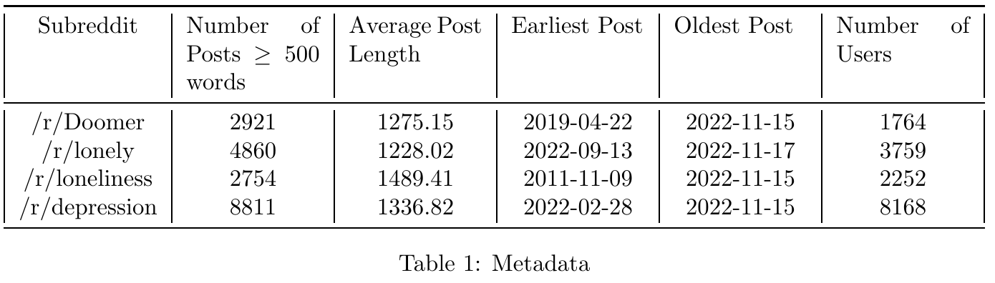
The Data

Slide 8
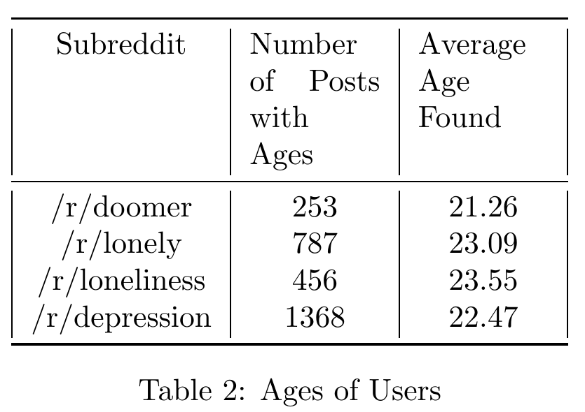
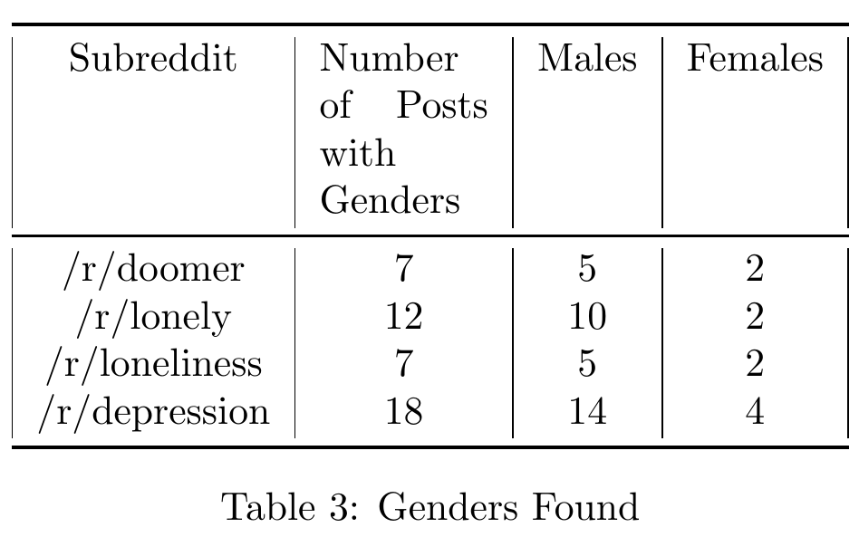
The Users
Young overall age
Mostly male, but there are females as well
Typical of the Internet, Reddit, and especially these Subreddits
Very inaccurate
  Most users don’t volunteer their gender online
Threat to validity
Unique users between Subreddits

Slide 9
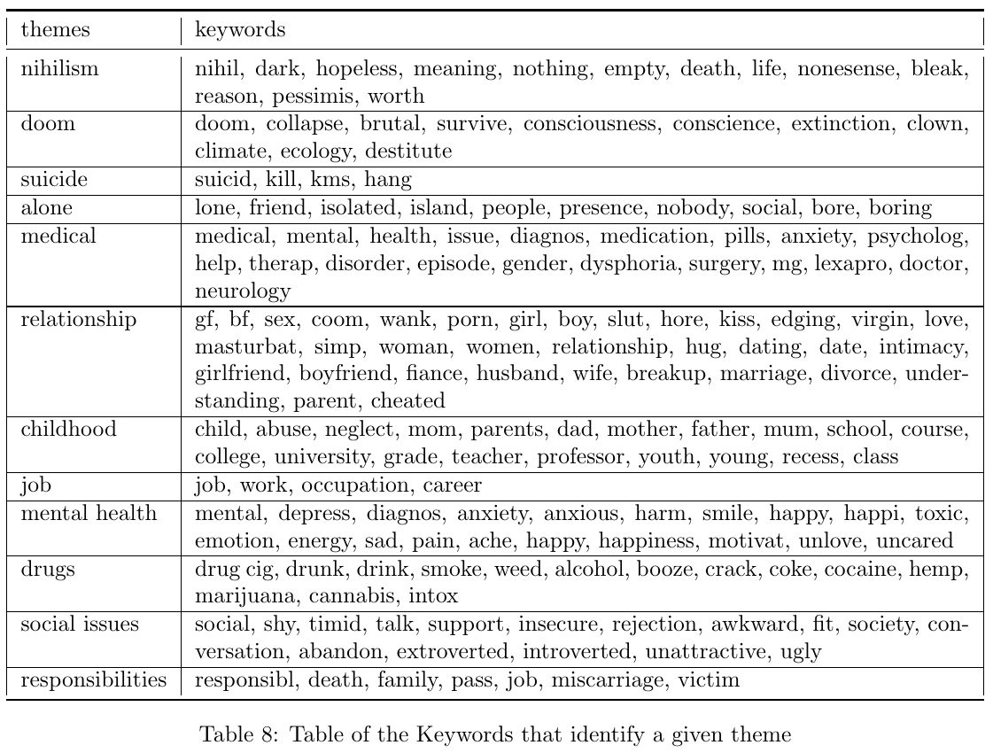
Manual
Inspection¹
Read a number of posts from each category.
Identified some themes and keywords that would be relevant to analyse.
[1] Hélène Joffe Sam Fardghassemi. “The causes of loneliness: The perspective of young adults in London’s most deprived areas”. In: PLOS ONE 17.4 (2022).

Slide 10
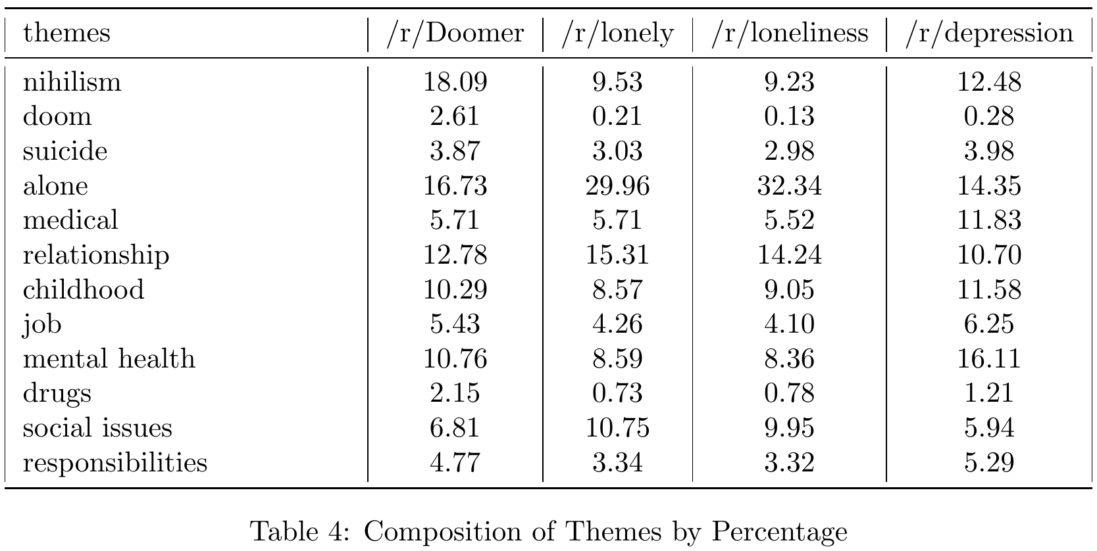
Frequency Analysis
[1] Sharath Chandra Guntuku et al. “Studying expressions of loneliness in individuals using Twitter: an observational study”. In: BMJ 9

Slide 11
Results of Frequency Analysis
Doomer
  Much more nihilistic
  Obsessed with doom, the brief collapse of the world
    But not as much as anticipated
  Slightly more mentions of drugs comparing with the other categories
Depression
  Medical
These results are similar to the themes identified by the manual inspection

Slide 12

Classification of Individual Posts

Slide 13
Classification of Individual Posts
The prophetic vision of the holy executioner finally begins to take shape and unfold
Nothing remains to view the final breaths of a dying star many eons after all signs of
life ceased their existence on the surface of our beautiful planet leaving behind a still
silhouette of memory of a once magnificently brilliant world The prophetic vision of the
holy executioner finally begins to take shape and unfold where the monochrome deafening
silence echoes throughout the remnants of what was our beautiful world.
Turned that into a vector
Classification: find its most similar vector

Slide 14
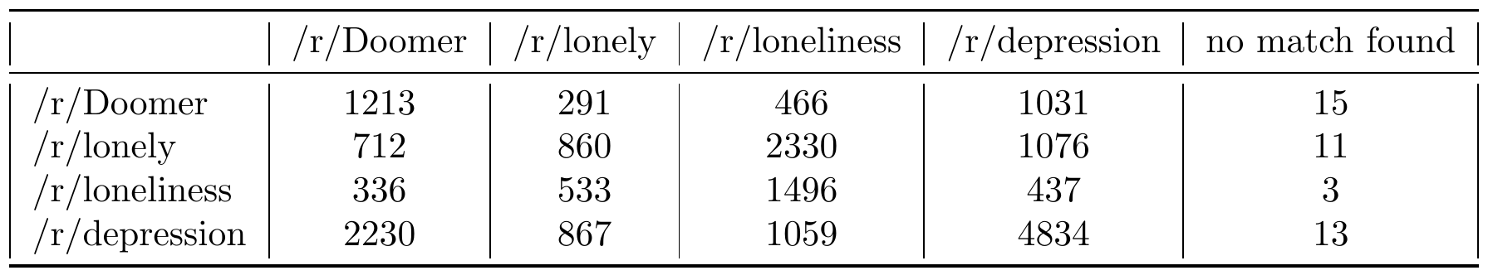

Classification of Individual Posts
Doomer is really similar to depression
  Depression is not as closely related to doomerism
Individual posts can have a varying composition of themes

Slide 15
Discussion
We sought to determine where doomerism fits with loneliness and depression.
It’s not a new phenomenon.
It is closely related to the other two, except that it is high in nihilism and the obsession with collapse.

Slide 16
Threats to Validity
Used only Reddit and these four Subreddits
  Relevant to the cultural icon and demographic
  The particular focus on Reddit makes sense to the problem scope
Female users are very small at most ~5%.
  There is no clear way to identify them, so as to give them more weight
The themes identified are too crude
  Bias & assumptions about each category
  Attempt to ground themes in a manual inspection of the posts

