Slide 1
A Computational Analysis of Doomerism

Slide 2
What is the problem
Wealth of surveys and research suggest youth aged 15-24 are the loneliest demographic.
  Statistics Canada

Slide 3

What is Doomerism
no gf
Urban hell
Obsesses over it
Dilapidated apartment complexes
suicidal
dark
There is no way out of it
Night walks
doomed
lonely
Predominately male
Has no sleep
Dead end job
depressed
Doomer-girl

Slide 4
What is the research
What exactly is the doomer?
How is it different from similar phenomenon that have previously been known?

Slide 5
Related Work
Fardghassemi’s interviews of lonely young adults in London’s most deprived boroughs
  Identifies themes and causes of loneliness from interviews
Twitter Analysis
  Posts tagged with “lonely” or “alone” analysed by frequency of words for causes and themes
Internet memes as reservoirs of meaning: Interpreting the Doomer
  Sociology research: analysis of the icons and imagery

Slide 6
The significance that I add
Computational analysis
  posts written on four Subreddits
Goal: answer a psychological question by computationally analysing a social, culture piece

Slide 7
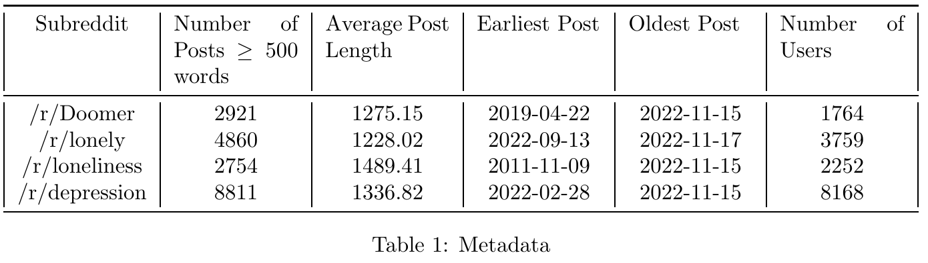
What is the data
The users between the subreddits were also very unique

Slide 8
Layered approach
Manual inspection
  ~ Reading of ~50 posts from each of the forums
  Identify the themes and causes
Frequency analysis
  What is the exact composition of the causes of doomerism compared with the other phenomenons
Classification
  Can an individual post be classified using the composition of each category

Slide 9

Results of manual inspection
Nihilism and doom seen in the doomer
/r/depression is more medical
Drugs not as common as literature suggest
Nothing remains to view the final breaths of a dying star many eons after all signs of life ceased their existence on the surface of our beautiful planet leaving behind a still silhouette of memory of a once magnificently brilliant world The prophetic vision of the holy executioner finally begins to take shape and unfold where the monochrome deafening silence echoes throughout the remnants of what was our beautiful world.

Slide 10
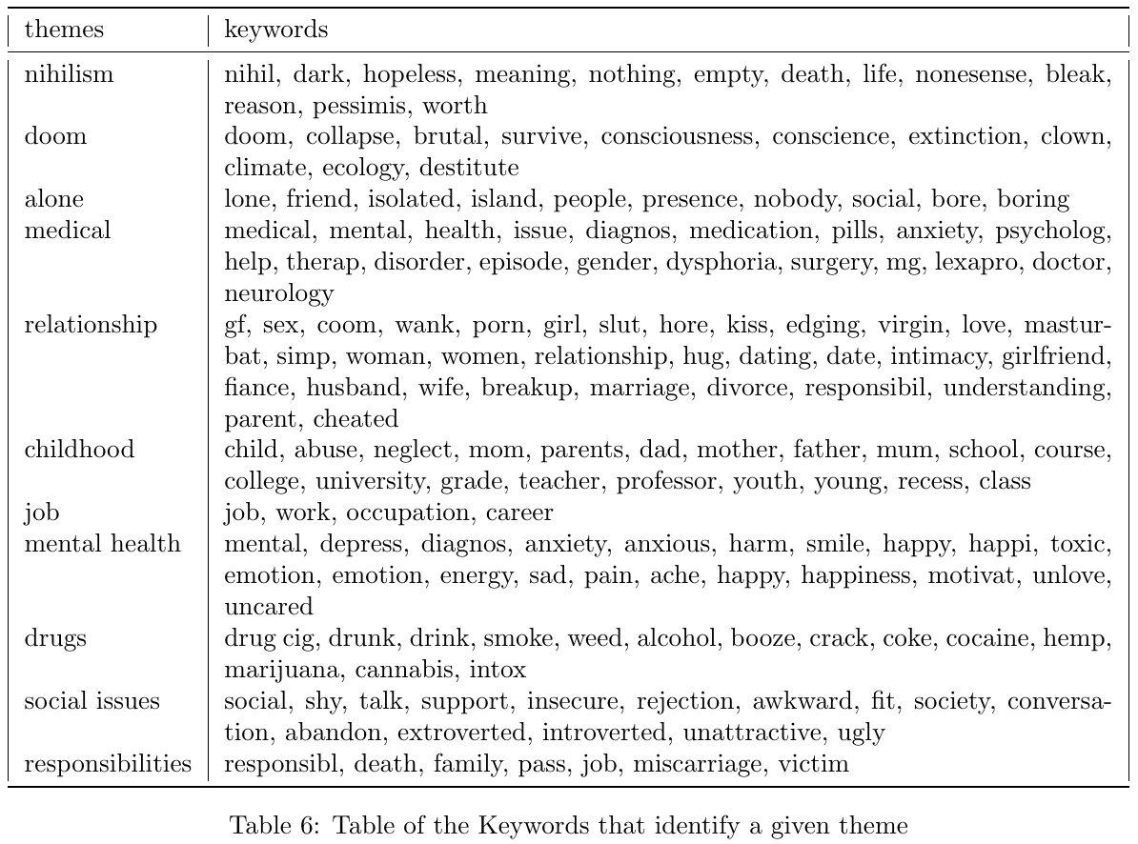
Themes and Keywords

Slide 11
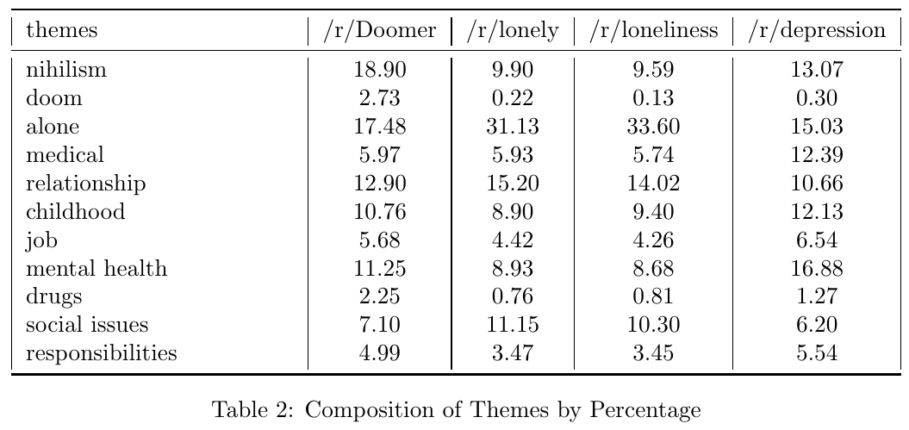
Results of frequency analysis

Slide 12
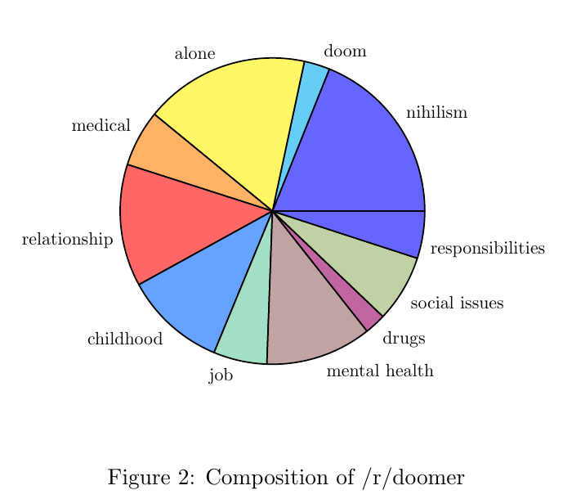
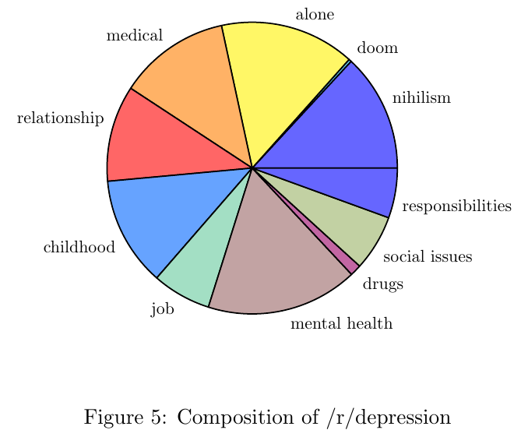
Compositions

Slide 13
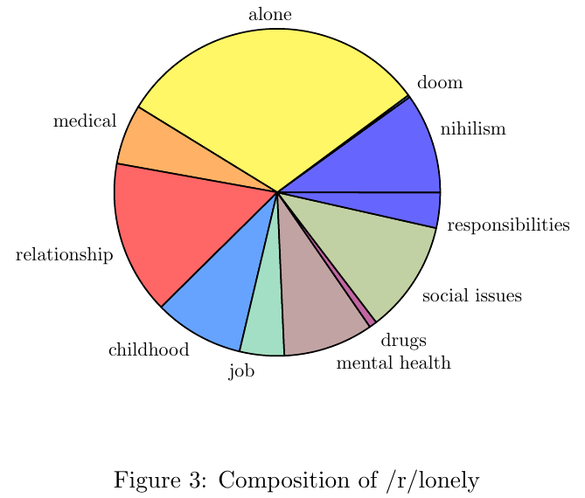
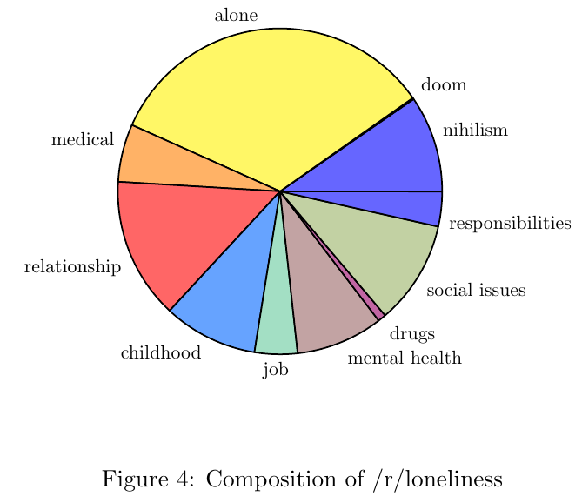
Compositions

Slide 14
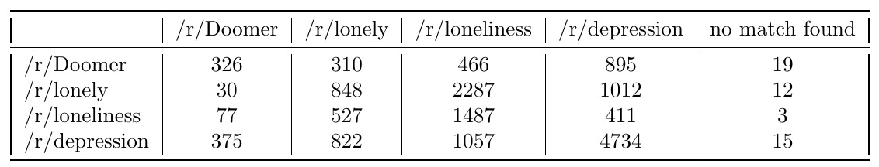
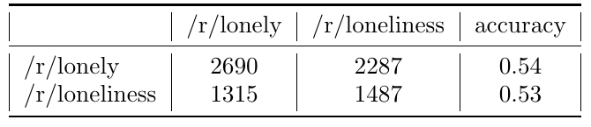
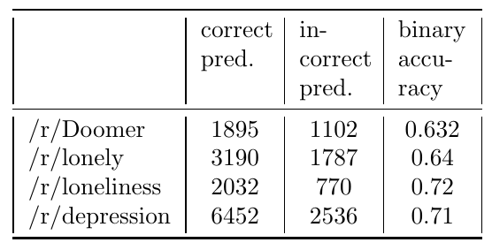
Classification Results

Slide 15
Conclusions
We have an exact composition of what the doomer is
Great diversity of individual thoughts and themes within the doomers
  As a whole they are nihilism is represented by doomers
The practitioner now knows that nihilism is on a trend
  However the doomers are facing similar problems as those faced by other more known identifications

Slide 16
Further steps
Improve the classification
Sharpen the themes and the keywords
Add longitudinal analysis, especially to measure effects of the pandemic
Submit this at a workshop

Slide 17
What I learned
LaTex
NLP
  It is not as strong as I thought it was
How to write a simple (toy) research project from start to finish

