Slide 1
Therapeutic Vaccines
Advisor: Dr. Abedian
Presenter: Ali Rahmati

Slide 2
Vaccines and Unmet Medical Needs
Infectious diseases were historically a major cause of death.
Vaccination has greatly reduced morbidity and mortality from diseases such as:
smallpox
poliomyelitis
diphtheria
tetanus
Measles
COVID-19 vaccines showed high efficacy in preventing severe disease
However, infectious diseases still remain a major global health burden.

Slide 3
Why Preventive Vaccines Are Not Enough
Despite highly effective COVID-19 vaccines, many individuals still developed SARS-CoV-2 infection.
Key limitations include:
limited vaccine acceptance
inequitable global distribution
short duration of protection
limited cross-protection
viral variants
immunosuppression in some individuals
Other infectious diseases such as HPV, HBV, HIV, HCV, and influenza continue to cause mortality.

Slide 4
Therapeutic Vaccine Concept: Targeting Persistent/Unique Antigens
Established diseases often show constant or unique antigen expression.
Example targets:
HPV E6/E7
tumor neoantigens
HBsAg (HBV)
Goal: induce epitope‑specific effector T cells and/or neutralizing antibodies.
Preclinical proof-of-concept:
E7 protein vaccine induced strong cellular immunity → rejection of established tumors
Notes:
واکسیناسیون درمانی از این واقعیت بهره می‌برد که آنتی‌ژن‌های خاصی به طور مداوم در بیماری بیان می‌شوند - انکوژن‌های ویروسی مانند E6/E7 در ضایعات ناشی از HPV، HBsAg در HBV مزمن و نئوآنتی‌ژن‌ها در سرطان. اگر بتوانیم این آنتی‌ژن‌ها را با زمینه مناسب ارائه دهیم، می‌توانیم سلول‌های T اختصاصی اپی‌توپ را که قادر به حرکت به ضایعات و واسطه‌گری پاکسازی هستند، یا پاسخ‌های سلول‌های B که آنتی‌بادی‌های خنثی‌کننده تولید می‌کنند، القا کنیم. کار اولیه واکسن E7 اثبات مفهومی قوی از مکانیسم آن ارائه داد.

Slide 5
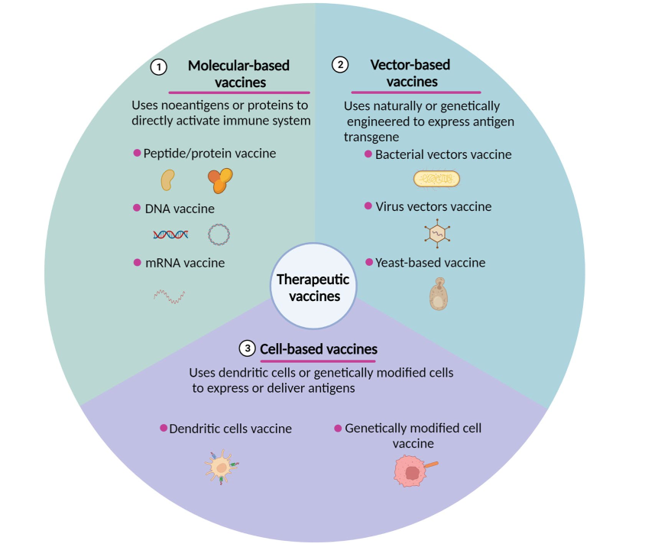
An overview of therapeutic vaccine types in preclinical and clinical trials.

Slide 6
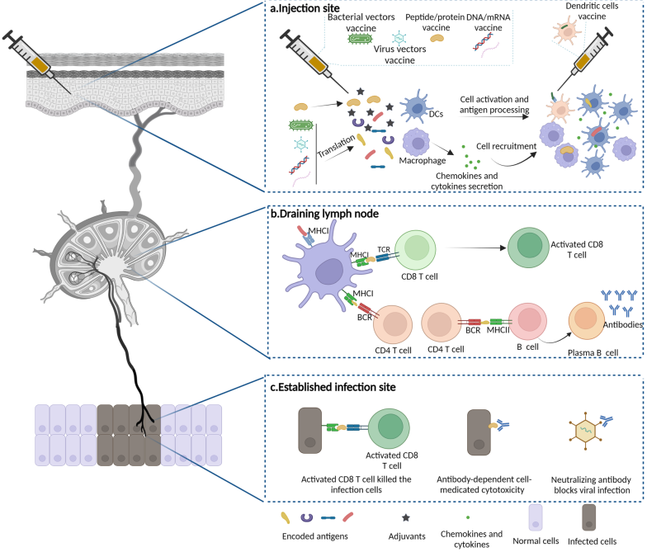

Slide 7
Immunologic Basis of Therapeutic HPV Vaccination
Therapeutic HPV vaccines aim to induce:
strong Th1-type responses
cytotoxic CD8+ T-cell responses
Goal: eliminate HPV-infected and transformed cells
An ideal target antigen should be:
essential for malignant transformation and maintenance
constitutively expressed
highly expressed
minimally mutable
HPV E6 and E7 oncoproteins are near-ideal targets
Therefore, most HPV therapeutic vaccines are designed around E6/E7

Slide 8
Vector-Based HPV Therapeutic Vaccines
Bacterial vectors
Examples: Listeria monocytogenes, Lactobacillus casei, Lactococcus/Lactobacillus, Salmonella
Advantages:
intrinsic adjuvant activity
MHC I / MHC II antigen presentation
activation of CD8+ and CD4+ T cells
Key examples
ADXS11-001: attenuated Listeria expressing HPV16 E7-LLO
acceptable safety in phase I
induced HPV16 E7-specific T-cell responses
phase II showed improved 12-month survival in advanced cervical cancer
phase III ongoing
GLBL101c / NZ8123-HPV16-optiE6
induced mucosal or E6-specific immune responses
showed encouraging early clinical activity
Viral vectors
Platforms: MVA, adenovirus, chimpanzee adenovirus, Semliki Forest virus, arenavirus
TA-HPV and Tipapkinogen Sovacivec
safe, immunogenic
induced HPV-specific CTLs

Slide 9
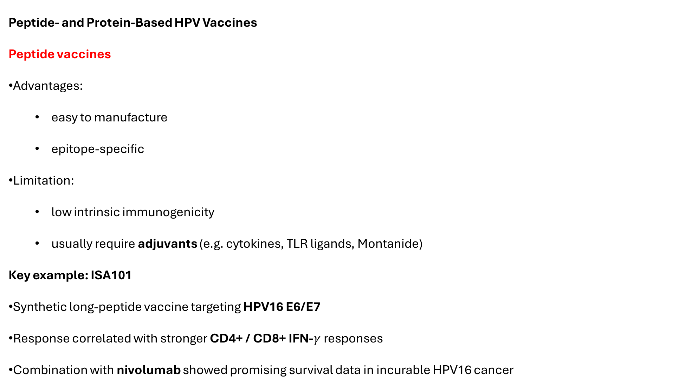
Peptide- and Protein-Based HPV Vaccines
Peptide vaccines
Advantages:
easy to manufacture
epitope-specific
Limitation:
low intrinsic immunogenicity
usually require adjuvants (e.g. cytokines, TLR ligands, Montanide)
Key example: ISA101
Synthetic long-peptide vaccine targeting HPV16 E6/E7
Response correlated with stronger CD4+ / CD8+ IFN-$γ$ responses
Combination with nivolumab showed promising survival data in incurable HPV16 cancer

Slide 10
Protein vaccines
Broader epitope content than peptides
Often more humoral-biased unless specifically engineered
Examples:
GTL001
SCN-00101
TVGV-1
Fusion strategies enhance APC targeting and immunogenicity

Slide 11
DNA Vaccines and Clinical Outlook in HPV
VGX-3100 (HPV16/18 E6/E7 DNA vaccine)
phase I: strong Th1-biased responses
phase II: higher histopathologic regression than placebo
GX-188E fused with Flt3L
to enhance antigen presentation
induced strong polyfunctional E6/E7-specific T-cell responses
associated with HPV clearance and CIN3 regression
Other candidates: pNGVL4a-CRT-E7, ZYC101

Slide 12
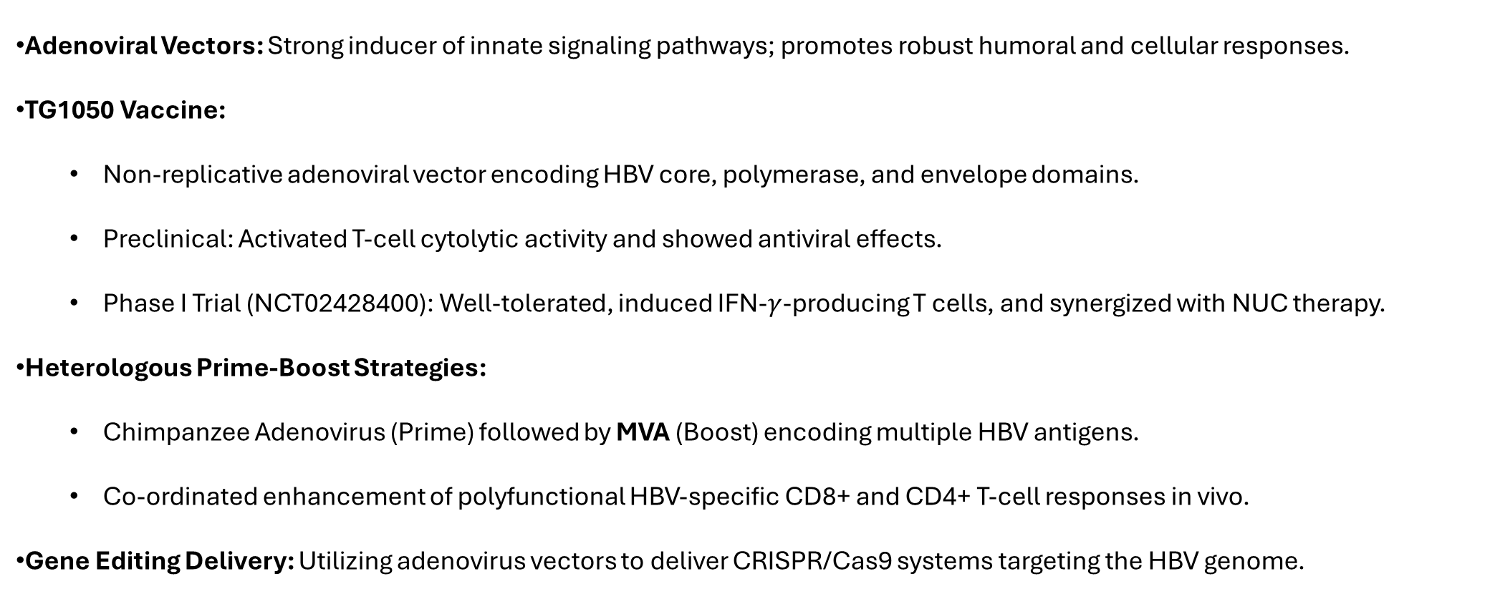
Viral Vector Platforms for HBV Immunotherapy
Adenoviral Vectors: Strong inducer of innate signaling pathways; promotes robust humoral and cellular responses.
TG1050 Vaccine:
Non-replicative adenoviral vector encoding HBV core, polymerase, and envelope domains.
Preclinical: Activated T-cell cytolytic activity and showed antiviral effects.
Phase I Trial (NCT02428400): Well-tolerated, induced IFN-$γ$-producing T cells, and synergized with NUC therapy.
Heterologous Prime-Boost Strategies:
Chimpanzee Adenovirus (Prime) followed by MVA (Boost) encoding multiple HBV antigens.
Co-ordinated enhancement of polyfunctional HBV-specific CD8+ and CD4+ T-cell responses in vivo.
Gene Editing Delivery: Utilizing adenovirus vectors to deliver CRISPR/Cas9 systems targeting the HBV genome.

Slide 13
Protein- and Peptide-Based HBV Vaccines
Theravax (DV-601): Recombinant HBsAg and HBcAg with saponin-based ISCOMATRIX adjuvant; induced lymphoproliferative and T-cell responses.
GS-4774: Engineered yeast expressing an HBsAg-HBcAg-HBx fusion.
Yeast cell wall acts as a strong adjuvant for DC presentation.
Phase II trials showed GS-4774 was safe and boosted CD8+ T cells, but did not significantly reduce serum HBsAg alone.
HeberNasvac (Approved Candidate):
Contains both HBsAg and HBcAg (nasal/subcutaneous delivery).
Phase III trial vs. Peg-IFN: Induced superior reduction in HBV DNA load (undetectable levels).
Approved by the Cuban Regulatory Authority (2015); evaluated as adjunct to NUCs (NCT02249988).
HepTcell: 9 synthetic CD4+/CD8+ peptides derived from conserved HBV domains + IC31 adjuvant.
Notes:
Protein and peptide vaccines have yielded some of the most advanced clinical candidates. While the yeast-based GS-4774 succeeded in boosting CD8 T cells but fell short of reducing HBsAg significantly as a monotherapy, HeberNasvac—a formulation containing both surface and core antigens—demonstrated superior viral control compared to pegylated interferon, leading to its regulatory approval in Cuba in 2015.

Slide 14
DNA-Based HBV Vaccines: Adjuvants & Synergy
Mechanism: Plasmids encoding HBV antigens directly transfect host cells to drive endogenously processed antigen expression.
Key Candidates:
INO-1800: Synthetic DNA vaccine encoding HBsAg and consensus HBcAg.
INO-9112 (Co-delivery): Plasmid expressing IL-12 co-administered with INO-1800 to boost cytotoxic T lymphocyte (CTL) activation.
HB-110: Multivalent plasmid encoding HBs, PreS1, HBc, Hbpol, and IL-12; showed strong antibody and T-cell responses in preclinical models.
Outlook: DNA platforms benefit from manufacturing ease and the ability to easily co-deliver genetic adjuvants (like IL-12) to rescue exhausted T cells.
Notes:
DNA-based vaccines represent the final major class. They are highly customizable, allowing the co-delivery of genetic adjuvants. For instance, combining the DNA vaccine INO-1800 with an IL-12-encoding plasmid significantly rescues and enhances CTL activation. This strategy of combining conserved antigens with local cytokine signaling is key to overcoming the deep immune tolerance seen in chronic hepatitis B.

Slide 15
Peptide, Protein, & Yeast-Based Platforms for HCV
Peptide/Protein Vaccines:
Relatively easy to manufacture but often suffer from HLA-restriction and low immunogenicity.
IC41 Vaccine: 5 synthetic peptides (Core, NS3, NS4) + poly-L-arginine adjuvant.
Phase I (HLA-A2+): Safe and immunogenic, but T-cell responses were too weak to clear viral RNA.
Intensified/Intradermal Dosing: Showed improved, more robust immune responses.
HCV Core (C35–44) + ISA51: Safe and well-tolerated in Phase I.
NCT00445419: Virosome-based vaccine containing NS3 peptides (Phase I completed).
Yeast Vector Vaccine:
GI-5005: Yeast-vector expressing an NS3-Core fusion protein.
Preclinical: Induced robust NS3- and core-specific cellular responses.
Phase I (NCT00124215): Safe, well-tolerated, and induced significant HCV-specific immunity.
Phase II (NCT00606086): Evaluated combined efficacy with standard-of-care
Notes:
Peptide and protein vaccines are highly specific but historically limited by poor immunogenicity. For instance, the peptide vaccine IC41 induced T-cell responses, but they were initially too weak to lower viral RNA until dosing was intensified and delivered intradermally. Another interesting platform is GI-5005, a yeast-vector vaccine expressing an NS3-Core fusion protein. GI-5005 successfully generated cellular immunity in preclinical models and progressed through Phase I and Phase II trials to evaluate its efficacy alongside standard-of-care therapy.

Slide 16
DNA-Based & Recombinant Viral Vector Vaccines for HCV
DNA Vaccines: Designed to express structural/non-structural proteins (NS3, NS4, NS5, Core, E1/E2) to trigger both humoral and cellular immunity.
CIGB-230: First therapeutic DNA vaccine evaluated in clinical trials; contains a mixture of core/E1/E2-expressing plasmids.
ChronVac-C (NCT01335711): Phase II trial; encodes conserved NS3/NS4a regions. Initial data confirmed safety and immunogenicity.
Modified NS3 DNA Vaccines: Engineered mutations in the catalytic triad/helicase domains to prevent the vaccine antigen from interfering with normal host cell functions.
Viral Vector-Based Vaccines:
Ad6-based vaccine: Encodes NS3, NS4A, NS4B, NS5A, and inactive NS5B.
Trial (NCT01094873): Safe and highly immunogenic in Phase I (previously validated in mice, macaques, and chimpanzees).
TG4040 (MVA-based): Expresses NS3/4/5B. Induces potent, long-lasting T-cell responses. Evaluated in Phase II (NCT01055821) in combination with PEG-IFN/Ribavirin.
Dendritic Cell (DC) Vaccines for HCV: Autologous DCs loaded and activated ex vivo with HCV HLA-A2 restricted T-cell epitopes.
Clinical Trial Results: Tested in chronic HCV patients; showed safety but only weak HCV-specific CD8+ T-cell responses.

Slide 17
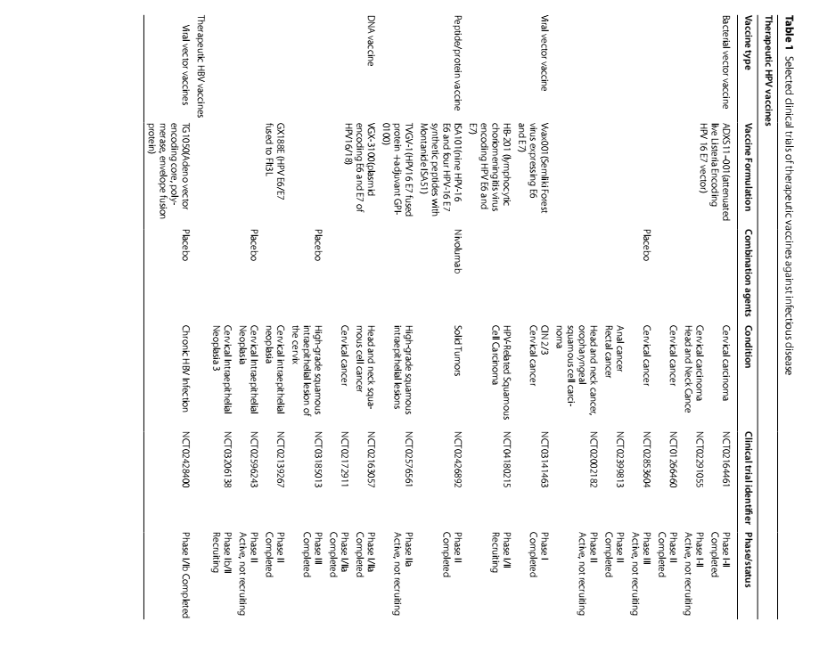

Slide 18
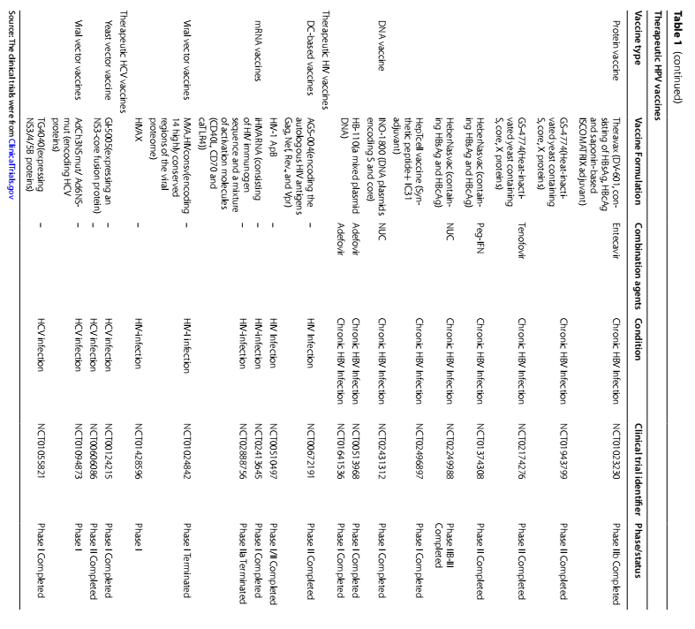

Slide 19
Noncommunicable Diseases

Slide 20
Therapeutic Vaccines Against Noncommunicable Diseases
Cancers are increasingly viewed as chronic, controllable diseases.
Therapeutic vaccines are being explored as immunotherapies for:
Cancer
Hypertension
Dyslipidemia
Alzheimer’s disease
Amyotrophic lateral sclerosis (ALS)
Diabetes
Cancer vaccines have shown modest clinical benefit so far.
Recent progress is driven by better understanding of:
Tumor-associated antigens
Neoantigens
Tumor microenvironment
Immune checkpoint inhibitors
Therapeutic vaccines may become an alternative strategy for chronic lifestyle-related diseases.

Slide 21
Cancer Vaccine Immunology: From Antigen Presentation to Tumor Killing
Effective antitumor immunity requires:
Tumor antigen release and presentation
T-cell priming and activation
Recognition of tumor cells by T cells
Effector mechanisms for tumor elimination
In the tumor microenvironment (TME):
TLRs recognize PAMPs and DAMPs
Cytokines and chemokines recruit immune cells
Innate immunity supports adaptive immunity
.

Slide 22
Why Earlier Cancer Vaccines Had Limited Success
Early cancer vaccines mainly aimed to activate tumor-specific T cells. Clinical outcomes were often limited:
Sipuleucel-T: FDA-approved in 2010 for metastatic castration-resistant prostate cancer; survival benefit in a subset of patients.
MAGE-A3 immunotherapeutic
Belagenpumatucel-L
Tecemotide / L-BLP25
IMA901
Major causes of failure:
Tumor heterogeneity
Immunosuppressive TME
Insufficient T-cell durability
Poor T-cell infiltration into tumor core
Immune escape and resistance

Slide 23
Neoantigen-Based Cancer Vaccines: Toward Personalized Immunotherapy
Successful cancer vaccination depends on:
High-quality antigen selection
Efficient uptake by DCs
Sustained CD4+ and CD8+ T-cell activation
T-cell infiltration into the TME
Persistent immune memory
Earlier vaccines focused on tumor-associated antigens (TAAs):
Cancer-testis antigens: MAGE-A1, MAGE-A3, NY-ESO-1
Differentiation antigens: tyrosinase, gp100, MART-1, PSA, PAP
Overexpressed antigens: HER2, hTERT, MUC-1, mesothelin
Oncoviral antigens: HPV E6/E7
Limitations of TAAs:
Immune tolerance
Antigen loss
Expression in some normal tissues
Collateral tissue damage
Neoantigens arise from tumor-specific mutations:
Nonsynonymous mutations
Frameshifts
Insertions/deletions
Alternative splicing
Gene fusions
Neoantigen vaccines support personalized cancer immunotherapy, often combined with checkpoint blockade.

Slide 24
Neoantigen Vaccines: Rationale for Personalized Cancer Immunotherapy
Neoantigens are tumor-specific, non-self antigens arising from somatic mutations.
They are expressed only in malignant cells, reducing off-target toxicity in normal tissues.
Their strong immunogenicity helps bypass central tolerance.
Key determinants of neoantigen quality:
Tumor mutational burden (TMB)
Clonality of mutations
TCR affinity
HLA class I/II genotype
Accurate neoantigen prediction is essential for clinical success.
Next-generation sequencing and MHC-epitope prediction algorithms enable personalized vaccine design.

Slide 25
Clinical Platforms: RNA, Peptide, and DC Neoantigen Vaccines
DC-loaded neoantigen vaccines Monocyte-derived dendritic cells loaded with personalized neoantigens induced T-cell-specific immune responses in melanoma.
RNA-based vaccines Flexible manufacturing and endogenous antigen expression
NCT02035956: RNA polyneoepitope vaccine in melanoma
Induced both CD4+ and CD8+ T-cell responses
8/13 patients had no recurrence at 12 months
Peptide-based vaccines
Personalized neoantigen peptides + poly-ICLC
In melanoma, ~60% of neoantigens activated CD4+ T cells and 16% activated CD8+ T cells

Slide 26
Clinical Impact in “Cold” Tumors: Glioblastoma and Beyond
Neoantigen vaccines are being tested in multiple cancers:
Melanoma
Pancreatic cancer
Breast cancer
Lung cancer
Glioblastoma
Glioblastoma is a key example because it has: low mutation burden
immunologically “cold” TME
weak response to ICIs
APVAC1 / APVAC2
APVAC1: unmutated antigens
APVAC2: neoantigens
15 glioblastoma patients treated sequentially
CD8+ response in 50% with APVAC1
CD4+ response in 84.7% with APVAC2
OS 29.0 months; PFS 14.2 months
Overall message: Neoantigen vaccines can induce CD4+ / CD8+ responses and improve T-cell infiltration into tumors.

Slide 27
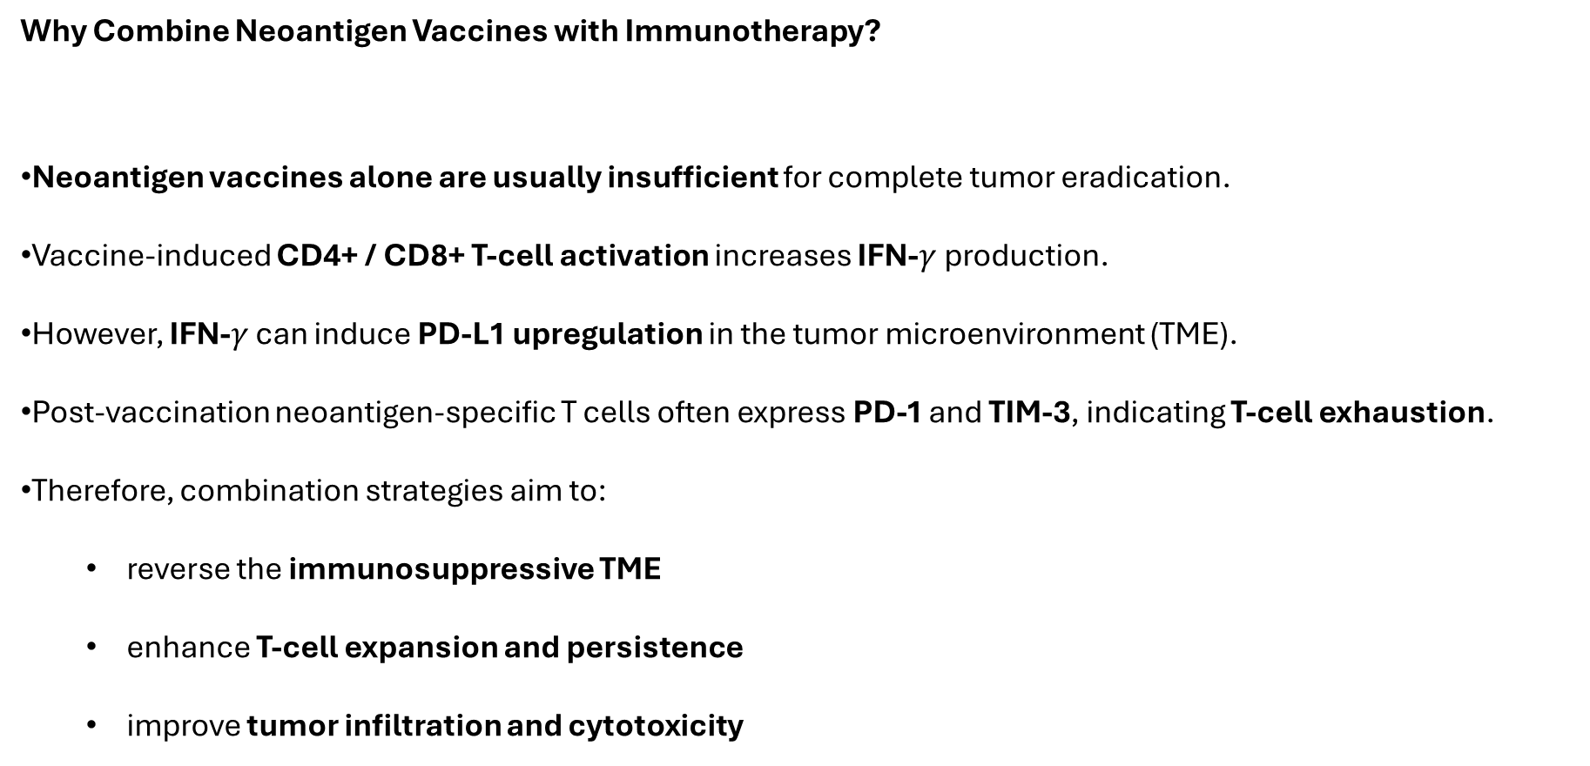
Why Combine Neoantigen Vaccines with Immunotherapy?
Neoantigen vaccines alone are usually insufficient for complete tumor eradication.
Vaccine-induced CD4+ / CD8+ T-cell activation increases IFN-$γ$ production.
However, IFN-$γ$ can induce PD-L1 upregulation in the tumor microenvironment (TME).
Post-vaccination neoantigen-specific T cells often express PD-1 and TIM-3, indicating T-cell exhaustion.
Therefore, combination strategies aim to:
reverse the immunosuppressive TME
enhance T-cell expansion and persistence
improve tumor infiltration and cytotoxicity

Slide 28
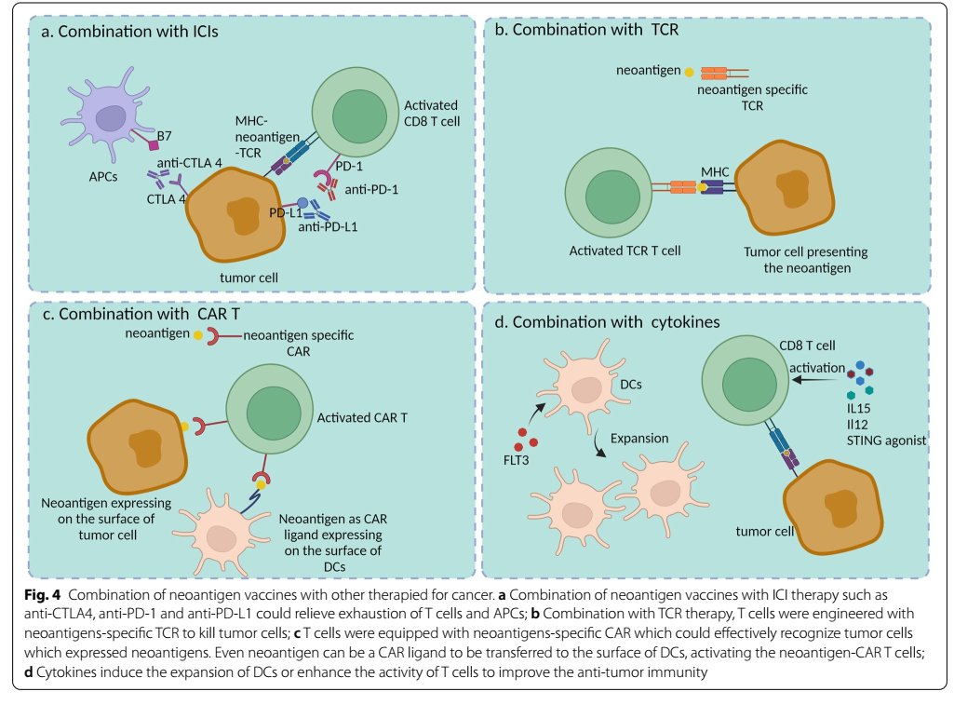

Slide 29
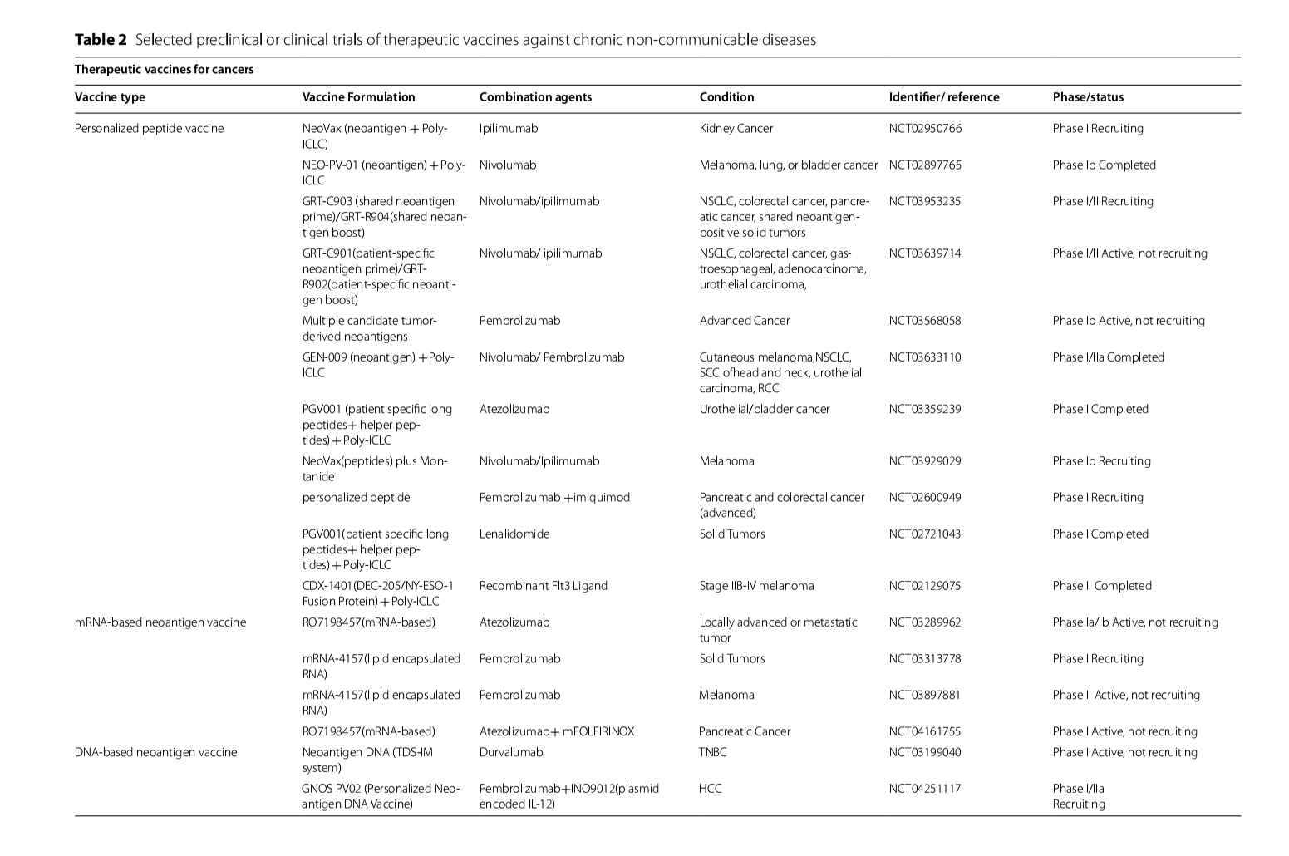

Slide 30
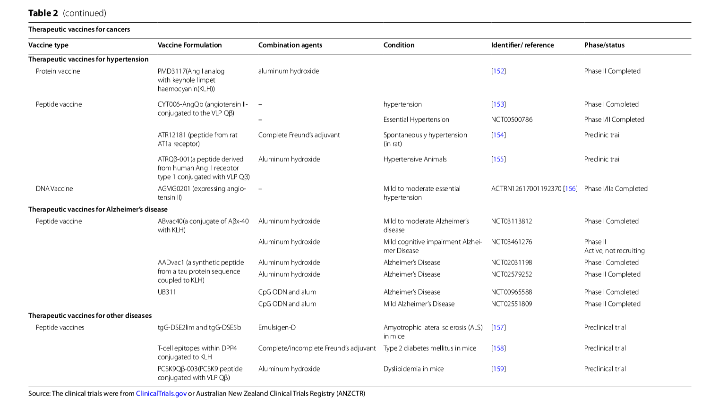

Slide 31
Expanded Program on Immunization (EPI)
Launch Context: Established in 1974, leveraging the momentum of successful smallpox eradication.
Formal Foundation: Mandated by World Health Assembly resolution WHA27.57 (May 1974).
Primary Mission: Ensuring universal access to life-saving vaccines for children in all nations.
برنامه توسعه ایمن‌سازی (EPI) در سال ۱۹۷۴ متولد شد. این برنامه نه تنها پاسخی به موفقیت ریشه‌کنی آبله بود، بلکه یک تلاش جهانی هماهنگ برای اطمینان از دسترسی برابر کودکان در سراسر جهان به واکسن‌های حیاتی است که با قطعنامه WHA27.57 رسمیت یافت.

Slide 32
Core Goals of the EPI (Set in 1977)
Universal Coverage: Goal to provide immunization against 6 core diseases (Diphtheria, Pertussis, Tetanus, Polio, Measles, Tuberculosis) globally by 1990.
National Capability: Fostering “self-reliance” in delivering immunization services within local health systems.
Regional Production: Strengthening regional capacity for vaccine manufacturing and quality control.
در سال ۱۹۷۷، اهداف بلندپروازانه‌ای برای سال ۱۹۹۰ تعیین شد. تمرکز فقط بر تزریق واکسن نبود، بلکه استقلال کشورها در ارائه خدمات بهداشتی و توانمندی تولید واکسن در مناطق مختلف جهان به عنوان دو رکن اصلی «خودکفایی» مطرح شد.

Slide 33
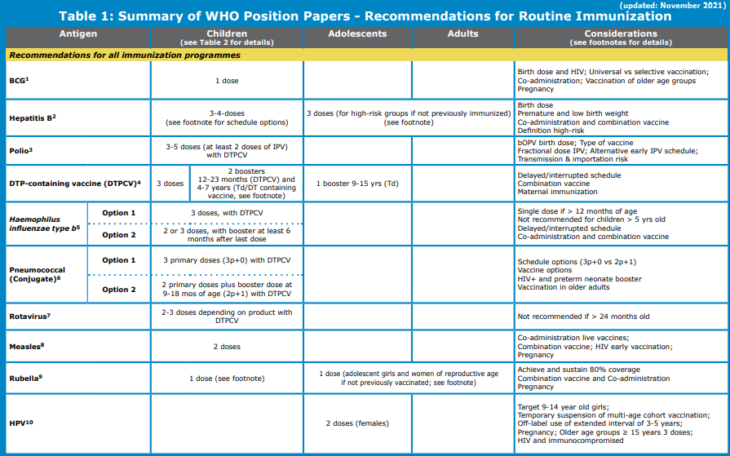

Slide 34
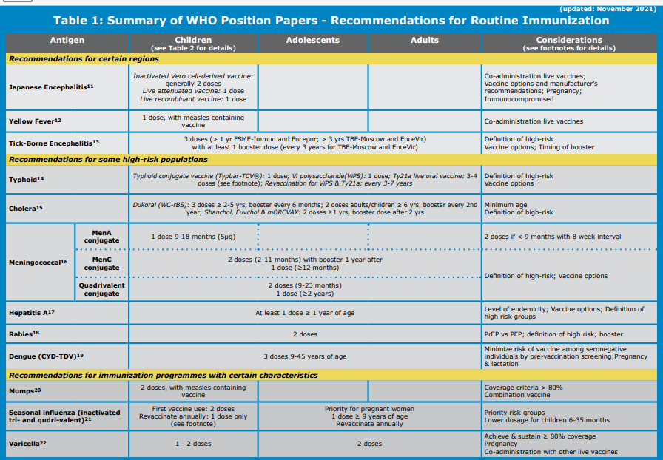

Slide 35
Introduction of new vaccines
Deliberations about incorporating a new vaccine into a national immunization schedule are often influenced by multiple factors, including:
Affordability and relative cost-effectiveness
Disease burden
Availability and price of vaccines
Safety and suitability of available vaccine products for national programmes.

Slide 36
Global Progress & Evolving Scope
Achievement (2012): Global coverage for full DTP vaccination reached approximately 83% of infants.
Future Development: Moving beyond traditional targets to include vaccines for Malaria, Dengue, and new-generation Tuberculosis/Typhoid vaccines.
Specific Needs: Ongoing introduction of targeted vaccines (Yellow Fever, JE) for endemic regions.

Slide 37
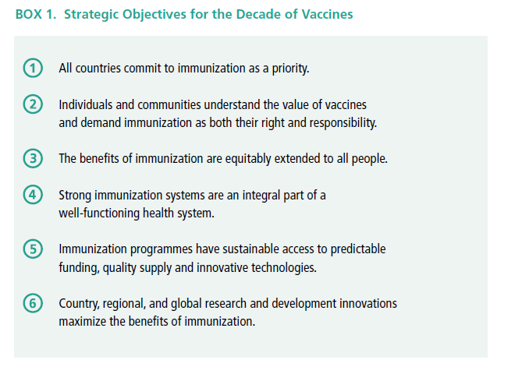
Global Vaccine Action Plan

Slide 38
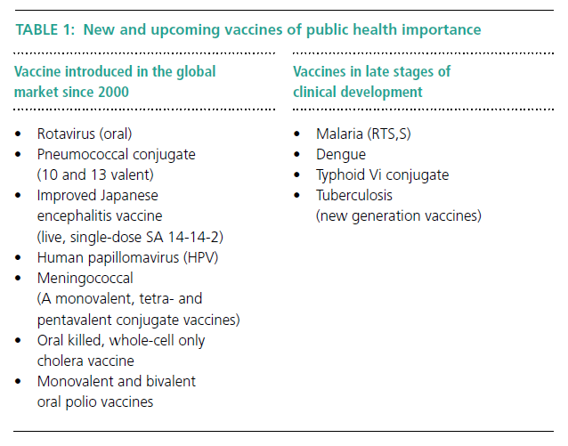

Slide 39
Problems encountered by the Program have included:
Lack of public and governmental awareness of the scope and seriousness of the target diseases
Ineffective program management
Inadequate equipment and skills for vaccine storage and handling
Insufficient means for monitoring program impact

Slide 40
The Essential Program on Immunization Unit is organized into five Teams:
Life Course & Integration;
Programme Strengthening;
Demand & Behavioral Science;
Vaccine Supply Chain & Logistics and
(VPD) Vaccine Preventable Diseases Outbreak Reduction

Slide 41
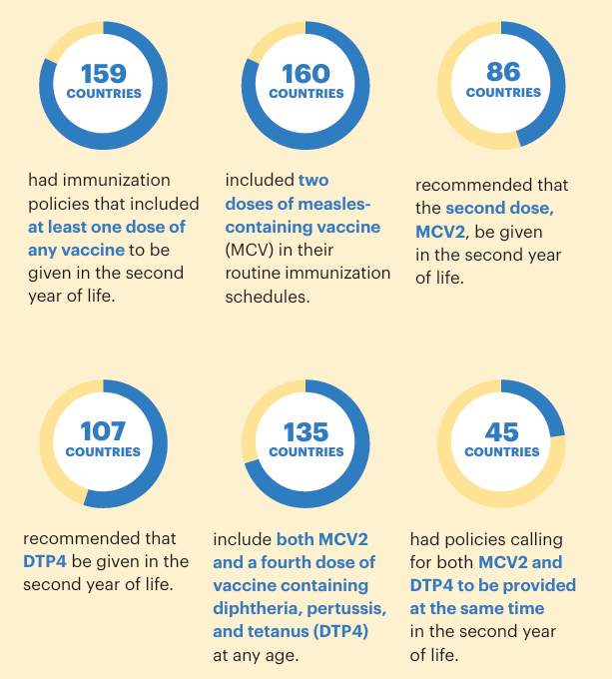
Life Course & Integration;
Vaccination in the second year of life (2YL)

Slide 42
Life Course & Integration;
School vaccination
Health worker vaccination
Linking with other health interventions

Slide 43
Confidence and demand
Increasing vaccination demand and uptake
Increasing and maintaining vaccination uptake is vital for vaccines to achieve their success. Addressing low vaccination requires an adequate understanding of the determinants of the problem, tailored evidence-based strategies to improve uptake, and monitoring and evaluation to determine the impact and sustainability of the interventions.
1. Understanding the drivers of immunization uptake
2. Engage with communities
3. Strengthen the quality of services
4. Support health workers

Slide 44
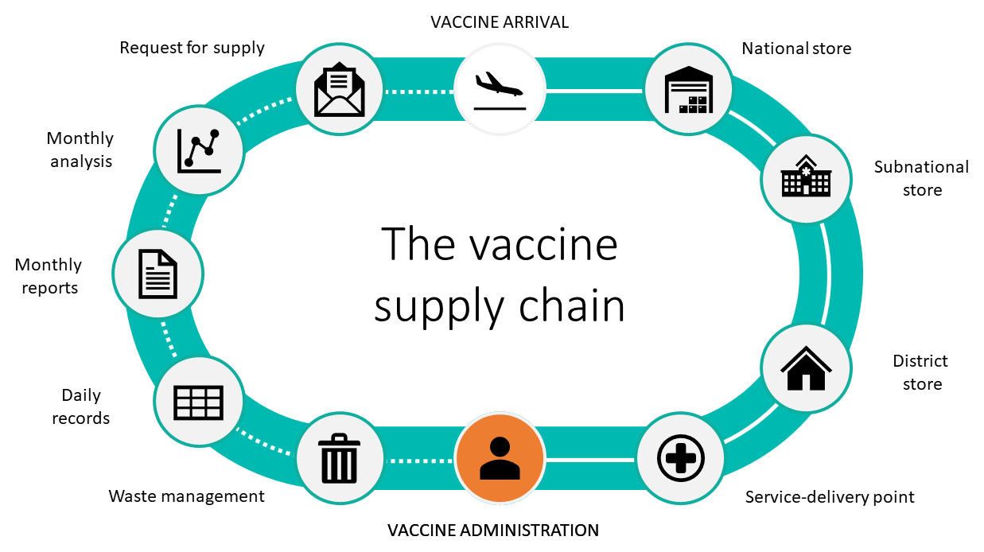
Supply chain and logistics
Successful immunization programmes are built on functional, end-to-end supply chain and logistics systems. These systems enable effective vaccine storage, distribution, handling, and management, ensure rigorous temperature control in the cold chain; and leverage logistics management information systems to promote resilient and efficient system performance. The ultimate goal is to ensure the uninterrupted availability of quality vaccines from manufacturer to service-delivery levels, so that opportunities to vaccinate are not missed because vaccines are unavailable.

Slide 45
Thanks For Your Attention

