Slide 1
Respiratory syncytial virus: recently developed rsv vaccines
In The Name Of God
Supervisor: dr. Tehrani
By: ali rahmati

Slide 2
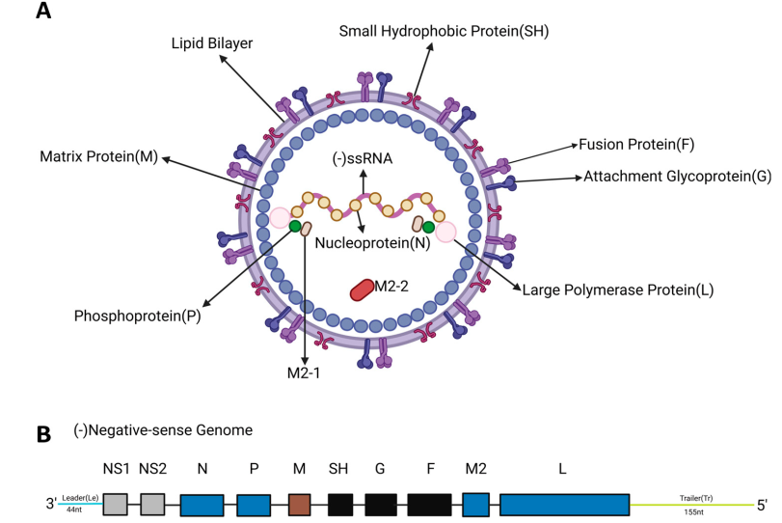



Structural and genomic organization of RSV
The F and G glycoproteins are both transmembrane proteins that are highly glycosylated and mediate viral entry
F protein directs virus-cell and cell-cell fusion. It presents multiple neutralizing epitopes and can elicit potent neutralizing antibody responses, making it a primary vaccine target & Due to its high level of conservation among RSV strains, it is the main vaccine target antigen
G protein contains a central conserved region that facilitates viral attachment by interacting with cell surface heparan sulfate receptor
the G protein contains a central conserved domain (CCD) with a low degree of glycosylation and the presence of a CX3C motif. This CX3C motif is necessary for G protein to mimic the chemokine fractalkine and bind to the host CX3CR1 receptor

Slide 3
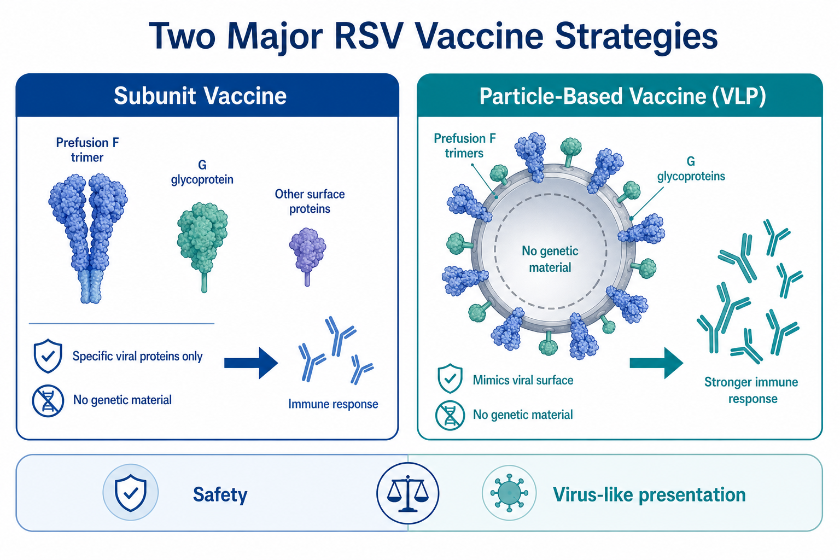
Rsv vaccines strategies
Two predominant strategies for RSV vaccine development:
Subunit vaccines are formulated using specific proteins (subunits) of the virus instead of the complete viral entity and are devoid of viral genetic material. Such vaccines typically incorporate the F protein of RSV or other immunogenic proteins, which can stimulate the body to produce an immune response.
The advantage of subunit vaccines lies in their favorable safety profile, as the absence of live viruses eliminates the risk of vaccine-induced infection. This characteristic makes them suitable for prophylactic immunization in target populations such as pregnant women and the elderly
Particle-based vaccines, particularly virus-like particles (VLP)

Slide 4
Subunit Vaccines: Abrysvo (RSVPreF)
Abrysvo (Pfizer) is a bivalent prefusion F (PreF) protein subunit vaccine designed to protect against both RSV-A and RSV-B.
Approved by the FDA in 2023 for:
Maternal immunization (pregnant women)
Adults aged ≥60 years
The vaccine antigen is produced in Chinese hamster ovary (CHO) cells and engineered to maintain the prefusion (PreF) conformation, which elicits potent neutralizing antibodies.

Slide 5
Arexvy (RSVPreF3): A Prefusion RSV Vaccine
Arexvy is a GSK-developed RSV vaccine approved by the FDA in May 2023.
It is designed to prevent RSV-related lower respiratory tract infection (LRTI) in older adults.
Main antigen: RSVPreF3, a recombinant prefusion F protein stabilized in the PreF conformation.
Adjuvant: AS01E, which enhances immunogenicity and immune activation.
AS01E contains:
MPL: a TLR4 agonist
QS-21: saponin-based immune stimulator

Slide 6
DS-Cav1: a prefusion-stabilized RSV F subunit vaccine
DS-Cav1 is a prefusion RSV F protein vaccine candidate developed by NIH/NIAID. It was designed because most potent neutralizing antibodies after natural RSV infection target the prefusion F (PreF) form. The most important vulnerable neutralizing regions are antigenic sites Ø and V. DS-Cav1 was engineered to stably preserve the PreF conformation and expose key neutralizing epitopes.
DS mutation: introduction of S155C-S290C creates a disulfide bond that helps prevent conversion from PreF to PostF.
Cav1 mutation: S190F-V207L fills a hydrophobic cavity and makes the membrane-distal head more ordered.
The DS-only variant is relatively unstable against temperature and pH changes. The combined DS-Cav1 design showed the best balance of:
structural order
production yield
resistance to temperature, pH, osmotic stress, and freeze-thaw cycles
Electron microscopy showed a homogeneous DS-Cav1 protein population.

Slide 7
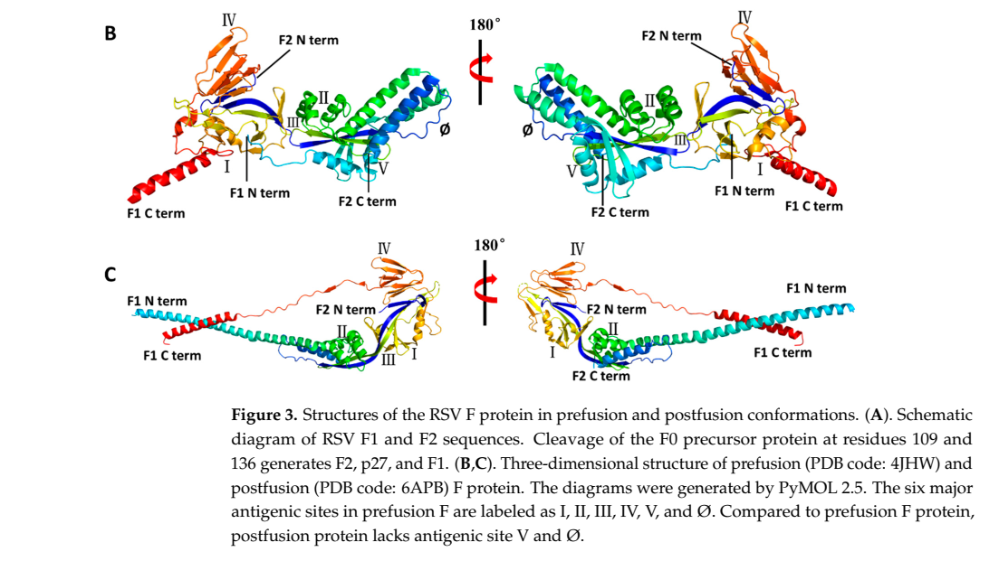

Slide 8
DT-PreF: a highly stable RSV prefusion subunit vaccine
DT-PreF is an RSV subunit vaccine candidate developed by Calder Biosciences.
It is a stable mutant of RSV prefusion F (PreF).
Its key innovation is the use of dityrosine (DT) bonds instead of conventional disulfide bonds.
DT bonds are zero-length covalent cross-links with very high chemical stability.
This “post-folding modification” helps stabilize the native PreF structure while reducing risks of:
misfolding
abnormal aggregation

Slide 9
Structural design and epitope preservation
DT-PreF contains two engineered dityrosine bonds:
V185Y–N428Y → stabilizes the IV/V interface
K226Y–Y198 → locks the major neutralizing Site Ø
These modifications keep key neutralizing epitopes exposed and prevent PreF-to-PostF transition.
Additional fold on mutations:
L512V
L513V
Y519F
These changes further improve trimer stability without blocking epitope access.

Slide 10
ADV110 (BARS13): an RSV G-protein subunit vaccine
ADV110 (BARS13) is a recombinant protein subunit RSV vaccine developed by Advaccine.
Unlike most RSV vaccines, it targets the G protein, not the F protein.
The RSV G protein functions as the viral attachment protein.
ADV110 aims to prevent RSV infection by targeting a more structurally independent neutralizing region of G protein.
It is formulated with the novel adjuvant AE011.

Slide 11
Targeting the CCD/CX3C region of RSV G protein
ADV110 is designed around the central conserved domain (CCD) of RSV G protein.
This region includes the CX3C motif, which binds to CX3CR1 on respiratory epithelial cells.
Antibodies against this domain may show:
strain-independent activity
interference with viral attachment and entry
The vaccine also includes cyclosporin A (CsA) in its design.
Proposed immune effect:
induction of neutralizing antibodies
induction of antigen-specific Tregs
reduced excessive T-cell activation

Slide 12
Particle-Based Vaccines (VLPs) in RSV
Virus-like particles (VLPs) are self-assembling multi-protein complexes structurally similar to viral capsids.
They lack genetic material, so they cannot replicate or infect cells.
In RSV, VLPs are designed as non-replicating nanoparticles approximately 80–400 nm in size.
VLPs can induce both humoral and cellular immune responses.
Compared with conventional subunit vaccines, they provide denser epitope display and stronger antibody reactivity.

Slide 13
Design Logic and Immunological Advantages
RSV VLPs typically display prefusion F protein trimers and membrane-anchored G glycoproteins with preserved CX3C motifs.
Two major assembly strategies are used:
RSV M protein-based assembly
Heterologous scaffold platforms such as HIV Gag or NDV chimeras
Repetitive antigen presentation strongly enhances B-cell activation.
VLPs co-displaying F + G proteins may provide broader and more durable neutralization than F-only vaccines.

Slide 14
What Is IVX-A12?
IVX-A12 is a bivalent VLP-based vaccine developed by Icosavax.
It is designed to prevent lower respiratory tract infections caused by:
RSV
human metapneumovirus (hMPV)
The vaccine combines two components:
IVX-121 targeting RSV
IVX-241 targeting hMPV
The RSV component, IVX-121, is based on the prefusion F (PreF) conformation of RSV F protein.
IVX-A12 is one of the most advanced combined RSV/hMPV vaccine candidates.

Slide 15
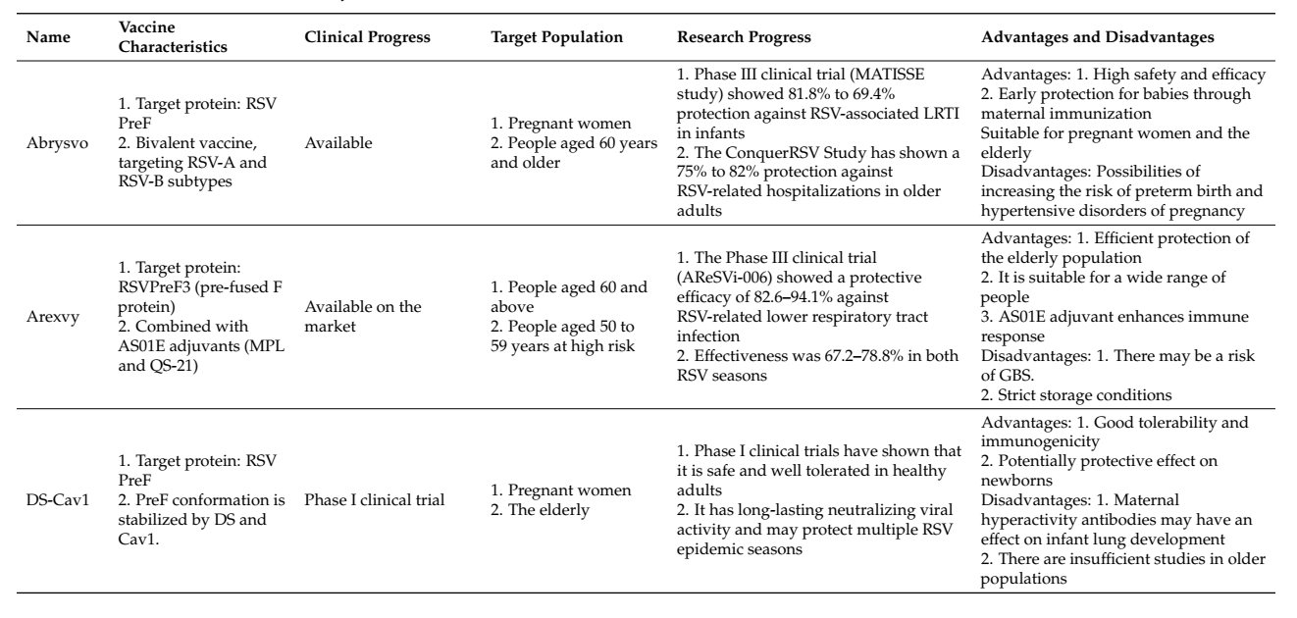
Summary of RSV vaccines

Slide 16
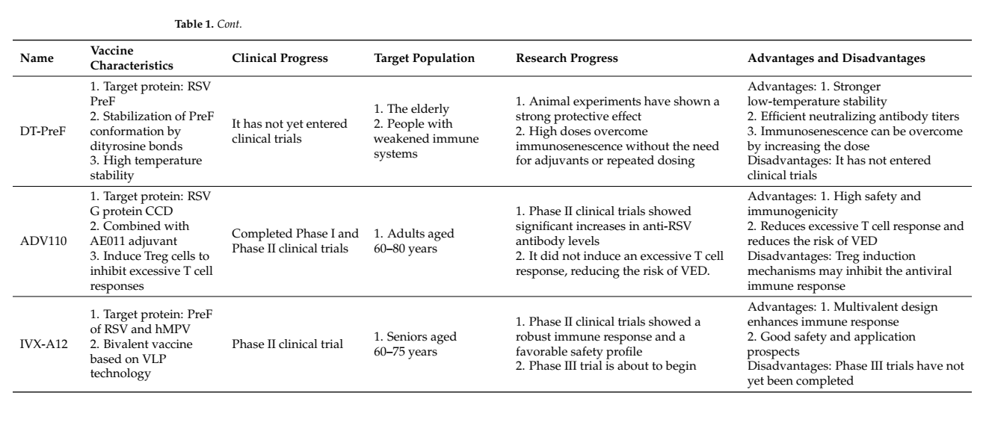
Summary of RSV vaccines

Slide 17
references
Topalidou, X.; Kalergis, A.M.; Papazisis, G. Respiratory Syncytial Virus Vaccines: A Review of the Candidates and the Approved Vaccines. Pathogens 2023, 12, 1259
Swathi, M. Arexvy: A Comprehensive Review of the Respiratory Syncytial Virus Vaccine for Revolutionary Protection. Viral Immunol. 2024, 37, 12–15.
Venkatesan, P. First RSV Vaccine Approvals. Lancet Microbe 2023, 4, e577.
Papi, A.; Ison, M.G.; Langley, J.M.; Lee, D.-G.; Leroux-Roels, I.; Martinon-Torres, F.; Schwarz, T.F.; van Zyl-Smit, R.N.; Campora, L.; Dezutter, N.; et al. Respiratory Syncytial Virus Prefusion F Protein Vaccine in Older Adults. N. Engl. J. Med. 2023, 388, 595–608.
Ison, M.G.; Papi, A.; Athan, E.; Feldman, R.G.; Langley, J.M.; Lee, D.-G.; Leroux-Roels, I.; Martinon-Torres, F.; Schwarz, T.F.; van Zyl-Smit, R.N.; et al. Efficacy and Safety of Respiratory Syncytial Virus (RSV) Prefusion F Protein Vaccine (RSVPreF3 OA) in Older Adults Over 2 RSV Seasons. Clin. Infect. Dis. 2024, 78, 1732–1744.
Gilman, M.S.A.; Castellanos, C.A.; Chen, M.; Ngwuta, J.O.; Goodwin, E.; Moin, S.M.; Mas, V.; Melero, J.A.; Wright, P.F.; Graham, B.S.; et al. Rapid Profiling of RSV Antibody Repertoires from the Memory B Cells of Naturally Infected Adult Donors. Sci. Immunol. 2016, 1, eaaj1879.

Slide 18
Thanks For Your Attention

