Slide 1

PHISHING
EMAIL AWARENESS
E THREATS

Slide 2


1. Urgency or Fear Tactic
Uses panic or threats to rush the victim.
Examples:
“Your account will be locked in 1 hour”
“Unauthorized login detected”
Goal: Make the user act quickly without thinking.
2. Impersonation of Authority
Appears to come from CEO, IT support, HR, or banks.
Tricks the user into trusting the message.
Often used in spear-phishing attacks.
3. Lookalike Domains
Fake websites that look similar to trusted ones.
Examples:
g00gle.com instead of google.com
secure-microsoft-login.com
Victims are tricked into entering credentials.
4. Malicious Links
Displayed text shows a trusted link, but the real URL is malicious.
Example:
Text: https://secure.microsoft.com
Real link: http://malicious-site.com
Clicking the link may lead to credential theft or malware download.
5. Malicious Attachments
Files that install malware when opened.
Common types: .exe, .zip, .docm, .pdf
File names are disguised to look safe or important.
6. Personalized Spear Phishing
Customized emails using victim’s name, job title, or company info.
Gathers information from social media or public records.
More convincing and harder to detect.
PHISHING
ATTACK TACTICS

Slide 3
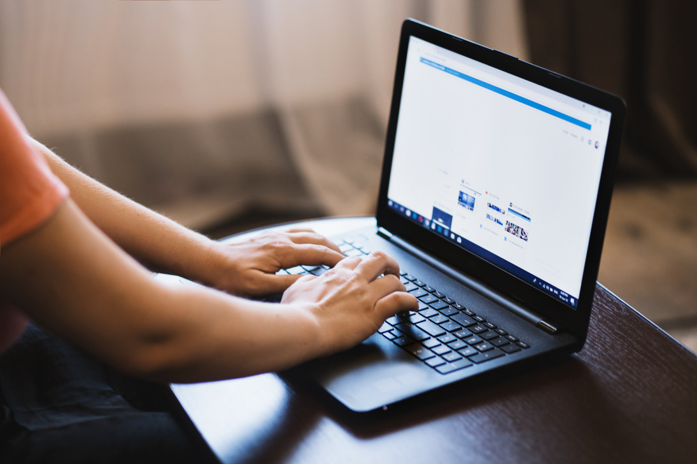

HOW TO DETECT PHISHING EMAILS
1.
CHECK THE SENDER'S EMAIL ADDRESS
2.
LOOK FOR URGENT OR THREATENING LANGUAGE
Look for misspelled domains or suspicious email addresses.
Example: support@micros0ft.com (notice the "0" instead of "o").
Phrases like “Account will be suspended” or “Action required immediately.”
Urgency is a tactic to make you act fast without thinking.

Slide 4
HOW TO DETECT PHISHING EMAILS
3
INSPECT THE LINK BEFORE CLICKING
4.
BE SUSPICIOUS OF ATTACHMENTS
Hover over links to see where they really lead.
Mismatched or shortened URLs may be a red flag.
Unexpected attachments, especially .zip, .exe, .docm, could contain malware.
Always verify with the sender if unsure.

Slide 5

STUDIO SHODWE
HOME
ABOUT US
SERVIVCES
PHOTOS
HOW TO STOP PHISHING EMAILS
Enable Spam Filters
Use built-in spam filters in your email client.
Regularly update and fine-tune these filters.
Implement Email Authentication Protocols
SPF, DKIM, and DMARC prevent email spoofing.
Help verify if the email really comes from the domain it claims.
Use Anti-Phishing Tools
Email security software and browser extensions can detect phishing attempts.
Warn users before visiting malicious websites.
Keep Software and Systems Updated
Regular updates patch vulnerabilities in browsers, email clients, and OS.
WWW.REALLYGREATSITE.COM
PAGE 04

Slide 6
STUDIO SHODWE
HOME
ABOUT US
SERVIVCES
PHOTOS
HOW TO STOP PHISHING EMAILS
User Awareness Training
Regular training for employees on phishing detection.
Use simulated phishing emails to test awareness.
Report Suspicious Emails
Encourage users to report phishing attempts to the IT or security team.
Helps protect the whole organization.
Block Malicious Domains
Use firewalls and DNS filtering to block access to known phishing sites.
Two-Factor Authentication (2FA)
Even if credentials are stolen, 2FA can block access to the account.
WWW.REALLYGREATSITE.COM
PAGE 04

Slide 7
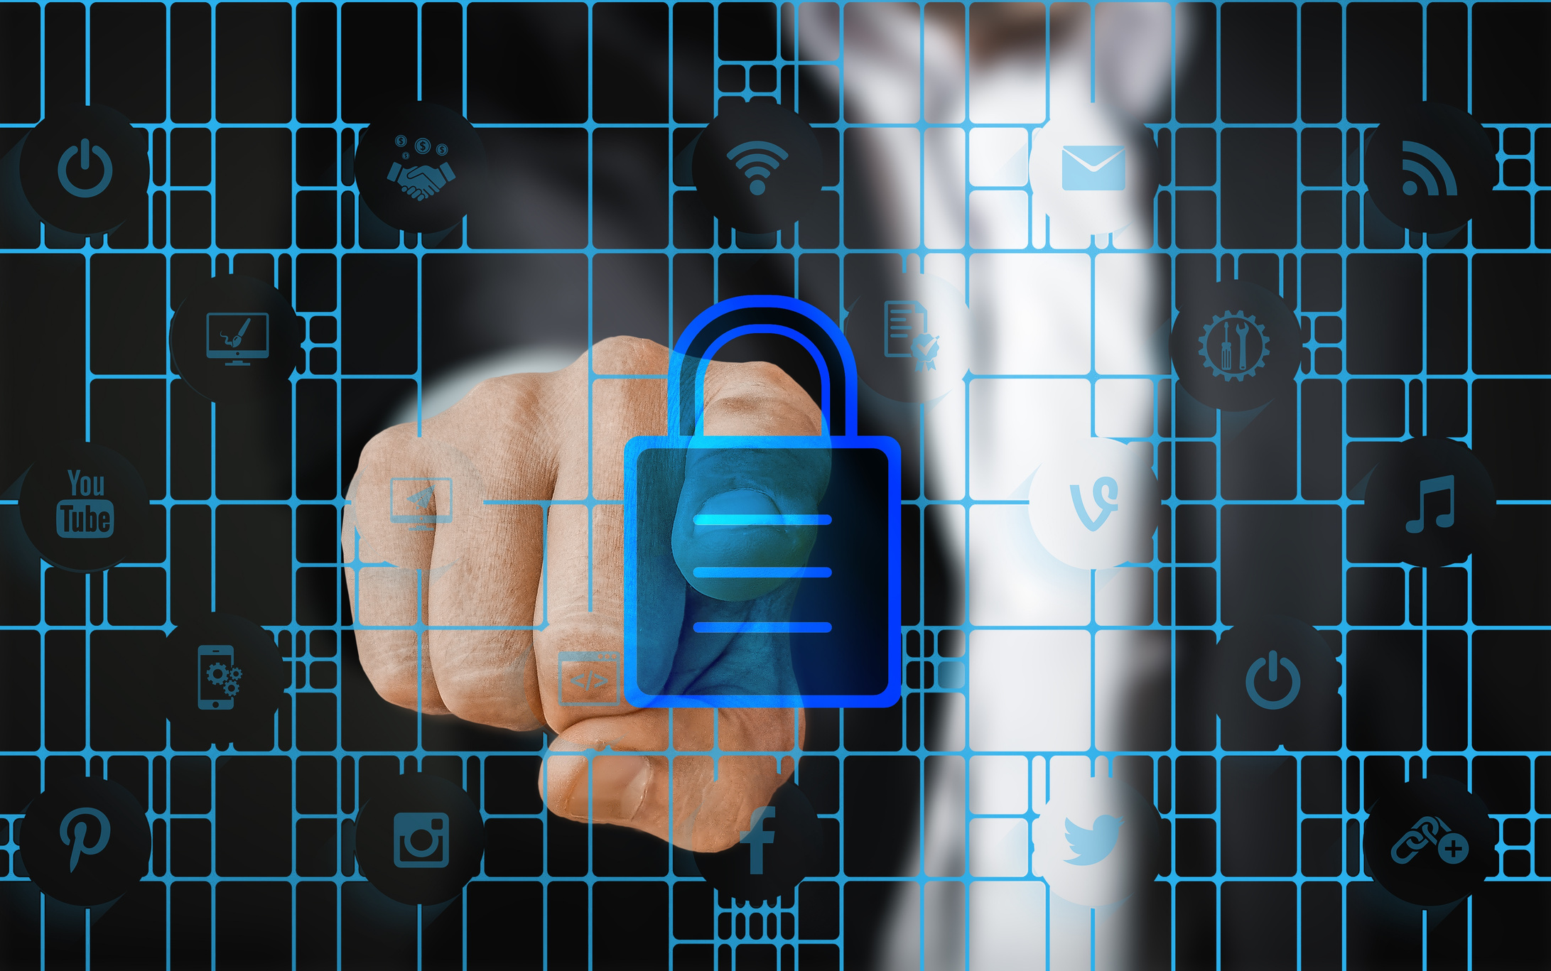
SOCIAL
ENGINEERING SCAMS
IMPERSONATION TACTICS
1.
FAKE SUPPORT CALLS
1.

Slide 8
THANK
YOU!
YOU!

