Slide 1

ALL-WEATHER SMART VEHICLE
Smart Vehicle Gate Recognition System
YOLOv8
EfficientNet-B4
Orange Pi 5
ANPR
VMMR
Multi-Stage Deep Learning Pipeline for Vehicle Make/Model Recognition,
License Plate Detection & Character Recognition Under Adverse Weather
PRESENTED BY
Supervisor: Dr. Taimoor Naeem
ABDUL HADI (FA22-BCE-018)
Ali Raza Chaudhry (FA22-BCE-102)
Abdullah Yaseen (FA22-BCE-065)
1 / 34

Slide 2
Problem Statement
Identifying key challenges in vehicle identification at gates
01
Manual vehicle identification at gates is slow, error-prone, and impractical at scale
02
Adverse weather (fog, rain) severely degrades image quality — AI models fail on unprocessed images
03
Existing systems address only one aspect (plate detection only), not complete vehicle identification
04
Pakistani license plates are non-standardized — varying sizes, fonts, colors — much harder than Turkish/Chinese/Nigerian plates
05
Cloud-based OCR (Google Vision AI) is costly and has privacy/latency concerns
06
No existing system integrates VMMR + ANPR + Weather Preprocessing + Dashboard + Edge Deployment
2 / 34

Slide 3
Objectives
Project goals and deliverables
1
Develop a Vehicle Make/Model Recognition (VMMR) system — 245 vehicle classes (Pakistani + JDM market)
2
Build License Plate Detection using YOLOv8 object detection
3
Implement Character Recognition module — 38 classes (0-9, A-Z) from detected plates
4
Design weather-aware preprocessing for Fog Removal (DCP) and Rain Removal (Vertical Median Filter)
5
Integrate all modules into a unified end-to-end pipeline
6
Deploy a web-based dashboard for real-time access control and monitoring
7
Implement on Orange Pi 5 (8GB) for edge deployment at gates
3 / 34

Slide 4
Literature Review
Analysis of 10 related works (Papers 1-5)
# | Paper (Year) | Method | Accuracy | Key Limitation
1 | Vehicle & LP Recognition for Toll (2025) | YOLOv5/v8/v11 | ~99% (nano 97-98%) | Broad categories only, no make/model
2 | ANPR for Pakistani Plates (2025) | YOLOv3, 200 imgs | 96.7% | Very small dataset, no VMMR
3 | Unified VMMR, ANPR, Color (2025) | MobileNetV2+EasyOCR | ANPR 93.3%, VMMR 90.6% | EasyOCR fails on Pakistani fonts
4 | LP Under Diverse Env. (2025) | CNN+RPN, CCPD 290K | 97.5% mAP | Chinese plates only
5 | Smart Parking IoT (2025) | Google Vision AI+ESP32 | 98% | Cloud-dependent, costly
4 / 34

Slide 5
Literature Review (Continued)
Analysis of 10 related works (Papers 6-10)
# | Paper (Year) | Method | Accuracy | Key Limitation
6 | ALPR Using Image Processing (2023) | MATLAB segmentation | Det 97.5%, Char 94.17% | 120 imgs, no VMMR, fails in rain
7 | YOLO for Smart Buildings (2024) | Edge det.+YOLO, 37K font | Prec 96%, OCR 95% | Font dataset, not real plates
8 | Real-Time Car & Plate (2024) | MobileNetV2+PaddleOCR | 97.5% all-weather | Only 30 models, 1K imgs, no UI
9 | ANPR Using TensorFlow (2024) | TF+EasyOCR, 203 imgs | 93.33% | Small dataset, no VMMR, no UI
10 | YOLOv12+Tesseract (2025) | YOLOv12+Tesseract | Plate 96%, OCR 82% | Tesseract very poor, Turkish only
GAP IDENTIFIED
No system combines VMMR + ANPR + Weather Preprocessing + Dashboard + Edge Deployment.
EasyOCR (93.3%) and Tesseract (82%) perform poorly on Pakistani plates.
5 / 34

Slide 6
Our Novelty vs. Literature
Head-to-head comparison with reviewed papers
Feature | Best in Literature | Our System
ANPR Accuracy | 99% (Paper 1, toll) | 99.4% mAP@50
VMMR Classes | 30 models (Paper 8) | 245 make/model classes
VMMR Accuracy | 90.6% (Paper 3) | 96.24% Top-1
OCR Method | EasyOCR 93.3% / Tesseract 82% | YOLOv8: 98.99% Precision
Dataset Scale (VMMR) | 364 images (Paper 3) | 57,135 images
Weather Handling | Trained on weather data (Paper 8) | Dedicated fog + rain preprocessing
Edge Deployment | Orange Pi (Paper 1) | Orange Pi 5 (8GB)
Dashboard | SQLite lookup only (Paper 9) | Full React+Express (auth, live feed, history)
Our system surpasses all 10 reviewed papers on every comparison metric.
6 / 34

Slide 7
System Overview
Architecture of the complete recognition system
AI
VMMR
LP
Plate Detection
CR
Char Recognition
EfficientNet-B4 — 245 vehicle classes (Pakistani + JDM)
YOLOv8n — detects license plate region in images
YOLOv8n — 38 classes (0-9, A-Z) from plates
PP
Preprocessing
WD
Web Dashboard
Pi
Edge Device
Fog removal (DCP) + Rain removal (Vertical Median)
React + Express — Auth, Live Feed, History, Override
Orange Pi 5 (8GB) with gate camera integration
7 / 34

Slide 8
Methodology
Systematic development approach
1
Data Collection
245-class VMMR dataset (~57K imgs), 1,235-image OCR dataset (Roboflow), plate detection dataset (600+ annotated)
2
Model Selection
EfficientNet-B4 (transfer learning) for VMMR; YOLOv8n for plate detection & character recognition
3
Preprocessing Design
Dark Channel Prior for fog; Vertical Median Filter for rain — classical CV, no extra training needed
4
Independent Training
Each model trained/evaluated separately on held-out test sets on Google Colab (Tesla T4)
5
Pipeline Integration
Preprocess → VMMR → Plate Detection → Char Recognition → Post-Processing (ABC-1234 format)
6
End-to-End Testing
Pipeline tested on fog-degraded (10 images) and rain-degraded (8 images) — 100% success rate
7
Dashboard & Deploy
React+Express web app; planned Orange Pi 5 edge deployment
8 / 34

Slide 9
Complete Pipeline
End-to-end processing flow
Input
Image
Pre-
process
VMMR
Plate
Detect
Crop
Plate
Char
Recog
Post-
Process
Output
▸
▸
▸
▸
▸
▸
▸
fog / rain
DCP / VMF
EffNet-B4
YOLOv8n
ROI
YOLOv8n
ABC-1234
Result
EXAMPLE END-TO-END FLOW
Input: Foggy image of a car on a road
Fog Removal (DCP): Clear, dehazed image produced
VMMR: "Toyota Corolla 2014-2016" (confidence: 95%)
Plate Detection: Plate region localized with bounding box
Char Recognition: L, E, B, 5, 7, 0, 0 detected
Post-Processing: "LEB-5700" — Status: Allowed
9 / 34

Slide 10
VMMR Module — EfficientNet-B4
Vehicle Make/Model Recognition across 245 classes
DATASET
TRAINING CONFIG
TEST RESULTS
Split | Images
Train | 31,904
Validation | 7,977
Test | 17,254
Total | ~57,135
Classes | 245
Size | ~6.4 GB
Parameter | Value
Epochs | 50 (early stop, p=5)
Batch Size | 32
Optimizer | AdamW (1e-4 → 5e-5)
Loss | CE (smooth=0.1)
Input Size | 224 × 224
GPU | Tesla T4
Metric | Value
Top-1 Accuracy | 96.24%
Top-5 Accuracy | 99.39%
Precision | 96.34%
Recall | 96.12%
F1 Score | 96.18%
FPR | 0.02%
Architecture: EfficientNet-B4 (ImageNet) → Classifier: nn.Linear(1792, 245) + Dropout(0.4) | 30+ brands with generation-level granularity
TRAINING PROGRESSION
Epoch | Train Loss | Val Loss | Train Acc | Val Acc | LR
33 | 1.0943 | 1.1112 | 97.70% | 95.76% | 1e-4
35 | 1.0684 | 1.1099 | 98.06% | 95.80% | → 5e-5
43 | 1.1804 | 1.0820 | 94.75% | 96.25% | 5e-5
50 | 1.1340 | 1.0738 | 95.83% | 96.41% | 5e-5
15 / 34

Slide 11
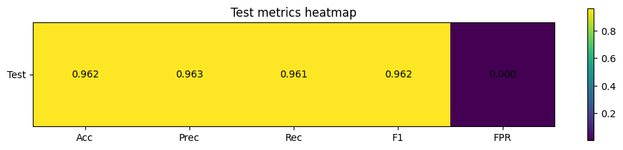
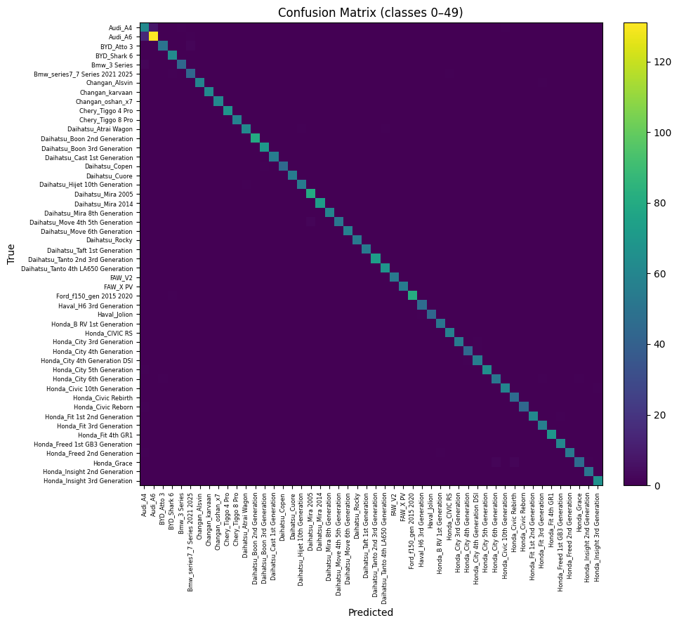
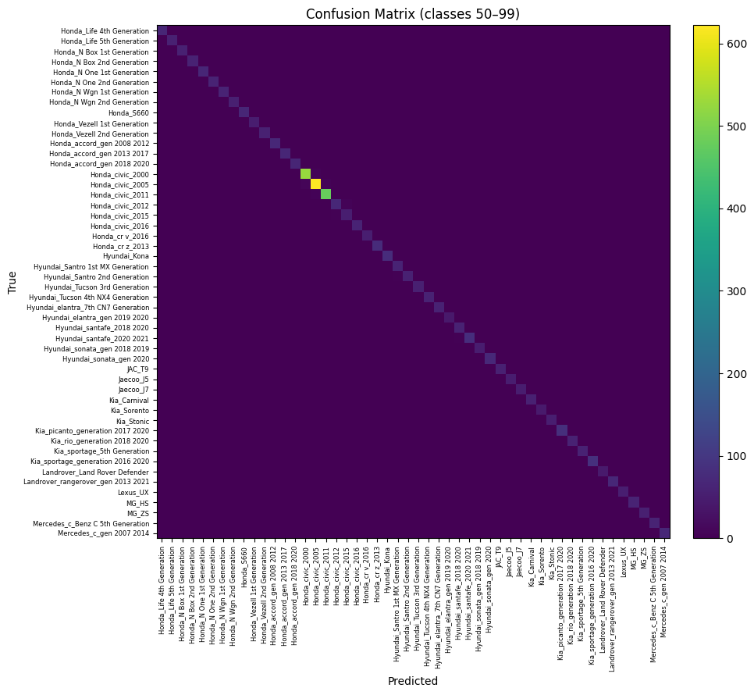
VMMR Results — Metrics & Confusion Matrices
Test performance heatmap and class-level accuracy (part 1)
TEST METRICS HEATMAP
CONFUSION MATRIX — CLASSES 0-49
CONFUSION MATRIX — CLASSES 50-99
16 / 34

Slide 12
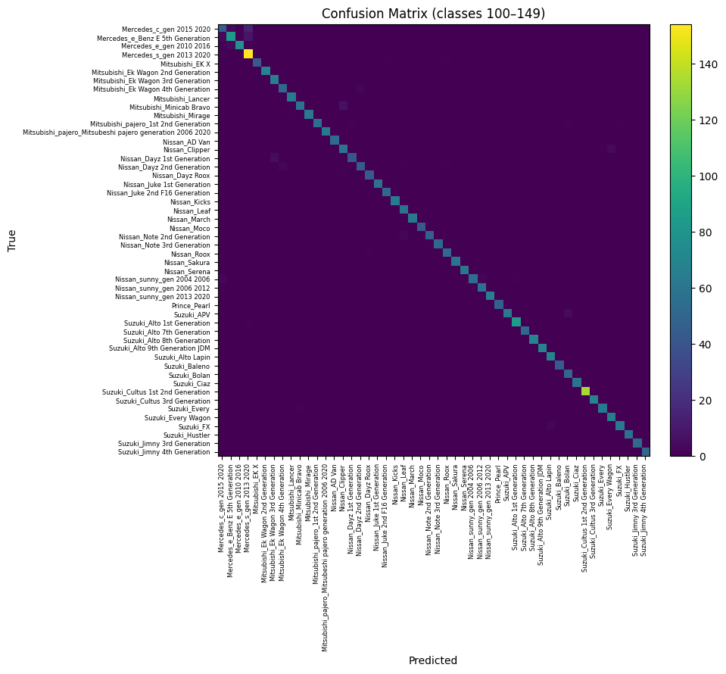
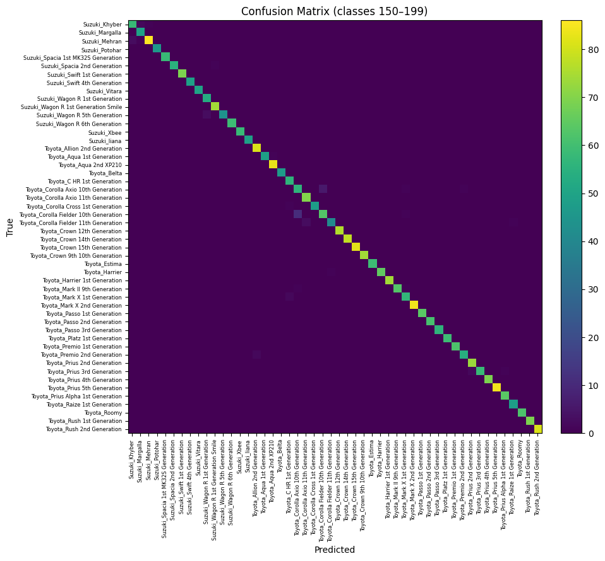
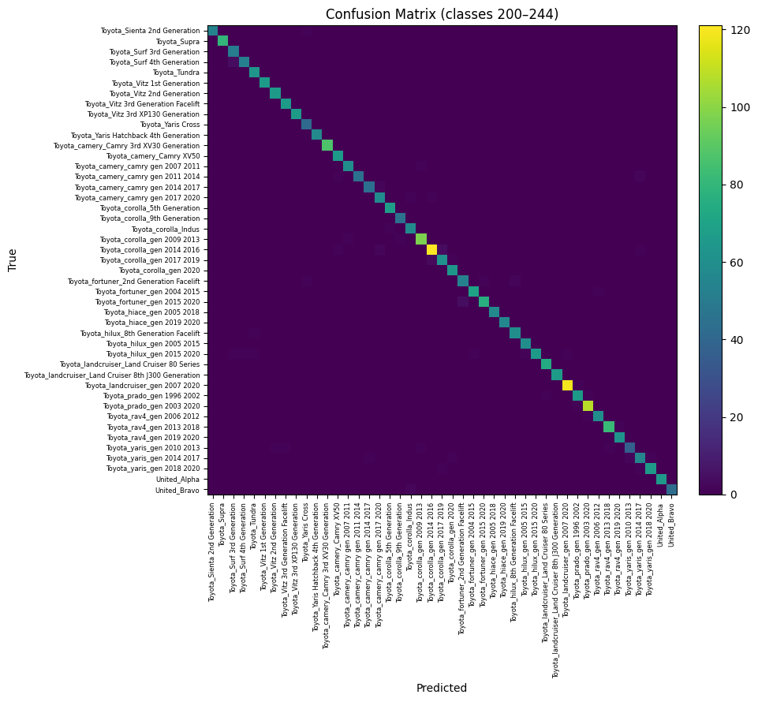
VMMR Results — Confusion Matrices (Continued)
Class-level accuracy across all 245 vehicle classes
CLASSES 100-149
CLASSES 150-199
CLASSES 200-244
KEY OBSERVATIONS
Strong diagonal dominance across all 245 classes — model predictions are highly concentrated on correct classes
Minor confusion observed between visually similar generations (e.g., Honda Civic 2000/2005, Toyota Corolla Indus/2009-2013)
96.24% Top-1 accuracy with near-zero off-diagonal values demonstrates excellent generalization
17 / 34

Slide 13
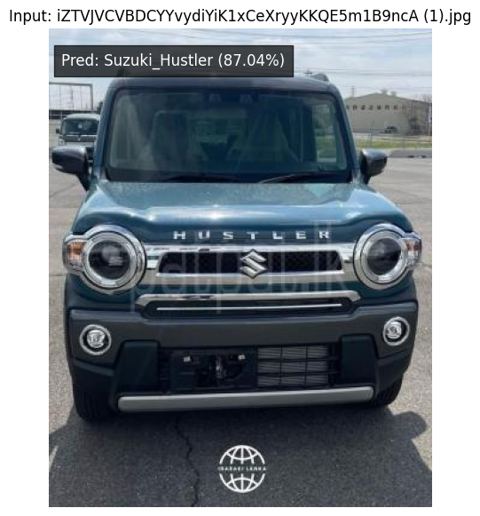
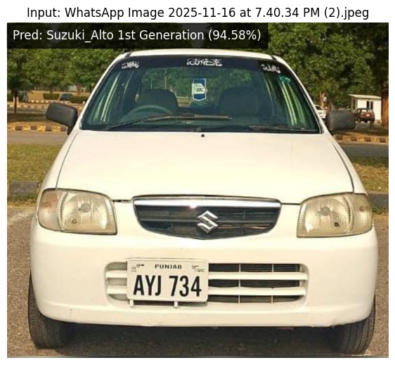
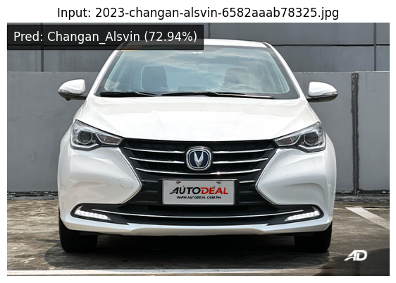
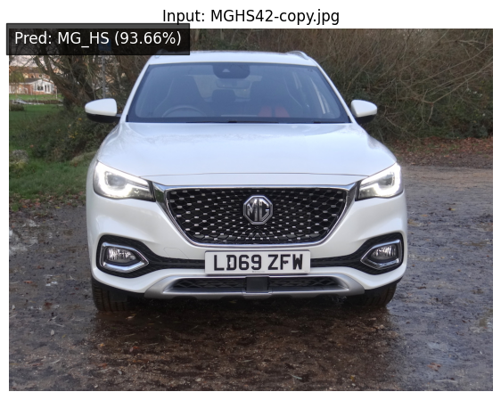
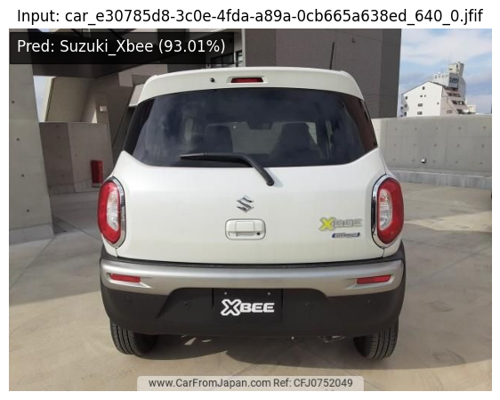
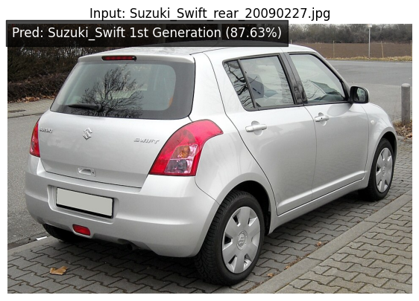
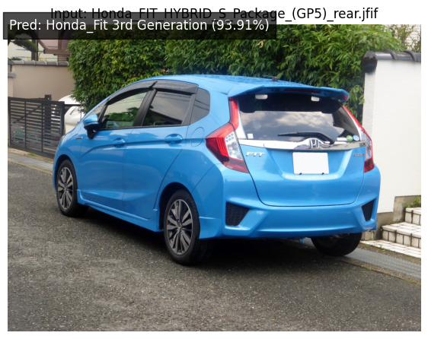
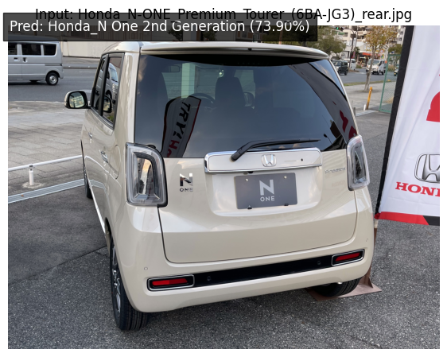
VMMR Results — Sample Predictions
Real-world test predictions with confidence scores
Suzuki Hustler
Suzuki Alto 1st Gen
Changan Alsvin
MG HS
87.04%
94.58%
72.94%
93.66%
Suzuki Xbee
Suzuki Swift 1st Gen
Honda Fit 3rd Gen
Honda N One 2nd Gen
93.01%
87.63%
93.91%
73.90%
18 / 34

Slide 14
License Plate Detection — YOLOv8n
Single-class plate detection module
TRAINING CONFIGURATION
FINAL RESULTS — EPOCH 50
Parameter | Value
Model | YOLOv8n (Nano), pretrained
Epochs | 50
Batch Size | 32
Image Size | 380 × 380
LR / Momentum | 0.01 / 0.937
Metric | Value | Metric | Value
Precision | 98.50% | mAP@50 | 98.07%
Recall | 95.53% | mAP@50-95 | 70.73%
Val Box Loss | 1.067 | Val Cls Loss | 0.384
TRAINING PROGRESSION
Epoch | Precision | Recall | mAP@50 | mAP@50-95
1 | 93.39% | 89.84% | 93.63% | 58.90%
10 | 96.59% | 92.67% | 96.17% | 65.96%
25 | 98.82% | 93.67% | 97.39% | 69.11%
50 | 98.50% | 95.53% | 98.07% | 70.73%
19 / 34

Slide 15
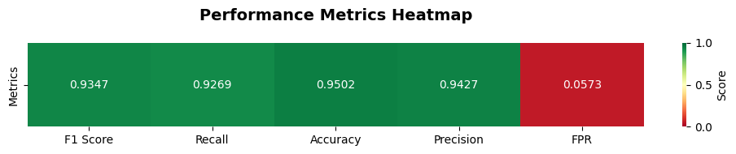
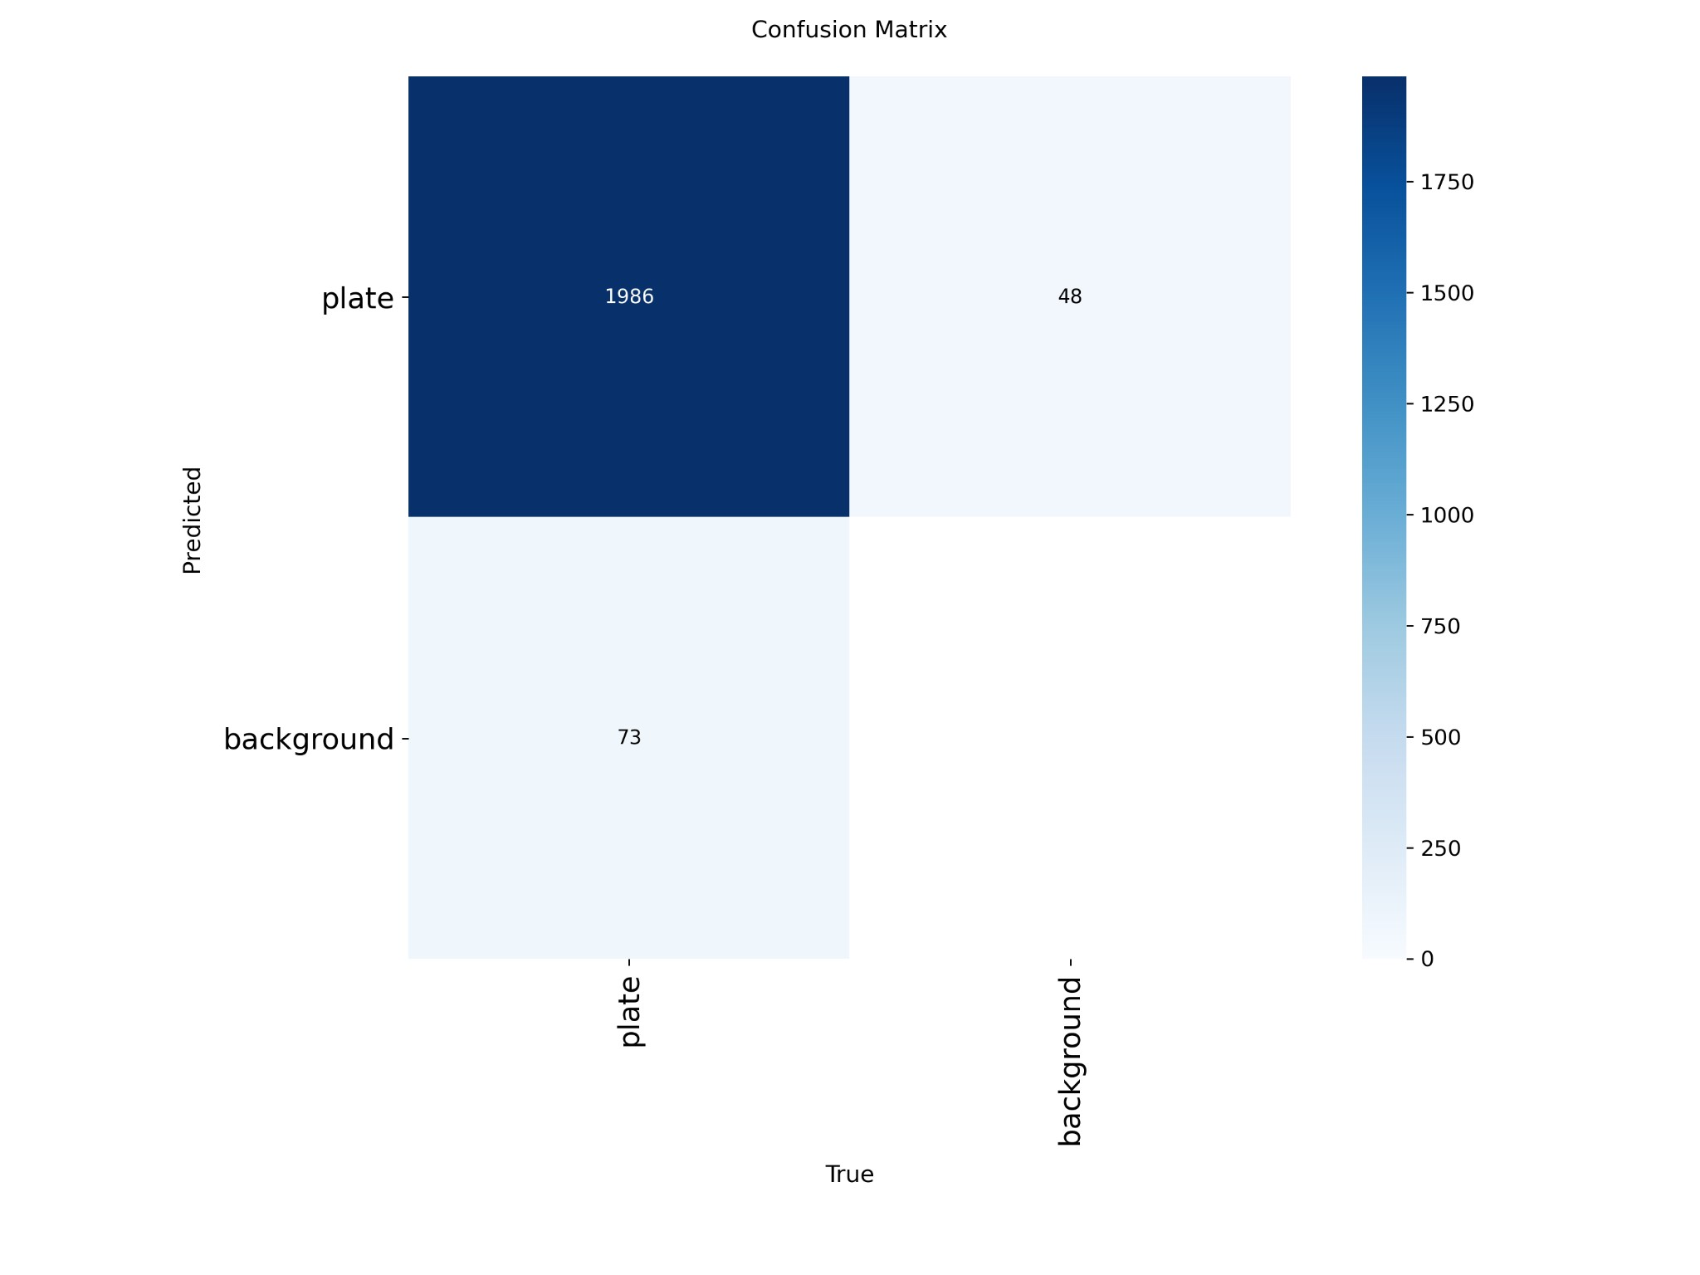
YOLO License Plate Detection — Result Visuals
Performance heatmap and confusion matrix
PERFORMANCE METRICS HEATMAP
CONFUSION MATRIX
20 / 34

Slide 16
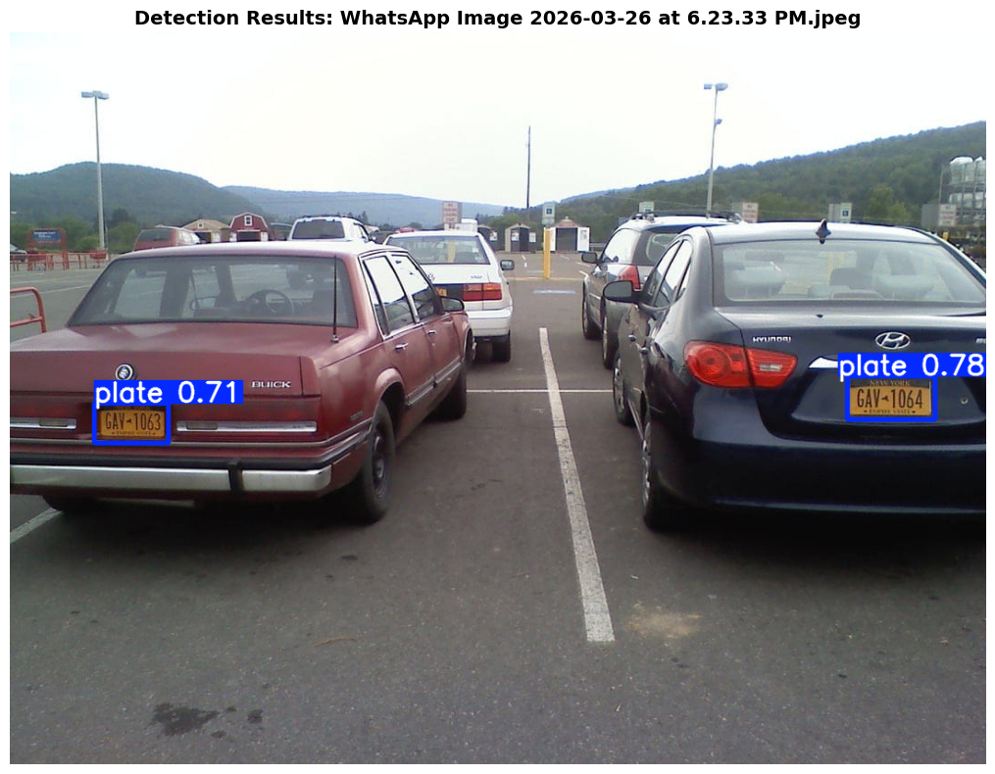
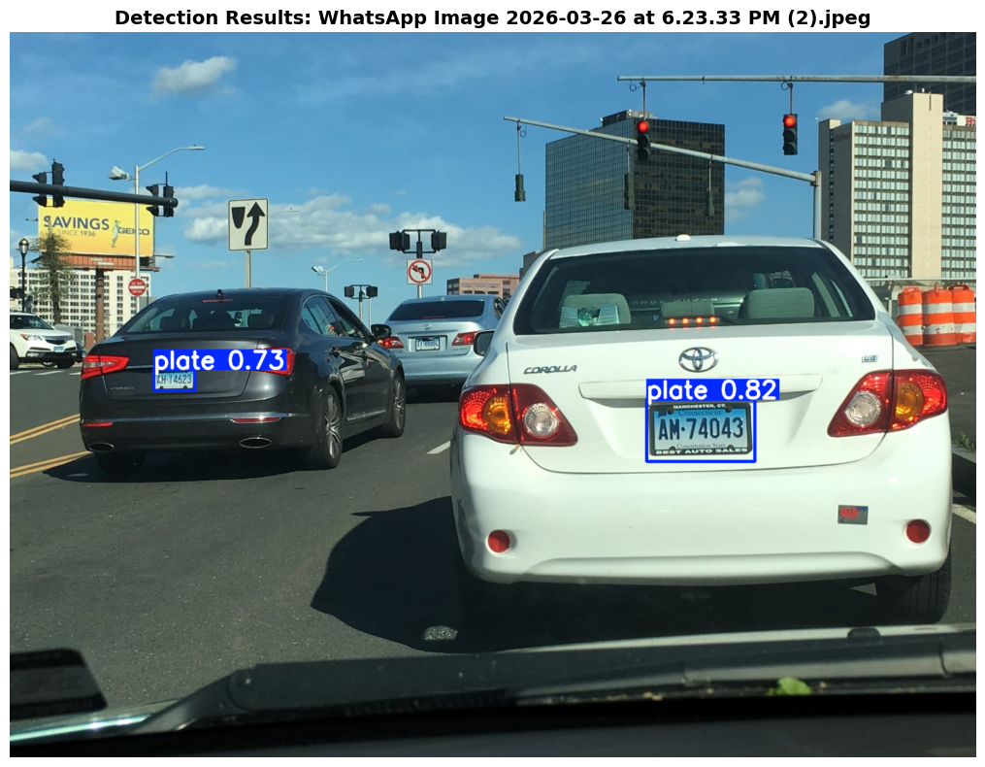
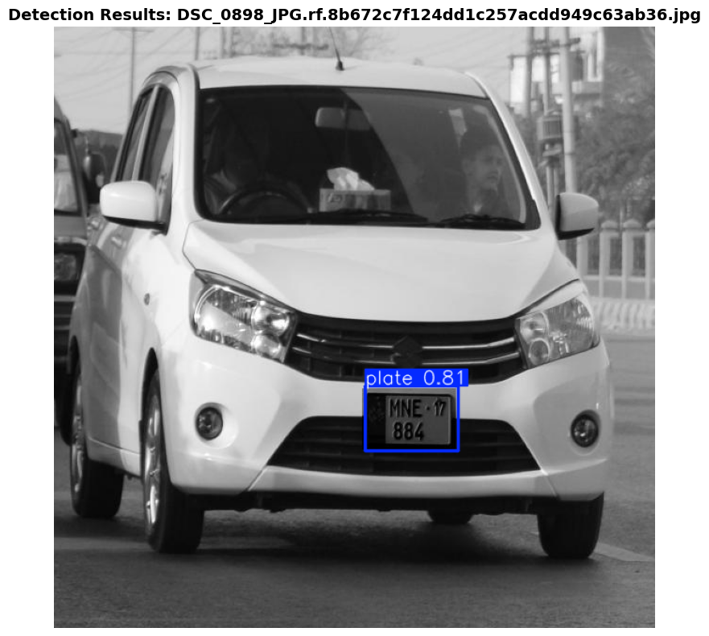
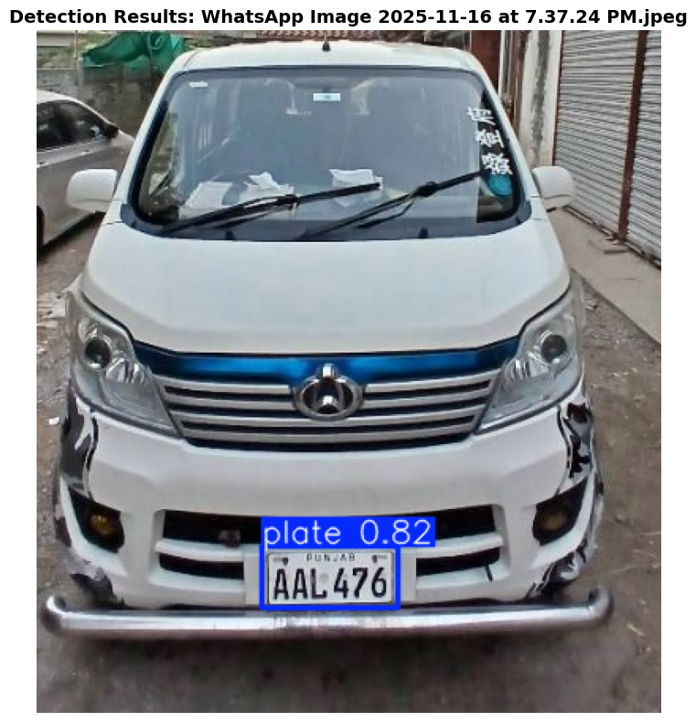
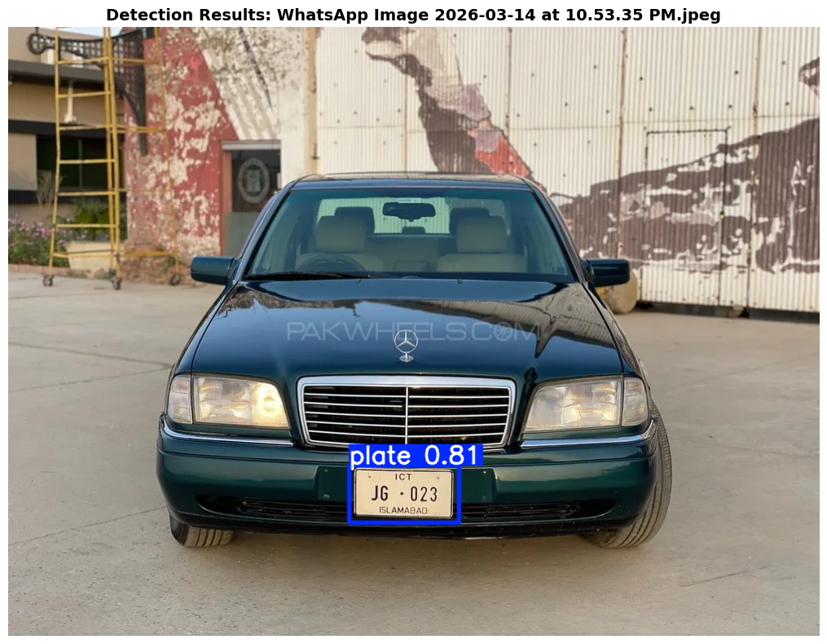
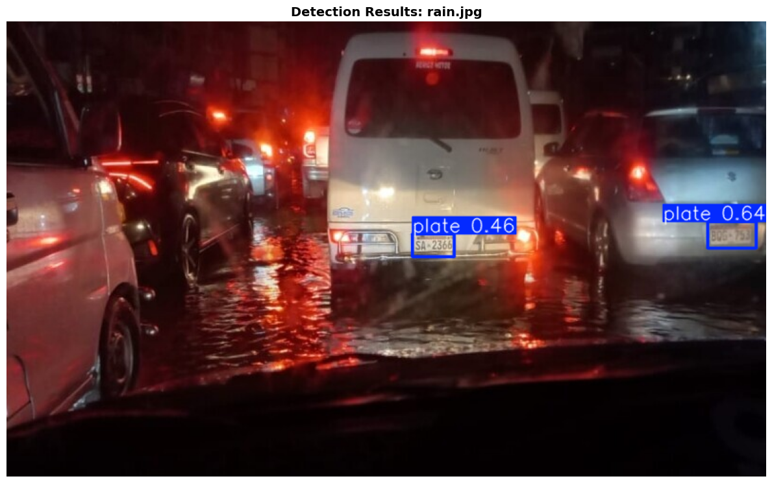
YOLO License Plate Detection — Sample Outputs
Real detection examples from validation/inference
21 / 34

Slide 17
Character Recognition — YOLOv8n
38-class character detection on license plates
DATASET
TRAINING CONFIG
FINAL RESULTS — EPOCH 100
Detail | Value
Images | 1,235
Classes | 38 (0-9, A-Z, YY, a)
Format | YOLOv8 bbox
Img Size | 512 × 512
Param | Value
Epochs | 100
Batch | 16
ImgSz | 640 × 640
Augment | Mosaic, FlipLR, HSV
Metric | Value
Precision | 98.99%
Recall | 96.88%
mAP@50 | 98.07%
mAP@50-95 | 76.11%
TRAINING PROGRESSION — DRAMATIC LEARNING CURVE
Epoch | Precision | Recall | mAP@50 | mAP@50-95
1 | 2.97% | 27.54% | 3.25% | 2.18%
10 | 87.65% | 78.47% | 84.49% | 58.09%
50 | 97.31% | 96.22% | 96.98% | 71.37%
95 | 98.98% | 96.84% | 99.41% (peak) | 76.91%
100 | 98.99% | 96.88% | 98.07% | 76.11%
Post-Processing: Characters sorted L→R by x-coord → split letters/digits → format ABC-1234 | Example: Raw "LL09614" → Corrected "LL-0149"
22 / 34

Slide 18
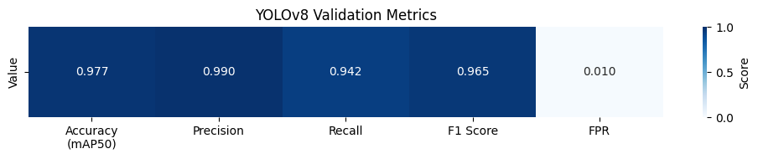
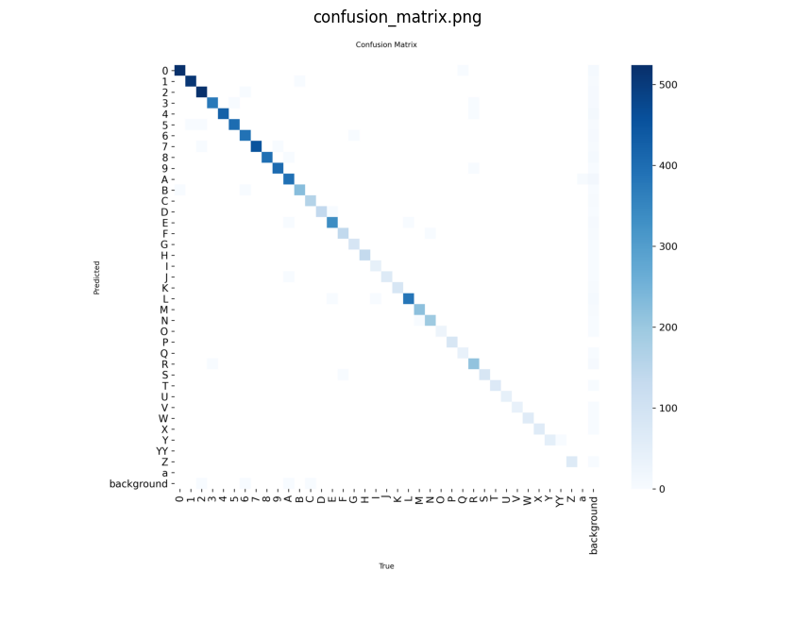
License Character YOLO — Result Visuals
Validation metrics and confusion matrix
YOLOv8 VALIDATION METRICS
CHARACTER RECOGNITION CONFUSION MATRIX
23 / 34

Slide 19
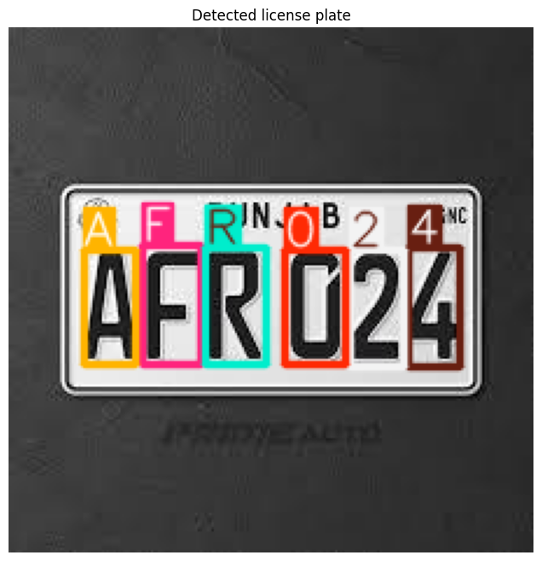
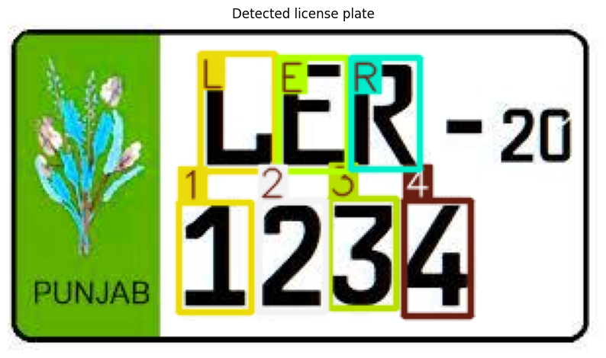
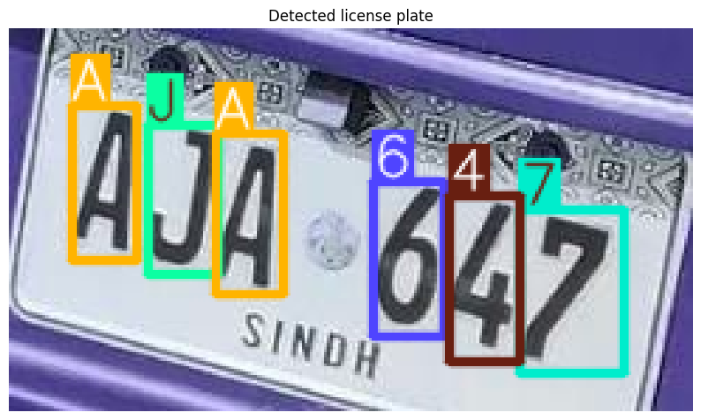
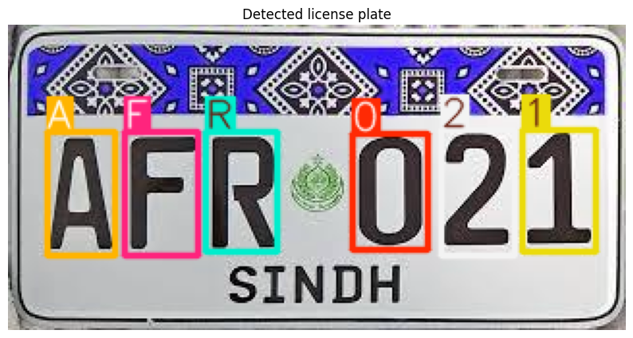
License Character YOLO — Sample Detections
Character-level detection outputs on license plates
These results show robust character localization for different plate layouts, fonts, and province styles (Punjab / Sindh).
24 / 34

Slide 20
Preprocessing Module
Fog & Rain Removal — currently implemented conditions
FOG REMOVAL — Dark Channel Prior
RAIN REMOVAL — Vertical Median Filter
Compute dark channel (patch=13)
Estimate atmospheric light (top 0.1%)
Transmission: t = 1 − 0.95 × DC(I/A)
Guided Image Filter refinement (r=50)
Residual haze pass on foggy regions
Gray-world white balance + CLAHE
Build protection mask for text/plate regions
Bilateral filter + Canny + density threshold
3 progressive V-median passes (k:15→11→7)
Blend filtered output, protecting text areas
Residual spot detection (area 2-250 px)
Inpaint via Telea algorithm (radius=3)
Image preprocessing is currently implemented for Fog and Rain conditions only.
10 / 34

Slide 21
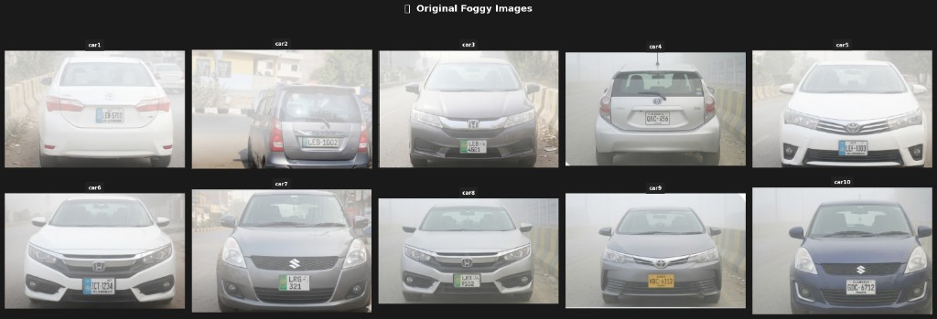
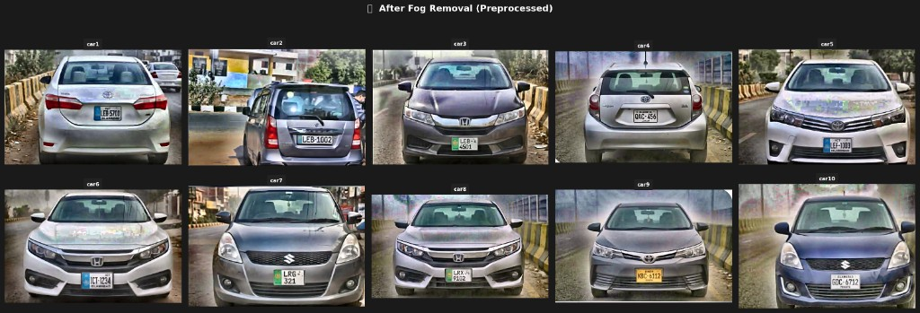
Preprocessing Visual Results — Fog
Original vs after fog removal
ORIGINAL FOGGY IMAGES
AFTER FOG REMOVAL (PREPROCESSED)
11 / 34

Slide 22
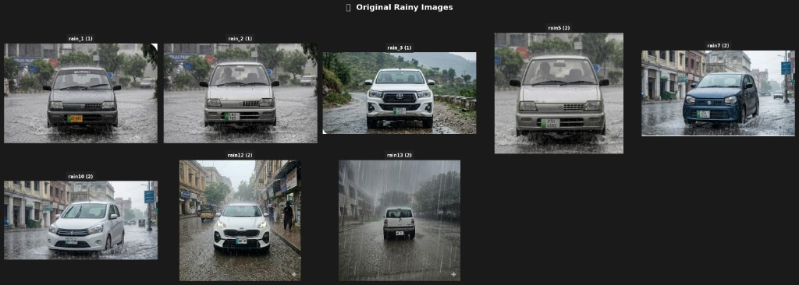
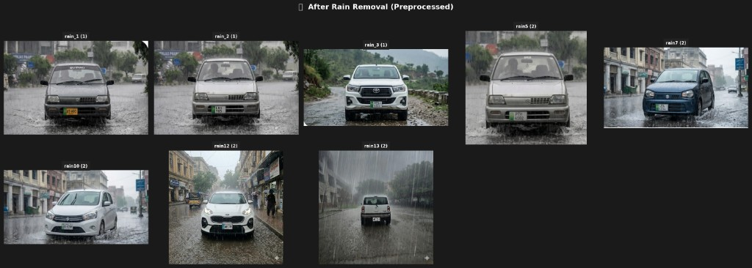
Preprocessing Visual Results — Rain
Original vs after rain removal
ORIGINAL RAINY IMAGES
AFTER RAIN REMOVAL (PREPROCESSED)
12 / 34

Slide 23
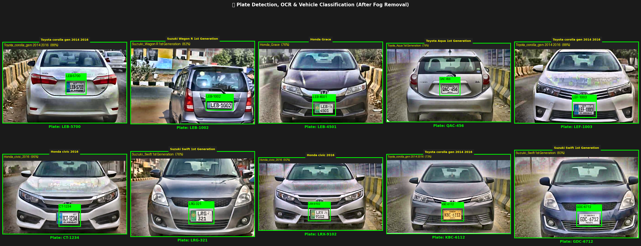
Complete Pipeline — Visual Results
End-to-end outputs after fog/rain preprocessing
AFTER FOG REMOVAL — COMPLETE PIPELINE
26 / 34

Slide 24
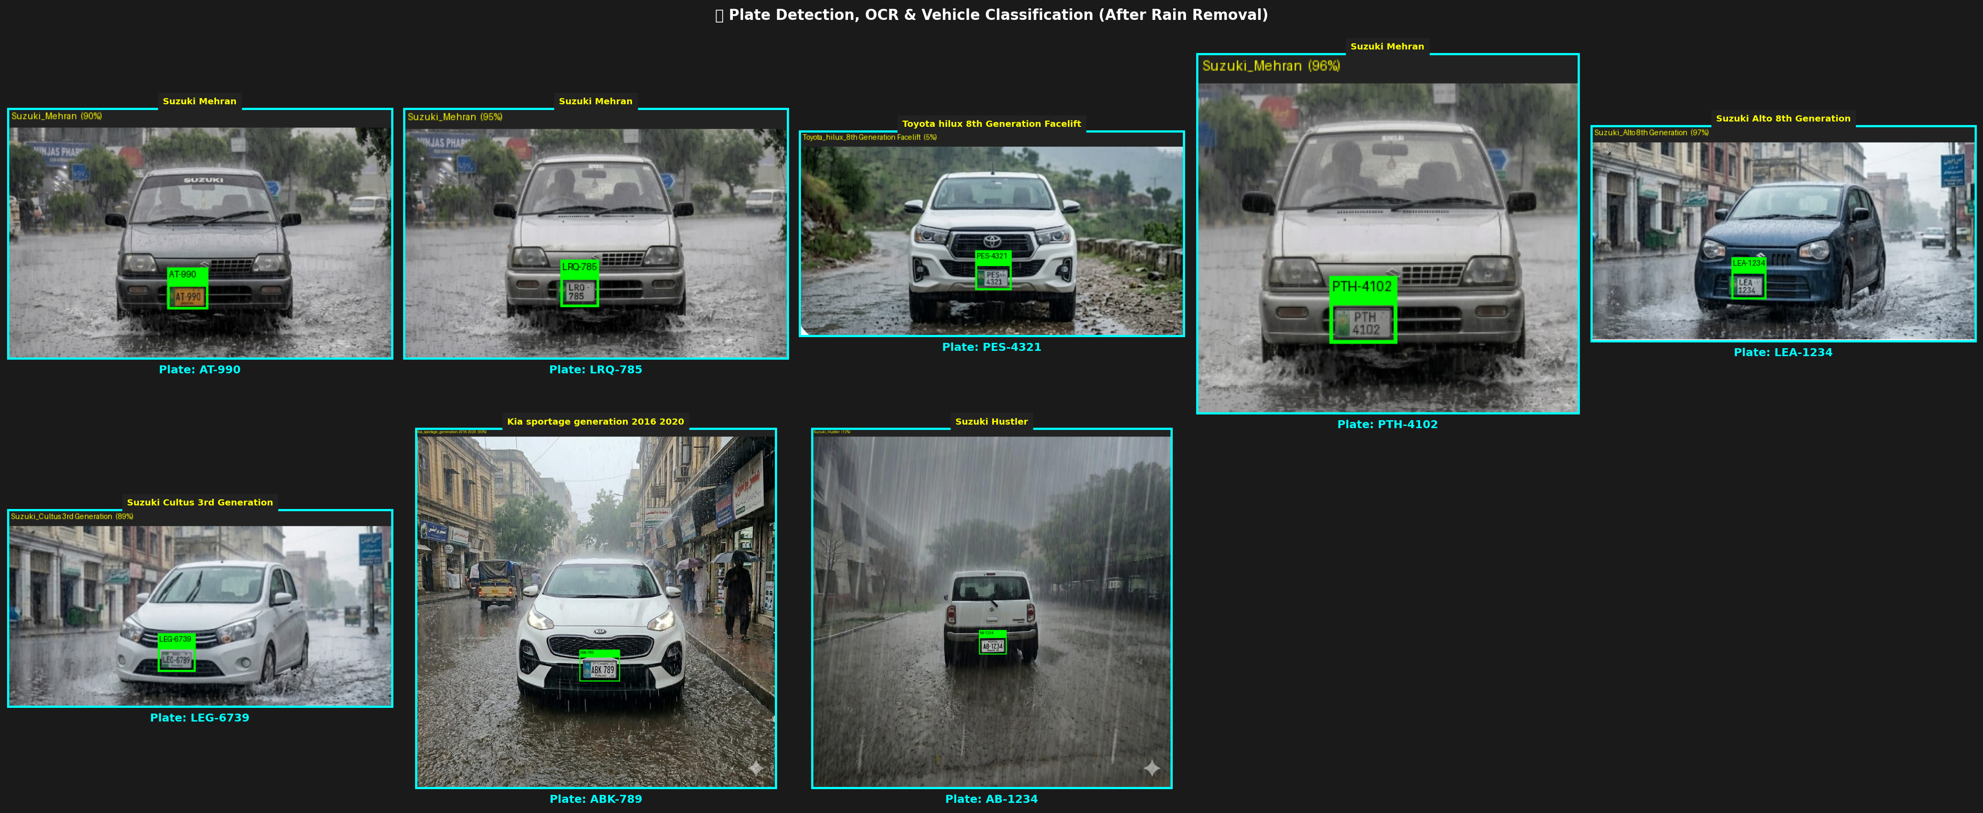
Complete Pipeline — Visual Results
End-to-end outputs after fog/rain preprocessing
AFTER RAIN REMOVAL — COMPLETE PIPELINE
26 / 34

Slide 25
Current Progress Status
Component completion overview
VMMR Dataset (245 classes, ~57K images)
Complete
VMMR Training (Top-1: 96.24%, Top-5: 99.39%)
Complete
Plate Detection Training (mAP@50: 98.07%)
Complete
Char Recognition Training (mAP@50: 98.07%)
Complete
Fog Removal Preprocessing (DCP)
Complete
Rain Removal Preprocessing (Vertical Median)
Complete
End-to-End Pipeline Integration
Complete
Pipeline Testing — Fog (10/10) & Rain (8/8)
Complete
Web Dashboard (React + Express)
Complete
Orange Pi 5 Deployment
In Progress
Additional Weather (snow, glare, night)
Pending
Real-Time Video Stream Processing
Pending
31 / 34

Slide 26
Future Work
Planned enhancements and next steps
1
Expand Preprocessing
6
Dashboard Enhancements
3
Edge Deployment
Sun glare handling, nighttime / low-light enhancement
Real-time camera integration, push notifications, analytics
Orange Pi 5 (8GB) with gate USB camera integration
32 / 34

Slide 27
THANK YOU
Questions & Discussion
All-Weather Smart Vehicle Gate Recognition System
34 / 34

