Slide 1
DRAMS LIVE
Complete System Documentation
Architecture · Data Model · End-to-End Process Flows
Platform: CTD telecom-data & person-intelligence analysis system Framework: Kohana 3.x PHP (HMVC)

Slide 2
OVERVIEW
What this deck covers
01 Executive overview
07 Federated databases
13 Cron / background engine
02 Technology stack
08 Authentication & RBAC
14 External integrations
03 System architecture
09 Login & person flows
15 Sitemap & navigation
04 Request lifecycle (HMVC)
10 Telecom request lifecycle
16 Roles & journeys
05 Codebase & controllers
11 CDR ingestion & identity sync
17 Table inventory
06 Data model (ER)
12 Watchlist & reporting
18 Glossary
DRAMS Live · System Documentation
1

Slide 3
01 · EXECUTIVE OVERVIEW
What DRAMS Live does
Person profiling
A 360° record per person: identity (CNIC/NADRA, foreigner, passport), addresses, education, banks, criminal record, affiliations, training, relations, devices & SIMs.
1
Telecom data acquisition
Submits formal CDR / subscriber / location requests to mobile operators by email, then auto-parses the email replies back into the database.
2
CDR analysis
Call/SMS summaries, B-party analysis, location & cell-tower tracking, device/IMEI/SIM history, and CDR network-graph visualisation.
3
External data federation
Searches subscriber, ECP, KPK-CTD, DLMS & govt-employee databases plus NADRA / Verisys / Family-Tree / Travel and an AIES/CCTW REST API.
4
Watchlists, reporting & audit
Tag and watch persons, build user/person/admin analytics, and keep a full audit trail of every analyst action.
5
DRAMS Live · System Documentation
2

Slide 4
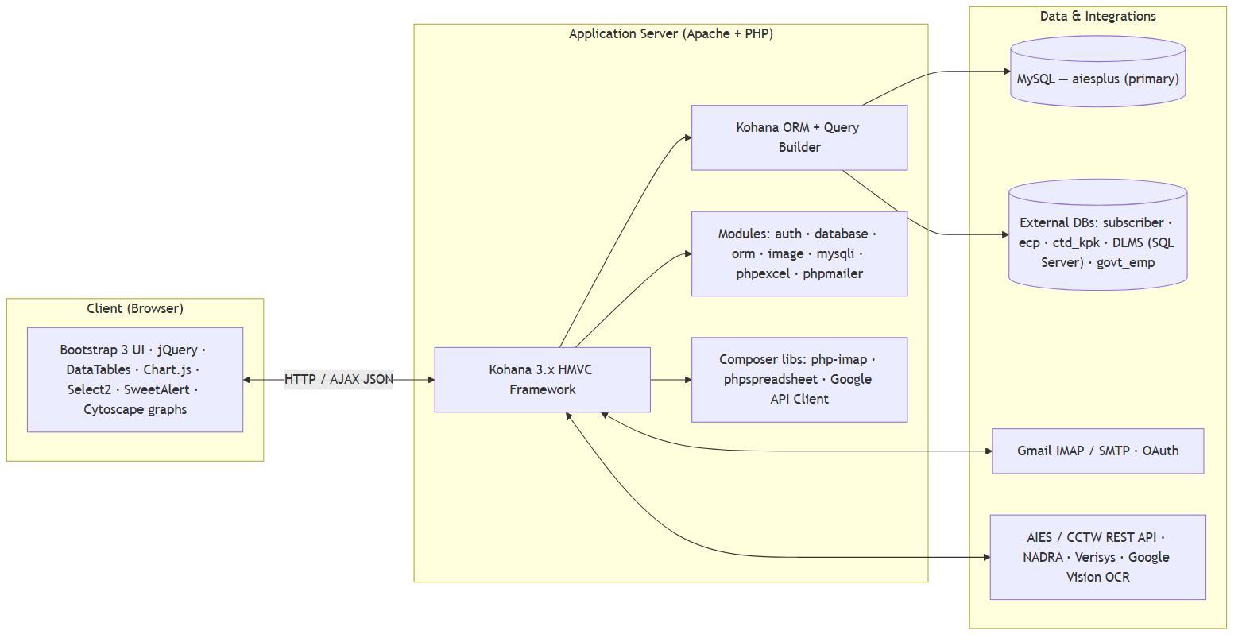
02 · TECHNOLOGY STACK
A layered Kohana / PHP stack
Key components
Kohana 3.x HMVC framework on Apache + PHP, ORM + Query Builder over MySQL.
Framework modules: auth, database, orm, image, mysqli, phpexcel, phpmailer.
Composer libraries: php-imap (receive mail), phpspreadsheet (Excel), Google API Client.
Front end: Bootstrap 3, jQuery, DataTables, Chart.js, Select2, Cytoscape graphs.
Primary DB aiesplus; five federated read-only data sources behind the Databank.
Figure 1
DRAMS Live · System Documentation
3

Slide 5
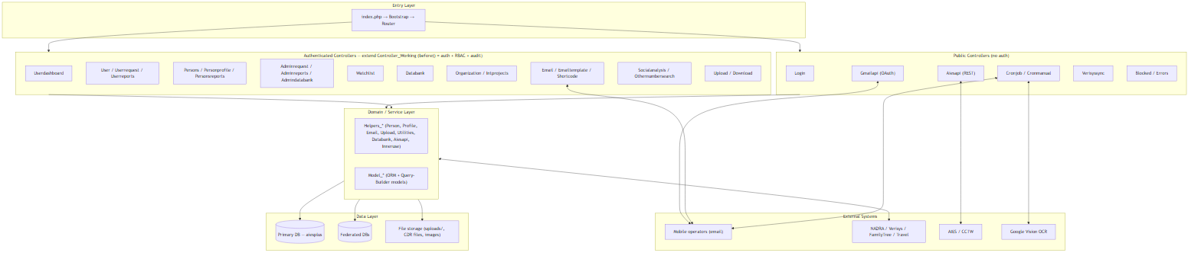
03 · SYSTEM ARCHITECTURE
Layered HMVC architecture
Figure 2
Public controllers (Login, Cronjob, Aiesapi, Gmailapi, Verisyssync) intentionally bypass auth.
Every authenticated controller extends Controller_Working — a single before() hook enforces auth, RBAC, IP-block and audit.
Domain logic lives in Helpers_* services and Model_* (ORM + query-builder) classes over the primary & federated databases.
DRAMS Live · System Documentation
4

Slide 6
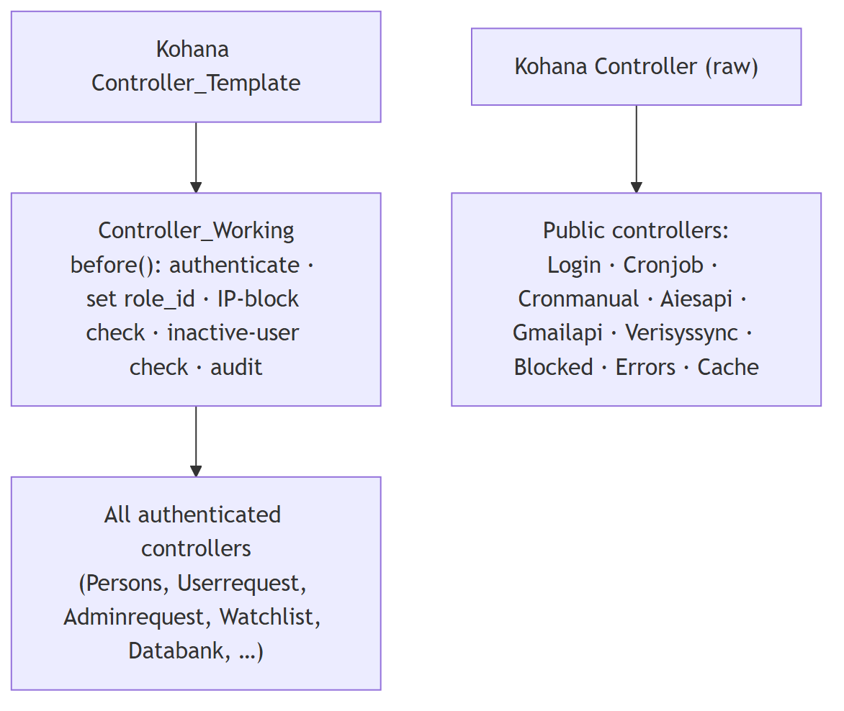
03 · CONTROLLERS
Controller inheritance & the security gate
How requests are gated
Controller_Working::before() runs on every authenticated page.
It authenticates the user, resolves role_id, checks the IP block-list and inactive-user status, then writes an audit log entry.
Raw public controllers (Login, Cron, REST API, Gmail OAuth) extend the bare Kohana controller and skip the gate by design.
≈30 controllers, several with 60–70 actions, organised by domain.
Figure 3
DRAMS Live · System Documentation
5

Slide 7
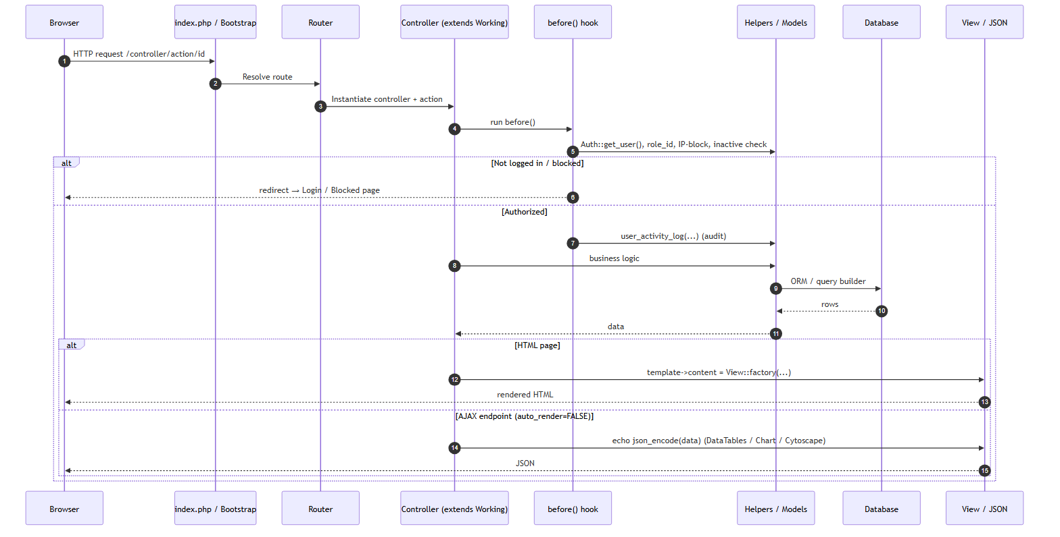
04 · REQUEST LIFECYCLE
How a browser request is served
Two response styles
index.php → Bootstrap → Router maps /controller/action/id (default controller = login).
before() authorises, then the action runs business logic via Helpers/Models.
Full pages render through the template wrapper (header, sidebar, footer) with .inc view bodies.
AJAX endpoints set auto_render=FALSE and echo JSON — DataTables tables, Chart.js charts, Cytoscape CDR graphs.
Figure 4
DRAMS Live · System Documentation
6

Slide 8
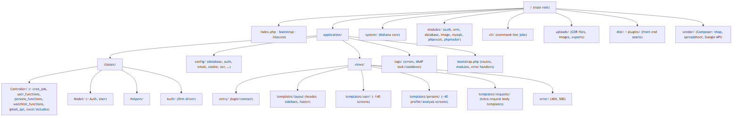
05 · CODEBASE
Module & directory structure
Figure 5
application/classes holds Controller, Model, Helpers and the Auth ORM driver; views split into entry / templates / error.
Include-file convention: each large action's view logic lives in a matching .inc (user_functions, persons_functions, watchlist_functions, excel, cron_job/<task>).
DRAMS Live · System Documentation
7

Slide 9
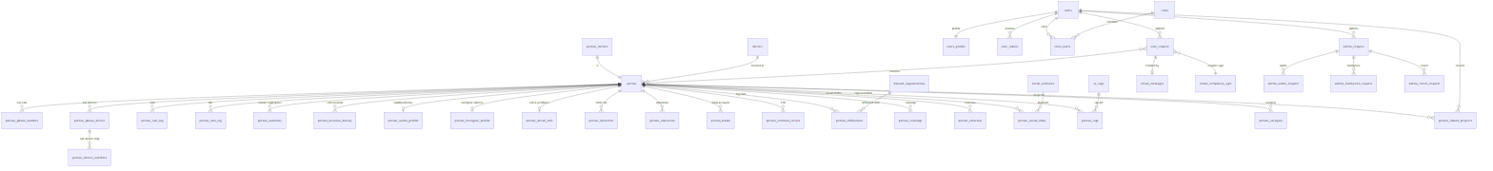
06 · DATA MODEL
Entity-relationship model — centred on the person
Figure 6 — person is the hub; identity, activity, attribute, request & access tables surround it
Core & identity
Activity (CDR)
Attributes
Requests & access
person_initiate · person · person_nadra_profile · person_foreigner_profile · person_detail_info
person_call_log · person_sms_log · person_summary · person_location_history · person_phone_number · person_phone_device
education · banks · criminal_record · affiliations · trainings · identities · relations · social_links · tags
user_request · admin_request (+nadra/familytree/travel) · email_messages · users · roles · roles_users · manu_management
DRAMS Live · System Documentation
8

Slide 10
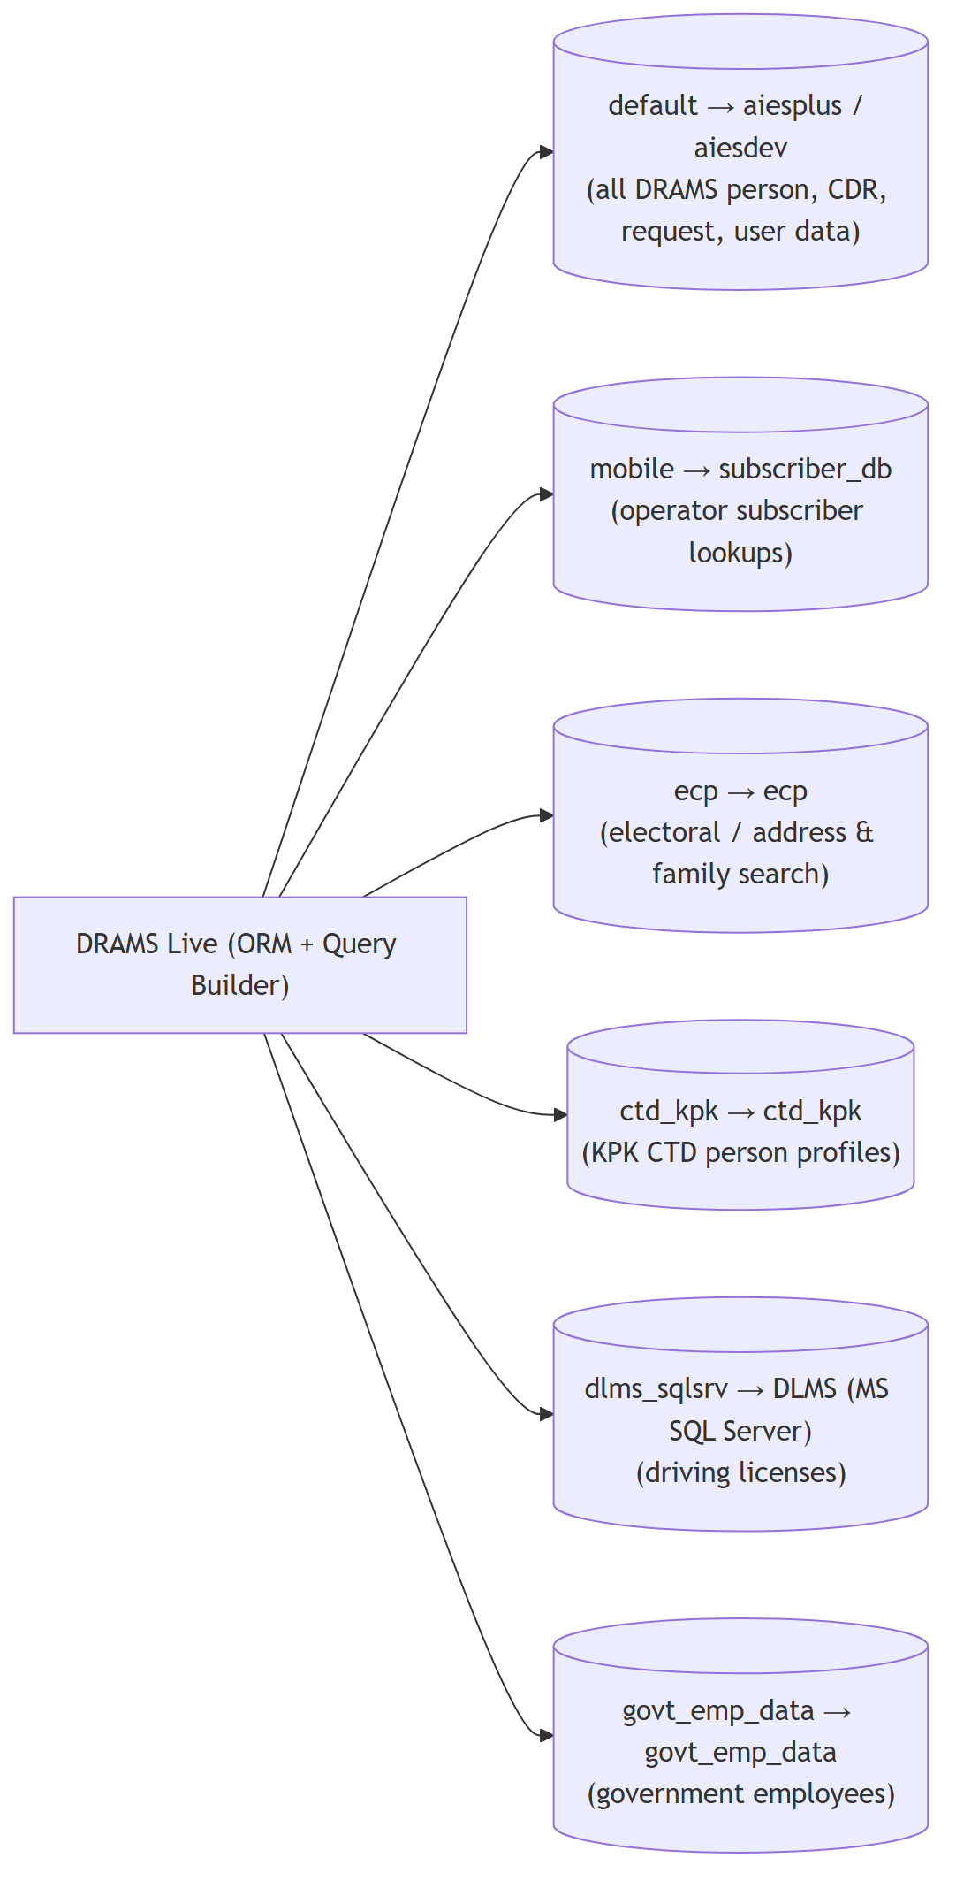
07 · DATA SOURCES
Six federated database connections
Connection | Database | Use
default | aiesplus / aiesdev (MySQL) | All DRAMS person, CDR, request & user data
mobile | subscriber_db (MySQL) | Operator subscriber lookups
ecp | ecp (MySQL) | Electoral / address & family search
ctd_kpk | ctd_kpk (MySQL) | KPK CTD person profiles
dlms_sqlsrv | DLMS (MS SQL Server) | Driving licenses
govt_emp_data | govt_emp_data (MySQL) | Government employees
The default connection holds all DRAMS data; the other five are read-only sources searched from the Databank module (DLMS is Microsoft SQL Server, the rest MySQL).
Figure 7 — database.php connections
DRAMS Live · System Documentation
9

Slide 11
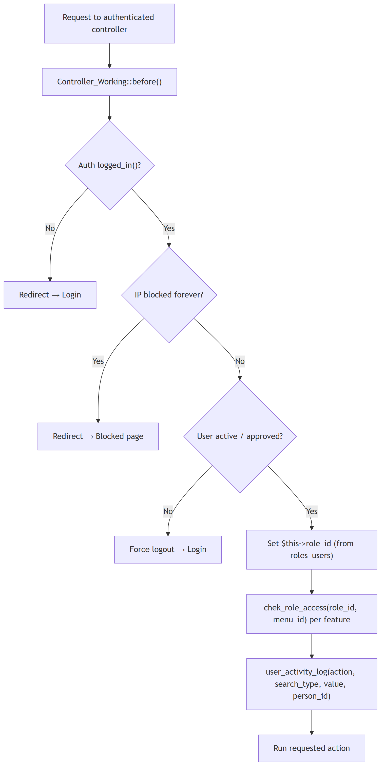
08 · SECURITY
Authentication & the before() gate
What every page checks
Driver: Kohana auth, ORM (Auth_Orm). Passwords SHA256-hashed; only user_id stored in session.
before() runs on each authenticated controller: logged-in? → IP blocked? → user active/approved? → set role_id → menu-access check → audit log.
Failures redirect to Login / Blocked or force a logout.
Three login paths: username+password (IP-throttled), one-time SSO token, and password recovery.
Figure 8
DRAMS Live · System Documentation
10

Slide 12
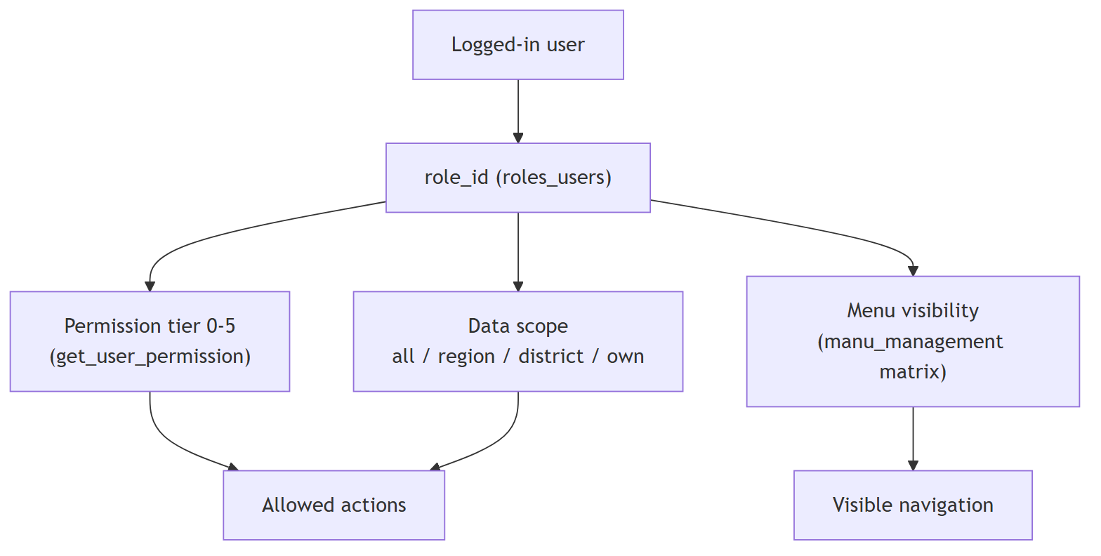
08 · ACCESS CONTROL
Role-based access — three combined checks
Permission tiers
Permission level (0–5): Administrator → Tech support → Executive → Field officer → Dev support.
Data scope: all · region · district · own — filters every request & report query.
Menu access: chek_role_access() reads the manu_management matrix to show/hide each sidebar item.
Fine-grained roles gate modules (Watchlist 25, Organization 31/32, Databank 34/35); sensitive persons protected by cis_sensitive_person_acl.
Figure 9
DRAMS Live · System Documentation
11

Slide 13
PART TWO
Core Process Flows
Login · Search · Telecom request lifecycle · Ingestion · Identity sync · Watchlist · Reporting · Cron · Integrations

Slide 14
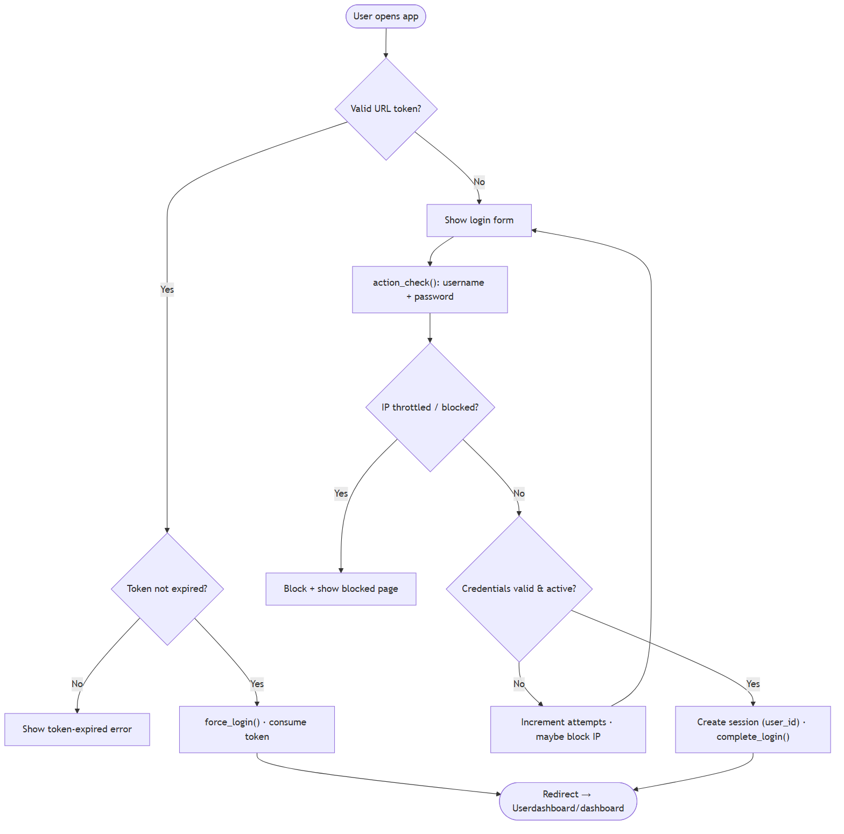
FLOW 10.1 · LOGIN
Login & session flow
Highlights
Valid URL token → expiry check → force_login() (token consumed once).
Otherwise the login form posts to action_check().
Per-IP throttling blocks brute-force attempts (~5 tries → IP block).
On success: session created (user_id), complete_login() runs, redirect to the dashboard.
Figure 10
DRAMS Live · System Documentation
12

Slide 15
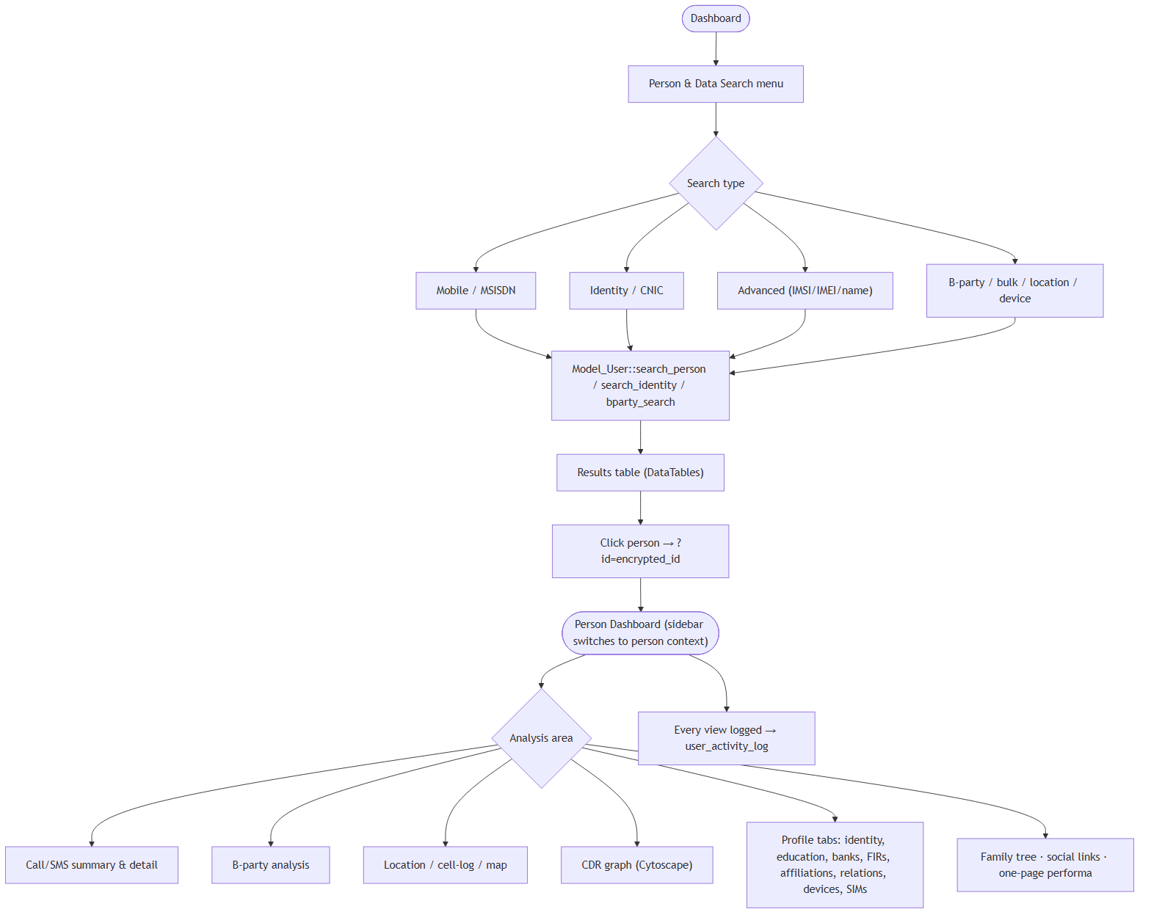
FLOW 10.2 · SEARCH
Person search → profile
Highlights
Search by mobile/MSISDN, CNIC identity, advanced (IMSI/IMEI/name), or B-party / bulk / location / device.
Results render in DataTables; clicking a person opens the profile with an encrypted id.
The sidebar switches to person context: call/SMS, B-party, location, CDR graph, profile tabs, family tree, social links.
Every view is written to user_activity_log.
Figure 11
DRAMS Live · System Documentation
13

Slide 16
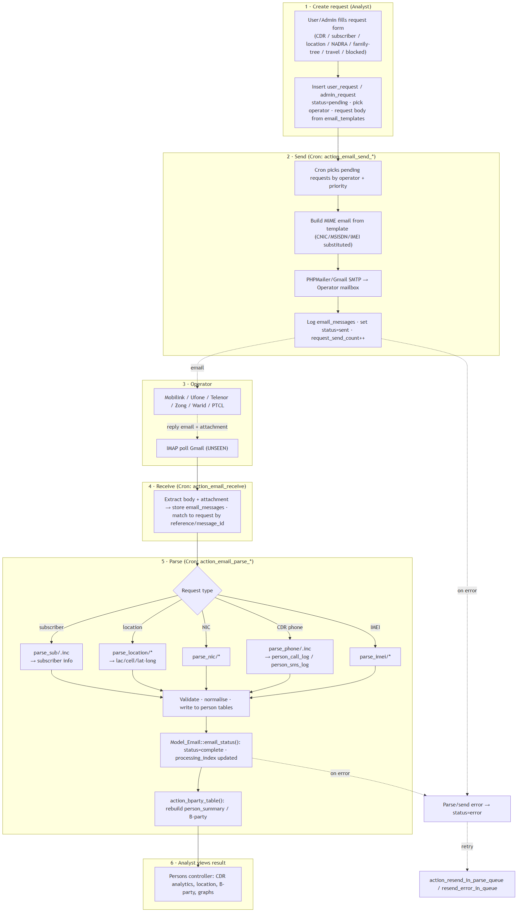
FLOW 10.3 · CORE
★
Telecom data request lifecycle
Six asynchronous stages
1 Create
Analyst files a user_request / admin_request (CDR, subscriber, location, NADRA…); status = pending, body built from email_templates.
2 Send
Cron action_email_send_* picks pending requests by operator + priority and emails the operator via SMTP; logs email_messages.
3 Operator
Mobile operator (Mobilink, Ufone, Telenor, Zong, Warid, PTCL) replies by email with an attachment.
4 Receive
Cron IMAP-polls Gmail (UNSEEN), stores the reply and matches it to the request by reference/message_id.
5 Parse
action_email_parse_* (per type & operator) validates and writes person_call_log / SMS / subscriber / location, then sets status = complete.
6 Consume
B-party table rebuilt; the analyst views CDR analytics, locations and graphs. Errors route to retry queues.
Figure 12 — fully asynchronous, email-driven
DRAMS Live · System Documentation
14

Slide 17
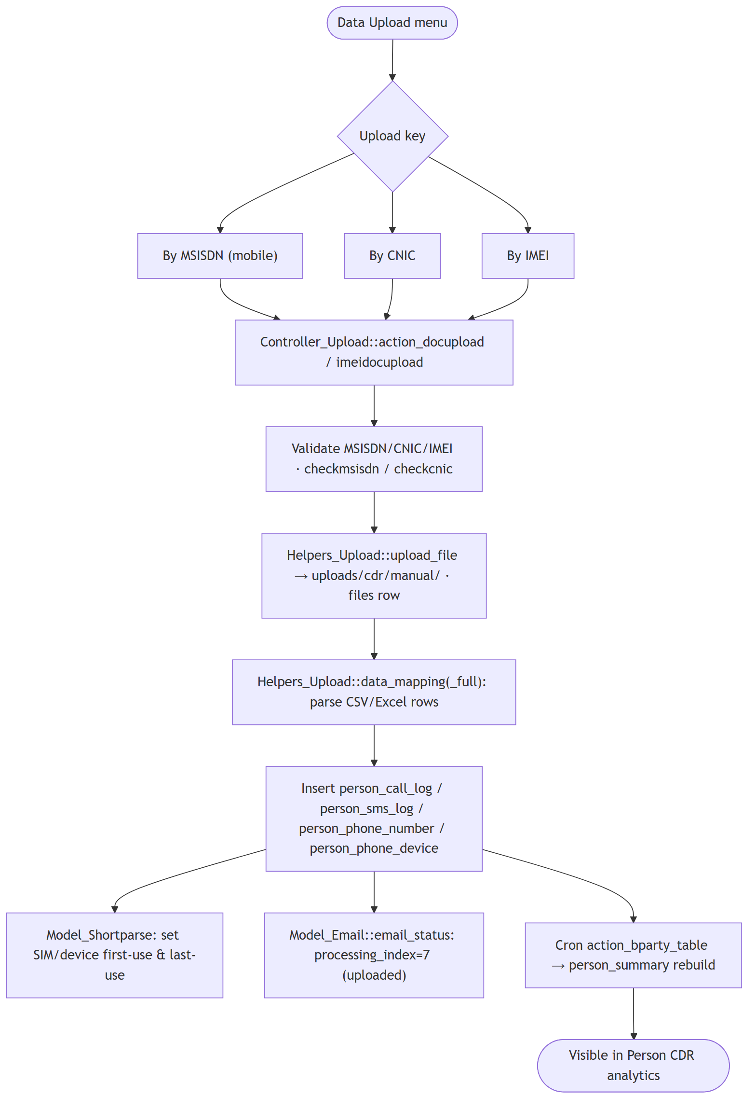
FLOW 10.4 · INGESTION
CDR / bulk data ingestion
When CDR arrives as a file
Analyst uploads by MSISDN, CNIC or IMEI via Controller_Upload.
Inputs validated (checkmsisdn / checkcnic), file stored under uploads/cdr/manual/ with a files row.
Helpers_Upload::data_mapping parses CSV/Excel rows into person_call_log / SMS / phone_number / device.
Model_Shortparse sets SIM/device first- & last-use; processing_index = 7 (uploaded).
Cron rebuilds person_summary → data appears in CDR analytics.
Figure 13
DRAMS Live · System Documentation
15

Slide 18
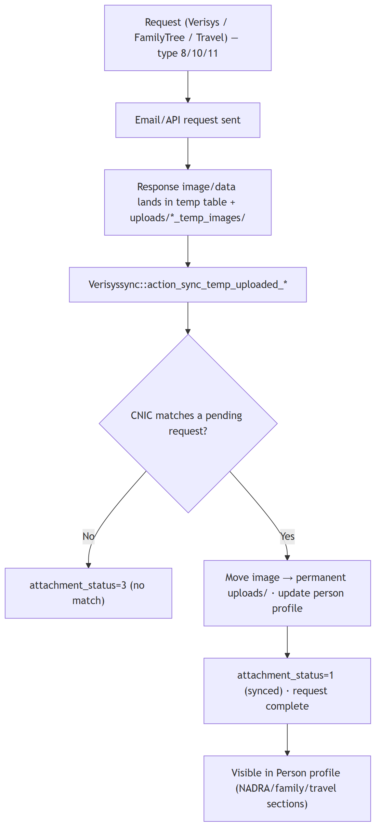
FLOW 10.5 · IDENTITY
NADRA / Verisys / Family-Tree / Travel sync
Two-step staging pattern
The identity request goes out by email or API (request types 8 / 10 / 11).
Responses (images/data) land in a temp table + uploads/*_temp_images/.
Controller_Verisyssync matches each by CNIC to a pending request.
On match: image moved to permanent storage, person profile updated, attachment_status = 1.
No match → attachment_status = 3; results then show in the person profile.
Figure 14
DRAMS Live · System Documentation
16

Slide 19
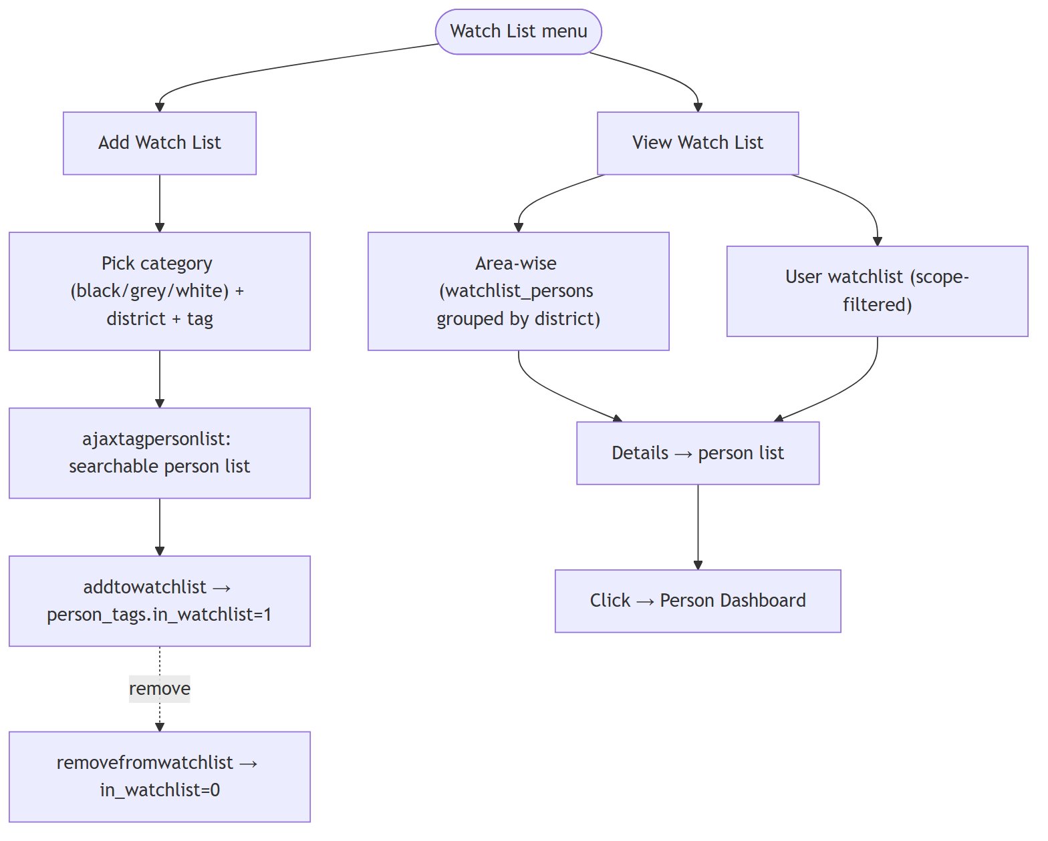
FLOW 10.6 · WATCHLIST
Watchlist management
Highlights
Add: choose category (black/grey/white) + district + tag, search persons, add to watchlist (in_watchlist = 1).
View: area-wise (grouped by district) or per-user (scope-filtered) watchlists.
Drill into details, then jump straight to a person dashboard.
Removal flips in_watchlist back to 0; tags stored in person_tags + lu_tags.
Figure 15
DRAMS Live · System Documentation
17

Slide 20
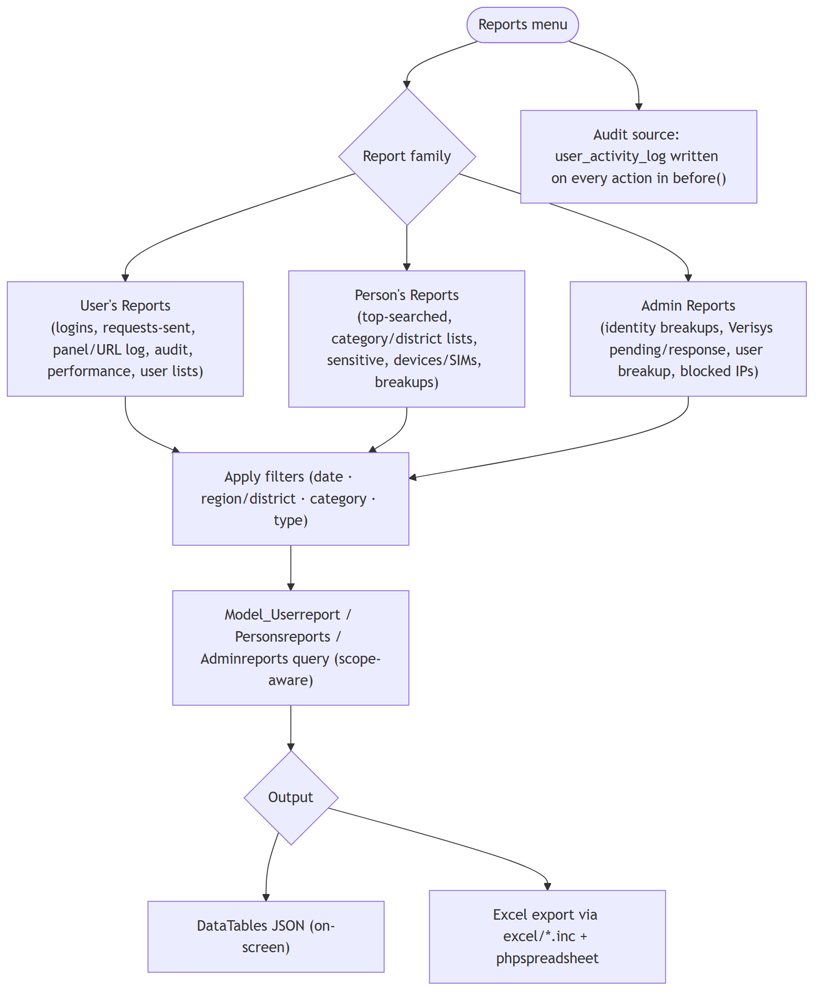
FLOW 10.7 · REPORTING
Reporting & audit
Three report families
User's reports: logins, requests sent, panel/URL logs, audit & performance.
Person's reports: top-searched, category/district lists, sensitive list, devices/SIMs, breakups.
Admin reports: identity breakups, Verisys pending/response, user breakup, blocked IPs.
All scope-aware; output as on-screen DataTables or Excel exports (phpspreadsheet).
Audit trail comes from user_activity_log written in before() on every action.
Figure 16
DRAMS Live · System Documentation
18

Slide 21
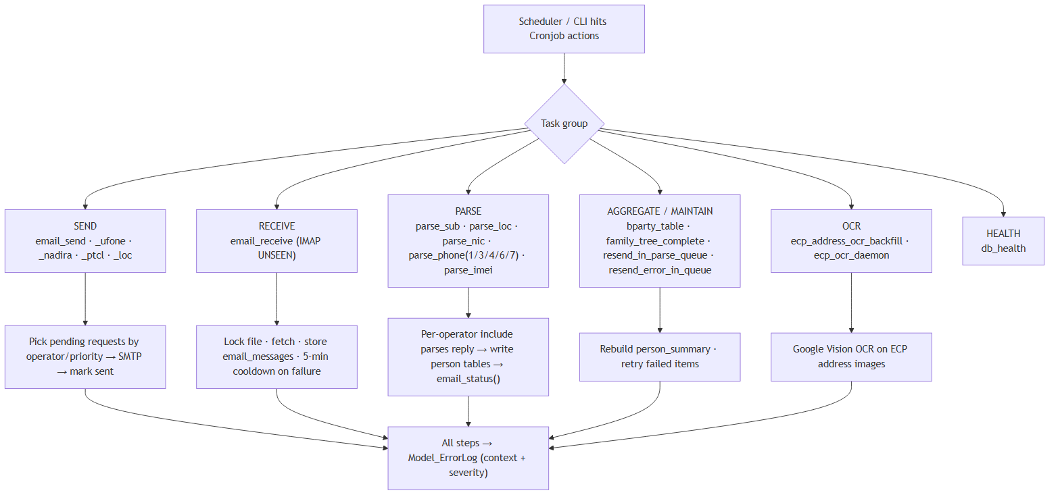
FLOW 10.8 · BACKGROUND ENGINE
Cron / background processing pipeline
Figure 17
Cronjob is the asynchronous engine — scheduled HTTP/CLI hits trigger SEND, RECEIVE, PARSE, AGGREGATE, OCR and HEALTH actions.
Lock files & cooldowns prevent overlapping IMAP runs; every step logs to Model_ErrorLog with context and severity; failed items route to retry queues.
DRAMS Live · System Documentation
19

Slide 22
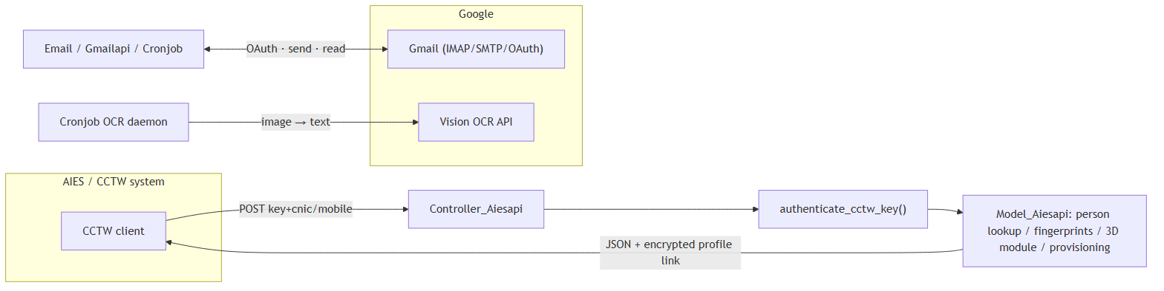
FLOW 10.9 · INTEGRATIONS
External integrations
Figure 18
AIES / CCTW: REST API (Controller_Aiesapi) — key-authenticated person lookup, 3D module, fingerprints and provisioning, returning JSON + an encrypted profile link.
Google: Gmail OAuth (send/receive operator email) and Vision OCR (ECP address backfill via the cron OCR daemon).
DRAMS Live · System Documentation
20

Slide 23
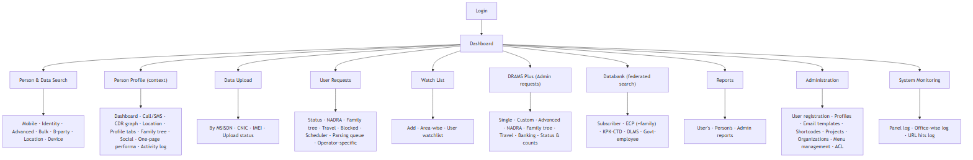
NAVIGATION
Sitemap & navigation
Figure 19
The left sidebar (sidebar_user.php) is role-filtered; opening a person swaps it to a person-context sidebar (sidebar_person.php).
Top-level areas: Search · Profile · Data Upload · User Requests · Watch List · DRAMS Plus · Databank · Reports · Administration · System Monitoring.
DRAMS Live · System Documentation
21

Slide 24
USERS
Roles & a representative analyst journey
User type | Roles | Primary journeys
Super Admin | 1 | User registration, menu management, ACL, all reports & DRAMS Plus
Analyst / Operator | 2–8 | Search persons, analyse CDR, submit requests, build reports
Request manager | 14+ | Manage request queue, scheduling, projects
Data-upload operator | 9–12 | Bulk-upload CDR files, monitor parsing
Watchlist / Databank | 25 / 34–35 | Tag & monitor persons; federated identity searches
Representative analyst journey
Figure 20 — log in → search → (request if missing) → analyse → watchlist / report
DRAMS Live · System Documentation
22

Slide 25
Summary
One platform, end-to-end
Acquire → Parse → Profile → Analyse → Report. DRAMS Live turns operator email replies and federated databases into a searchable, audited, role-governed intelligence picture of persons and their communications.
Companion files: DRAMS_Live_System_Documentation.docx · .md · 20 diagram PNGs

