Slide 1



ITU-ML5G-PS-038: Traffic recognition and Long-term traffic forecasting based on AI algorithms and metadata
Artem Volkov and Dr. Ammar Muthanna
SPbSUT, 31 Aug 2020
Sponsors
Organizer
Register here
Join us on Slack

Slide 2
Agenda
Common Background
SDN as a part of 5G/IMT-2020 and related AI technologies
Our SDNLab infrastructure
Problem with fastly traffic recognition on the DataPlane
Problem Statement. Key Features
Challenges
Research Background. Examples
Task. Output Format
Q/A
2 page

Slide 3
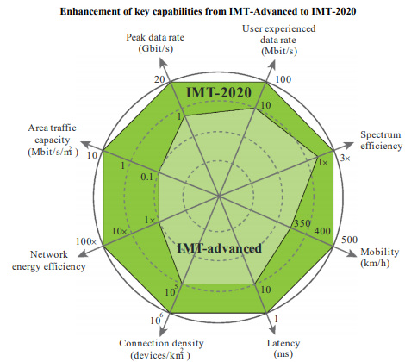
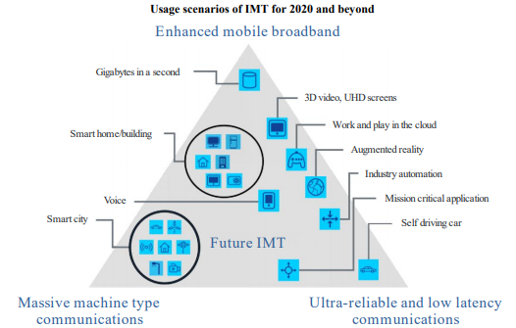
Common Background
Fig. 1*
Fig. 2*
* - Reference to ITU-R 2083-0 (09/2015) “IMT Vision – Framework and overall objectives of the future development of IMT for 2020 and beyond “
3 page

Slide 4
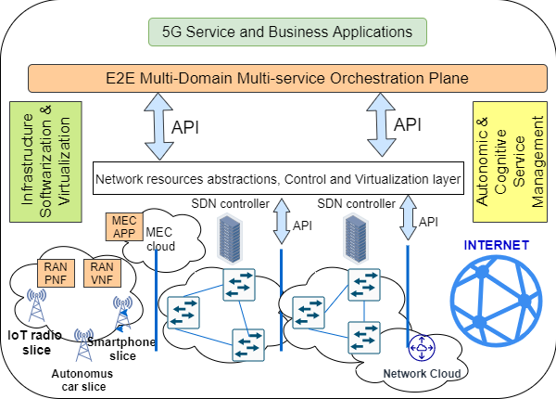
SDN as a part of 5G/IMT-2020 and related AI technologies
4 page

Slide 5
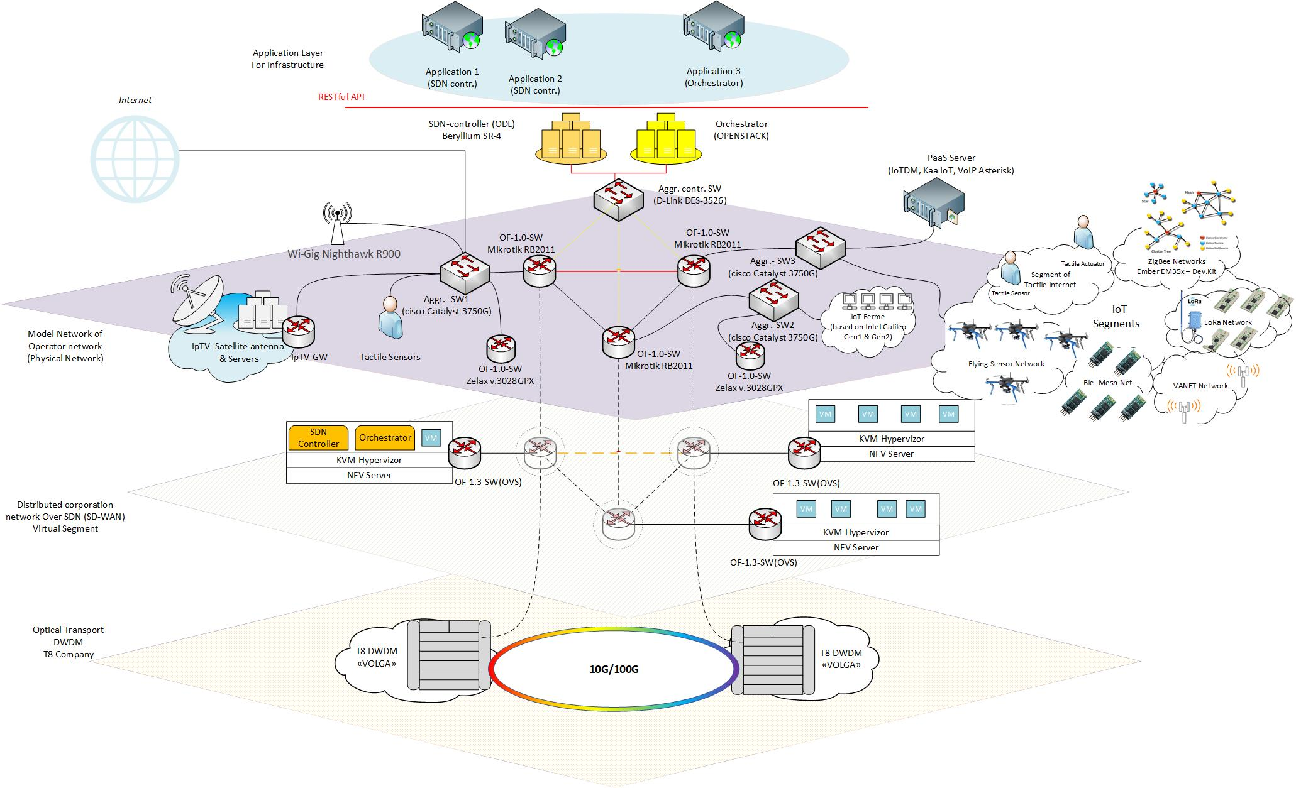
Our SDNLab Infrastructure
5 page
Notes:
Taking into account

Slide 6
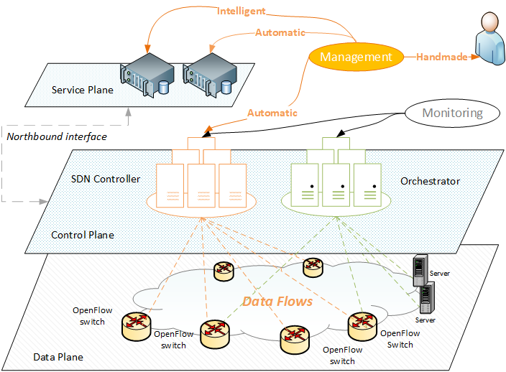
Problem with fastly traffic recognition on the DataPlane
Traffic recognition on the Data Plane is required for Intelligent and Automatic management
De-facto requirements
SaaS approach
Independence from the vendor’s solutions (open API);
OpenSource platforms;
Cross-platform
live-migration (it's desirable)
Fig. 3
6 page

Slide 7
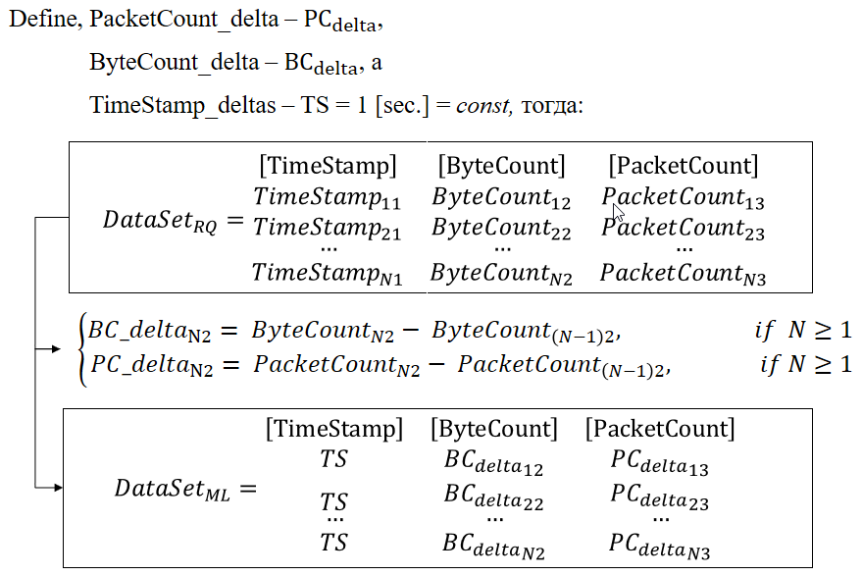
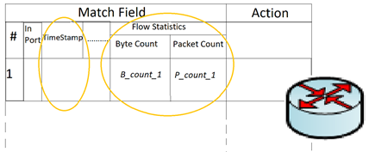
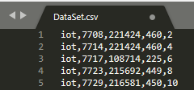
Problem Statement. Key Features
Fig.4 - Flow Table (ver. Openflow 1.0)
Fig.5 - Example of Marked Data Sets
Key features:
Metadata, Long-term forecasting
7 page
Notes:
Taking into account

Slide 8
Challenges
Part 1: AI for traffic recognition and classification*
Propose for traffic types recognition based on Machine Learning, using Metadata of flows
Part 2: AI for Long-term traffic forecasting*
Propose long-term traffic forecasting on the data plane, using Metadata of recognized flows
Part 3: Suggestion with both 1st and 2nd algorithms (theoretical)
Propose theoretical models for both 1st & 2nd algorithms collaboration (UML Scheme with definition and description)
The key features of the proposal is to use the metadata of flows on the data plane at the same time the analytical application with AI/ML algorithms is located on the service level and working with the SDN/NFV network via northbound API.
For Challenge we prepared the ready to make the ML models data sets of IoT and Video traffic.
* Reference to the 6.2.1 and 6.2.2 clauses were taken from the following document “ITU AI/ML in 5G Challenge - Participation guidelines”]
8 page
Notes:
Taking into account

Slide 9
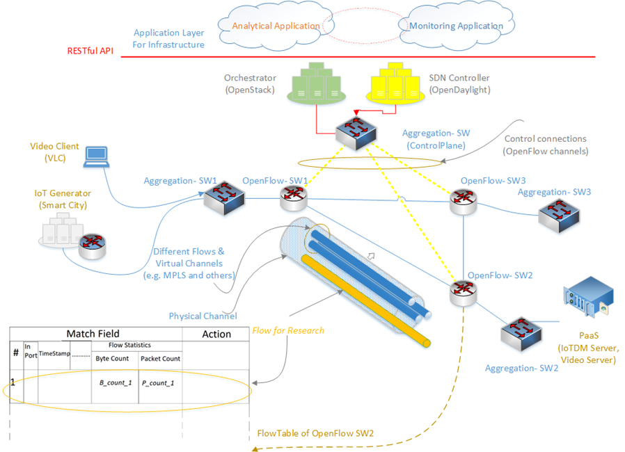
Research Background. Part 1 - Traffic recognition (Examples)
*Reference: Volkov, A., Ateya, A. A., Muthanna, A., Koucheryavy, A. (2019). Novel AI-Based Scheme for Traffic Detection and Recognition in 5G Based Networks. In Lecture Notes in Computer Science (including subseries Lecture Notes in Artificial Intelligence and Lecture Notes in Bioinformatics) (Vol. 11660 LNCS, pp. 243{255). Springer Verlag. https://doi.org/10.1007/978-3-030-30859-921.
9 page
Notes:
Taking into account

Slide 10
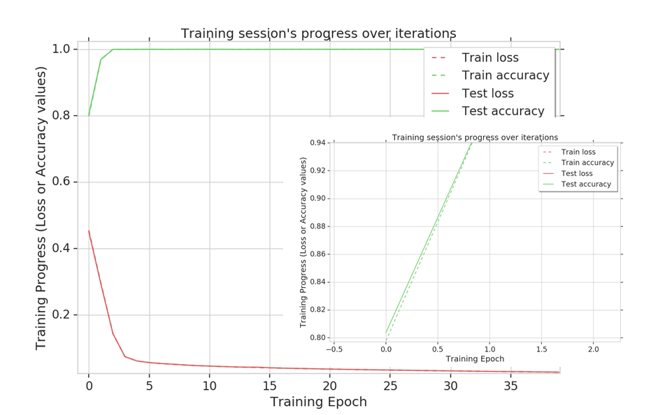
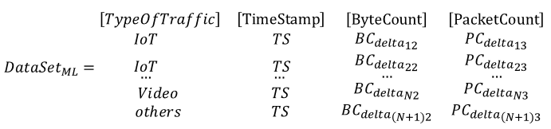
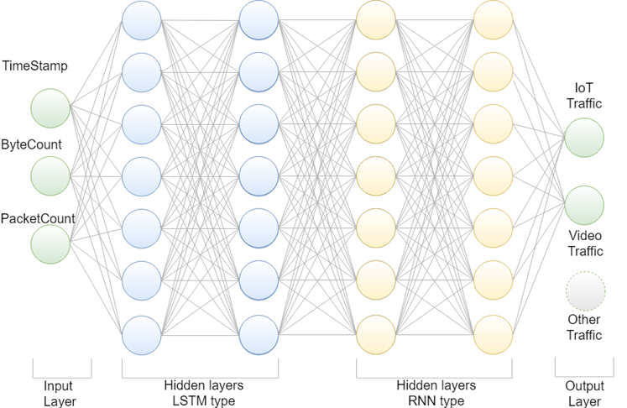
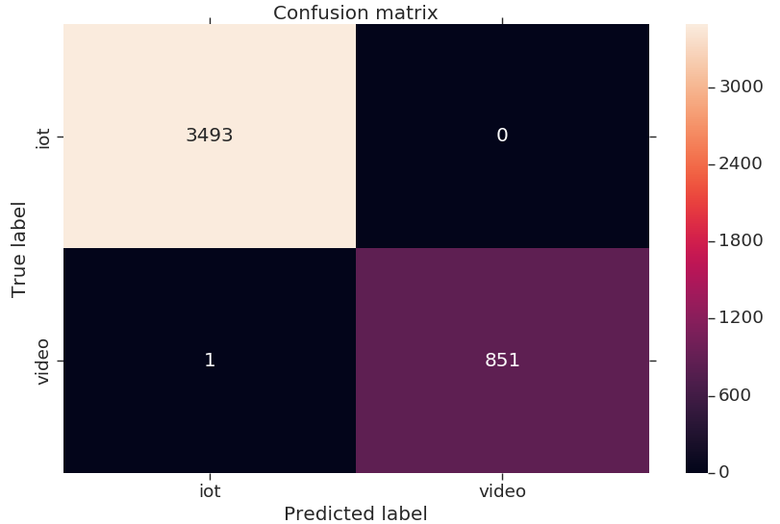
Research Background. Part 1 - Traffic recognition (Examples)
*Reference: Volkov, A., Ateya, A. A., Muthanna, A., Koucheryavy, A. (2019). Novel AI-Based Scheme for Traffic Detection and Recognition in 5G Based Networks. In Lecture Notes in Computer Science (including subseries Lecture Notes in Artificial Intelligence and Lecture Notes in Bioinformatics) (Vol. 11660 LNCS, pp. 243{255). Springer Verlag. https://doi.org/10.1007/978-3-030-30859-921.
10 page
Notes:
Taking into account

Slide 11
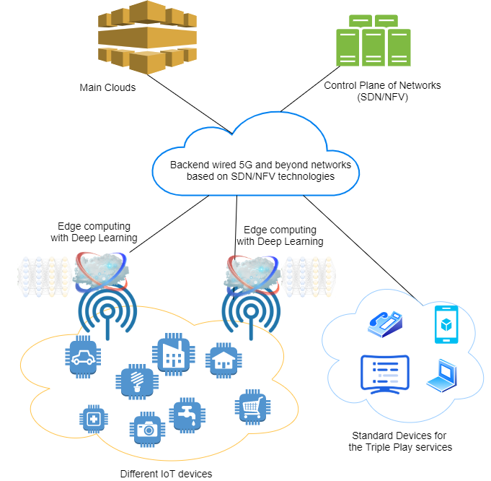
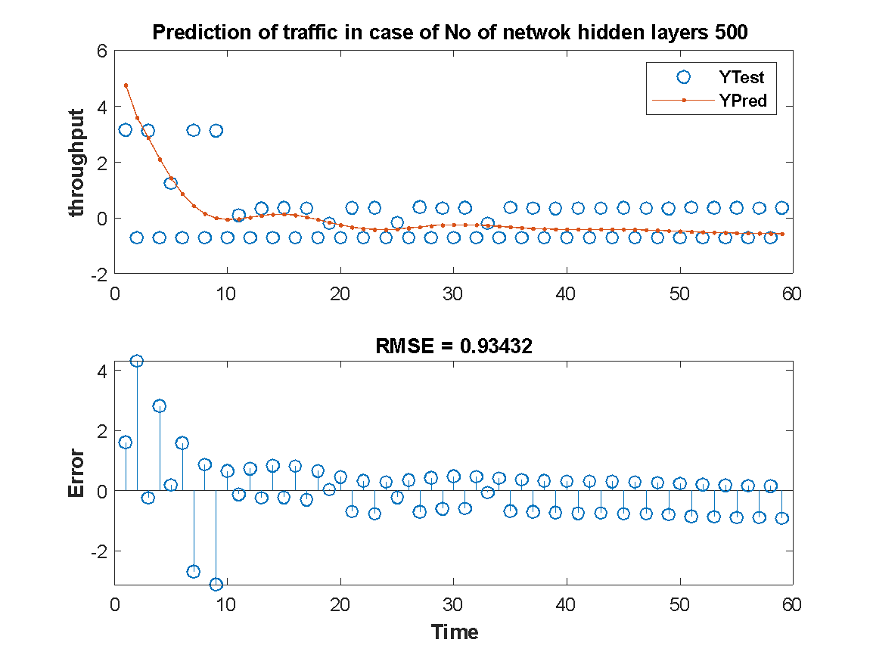
Research Background. Part 2 - Traffic prediction (Examples)
*Reference: Ali R. Abdellah , Artem Volkov , Ammar Muthanna , Andrey Koucheryavy. Deep Learning for IoT Traffic Prediction based on Edge Computing. 23rd International Conference on Distributed Computer and Communication Network 2020. [Accepted. Publishing in process]
11 page
Notes:
Taking into account

Slide 12
Research Background. Direction 1/ Direction 2
Volkov, A., Ateya, A. A., Muthanna, A., Koucheryavy, A. (2019). Novel AI-Based Scheme for Traffic Detection and Recognition in 5G Based Networks. In Lecture Notes in Computer Science (including subseries Lecture Notes in Artificial Intelligence and Lecture Notes in Bioinformatics) (Vol. 11660 LNCS, pp. 243{255). Springer Verlag. https://doi.org/10.1007/978-3-030-30859-921.
Volkov, A., Proshutinskiy, K., Adam, A. B. M., Ateya, A. A., Muthanna, A., Koucheryavy, A. (2019). SDN Load Prediction Algorithm Based on Artificial Intelligence. In Communications in Computer and Information Science (Vol. 1141 CCIS, pp. 27{40). Springer. https://doi.org/10.1007/978-3-030-36625-43
Ali R. Abdellah, Omar Abdul Kareem Mahmood, Alexander Paramonov, Andrey Koucheryavy, “IoT traffic prediction using multi-step ahead prediction with neural network”, IEEE 11th International Congress on Ultra-Modern Telecommunications and Control Systems and Workshops (ICUMT), 2019. https://doi.org/10.1109/ICUMT48472.2019.8970675 .
Ali R. Abdellah , Artem Volkov , Ammar Muthanna , Andrey Koucheryavy. Deep Learning for IoT Traffic Prediction based on Edge Computing. 23rd International Conference on Distributed Computer and Communication Network 2020. [Accepted. Publishing in process]
Artem Volkov , Ali R. Abdellah , Ammar Muthanna , Andrey Koucheryavy. IoT traffic prediction with Neural networks learning based on SDN infrastructure. 23rd International Conference on Distributed Computer and Communication Network 2020. [Accepted. Publishing in process]
12 page
Notes:
Taking into account

Slide 13
Task. Output Format
Task
Based on the the proposed method make the suggestions:
Propose for traffic types recognition based on Machine Learning, using Metadata of flows;
Propose long-term traffic forecasting on the data plane, using Metadata of recognized flows;
Propose theoretical models for both 1st & 2nd algorithms collaboration (UML Scheme with definition and description)
The output format is the report (expected) which include the following:
Problem analysis include the Gap analysis of current approaches for solve defined research problem;
Architectural scheme, models, algorithm in UML notation;
Description of solution;
Results of modeling in the graphs and their explanation;
Software with ML and Big data (if necessary) algorithms,
trained ML-models;
results in the CSV file, which contains results of training: necessary parameters (find in the evaluation clause).
*the “.docx” format is required for report.
Tools:
Python (version: 2.7 - 3.4)
or Matlab
13 page
Notes:
Taking into account

Slide 14
Thank you!
https://www.sut.ru/
Contacts:
Dr.Ammar Muthanna
https://muthanna.ru/
Artem Volkov
artemanv.work@gmail.com
Ali Refaee
alirefaee@azhar.edu.eg

Slide 15
Invited talk – Milvus: An Open Source Vector Similarity Search Engine
Jun Gu, ZILLIZ, 1 Sep 2020
(brought to you by – ZTE)
Sponsors
Organizer
Register here
Join us on Slack

