Slide 1


Vibrations of particle sensing MEMS
Alireza Mostafavi
Seyed Mahdi Hosseini Maasoum
School of Mechanical Engineering
University of Tehran
June 2019

Slide 2
Introduction:
Micro-cantilevers and micro-bridges MEMS devices
Applications:
scanning microscopy
energy harvesting devices
wafer probes
bio-sensors

Slide 3
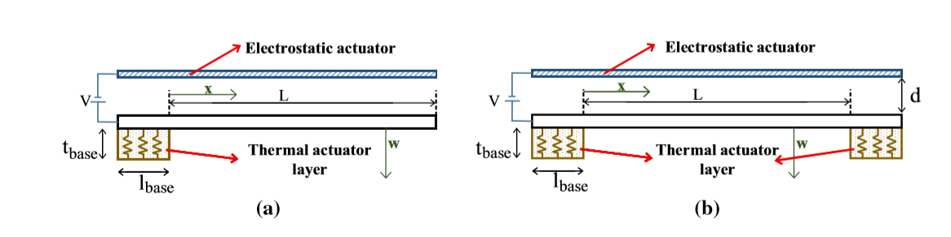
Literature review
Dynamics and vibrations of particle-sensing MEMS considering thermal and electrostatic actuation
Shahin Siahpour • Mahdi Moghimi Zand • Mohammad Mousavi

Slide 4
Tip Vibrations Time History
Frequency Domain
Midpoint Vibrations Time History For a Micro bridge
A comparison between FEM results and Ansys Results

Slide 5
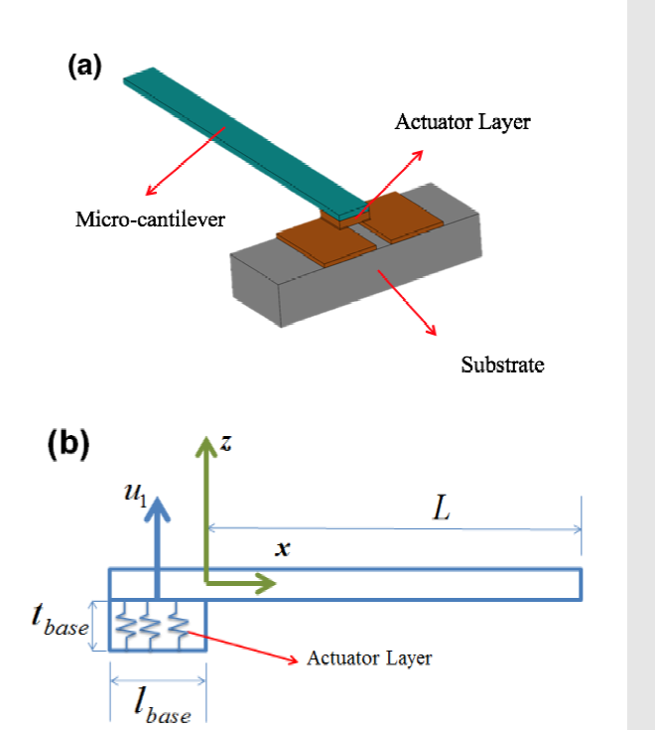
Modelling a micro-cantilever vibrating in vacuum, gas or liquid under thermal base excitation, Mechanics Research Communications (2016)
Mojtaba Komeili, Carlo Menon

Slide 6
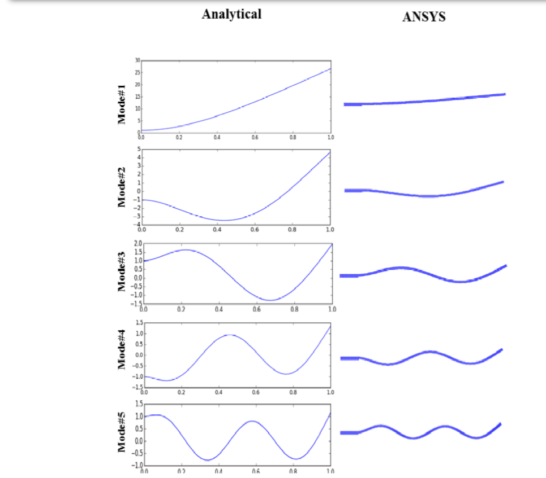
They derived Shape modes as well

Slide 7
Current project
Validation
Based on paper of Siahpour et al
Micro cantilever and micro bridge Vibrations Time History and Frequency Domain
New
Effect of beam length and gap size on Amplitude of Vibrations
Comparing the results of COMSOOL with results of a lumped Model Solved By MATLAB

Slide 8
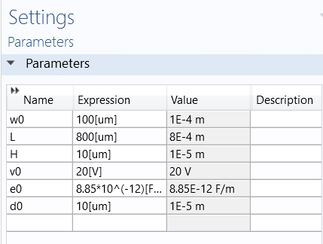

modeling
Parameters
Material

Slide 9
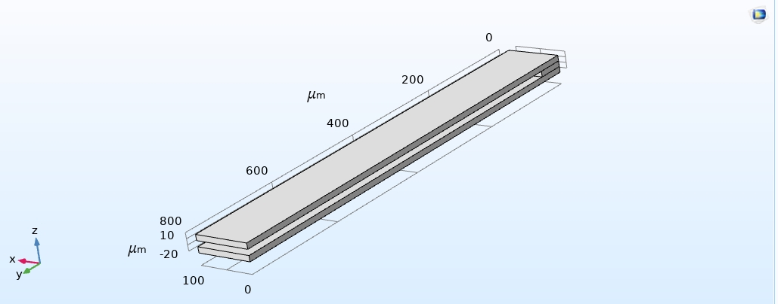
Design Geometry

Slide 10
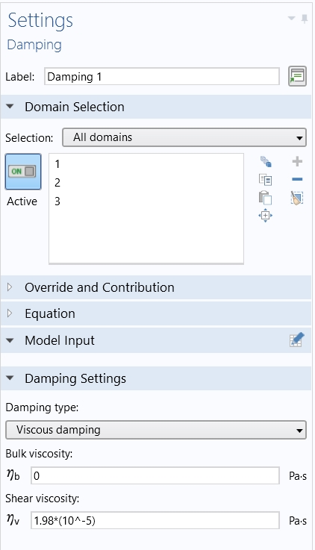
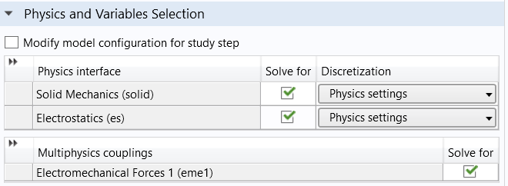
Multyphysics coupling
Damping model

Slide 11
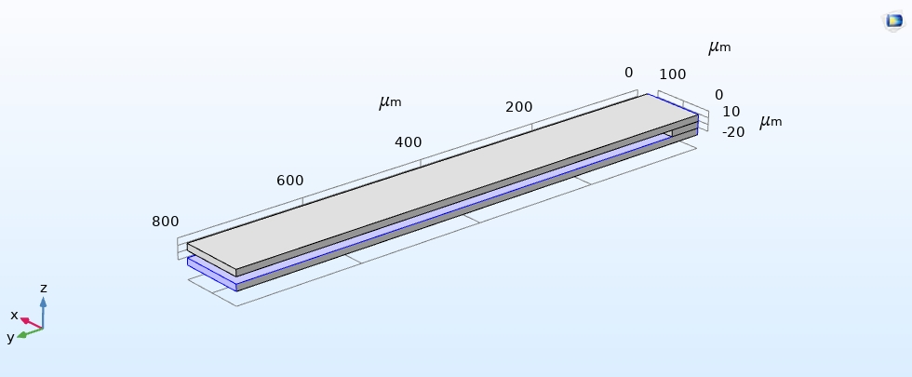
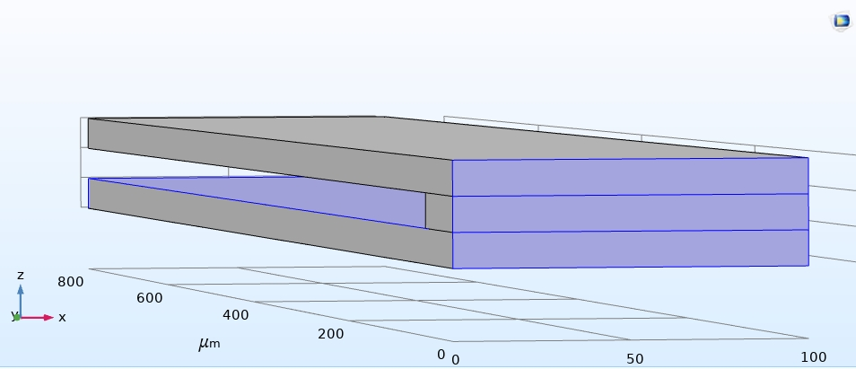
Boundary conditions
Fixed constraint

Slide 12
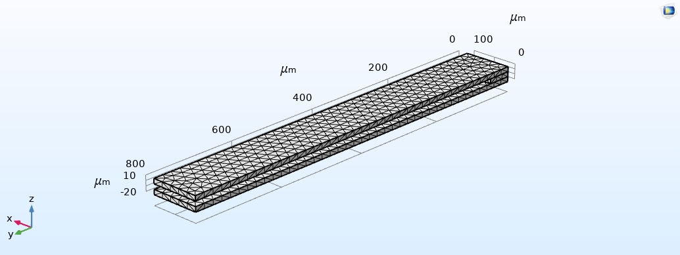
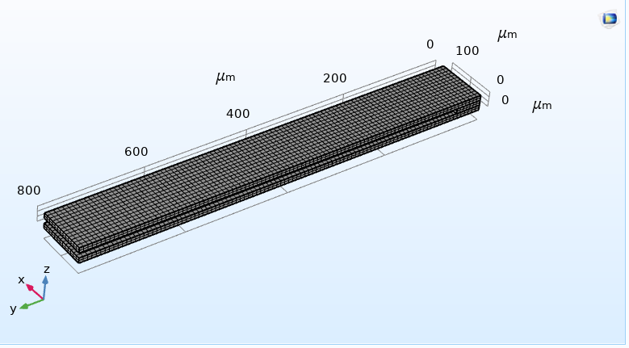
Mesh and validation

Slide 13
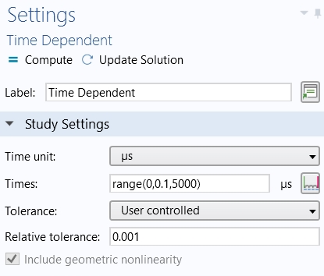
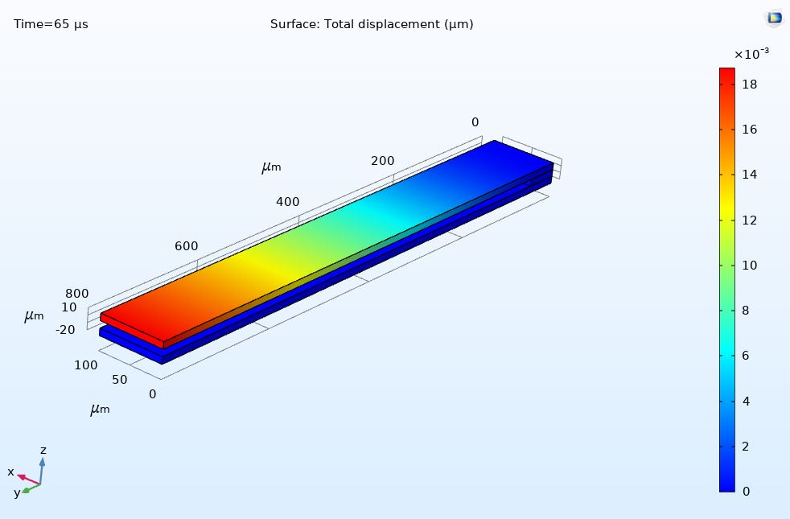
Study
Results

Slide 14
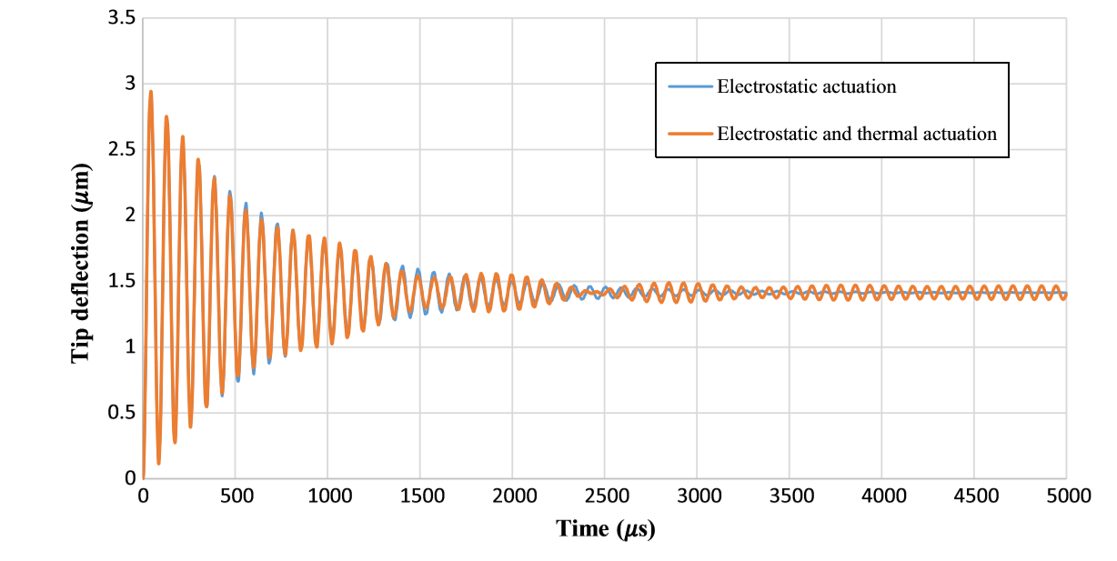
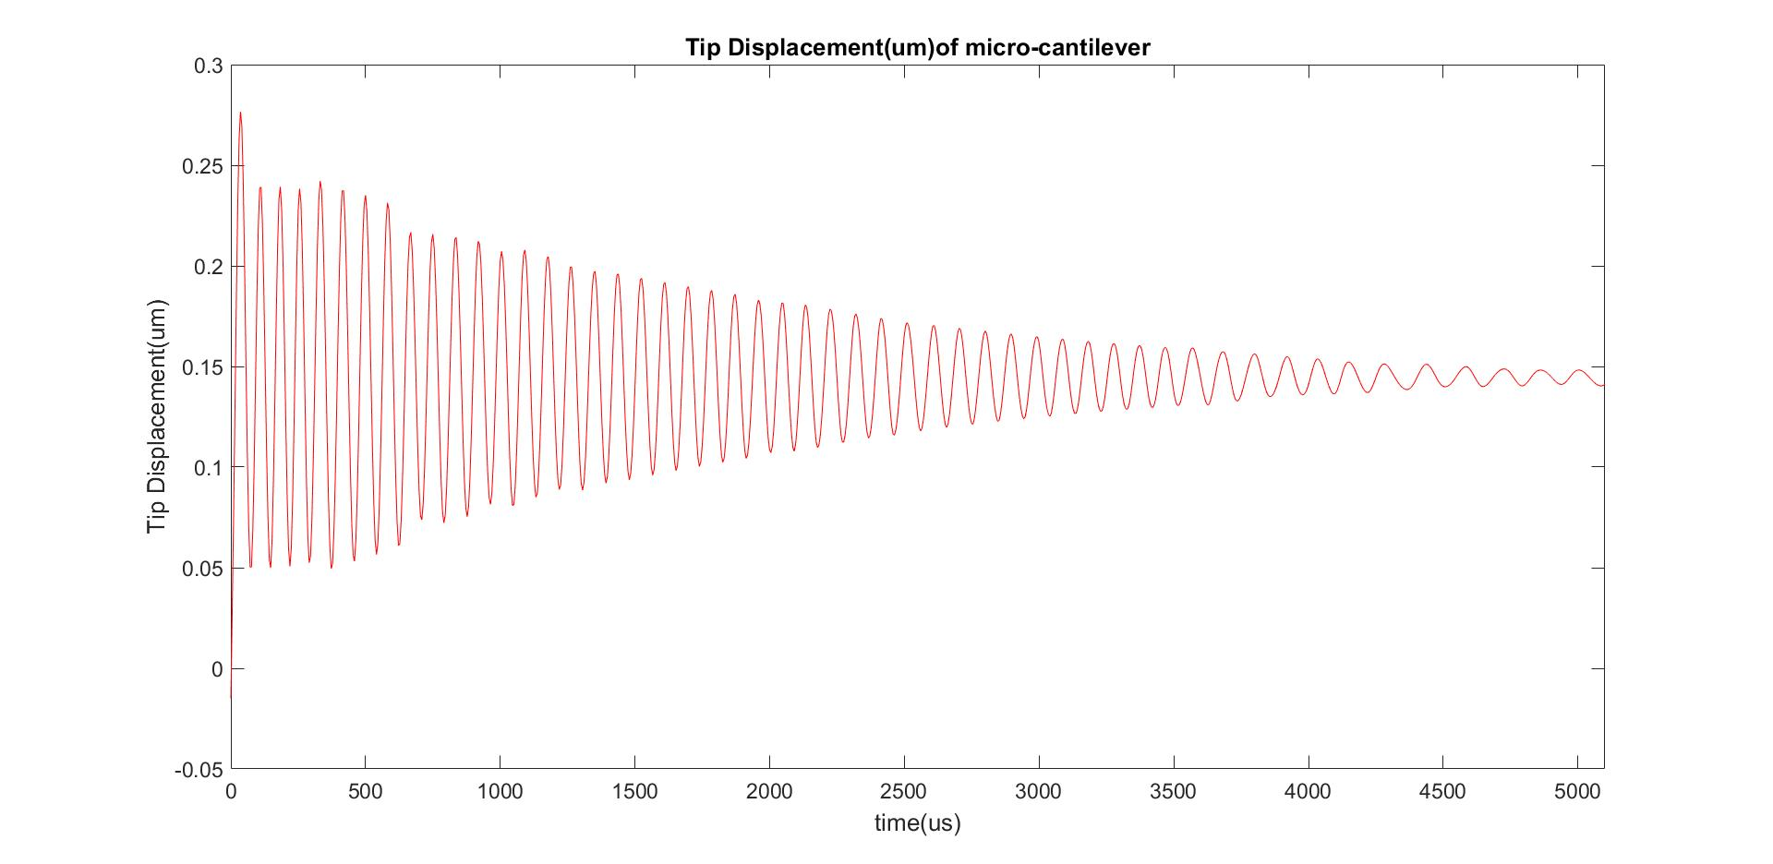
Results
Section1: Validating
Micro cantilever
Siahpour et al.
Current project

Slide 15
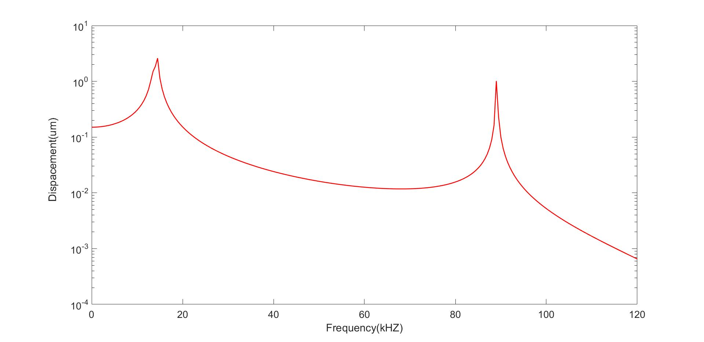
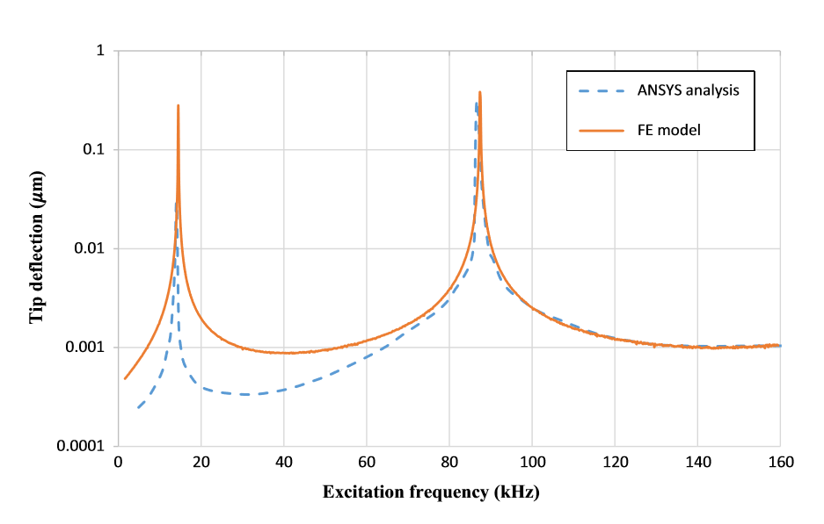
Section1: Validating
Micro cantilever
Frequency Response
Current project
Siahpour et al.

Slide 16
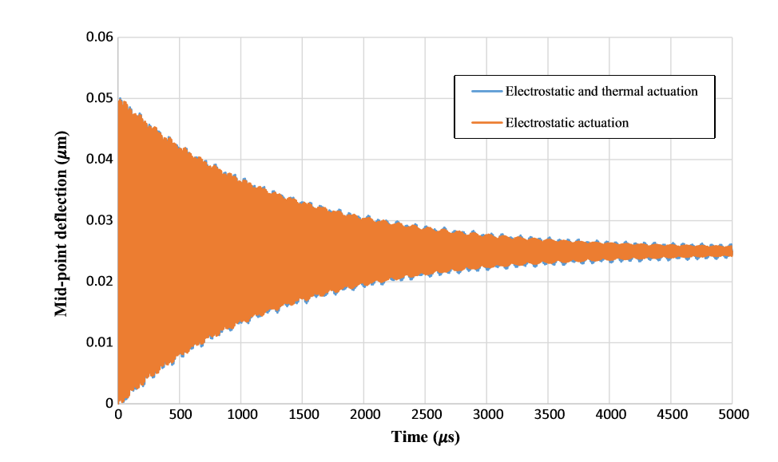
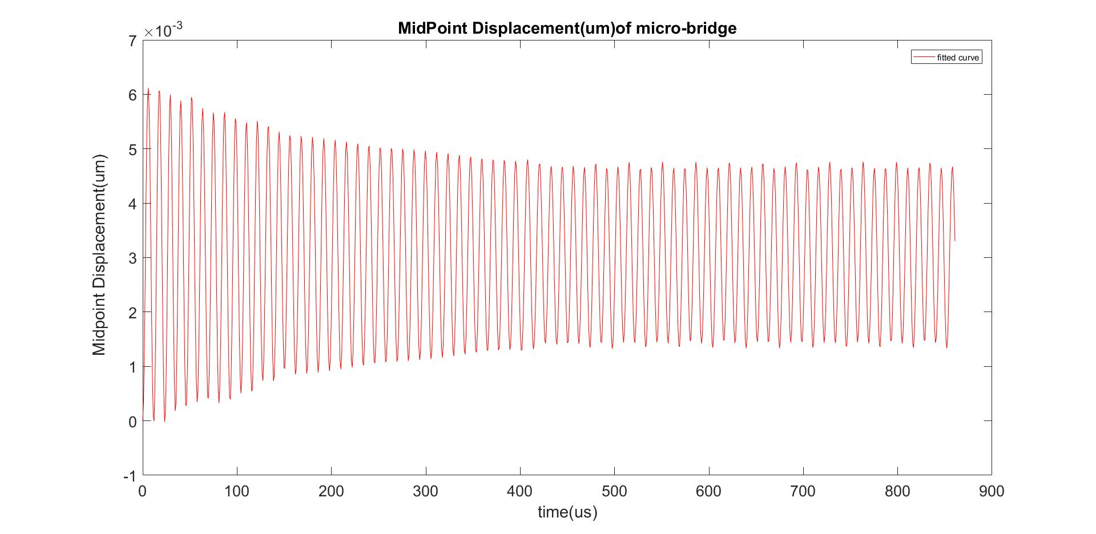
Midpoint vibrations Time history
Section2: Comparing
Micro Bridge
Siahpour et al.
Current project

Slide 17
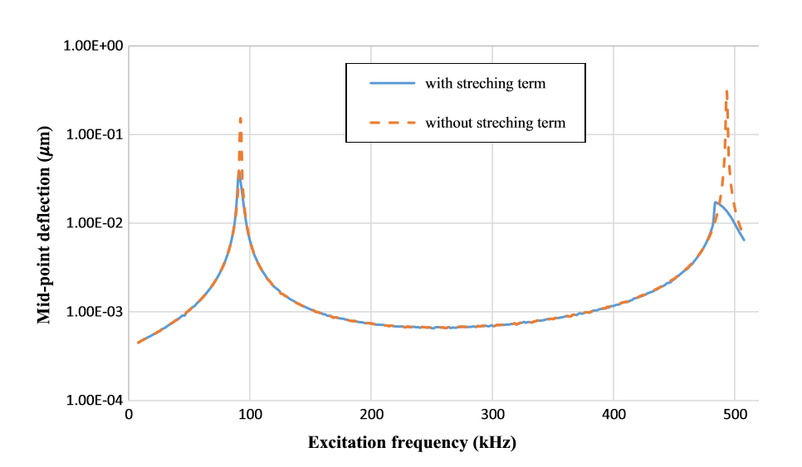
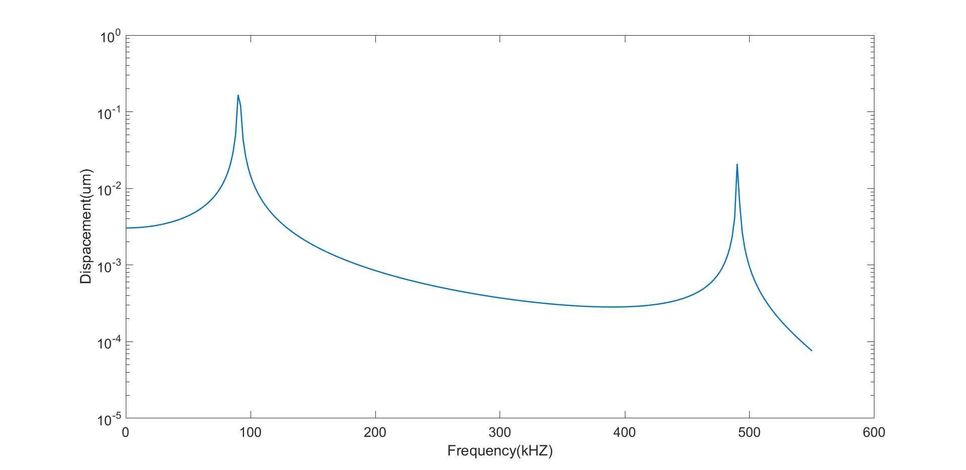
Frequency response
Section2: Comparing
Micro Bridge
Siahpour et al.
Current project

Slide 18
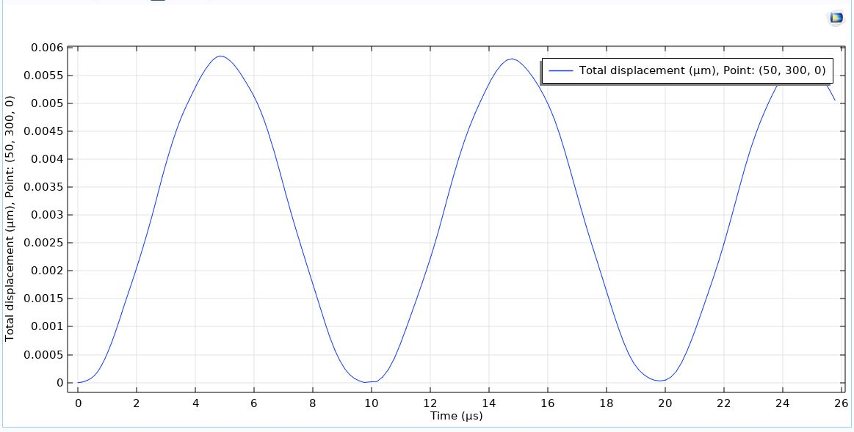
New investigations
Section3: New Parts
Effect of Beam Length
Tip Deflection for a beam with a Length of 300 micro meters

Slide 19
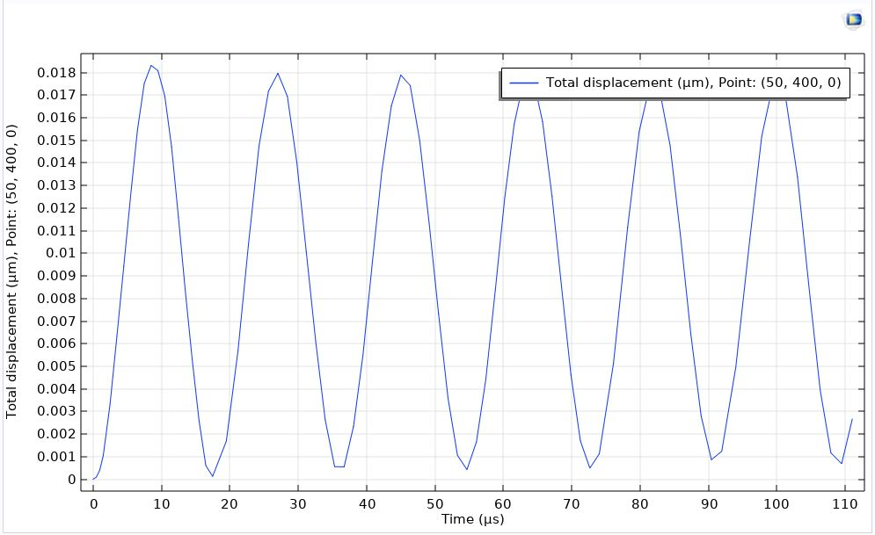
Section3: New Parts
Effect of Beam Length
Tip Deflection for a beam with a Length of 400 micro meters

Slide 20
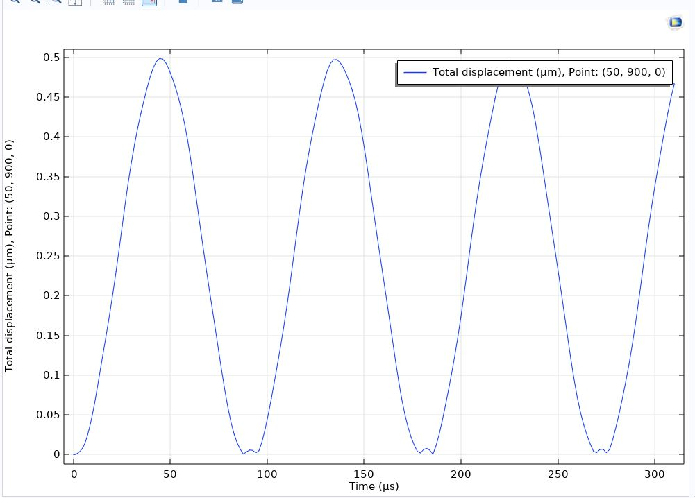
Section3: New Parts
Effect of Beam Length
Tip Deflection for a beam with a Length of 900 micro meters

Slide 21
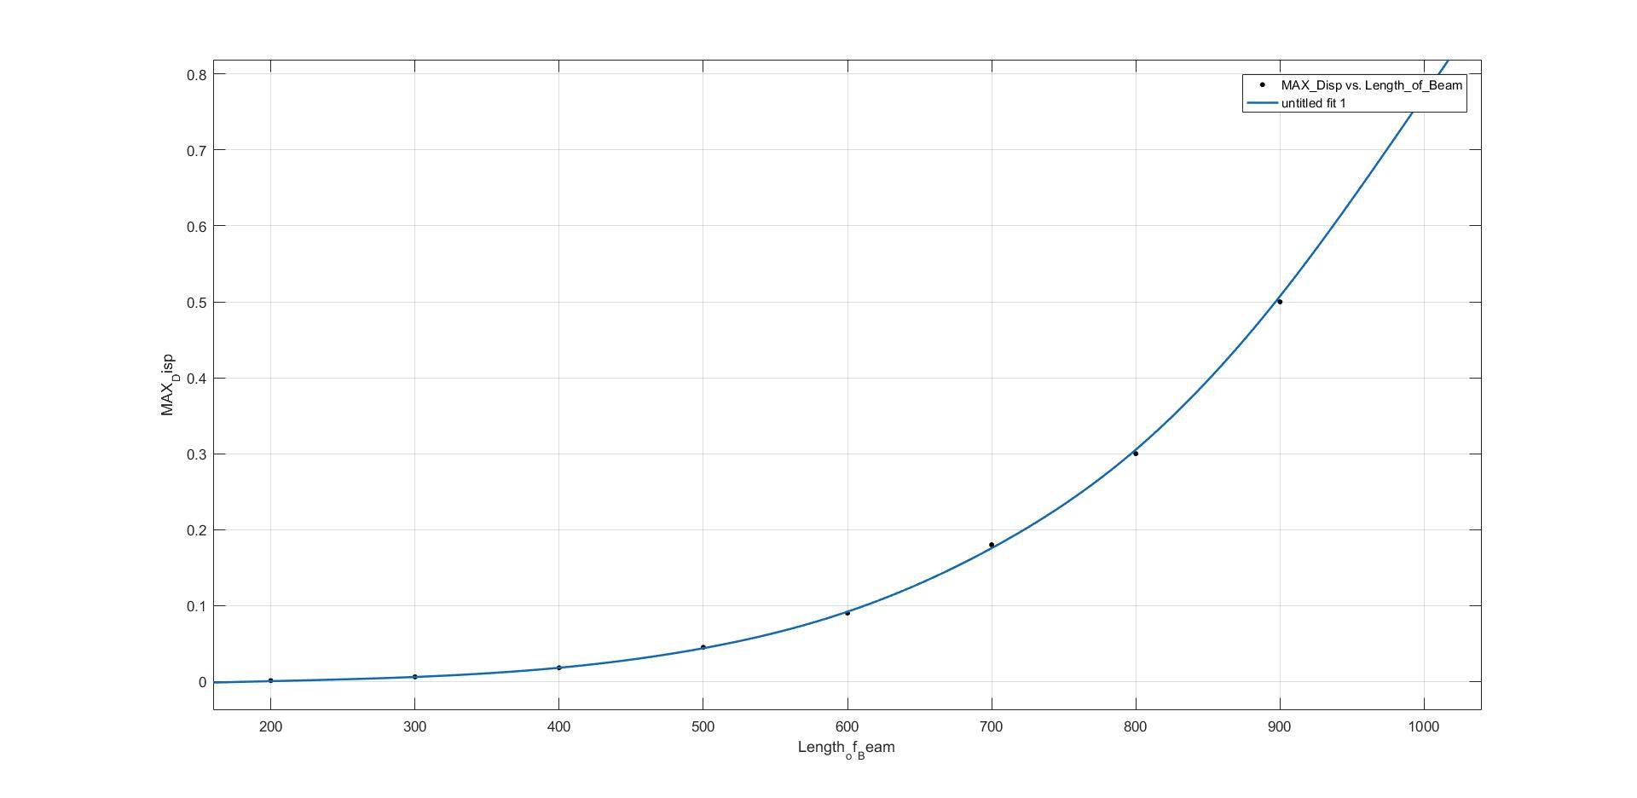
New investigations
Section3: New Parts
Effect of Beam Length

Slide 22
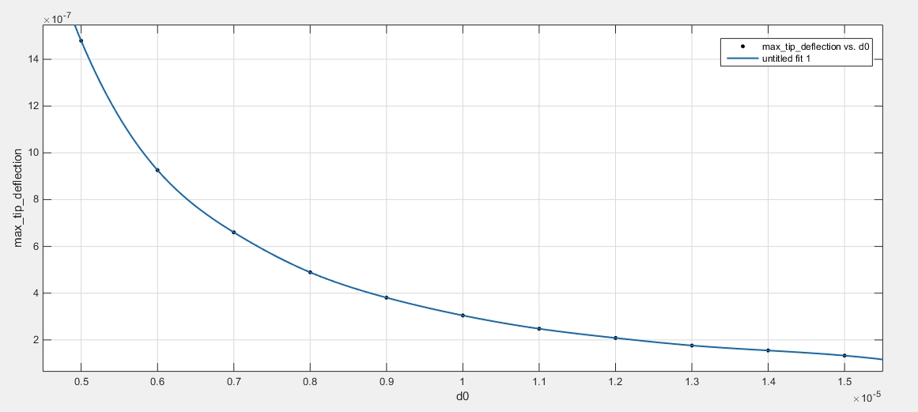
New investigations
Section3: New Parts
Effect of gap size

Slide 23
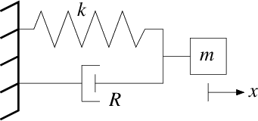



Section 4: Lumped model vs distributed model
$$F=\frac{1}{2}×\frac{ϵ∗V^{2}×A}{{(d0−x)}^{2}}$$
$$k=\frac{3EI}{L^{3}}$$
$$m=w×L×H×ρ$$

Slide 24
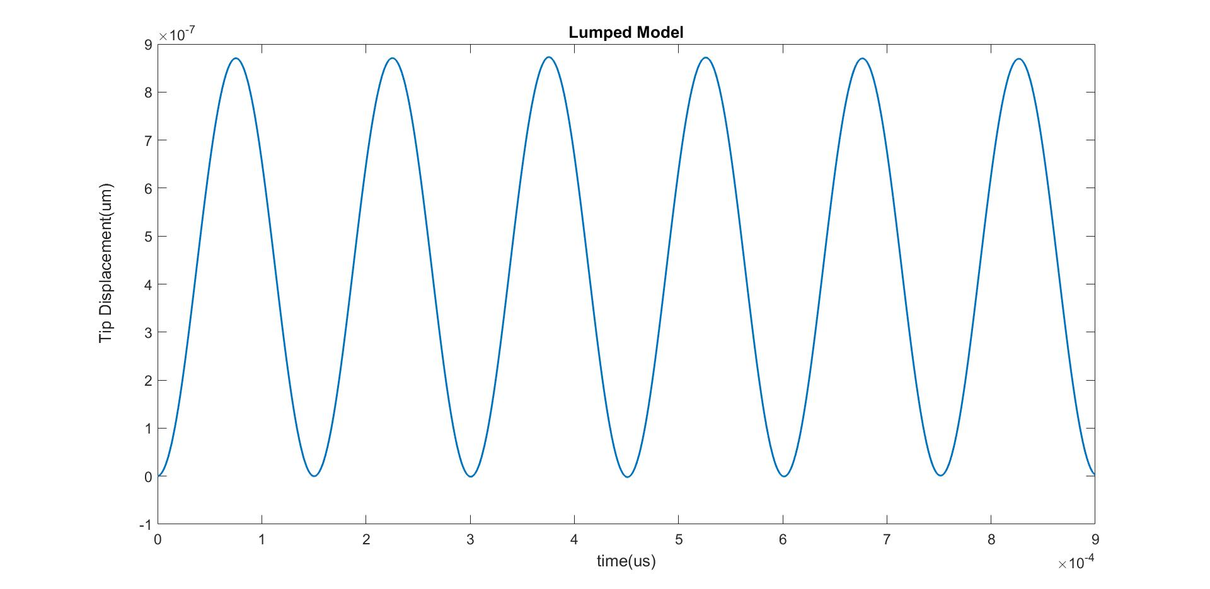
Section 4: Lumped model vs distributed model

Slide 25
Conclusion and future prospective
1- The Frequency Response Results for both micro cantilever and micro bridge have great consistency with the results of Siahpour et al.
2-Time Domain Response for micro cantilever has an acceptable consistency with the results of Siahpour et al but the steady state response for micro bridge does not damp completely.
Future Works: More accurate investigation of micro bridge and revising the time domain results.( including non-linear term of von Ka´rma´n)

Slide 26
References
Dynamics and vibrations of particle-sensing MEMS considering thermal and electrostatic actuation, Micro system Technologies March 2018, Shahin Siahpour • Mahdi Moghimi Zand • Mohammad Mousavi
Modelling a micro-cantilever vibrating in vacuum, gas or liquid under thermal base excitation,Mojtaba Komeili et al, Mechanics Research Communication, April 2016, Pages 39-46
COMSOL® Documentation, Website and Forums

Slide 27

Thanks for Your Attention!
Questions are welcomed.
s.mahdihosseini@ut.ac.ir
ali.mostafavi@ut.ac.ir

