Slide 1
Tocilizumab and Systemic Corticosteroids in the Management of COVID-19 Patients:
A Systematic Review and Meta-Analysis
Supplementary Figures

Slide 2
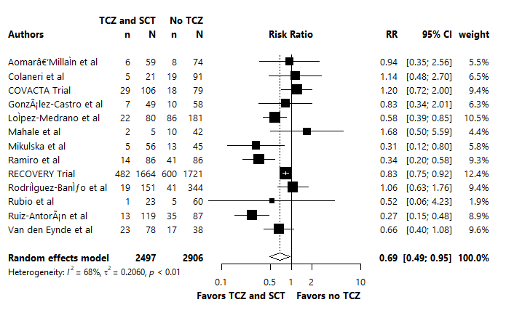
Notes:
Figure 1: Crude mortality rates in the TCZ and SCT arm versus no TCZ arm, combining observational studies and subgroup analyses from RCTs
Meta-analysis of the crude mortality outcome.
CI: Confidence Interval; RR: relative Risk; RCT, randomized controlled trials; SCT: Systematic Corticosteroids; TCZ: Tocilizumab

Slide 3
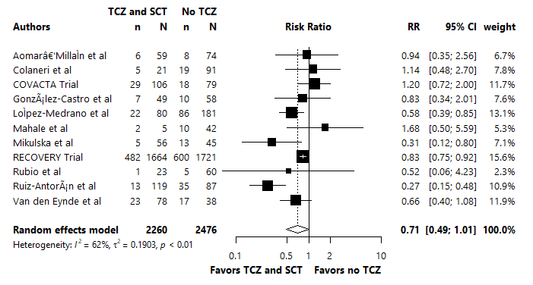
Notes:
Figure 2: Crude mortality rates in the TCZ and SCT arm versus no TCZ arm, in studies which the SOC were SCT.
Meta-analysis of the crude mortality outcome.
CI: Confidence Interval; RR: relative Risk; SCT: Systematic Corticosteroids; SOC, Standard of Care; TCZ: Tocilizumab.

Slide 4
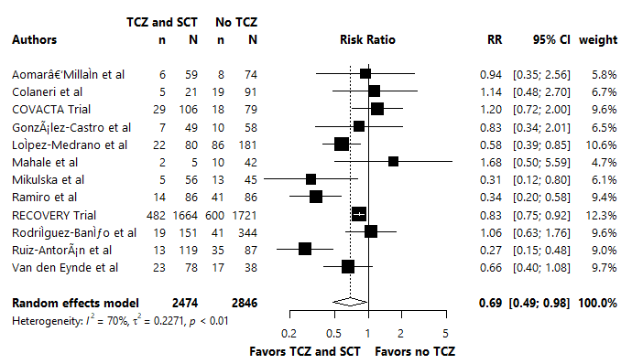
Notes:
Figure 3: Crude mortality rates in the TCZ and SCT arm versus no TCZ arm, excluding low-quality studies.
Meta-analysis of the crude mortality outcome.
CI: Confidence Interval; RR: relative Risk; SCT: Systematic Corticosteroids; SOC, Standard of Care; TCZ: Tocilizumab.

Slide 5
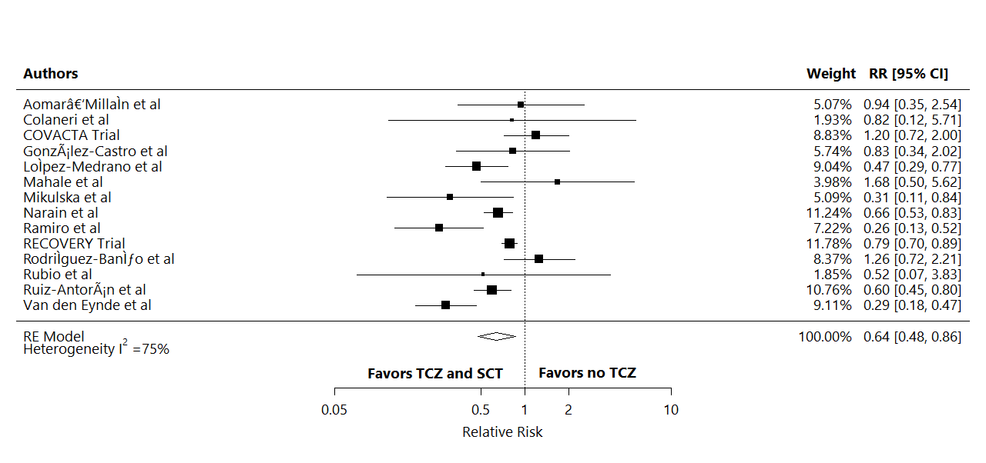
Notes:
Figure 4. Adjusted mortality rates in the TCZ and SCT arm versus no TCZ arm, combining observational studies and subgroup analyses from RCTs.
Meta-analysis of the most adjusted mortality rates using HRs and RRs as reported in each included study.
CI: Confidence Interval; HR: Hazard Ratio; RCT: Randomized Controlled Trials; RR: Relative Risk; SCT: Systematic Corticosteroids; TCZ: Tocilizumab

Slide 6
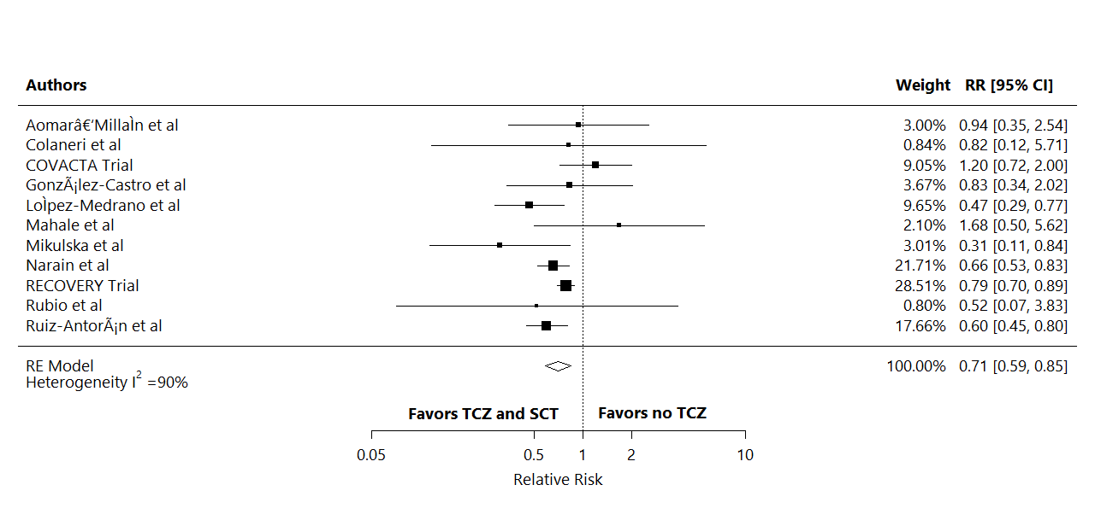
Notes:
Figure 5. Adjusted mortality rates in the TCZ and SCT arm versus no TCZ arm, in studies which the SOC were SCT.
Meta-analysis of the most adjusted mortality rates using HRs and RRs as reported in each included study.
CI: Confidence Interval; HR: Hazard Ratio; RR: Relative Risk; SCT: Systematic Corticosteroids; SOC, Standard of Care; TCZ: Tocilizumab

Slide 7
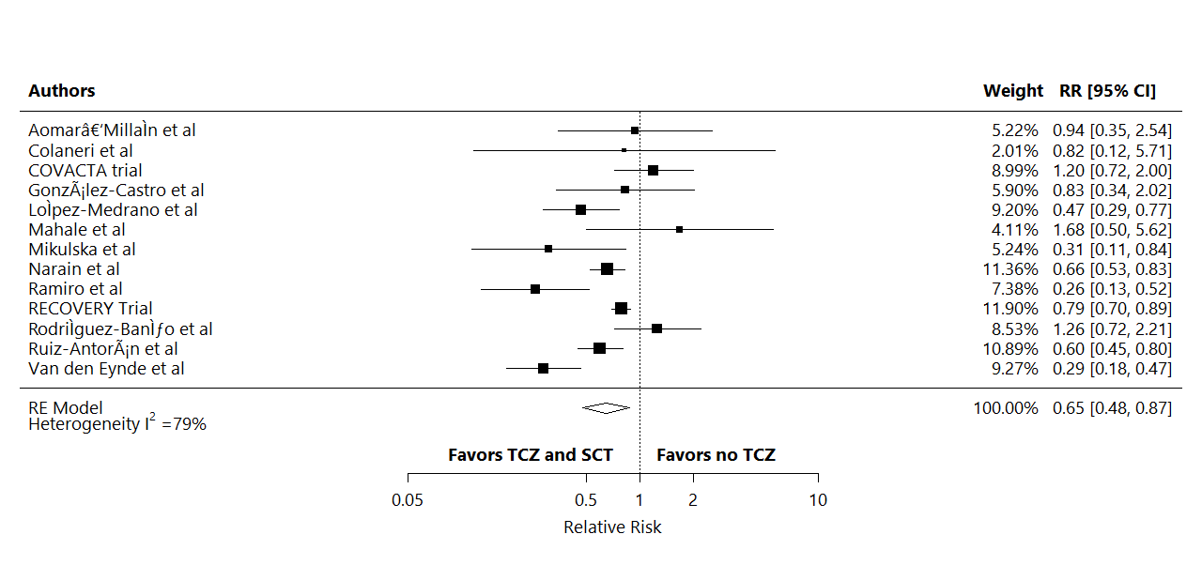
Notes:
Figure 6. Adjusted mortality rates in the TCZ and SCT arm versus no TCZ arm, excluding low-quality studies
Meta-analysis of the most adjusted mortality rates using HRs and RRs as reported in each included study.
CI: Confidence Interval; HR: Hazard Ratio; RR: Relative Risk; SCT: Systematic Corticosteroids; TCZ: Tocilizumab.

Slide 8
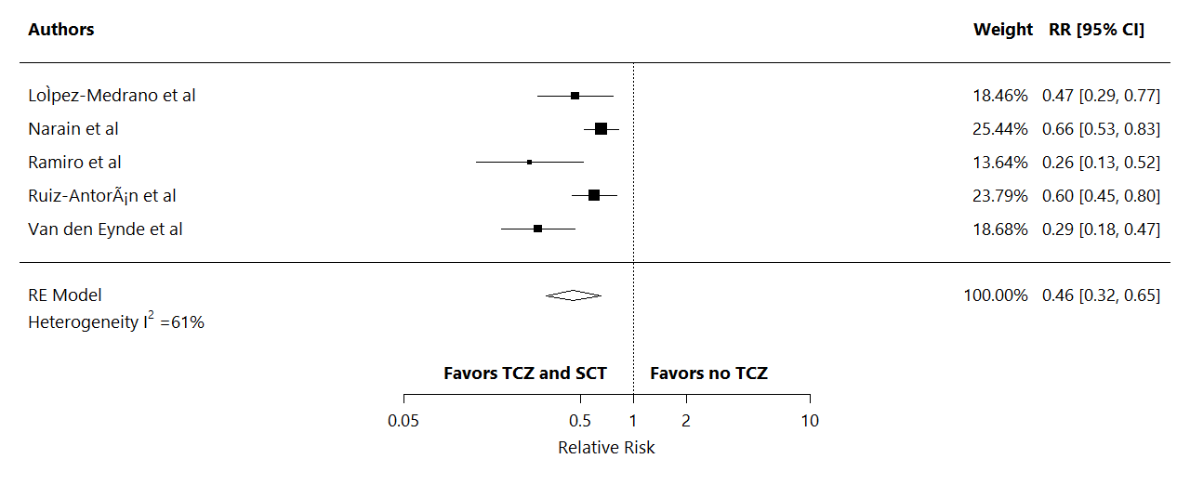
Notes:
Figure 7. Adjusted mortality rates in the TCZ and SCT arm versus no TCZ arm with studies that reported HR only.
Meta-analysis of the most adjusted mortality rates using HRs and RRs as reported in each included study.
CI: Confidence Interval; HR: Hazard Ratio; RR: Relative Risk; SCT: Systematic Corticosteroids; TCZ: Tocilizumab

Slide 9
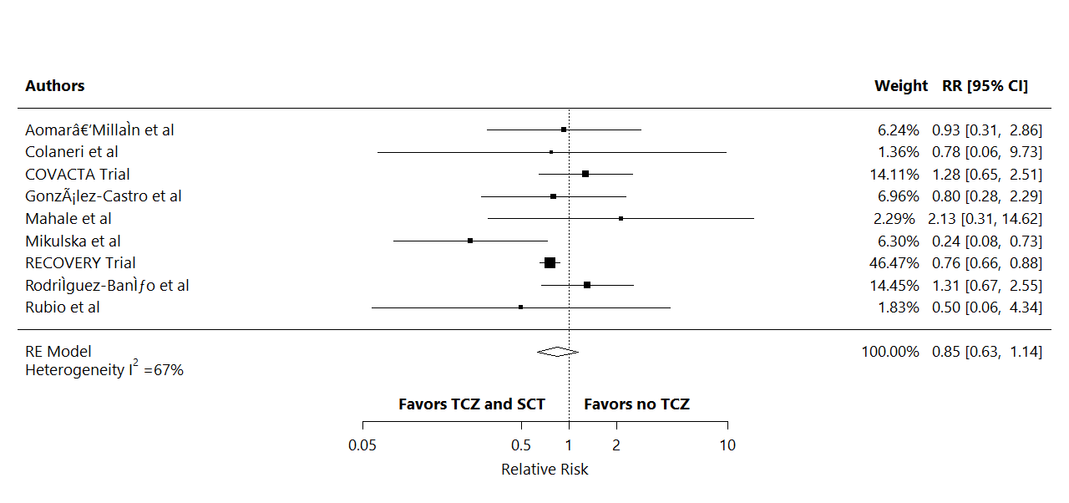
Notes:
Figure 8. Adjusted mortality rates in the TCZ and SCT arm versus no TCZ arm, with studies that reported ORs only.
Meta-analysis of the most adjusted mortality rates using ORs as reported in each included study.
CI: Confidence Interval; OR: Odds ratio, RR: relative Risk; SCT: Systematic Corticosteroids; TCZ: Tocilizumab.

Slide 10
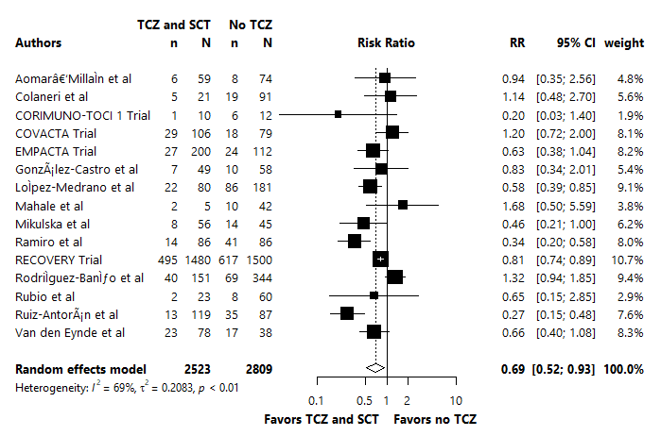
Notes:
Figure 9: Crude composite outcome rates of intubation or death in the TCZ and SCT arm versus no TCZ arm, combining observational studies and subgroup analyses from RCTs.
Meta-analysis of the composite outcome rates of intubation and death.
CI: Confidence Interval; RCT: Randomized Controlled Trials; RR: Relative Risk; SCT: Systematic Corticosteroids; TCZ: Tocilizumab

Slide 11
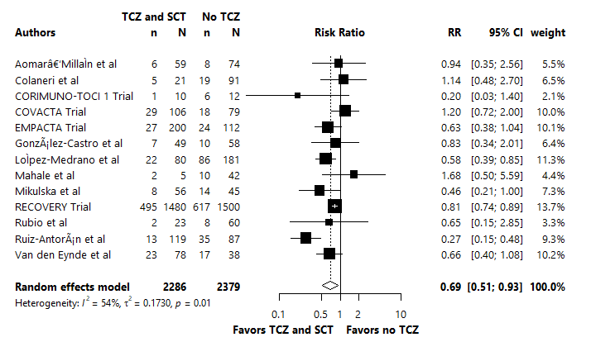
Notes:
Figure 10: Crude composite outcome rates of intubation or death in the TCZ and SCT arm versus no TCZ arm, in studies which the SOC were SCT.
Meta-analysis of the crude mortality outcome.
CI: Confidence Interval; RR: Relative Risk; SCT: Systematic Corticosteroids; SOC, Standard of Care; TCZ: Tocilizumab.

Slide 12
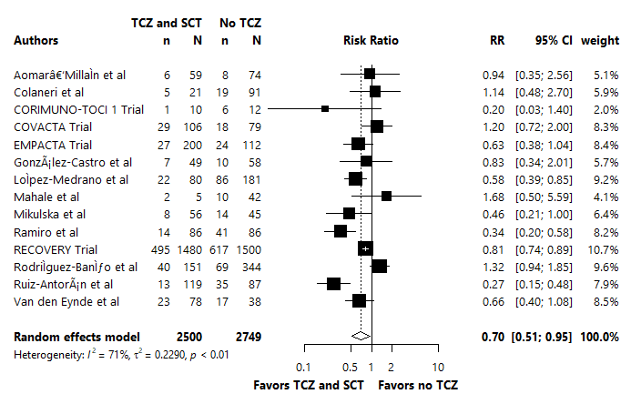
Notes:
Figure 11: Crude composite outcome rates of intubation or death in the TCZ and SCT arm versus no TCZ arm, excluding low quality studies.
Meta-analysis of the crude mortality outcome.
CI: Confidence Interval; RR: Relative Risk; SCT: Systematic Corticosteroids; TCZ: Tocilizumab

Slide 13
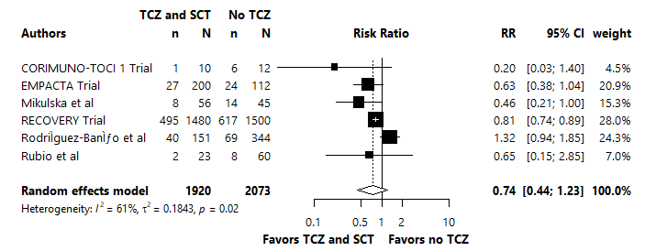
Notes:
Figure 12: Crude composite outcome rates of intubation or death in the TCZ and SCT arm versus no TCZ arm, including studies with strict composite outcome definition.
Meta-analysis of the crude mortality outcome.
CI: Confidence Interval; RR: Relative Risk; SCT: Systematic Corticosteroids; TCZ: Tocilizumab

Slide 14
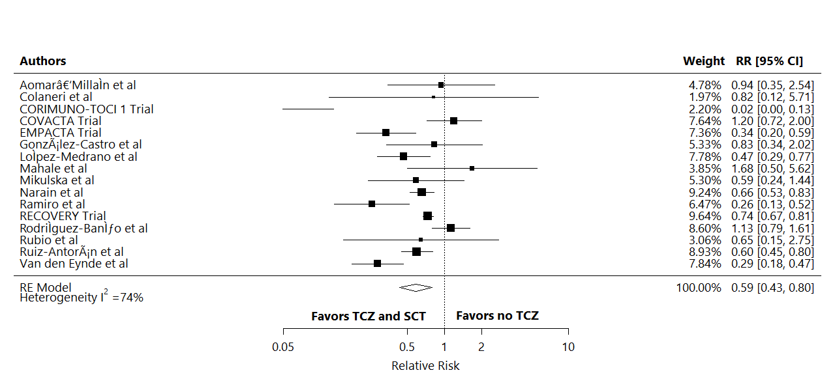
Notes:
Figure 13. Adjusted composite outcome rates of intubation or death in the TCZ and SCT arm versus no TCZ arm, combining observational studies and subgroup analyses from RCTs.
Meta-analysis of the most adjusted composite outcome rates of intubation and death using HRs and RRs as reported in each included study.
CI: Confidence Interval; HR: Hazard Ratio; RCT: Randomized Controlled Trials; RR: Relative Risk; SCT: Systematic Corticosteroids; TCZ: Tocilizumab.

Slide 15
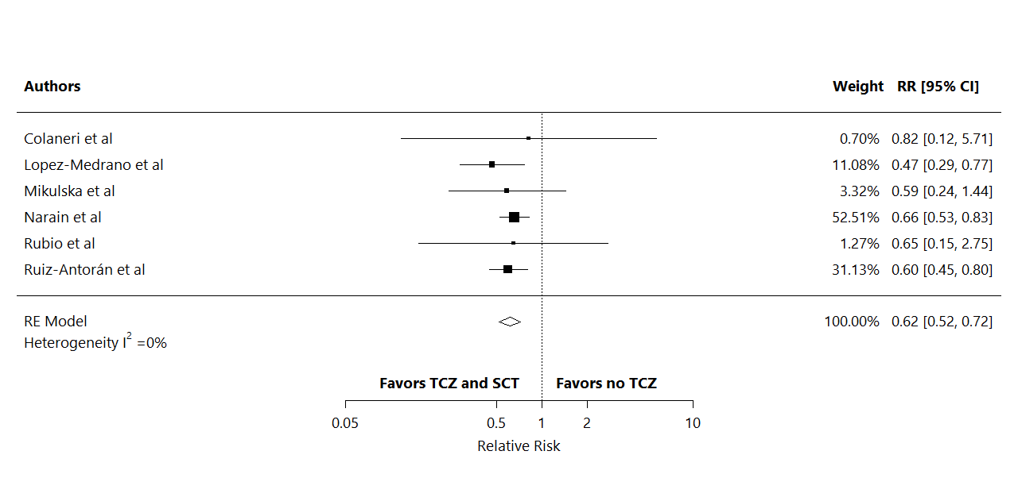
Notes:
Figure 14. Adjusted composite outcome rates of intubation or death in the TCZ and SCT arm versus no TCZ arm, in studies which the SOC were SCT.
Meta-analysis of the most adjusted mortality rates using HRs and RRs as reported in each included study.
CI: Confidence Interval; HR: Hazard Ratio; RR: Relative Risk; SCT: Systematic Corticosteroids; SOC, Standard of Care; TCZ: Tocilizumab

Slide 16

Notes:
Figure 15. Adjusted composite outcome rates of intubation and death in the TCZ and SCT arm versus no TCZ arm, excluding low quality studies.
Meta-analysis of the most adjusted mortality rates using HRs and RRs as reported in each included study.
CI: Confidence Interval; HR: Hazard Ratio; RR: Relative Risk; SCT: Systematic Corticosteroids; TCZ: Tocilizumab

Slide 17
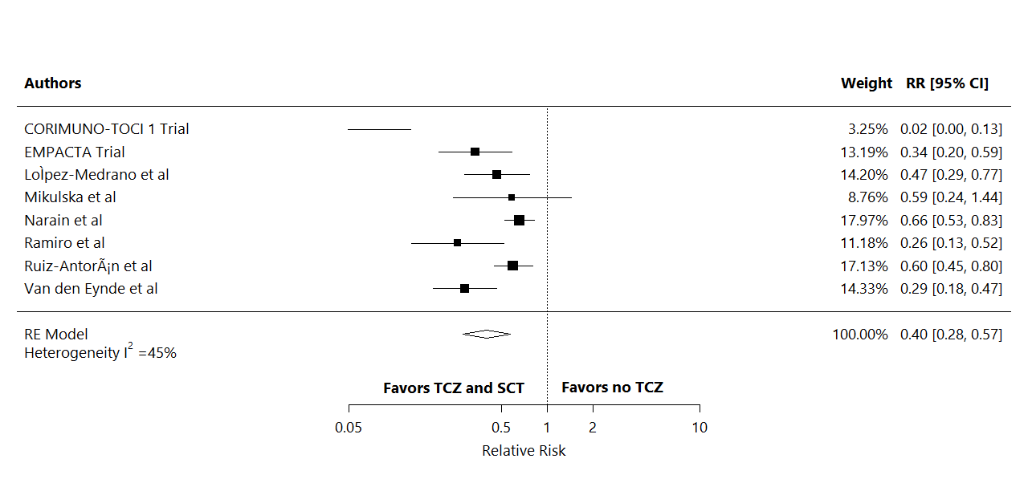
Notes:
Figure 16. Adjusted composite outcome rates of intubation and death in the TCZ and SCT arm versus no TCZ arm, with studies that reported HR only.
Meta-analysis of the most adjusted mortality rates using HRs as reported in each included study.
CI: Confidence Interval; HR: Hazard Ratio; RR: Relative Risk; SCT: Systematic Corticosteroids; TCZ: Tocilizumab.

Slide 18

Notes:
Figure 17. Adjusted composite outcome rates of intubation and death in the TCZ and SCT arm versus no TCZ arm, with studies that reported ORs only.
Meta-analysis of the most adjusted mortality rates using ORs as reported in each included study.
CI: Confidence Interval; OR: Odds ratio, RR: relative Risk; SCT: Systematic Corticosteroids; TCZ: Tocilizumab

Slide 19
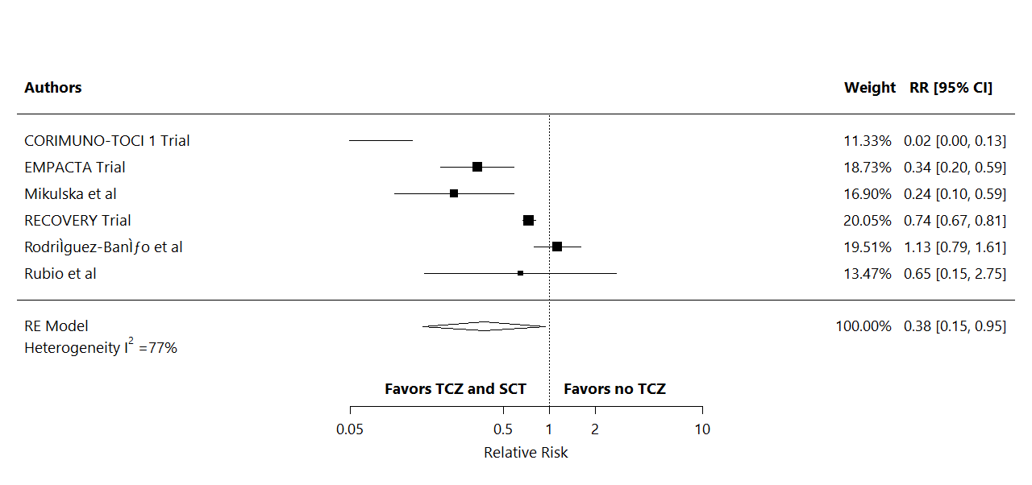
Notes:
Figure 18. Adjusted composite outcome rates of intubation or death in the TCZ and SCT arm versus no TCZ arm, including studies with strict composite outcome definition.
Meta-analysis of the most adjusted mortality rates using HRs or RRs as reported in each included study.
CI: Confidence Interval; HR: Hazard Ratio; RR: Relative Risk; SCT: Systematic Corticosteroids; TCZ: Tocilizumab.

Slide 20
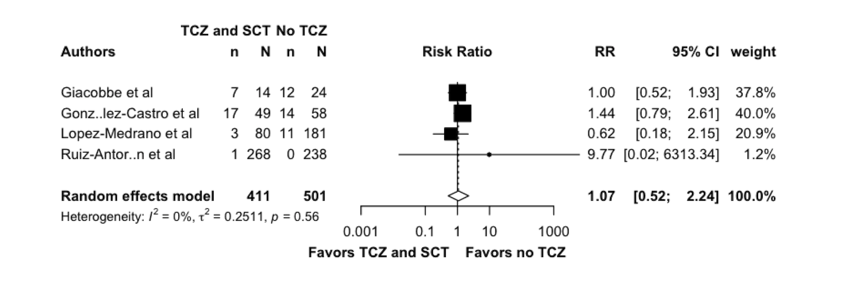
Notes:
Figure 19: Crude superinfection outcome rates of intubation and death in the TCZ and steroids arm versus no TCZ arm, in studies which the SOC were SCT.
Meta-analysis of the crude mortality outcome.
CI: Confidence Interval; RR: relative Risk; SCT: Systematic Corticosteroids; SOC, Standard of Care; TCZ: Tocilizumab

