Slide 1




Diagnostic accuracy of myocardial perfusion imaging in patients evaluated for kidney transplantation: a systematic review and meta-analysis
Journal of Nuclear Cardiology | Official Journal of the American Society of Nuclear Cardiology
Jeroen R. Kelderman, BSc, Floris E.J. Jolink, BSc, Stan Benjamens, BSc, Andrea G. Monroy Gonzalez, MD, Robert A. Pol, MD, PhD, Riemer H.J.A. Slart, MD, PhD
University Medical Center Groningen, The Netherlands
Head shot of author
required
Copyright American Society of Nuclear Cardiology

Slide 2
BACKGROUND
Journal of Nuclear Cardiology | Official Journal of the American Society of Nuclear Cardiology
1- CV event most common cause of death
2- High CAD prevalence
3- Asymptomatic patients
4- Current guidelines
5- Diagnostic accuracy
Copyright American Society of Nuclear Cardiology

Slide 3
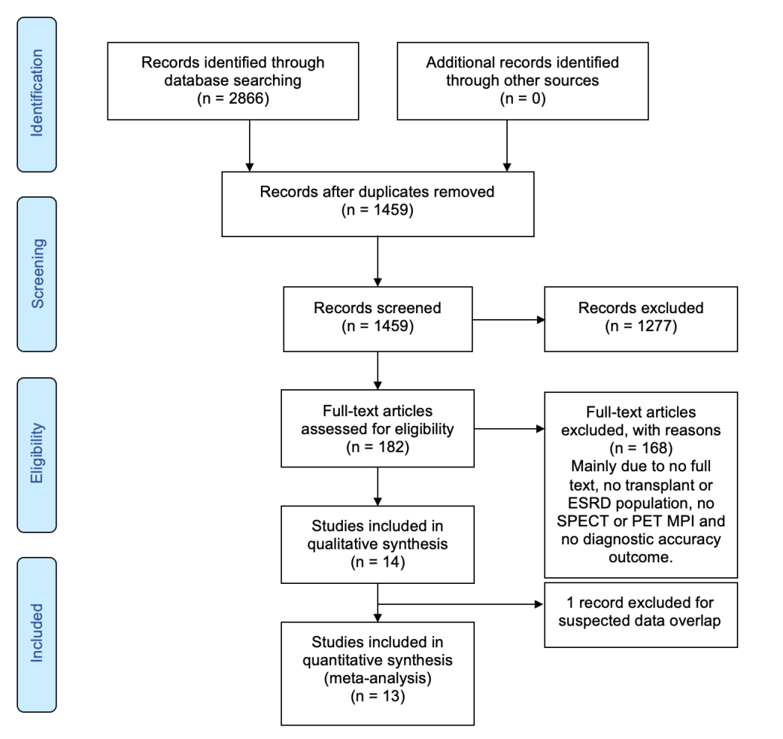
Summary- 1
Journal of Nuclear Cardiology | Official Journal of the American Society of Nuclear Cardiology
Flowchart of included studies.
Copyright American Society of Nuclear Cardiology

Slide 4
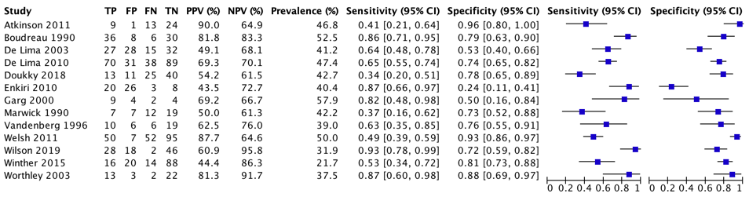
Summary- 2
Journal of Nuclear Cardiology | Official Journal of the American Society of Nuclear Cardiology
Sensitivity and specificity of myocardial perfusion imaging SPECT for coronary artery disease in patients evaluated for kidney transplantation.
Copyright American Society of Nuclear Cardiology

Slide 5
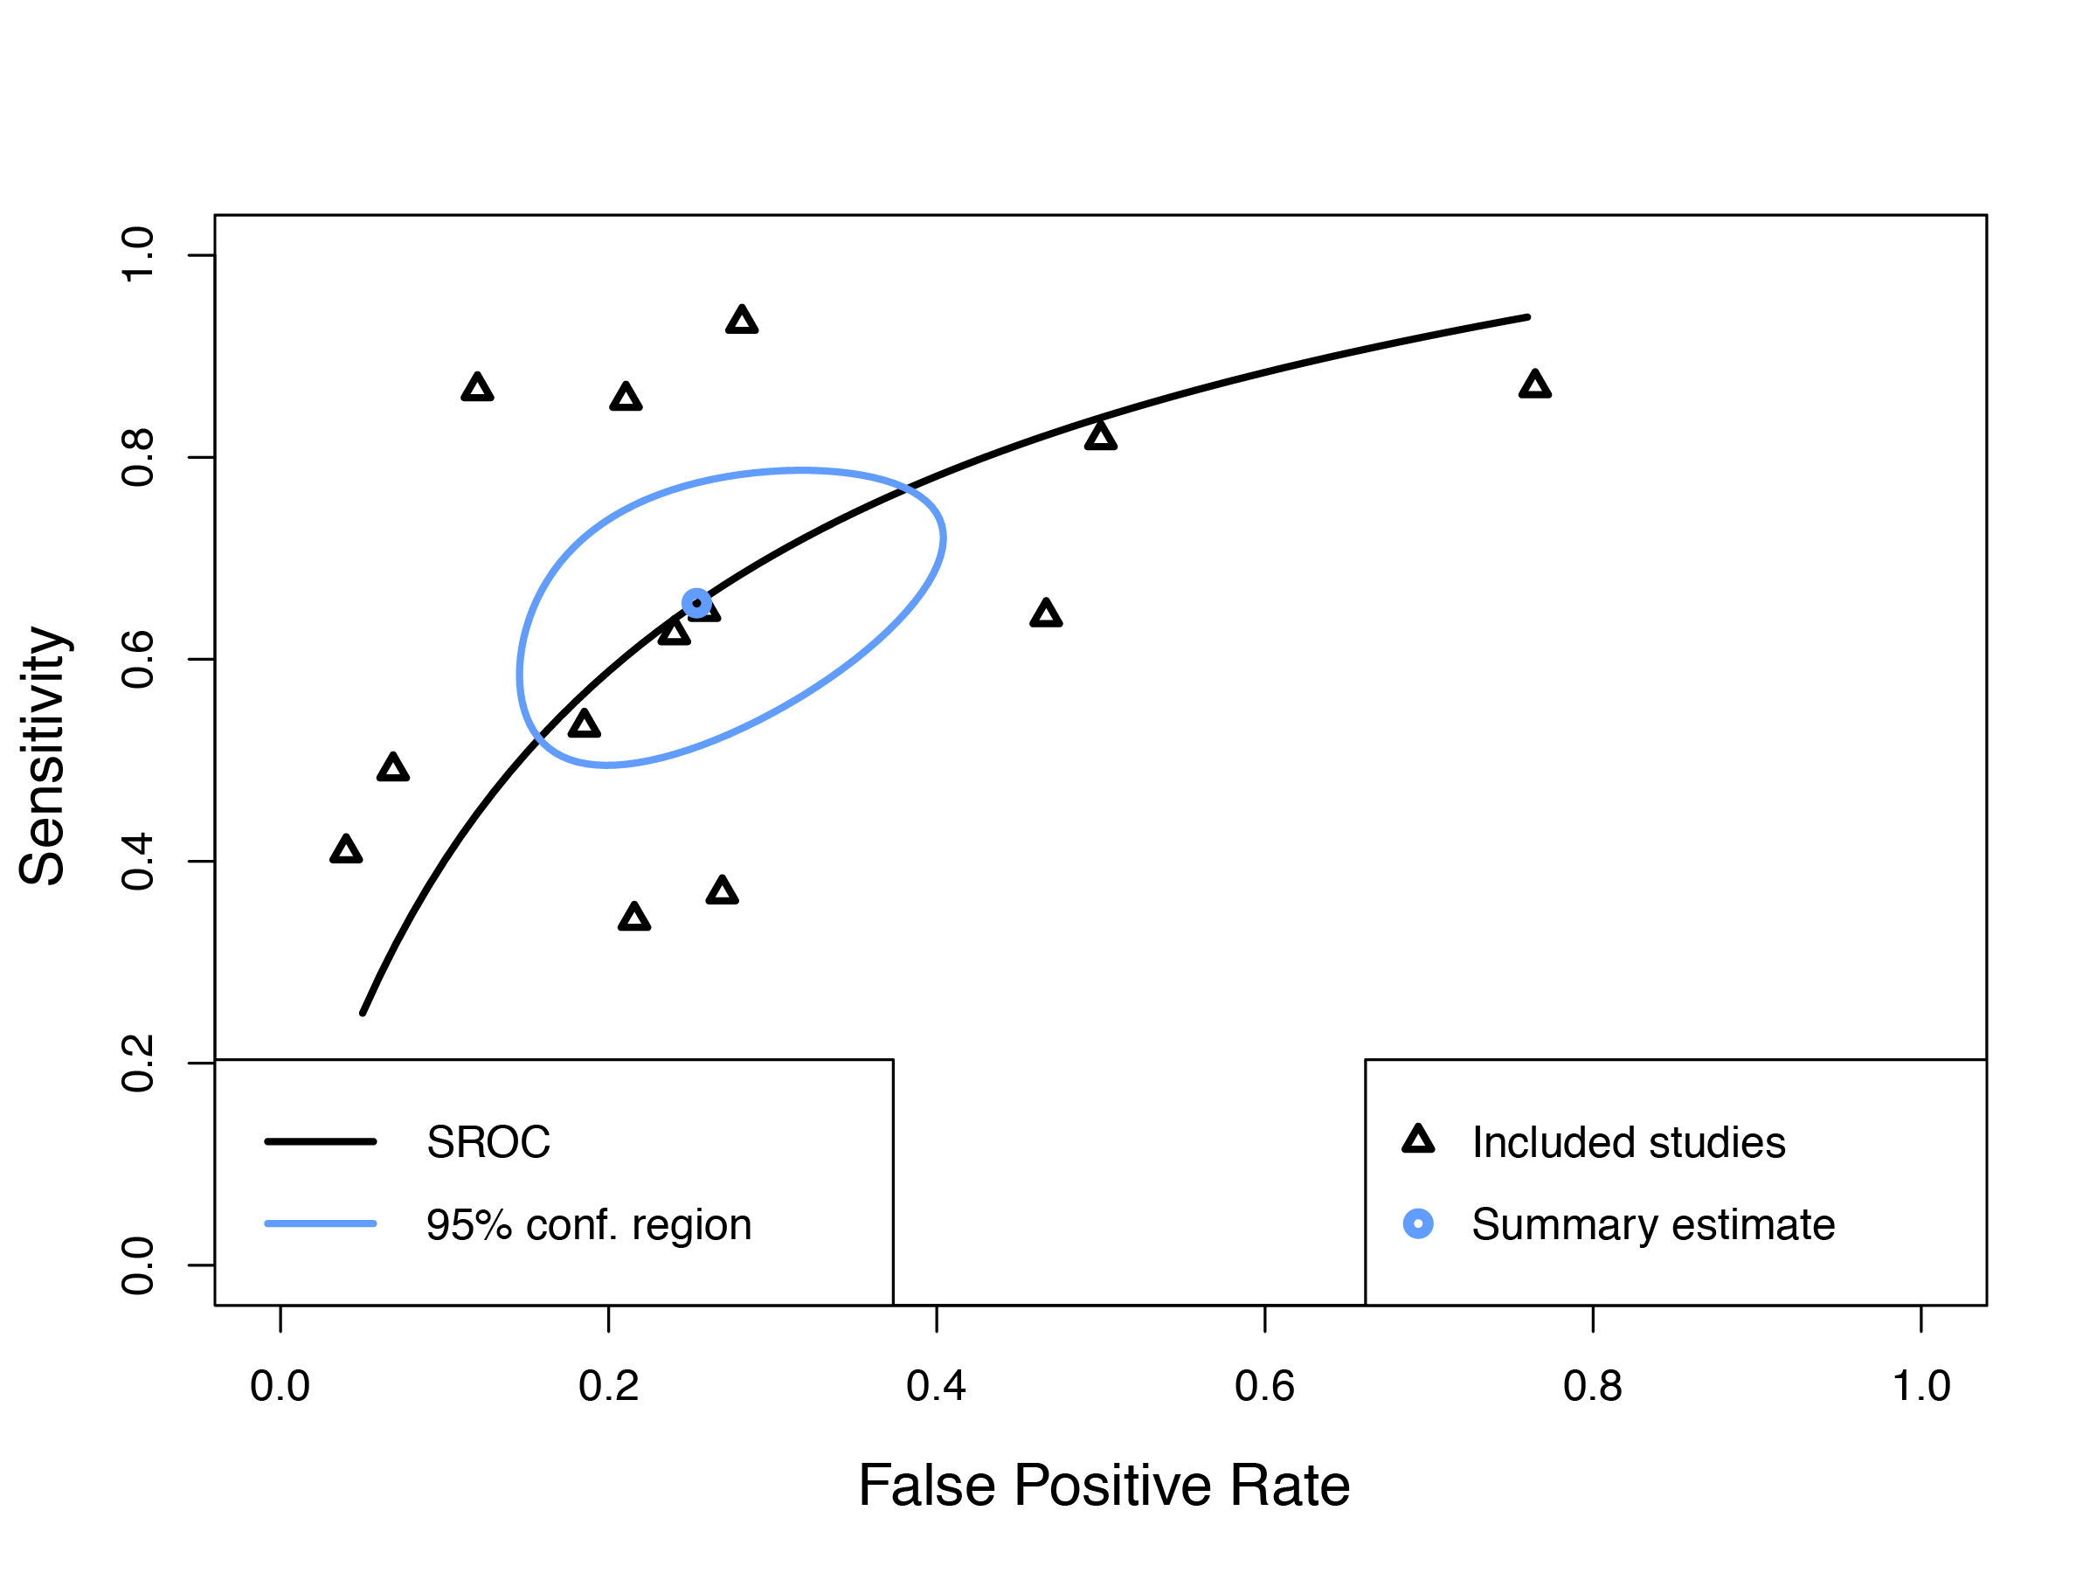
Summary- 3
Journal of Nuclear Cardiology | Official Journal of the American Society of Nuclear Cardiology
Summary Receiver Operating Curve (SROC) of included studies.
Copyright American Society of Nuclear Cardiology

Slide 6
CONCLUSIONS & FUTURE DIRECTIONS
Journal of Nuclear Cardiology | Official Journal of the American Society of Nuclear Cardiology
1- Moderate sensitivity and specificity MPI SPECT
2- Using coronary anatomic reference major draw back
3- Standardization of MPI SPECT protocols needed
Copyright American Society of Nuclear Cardiology

