Slide 1
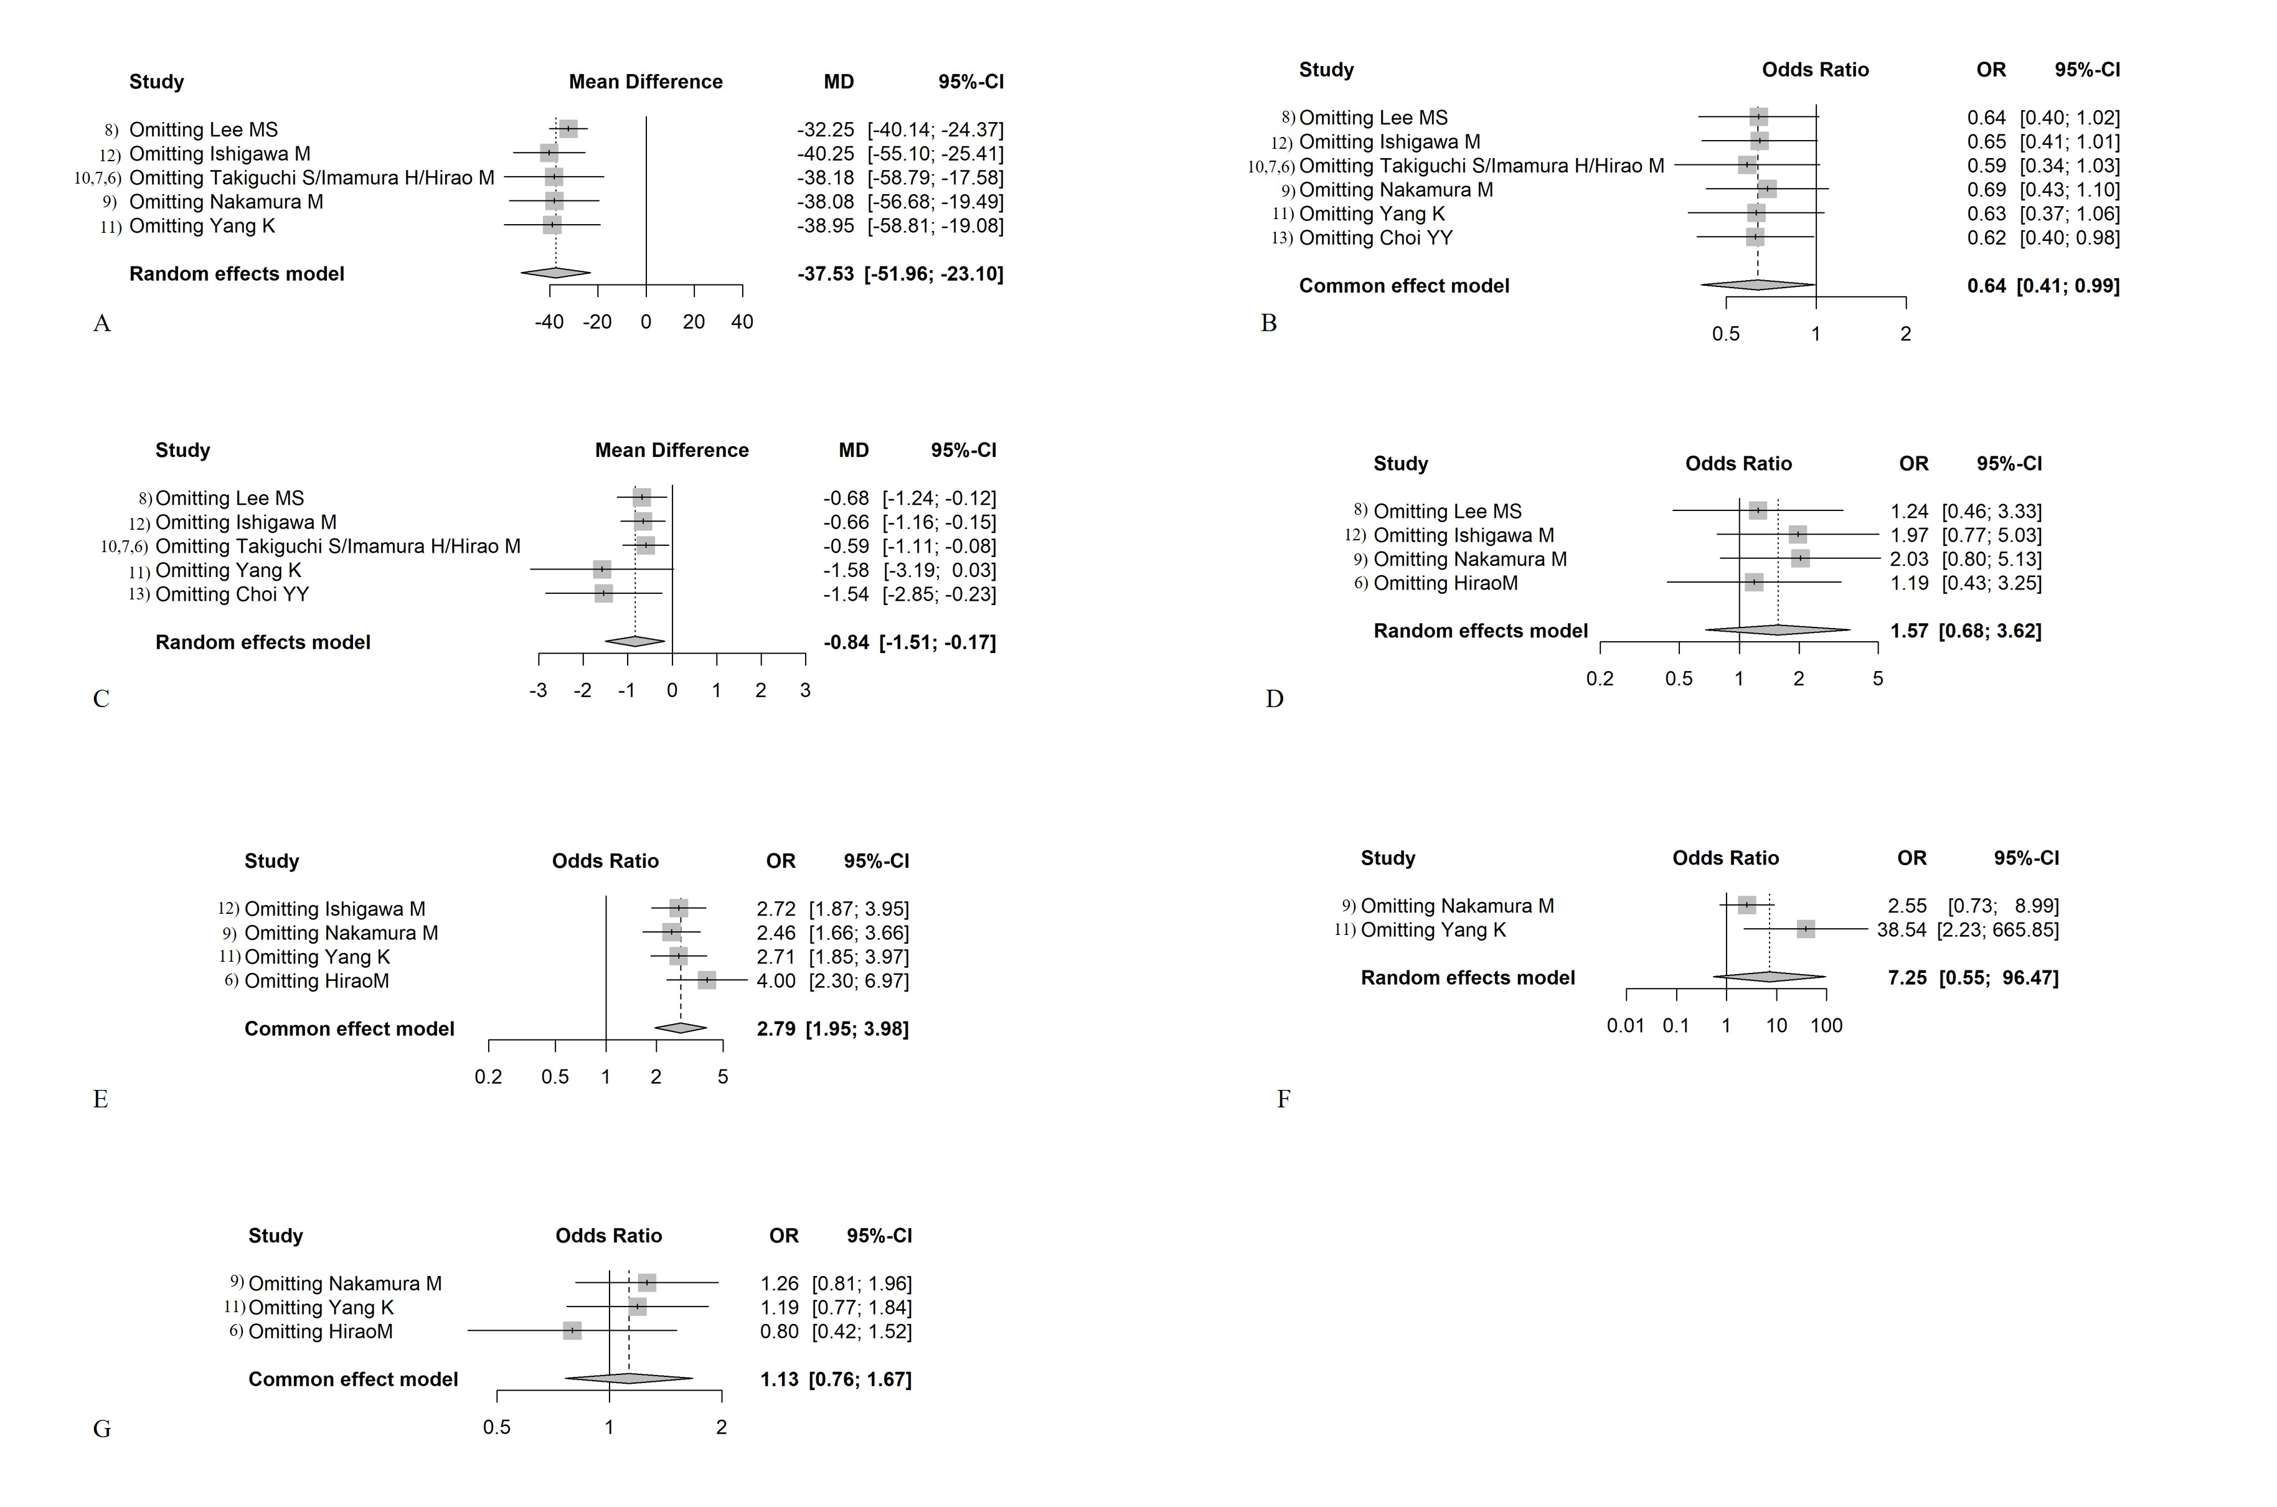
Supplementary Fig. 1. Sensitivity analysis between B-I and RNY. (A) Operation time; (B) Postoperative complications; (C) Hospital stay; (D) Reflux esophagitis; (E) Reflux gastritis; (F) Bile reflux; (G) Residual food.
J Gastric Cancer 2022 Apr;22(2):83-93. https://doi.org/10.5230/jgc.2022.22.e9
Notes:
Supplementary Fig. 1. Sensitivity analysis between B-I and RNY. (A) Operation time; (B) Postoperative complications; (C) Hospital stay; (D) Reflux esophagitis; (E) Reflux gastritis; (F) Bile reflux; (G) Residual food.
B-I = Billroth type I; RNY = Roux-en-Y; MD = mean difference; OR = odds ratio; CI = confidence interval

