Slide 1
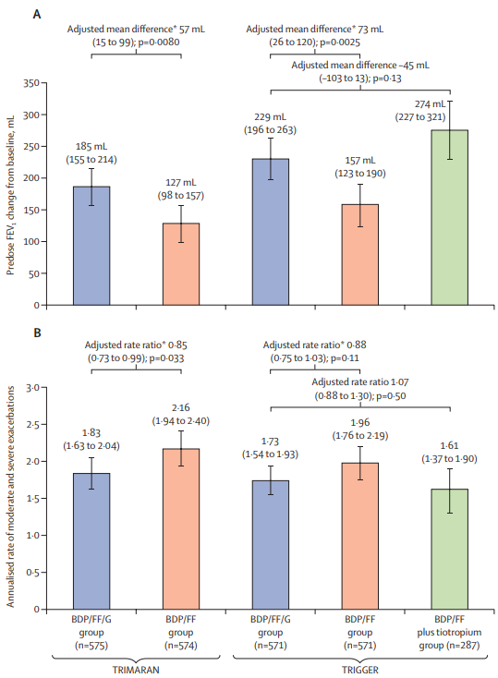
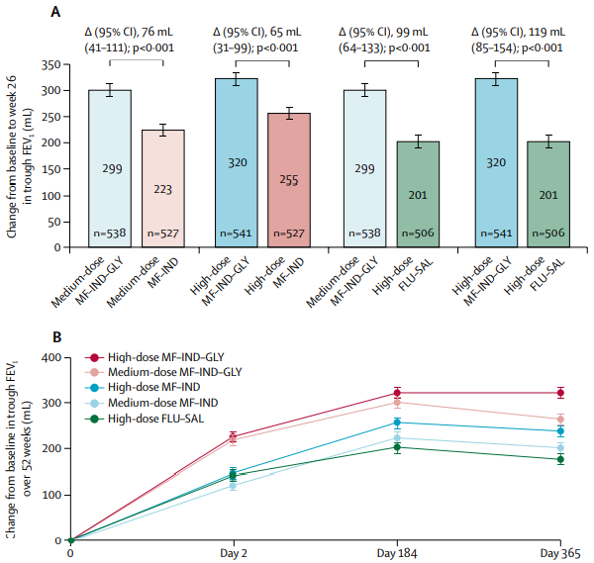
TRIMARAN & TRIGGER
IRIDIUM
Figure 1

Slide 2
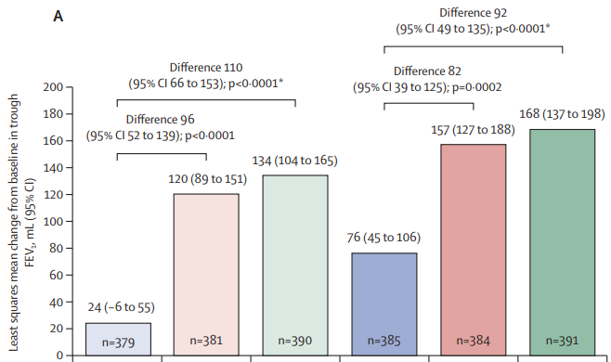
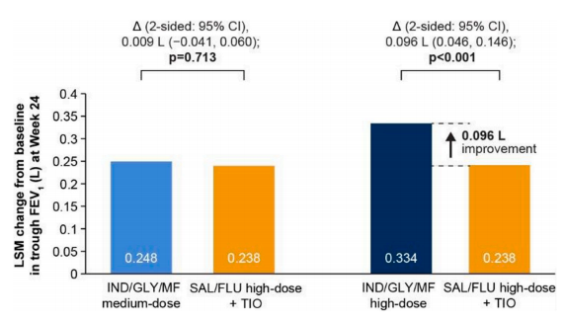
CAPTAIN
ARGON
Figure 2

Slide 3
On-line supplement figures

Slide 4

PRISMA 2009 Flow Diagram
From: Moher D, Liberati A, Tetzlaff J, Altman DG, The PRISMA Group (2009). Preferred Reporting Items for Systematic Reviews and Meta-Analyses: The PRISMA Statement. PLoS Med 6(7): e1000097. doi:10.1371/journal.pmed1000097
For more information, visit www.prisma-statement.org.
Figure S1

Slide 5
Figure S2

Slide 6
Figure S3

