Slide 1




Diagnostic accuracy of dynamic CZT-SPECT in coronary artery disease.A systematic review and meta-analysis.
Journal of Nuclear Cardiology | Official Journal of the American Society of Nuclear Cardiology
  Mariska Panjer1, Magdalena Dobrolinska1,2, Nils R.L Wagenaar3,4, Riemer H.J.A Slart1,3
  Affiliations:
  1University Medical Center Groningen, 2Medical University of Silesia, 3University of Twente, 4Ziekenhuis Groep Twente
Copyright American Society of Nuclear Cardiology

Slide 2
BACKGROUND
Journal of Nuclear Cardiology | Official Journal of the American Society of Nuclear Cardiology
1-PET is the non invasive gold standard in the CAD diagnosis
2-In contrast to PET, SPECT is less expensive, wider, and more easily available.
3-The recently introduced CZT camera have a higher resolution and shorter acquisition time, this not only improves the overall SPECT performance, but also decreases radiation dose.
4-The comparison between dynamic CZT SPECT and clinical standards used in CAD diagnosis has not been available yet.
Copyright American Society of Nuclear Cardiology

Slide 3
Methods
Journal of Nuclear Cardiology | Official Journal of the American Society of Nuclear Cardiology
A. Study type:
  A systematic review and meta-analysis.
B. Study subjects: studies which reported to perform dynamic CZT-SPECT and within half a year the methodological references coronary angiography with FFR and positron emission tomography
C. Study endpoints:
A. Primary end point(s): sensitivity and specificity
B. Secondary end point(s): negative likelihood ratio, positive likelihood ratio, diagnostic odds ratio and heterogeneity
D. Study variables: true positive, true negative, false positive, false negative
Copyright American Society of Nuclear Cardiology

Slide 4
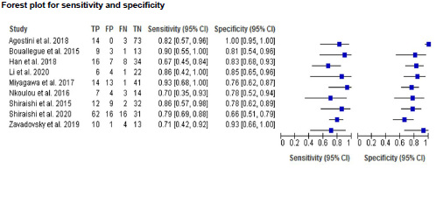
Results
Journal of Nuclear Cardiology | Official Journal of the American Society of Nuclear Cardiology
Copyright American Society of Nuclear Cardiology

Slide 5
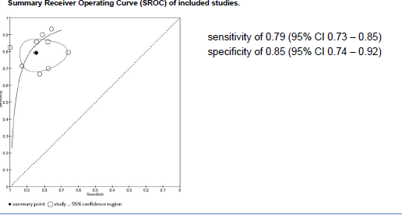
Results
Journal of Nuclear Cardiology | Official Journal of the American Society of Nuclear Cardiology
Copyright American Society of Nuclear Cardiology

Slide 6
CONCLUSIONS
Journal of Nuclear Cardiology | Official Journal of the American Society of Nuclear Cardiology
1- Overall, dynamic CZT-SPECT MPI has a good diagnostic sensitivity and specificity for CAD diagnosis as compared to gold standards used in clinical practice.
2- However, due to the heterogeneity of the methodologies between the CZT-SPECT MPI studies and the gold standards, and the relatively small number of included studies, it warrants further well-defined research protocols.
Copyright American Society of Nuclear Cardiology

