Slide 1
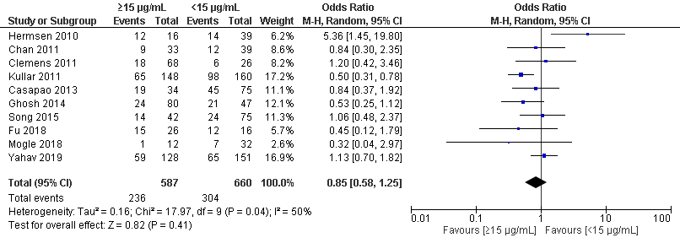
Suppl Figure S1

