Slide 1
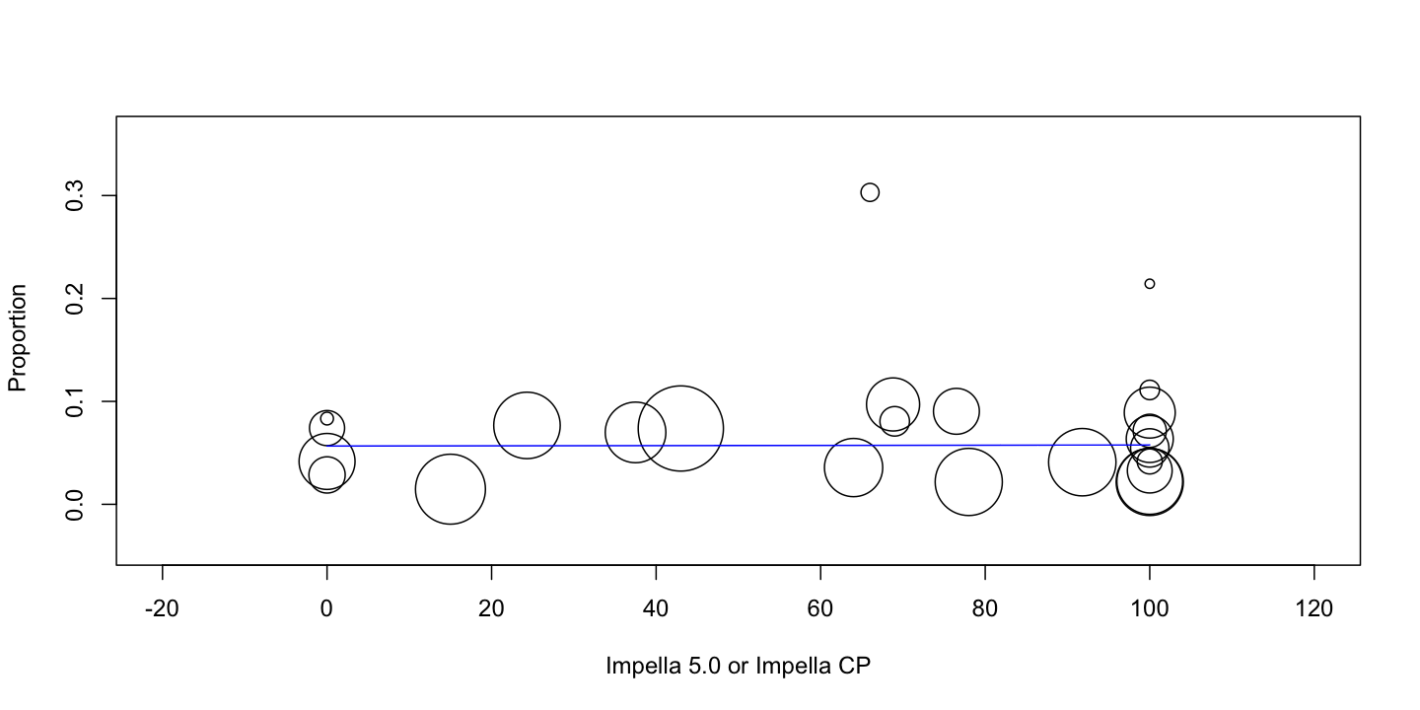
Supplementary figure 1: effects of larger support Impella formats (Impella 5.0 or Impella CP on vascular access complications) rate.

Slide 2
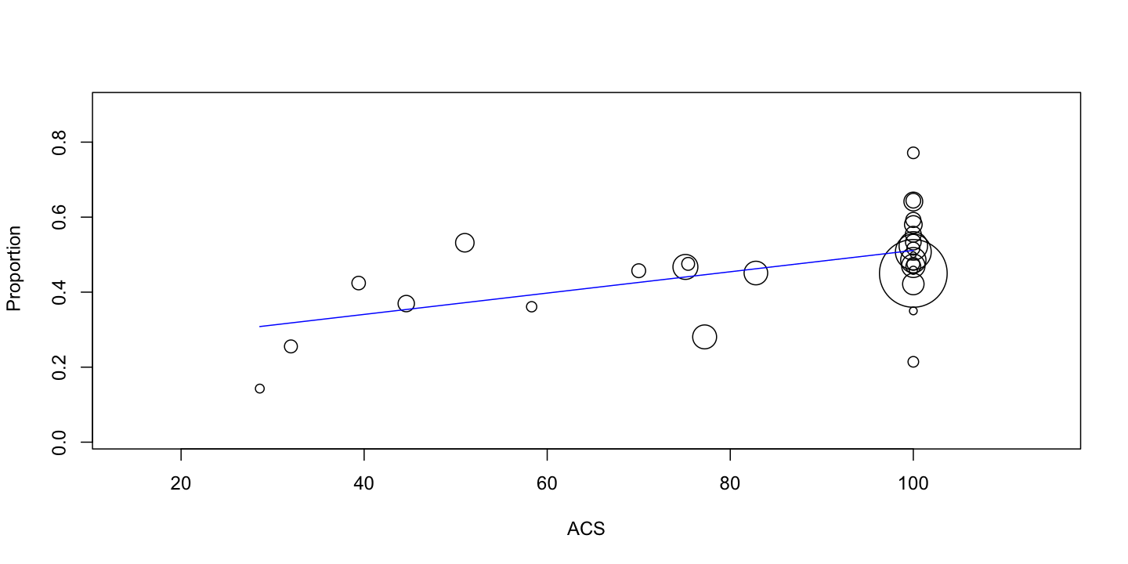
Supplementary figure 2: impact of aetiology on short-term mortality (ACS).

Slide 3
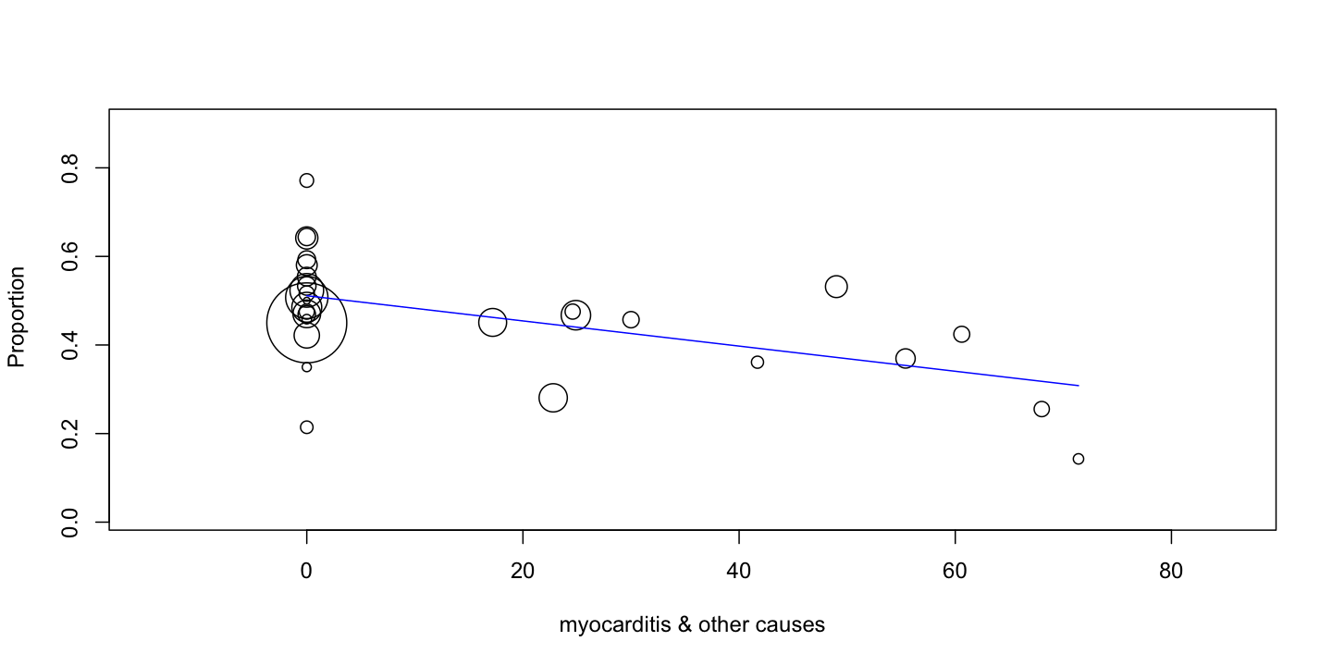
Supplementary figure 3: impact of aetiology on short-term mortality (myocarditis & other causes).

Slide 4
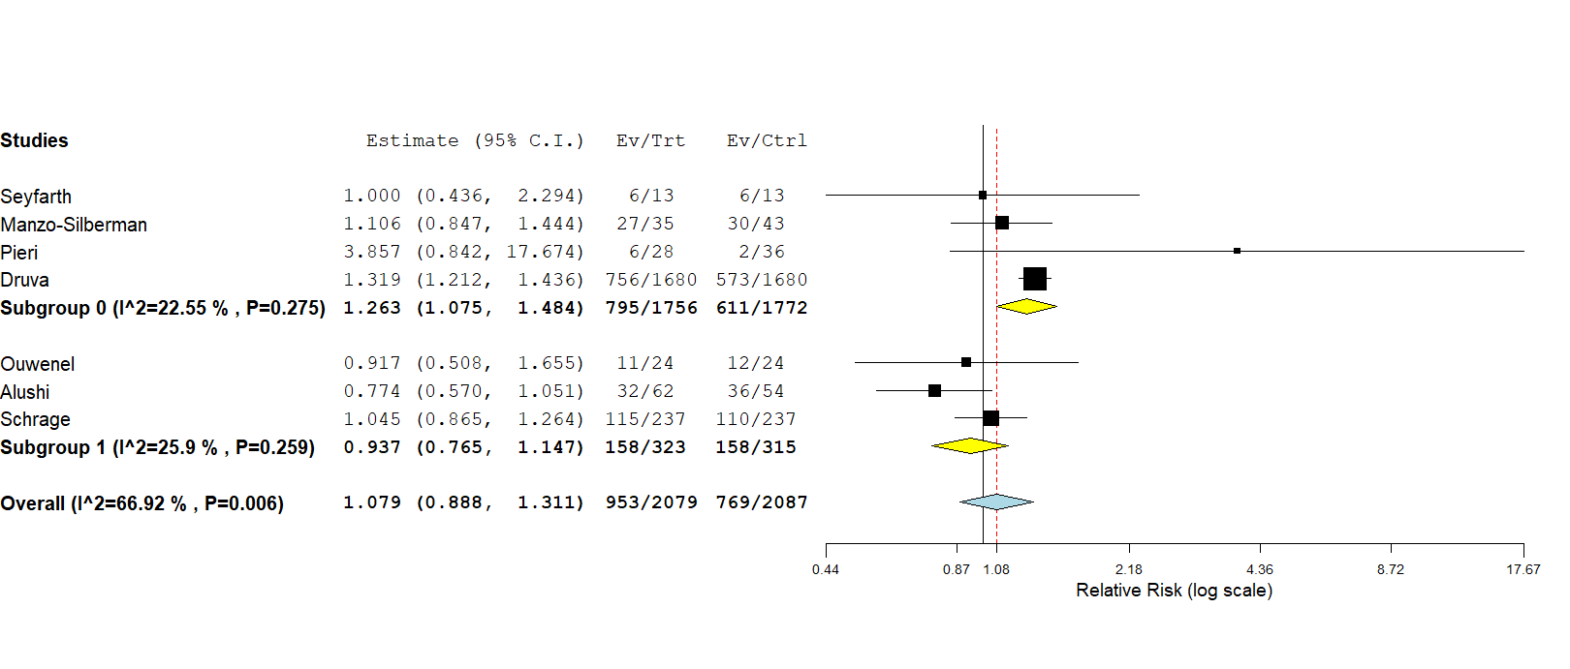
Supplementary Figure 4: subgroup analysis.

Slide 5
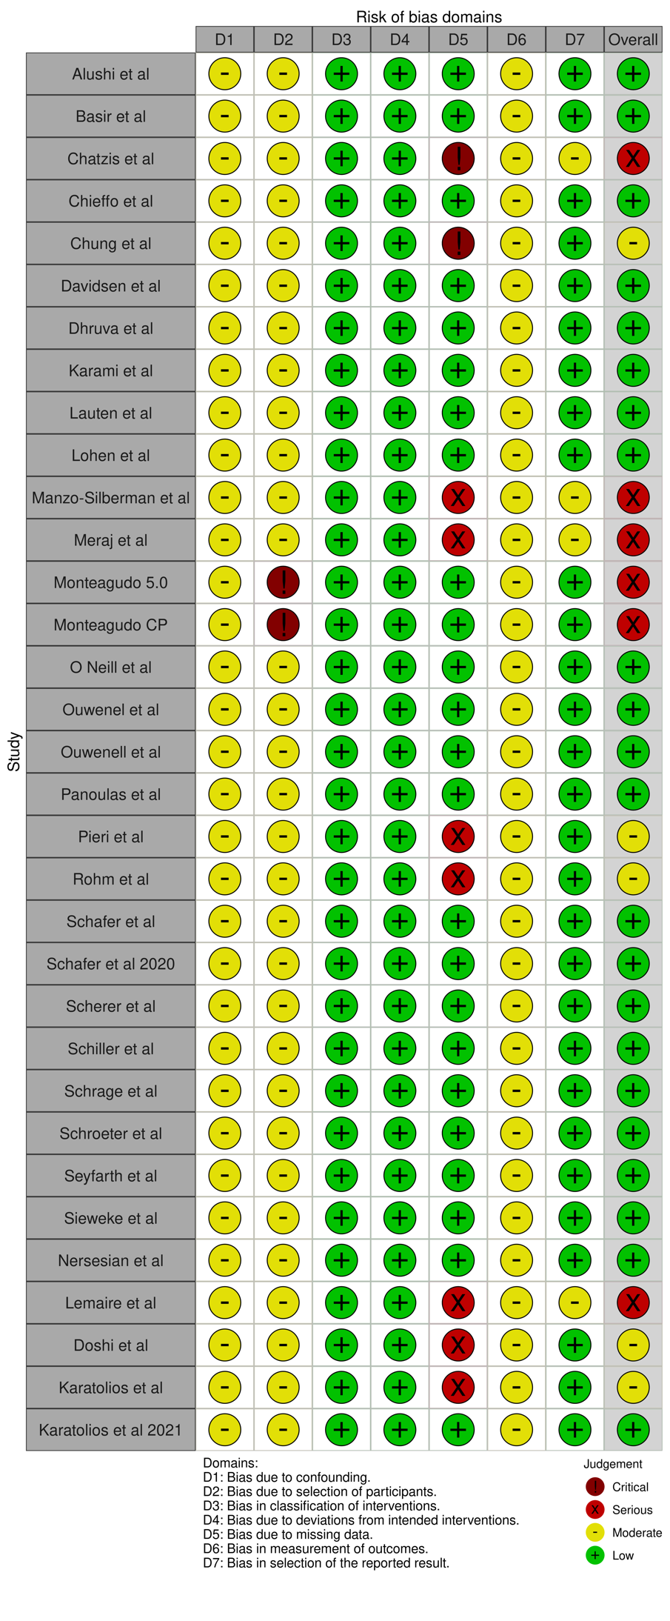
Supplementary Figure 5: traffic light plot for evaluation of bias.

Slide 6
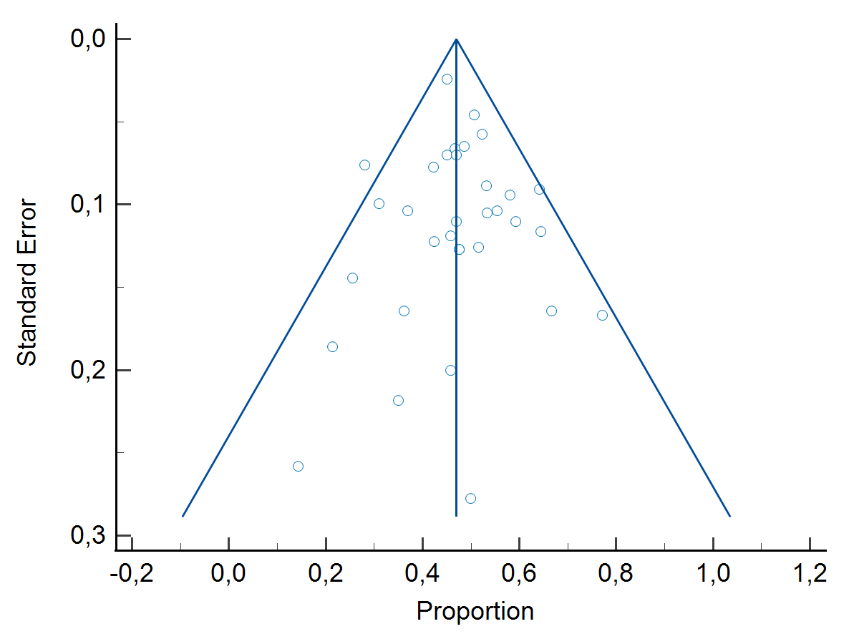
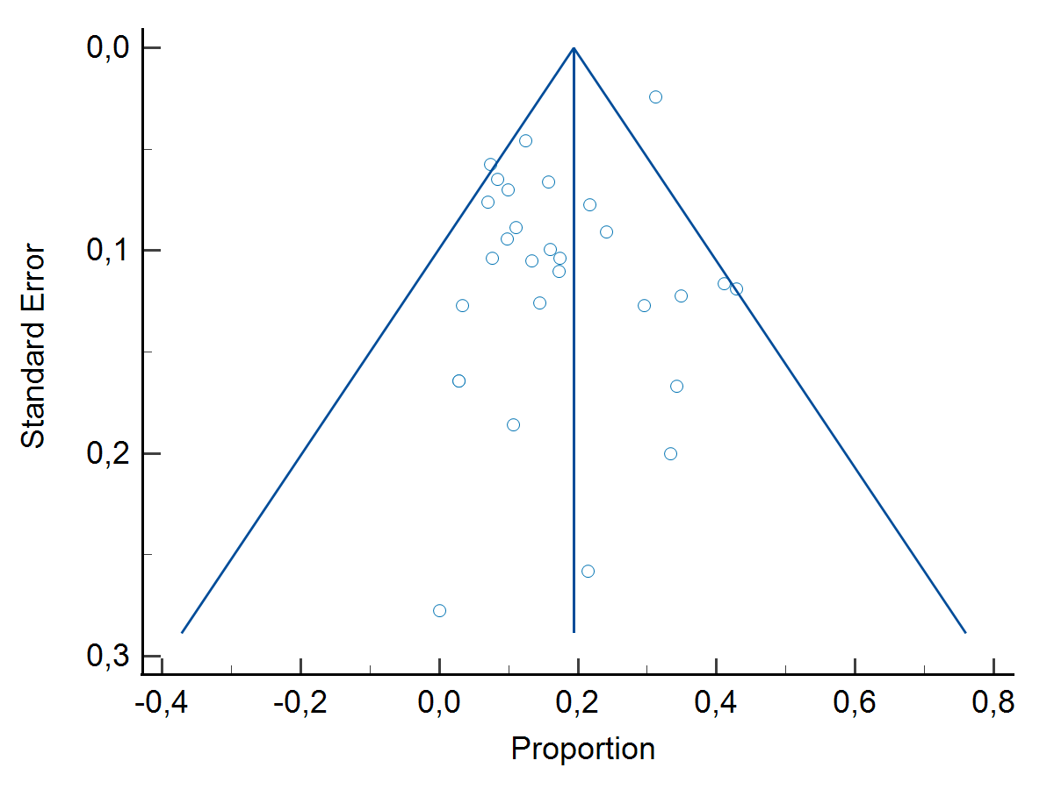
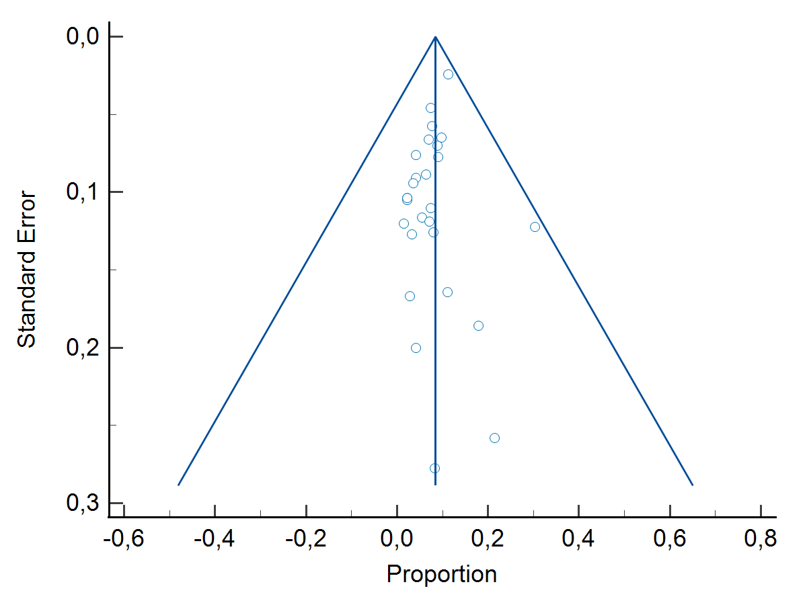
A
C
B
Supplementary Figure 6: Funnel Plots for: A) 30-day mortality; B) Vascular access complications; C) Major Bleeding.

Slide 7
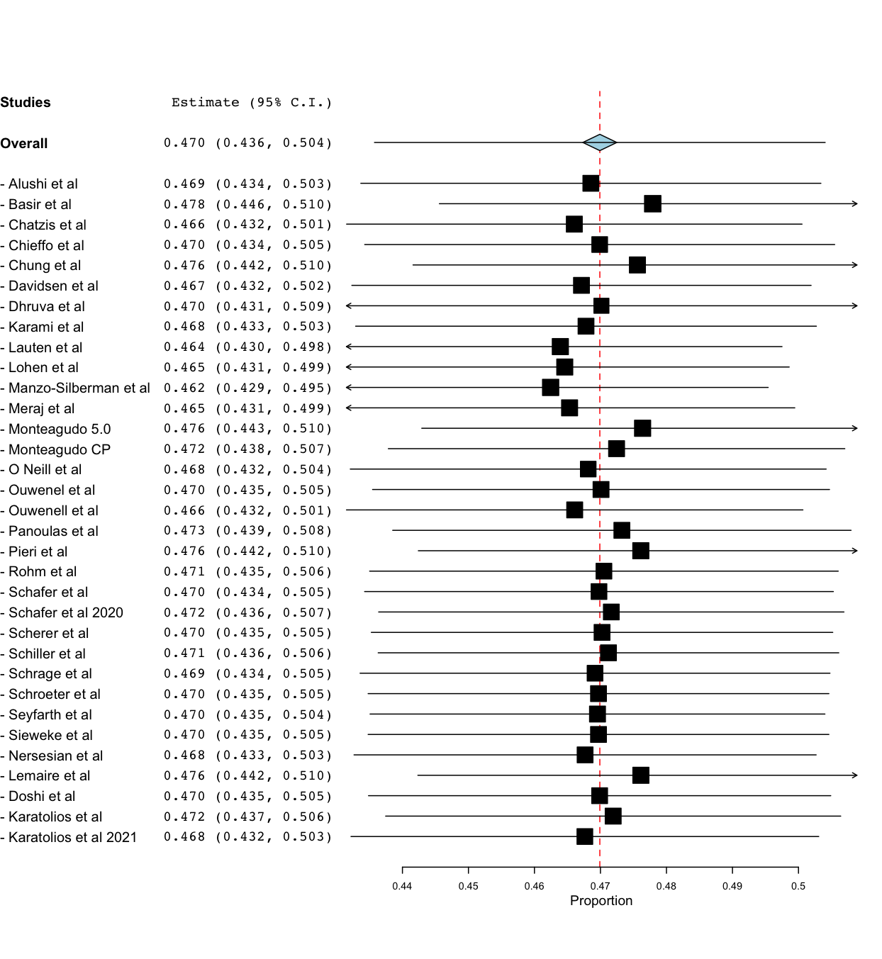
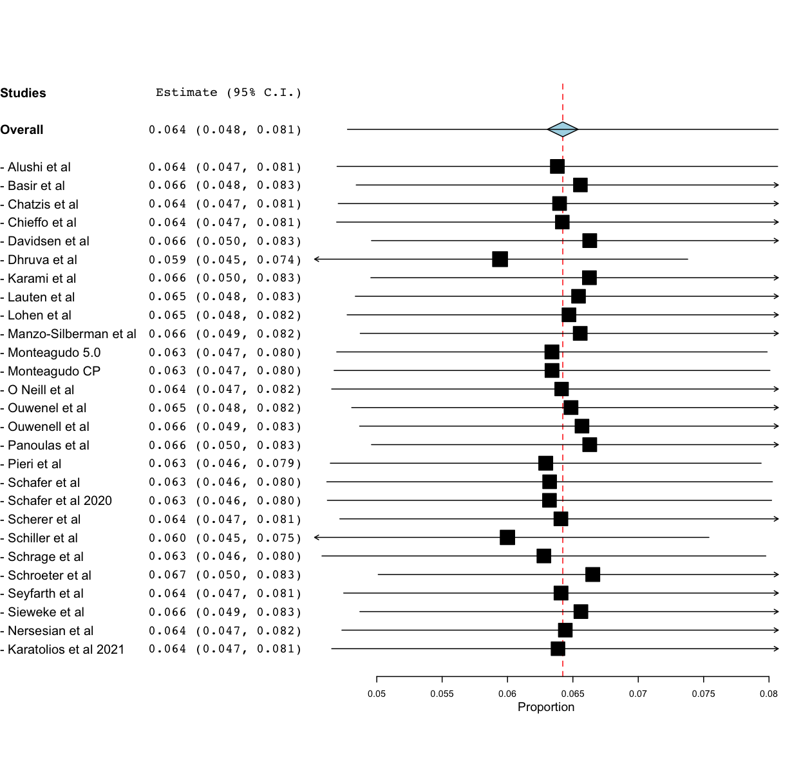
Supplementary figure 7: leave one-out meta analysis.
30-days Mortality
Vascular Access Complications

Slide 8
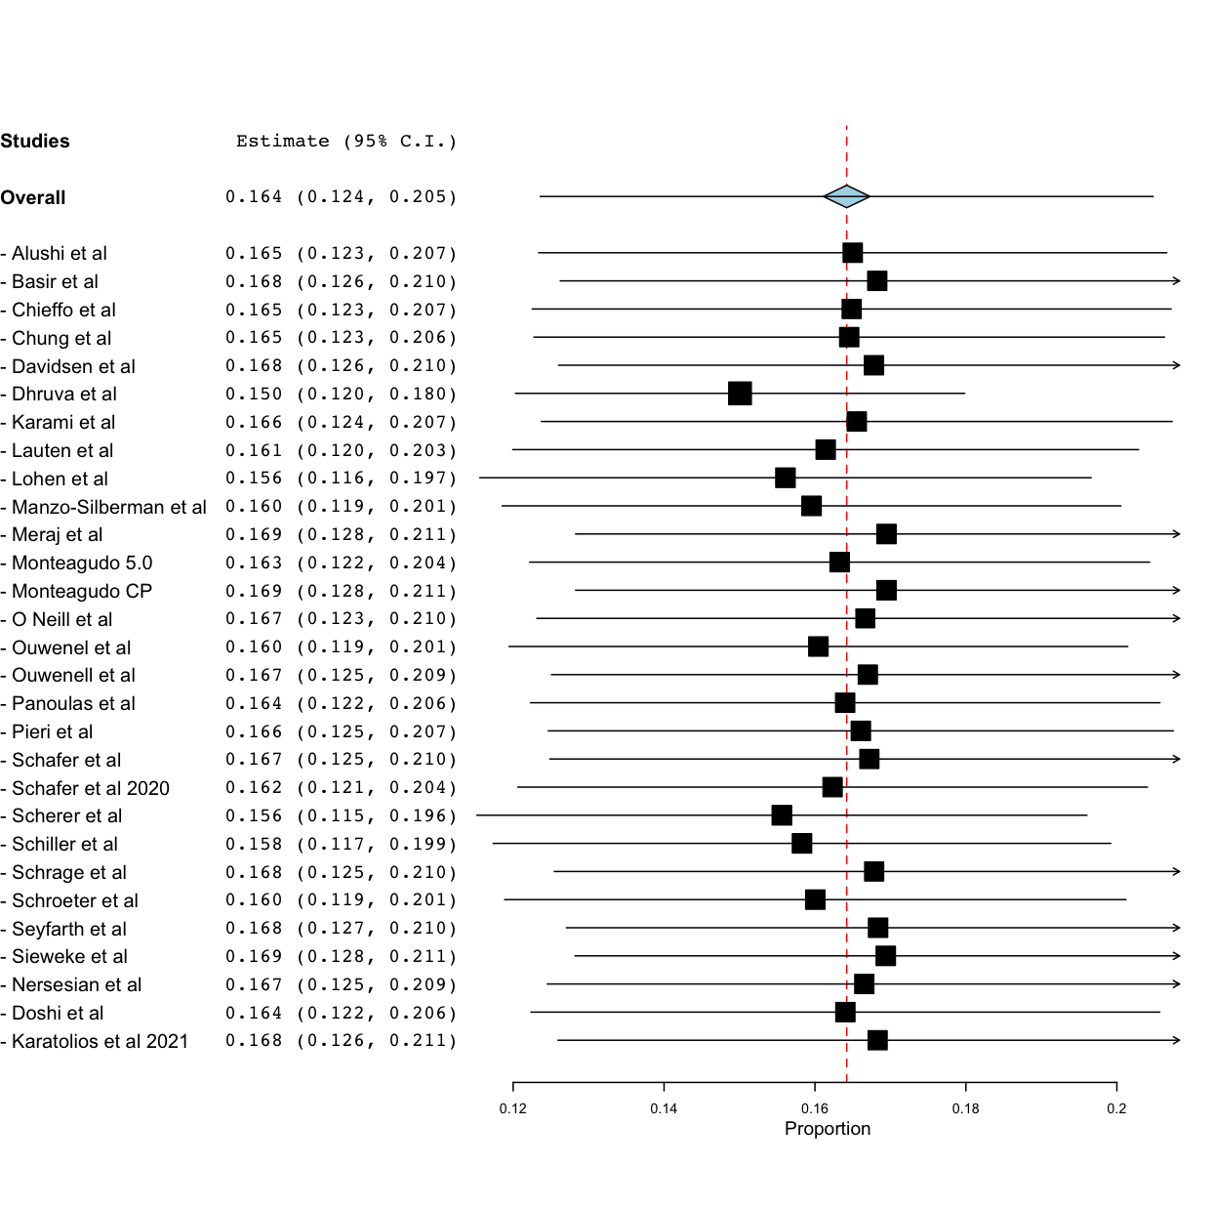
Supplementary figure 7: leave one-out meta analysis for major bleeding

