Slide 1
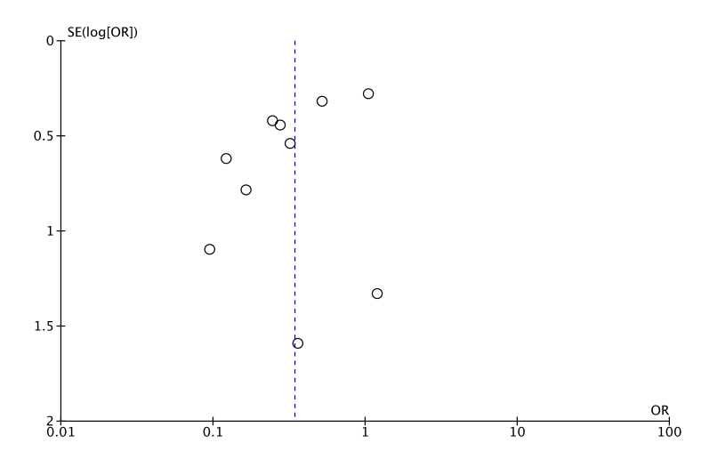
Supplementary Figure 1

Slide 2
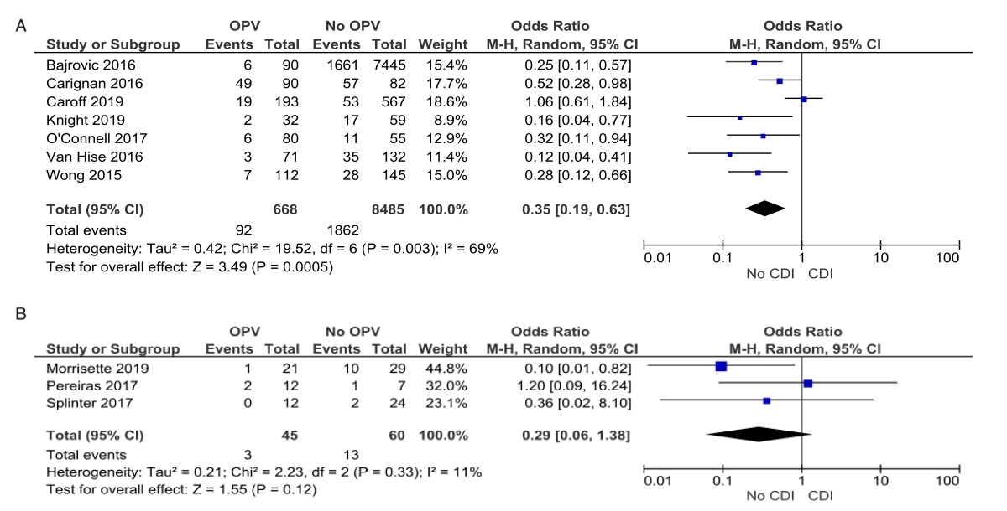
Supplementary Figure 2

Slide 3
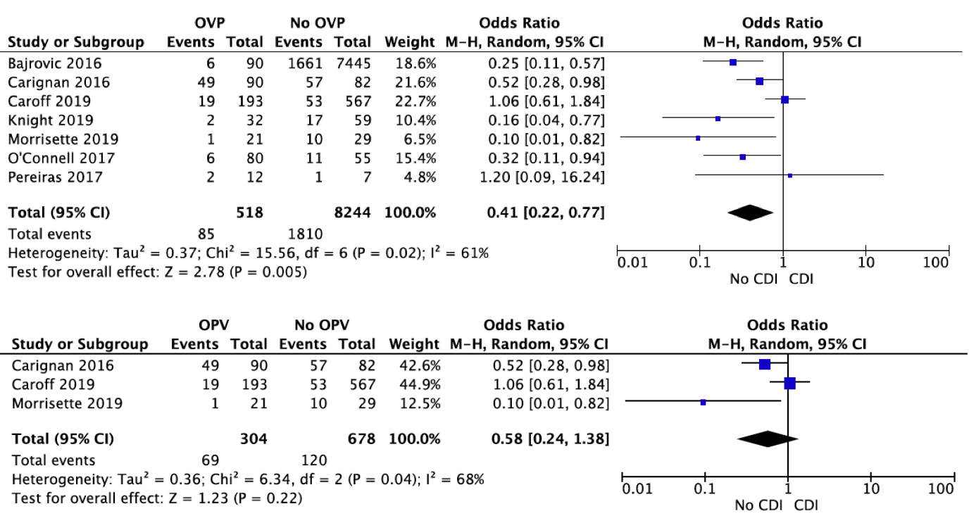
Supplementary Figure 3

Slide 4
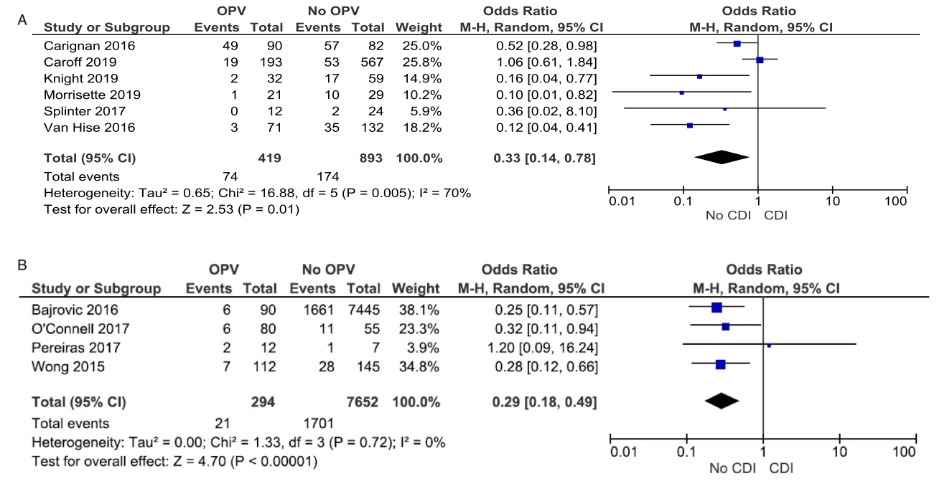
Supplementary Figure 4

Slide 5
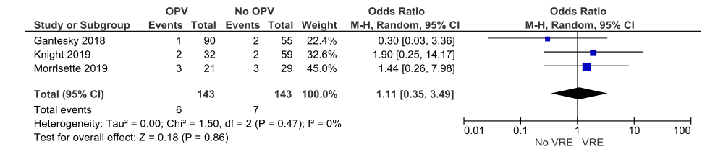
Supplementary Figure 5

