Slide 1
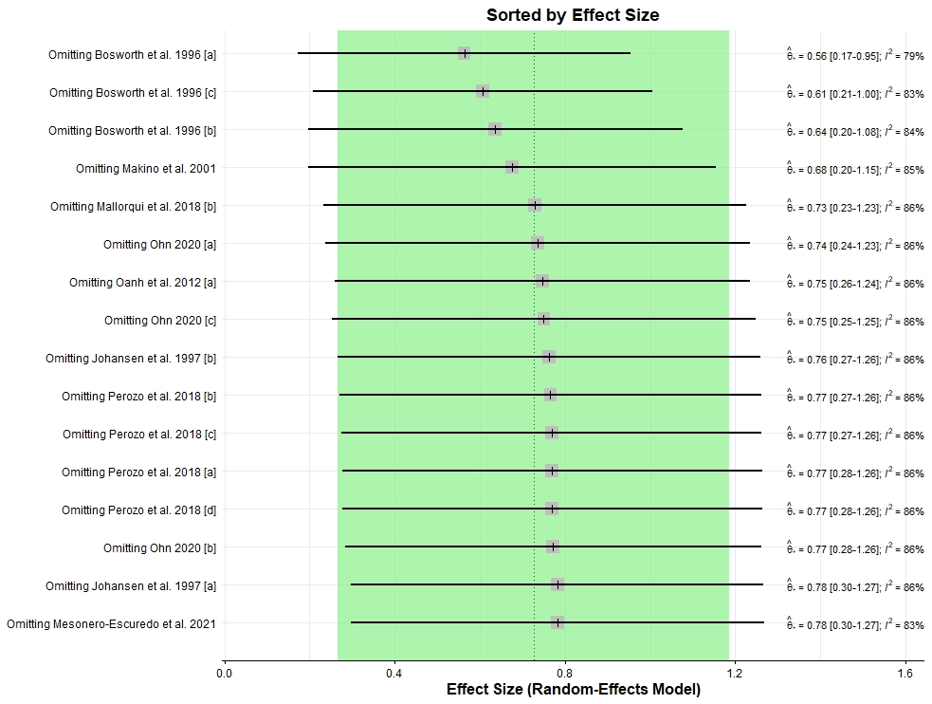
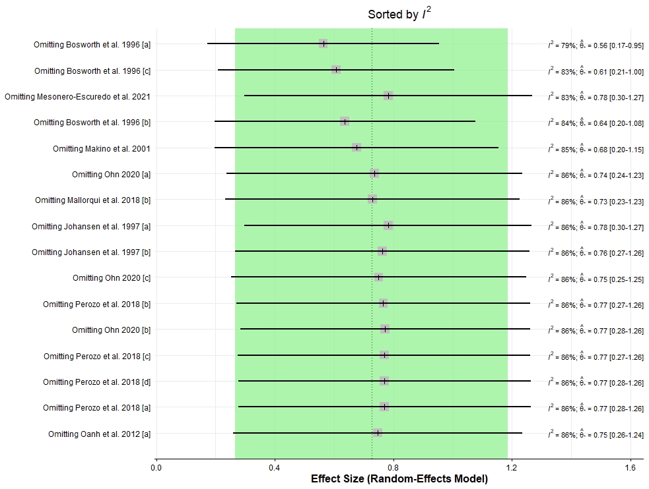
Supplemental Figure S1. Influence analysis of the average daily gain (ADG) data. Results were computed by omitting each study (left) and informed on the right. The green interval represents the 95% confidence interval for the pooled effect size.

