Slide 1
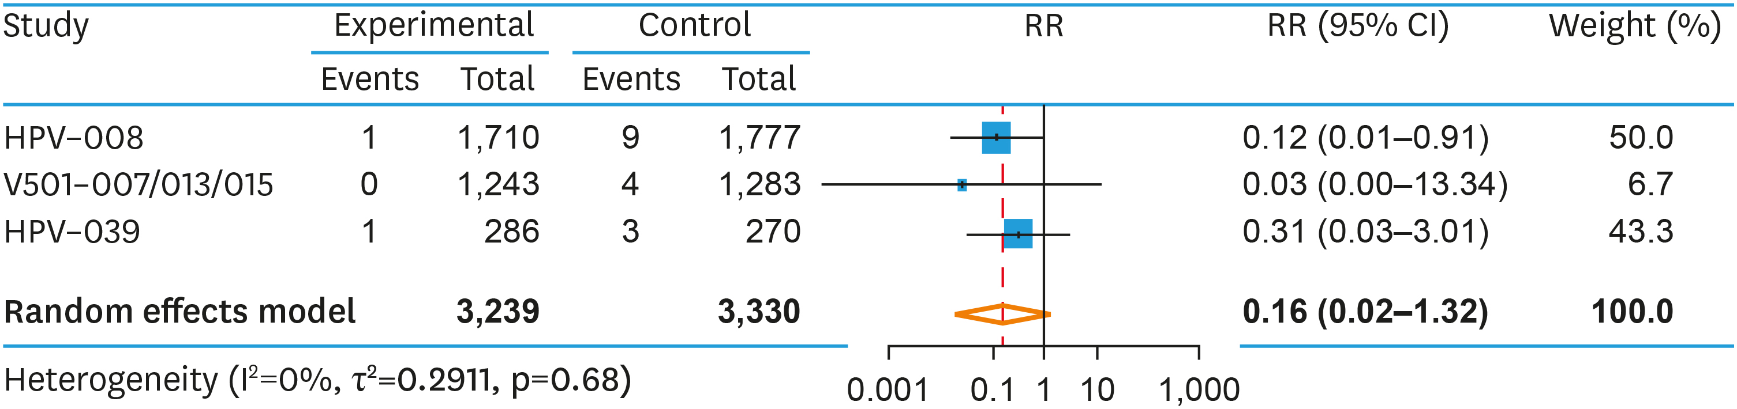
Fig. S4. Bias assessment, CIN 2+ Endpoint
J Gynecol Oncol. 2022 May;33(3):e24.
https://doi.org/10.3802/jgo.2022.33.e24
Notes:
Fig. S4. Bias assessment, CIN 2+ Endpoint
CI, confidence interval; HPV, human papillomavirus; RR, relative risk.

