Slide 1

Global Guidelines in Dermatology Mapping Project (GUIDEMAP) - a systematic review of atopic dermatitis clinical practice guidelines: are they clear, unbiased, trustworthy and evidence based (CUTE)?
Bernd W M Arents^{1*}, Esther J van Zuuren^{2*}, Sofieke Vermeulen³
Jan W Schoones⁴, Zbys Fedorowicz⁵
Dutch Association for People with Atopic Dermatitis, Nijkerk, The Netherlands.
Dermatology Department, Leiden University Medical Centre, Leiden, The Netherlands.
Department of Dermatology, Reinier De Graaf Hospital, Delft, The Netherlands.
Directorate of Research Policy (Formerly: Walaeus Library), Leiden University Medical Centre, Leiden, The Netherlands.
Veritas Health Sciences Consultancy, Huntingdon, United Kingdom.
* Contributed equally
British Journal of Dermatology. DOI: 10.111/bjd.20972

Slide 2

Lead Researcher
Bernd WM Arents
Dutch Association for People with
Atopic Dermatitis
Nijkerk, The Netherlands
@bernd_020
British Journal of Dermatology. DOI: 10.111/bjd.20972

Slide 3
Introduction
What’s already known?
Atopic dermatitis is a skin disease with a high prevalence and high burden of disease;
Clinical practice guidelines are essential for good clinical practice and shared decision making, for both patients and caregivers, in order to reduce disease burden;
Many clinical practice guidelines are available for atopic dermatitis worldwide, but their quality has not been critically appraised as yet.
British Journal of Dermatology. DOI: 10.111/bjd.20972

Slide 4
Objective
Our aim was to identify worldwide all the clinical practice guidelines (CPGs) for atopic dermatitis less than five years old and assess with validated instruments if those CPGs are clear, unbiased, trustworthy and evidence based (CUTE).
British Journal of Dermatology. DOI: 10.111/bjd.20972

Slide 5
Methods
We searched MEDLINE, Embase, PubMed, Web of Science, Cochrane Library, Emcare, Epistemonikos, PsycINFO and Academic Search Premier for CPGs on AD published between 1 April 2016 and 1 April 2021. Additionally we hand searched prespecified guideline resources.
Screening, data extraction and quality assessment of eligible guidelines were independently carried out by two authors.
Instruments used for quality assessment were the Appraisal of Guidelines for Research and Evaluation (AGREE) II Reporting Checklist, the U.S. Institute of Medicine’s (IOM) criteria of trustworthiness and Lenzer’s Red Flags.
British Journal of Dermatology. DOI: 10.111/bjd.20972

Slide 6
Results
Forty CPGs were included, mostly from countries with a high socio-demographic index;
Three CPGs scored ‘Excellent’ on all AGREEII-domains; three scored ‘Poor’ on all;
‘Applicability’ and ‘Rigour of development’ were the lowest scoring AGREEII-domains;
One CPG fully met all nine IOM criteria and two fully met eight;
‘External review’, ‘Updating procedures’ and ‘Rating strength of recommendations’ were the IOM criteria least met;
British Journal of Dermatology. DOI: 10.111/bjd.20972

Slide 7
Results
Three CPGs had no red flags;
Most red flags were for ‘Limited or no involvement of methodological expertise’ and ‘No external review’;
Management of conflicts of interests (COIs) appeared to be challenging;
We found no association between AGREEII-scores and a country’s GDP (Columbia and Malaysia were amongst the top scorers).
When constructs of the instruments overlapped, they showed high concordance.
British Journal of Dermatology. DOI: 10.111/bjd.20972

Slide 8
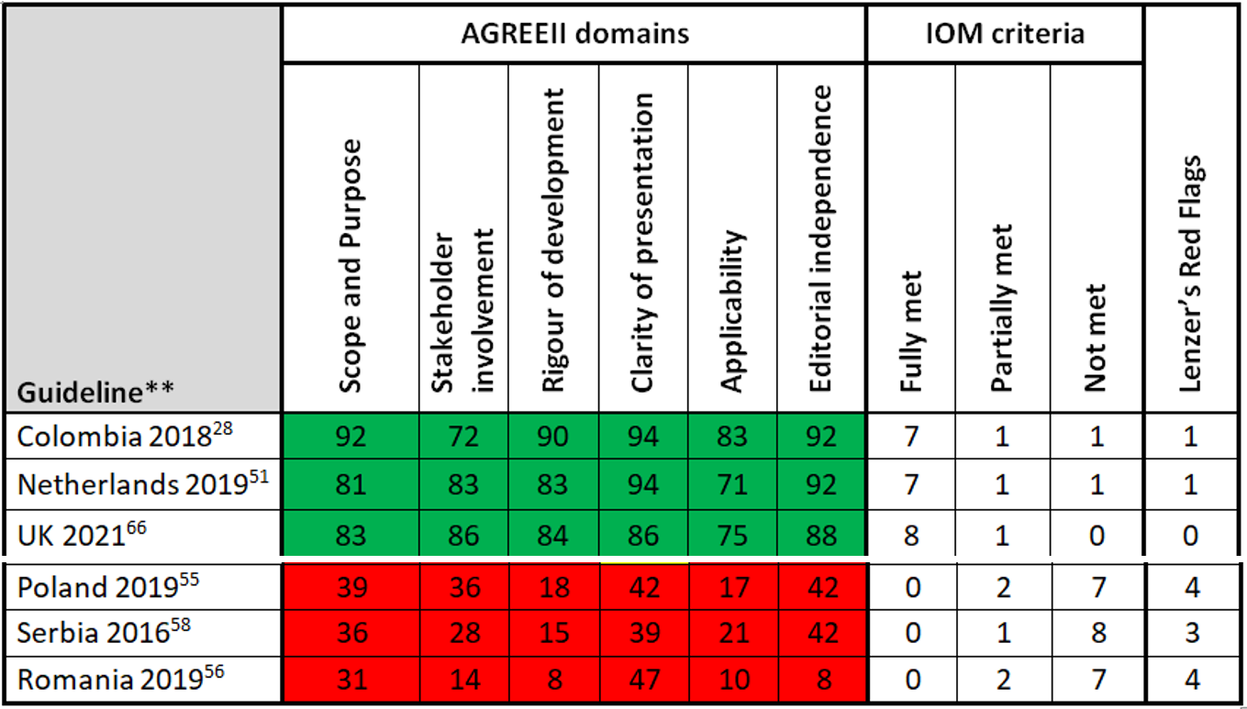
Results
Legend
Three highest and lowest scoring CPGs:
AGREEII: 0-100%;
IOM: 9 criteria
RedFlags: max. 8
British Journal of Dermatology. DOI: 10.111/bjd.20972

Slide 9
Discussion
There was little use of AGREEII (six CPGs) and GRADE (seven CPGs) methodology in guideline development;
There was lack of stakeholder/patient involvement;
When resources are an issue, the GRADE-ADOLOPMENT, ADAPTE or RAPADAPTE methodologies can be used to adopt, adapt or develop guideline recommendations;
Managing conflicts of interest is now especially important in AD CPGs, with new and expensive systemic treatments becoming available.
British Journal of Dermatology. DOI: 10.111/bjd.20972

Slide 10
Conclusions
What does this study add?
Forty guidelines less than five years old were identified, mostly from countries with a high socio-demographic index, many of which are not clear, unbiased, trustworthy or evidence based (CUTE) enough;
Improvement of guidelines is warranted, e.g. by using the AGREEII instrument and robust reporting;
Some guideline domains can be improved without much effort, yet improving transparency, applicability and managing conflicts of interest might be more challenging.
British Journal of Dermatology. DOI: 10.111/bjd.20972

Slide 11




The Team
Bernd Arents Esther van Zuuren Sofieke Vermeulen Jan Schoones Zbys Fedorowicz
British Journal of Dermatology. DOI: 10.111/bjd.20972

Slide 12
Call for correspondence
Why not join the debate on this article through our correspondence section?
Rapid responses should not exceed 350 words, four references and one figure
Further details can be found on the BJD website
British Journal of Dermatology. DOI: 10.111/bjd.20972

