Slide 1
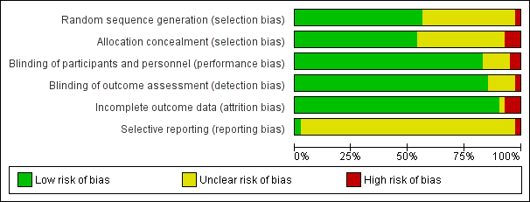
Supplementary Figure 2. Risk of bias graph: review authors' judgments about each risk of bias item presented as percentages across all included studies.
Restor Dent Endod 2021;46:e41. https://doi.org/10.5395/rde.2021.46.e41
Notes:
Supplementary Figure 2. Risk of bias graph: review authors' judgments about each risk of bias item presented as percentages across all included studies.

