Slide 1
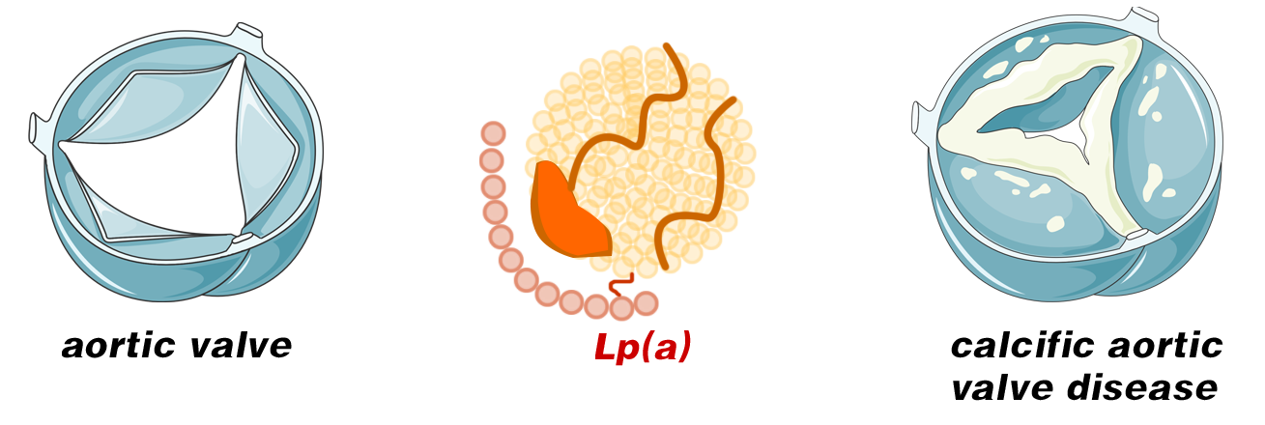
？
（lp(a) ≥50 mg/dL and CAVD）
(lp(a) ≥30 mg/dL and CAVD）
Meta-analysis
High plasma lp(a) levels (≥50 mg/dL) are significantly associated with increased risk of CAVD

