Slide 1
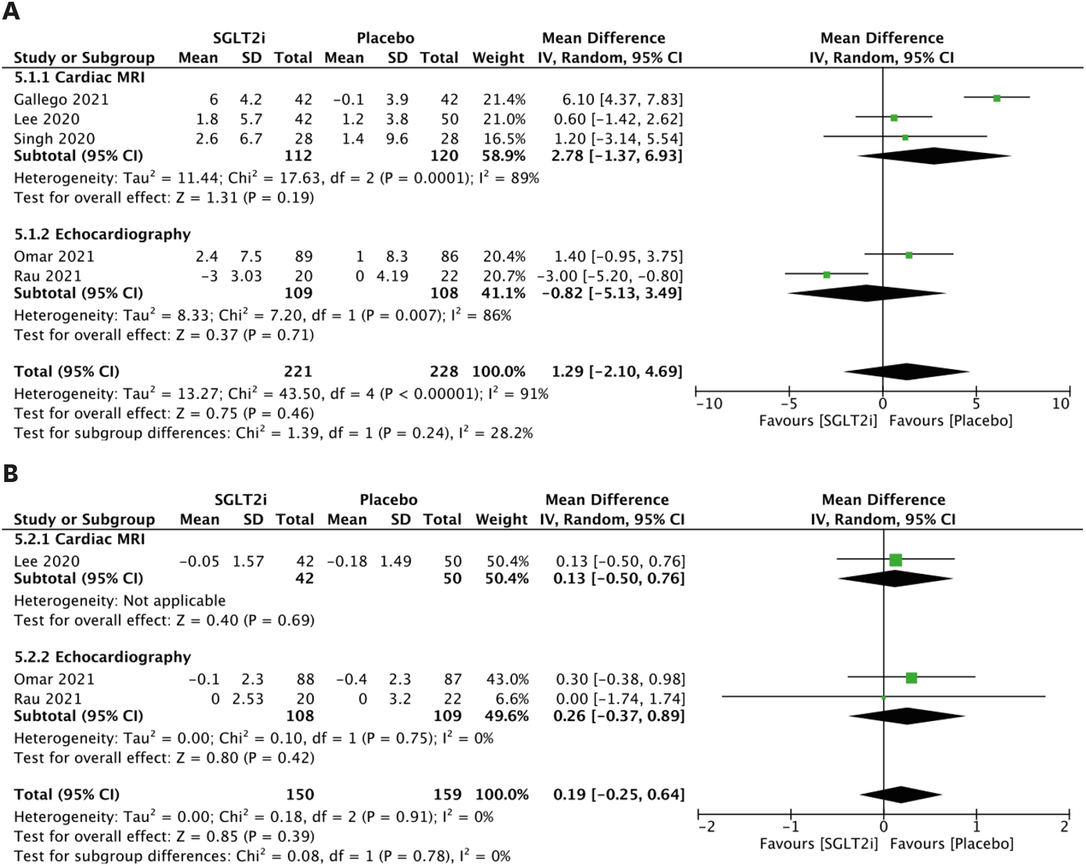
Supplementary Figure 9. Parameters of LV function in patients with reduced/mildly reduced LVEF. (A) Forest plot of mean change in LVEF (%). (B) Forest plot of mean change in LVGLS (%).
J Cardiovasc Imaging 2022 Jul;30(3):153-168. https://doi.org/10.4250/jcvi.2021.0159
Notes:
Supplementary Figure 9. Parameters of LV function in patients with reduced/mildly reduced LVEF. (A) Forest plot of mean change in LVEF (%). (B) Forest plot of mean change in LVGLS (%).
CI: confidence interval, IV: interval variable, LV: left ventricular, LVEF: left ventricular ejection fraction, LVGLS: left ventricular global longitudinal strain, MRI: magnetic resonance imaging, SD: standard deviation, SGLT2i: sodium-glucose cotransporter 2 inhibitor.

