Slide 1
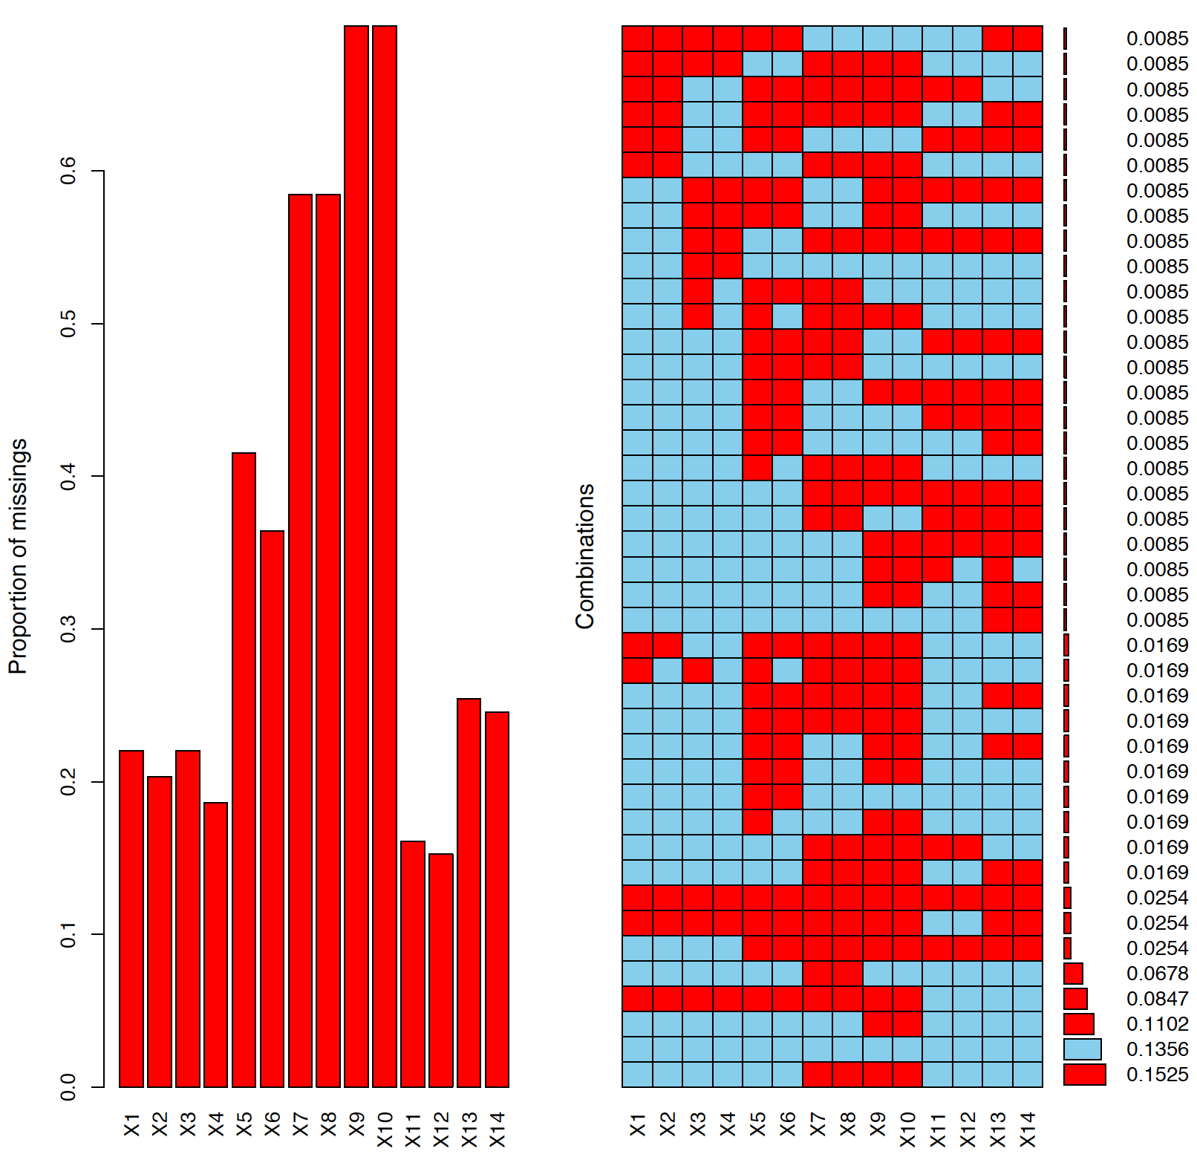
Supplemental Figure S1 Proportion and pattern of missing data

Slide 2
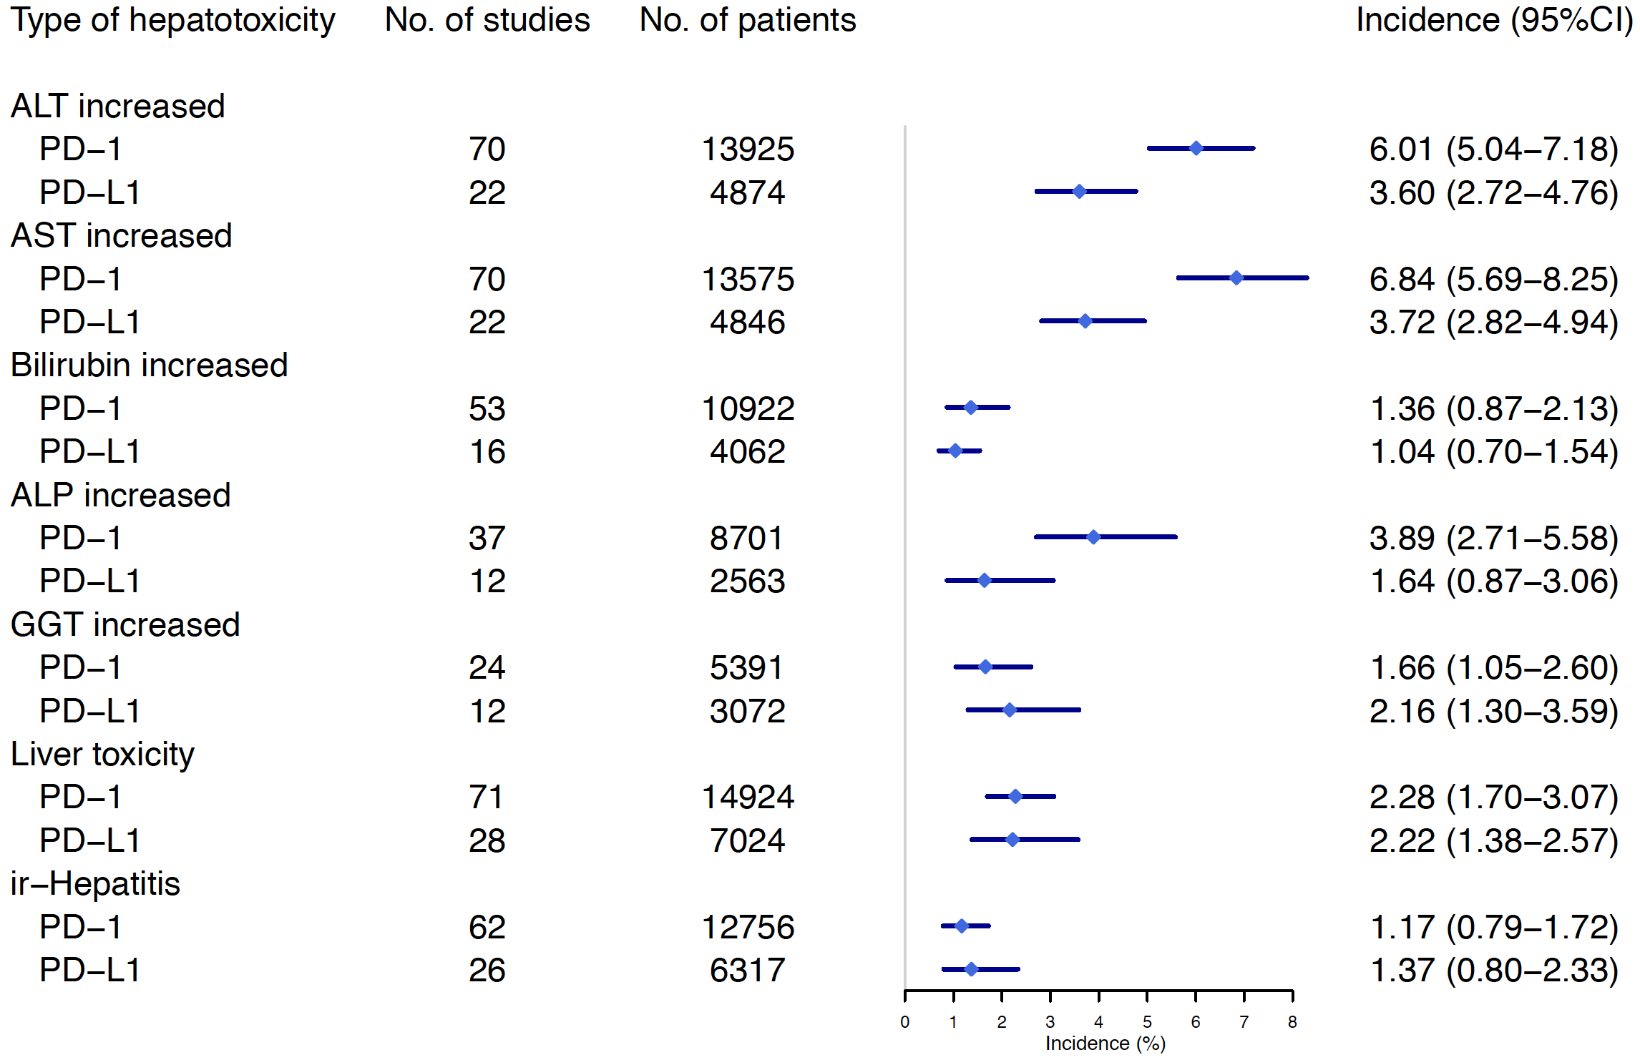
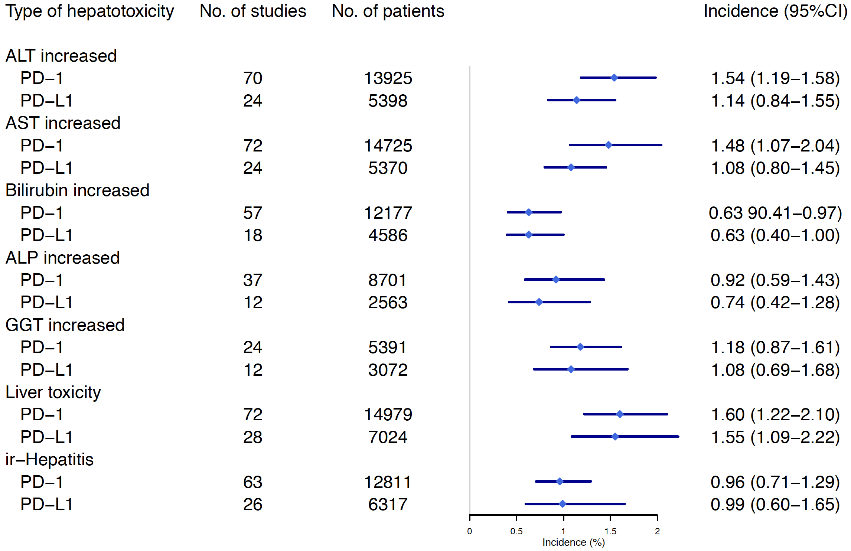
S2A
S2B
Supplemental Figure S2 Incidence of hepatotoxicity secondary from anti-PD-1 vs. anti-PD-L1

Slide 3
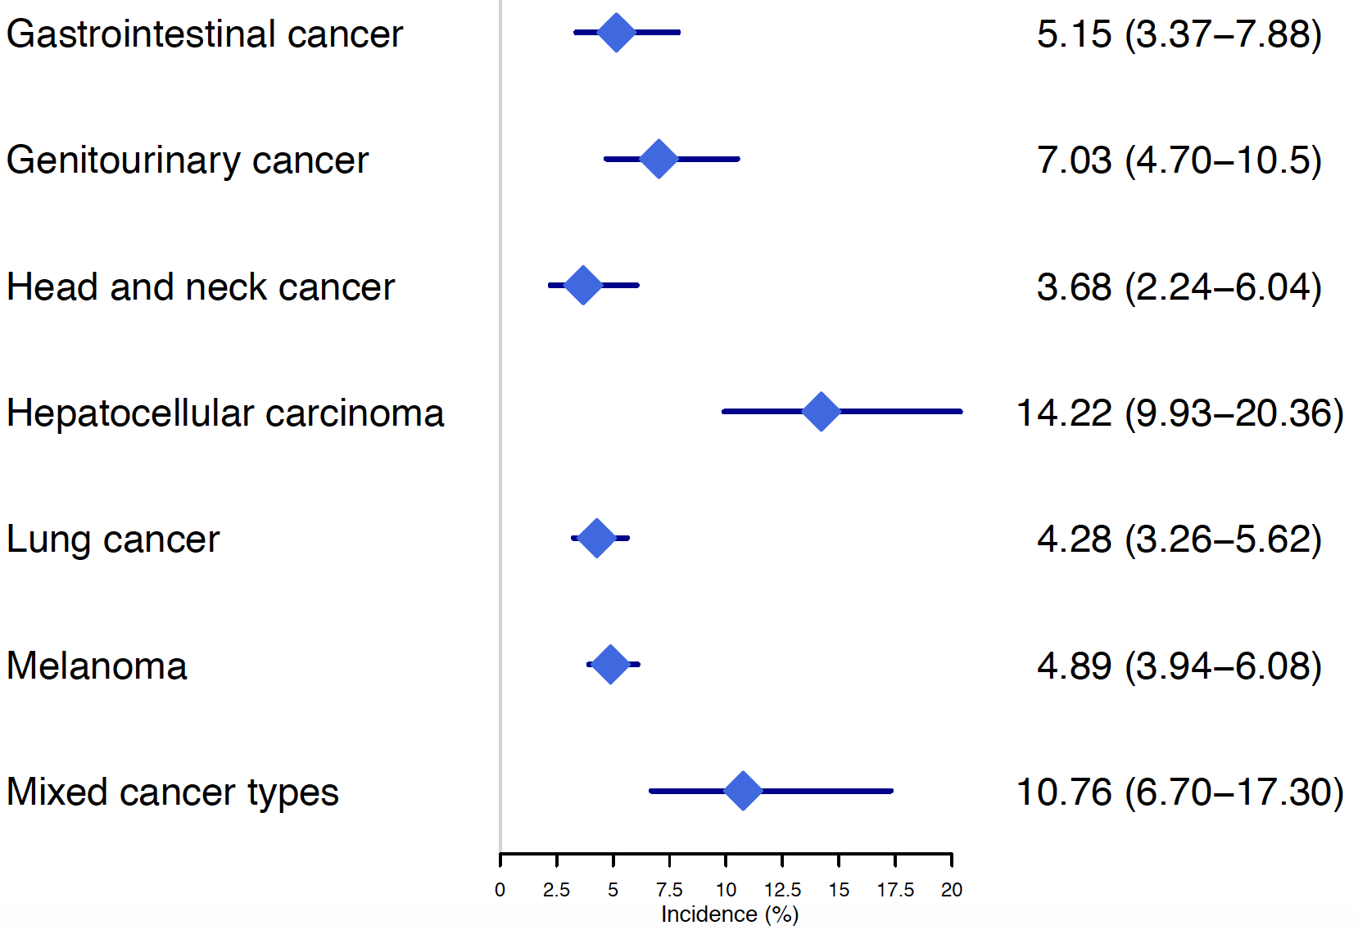
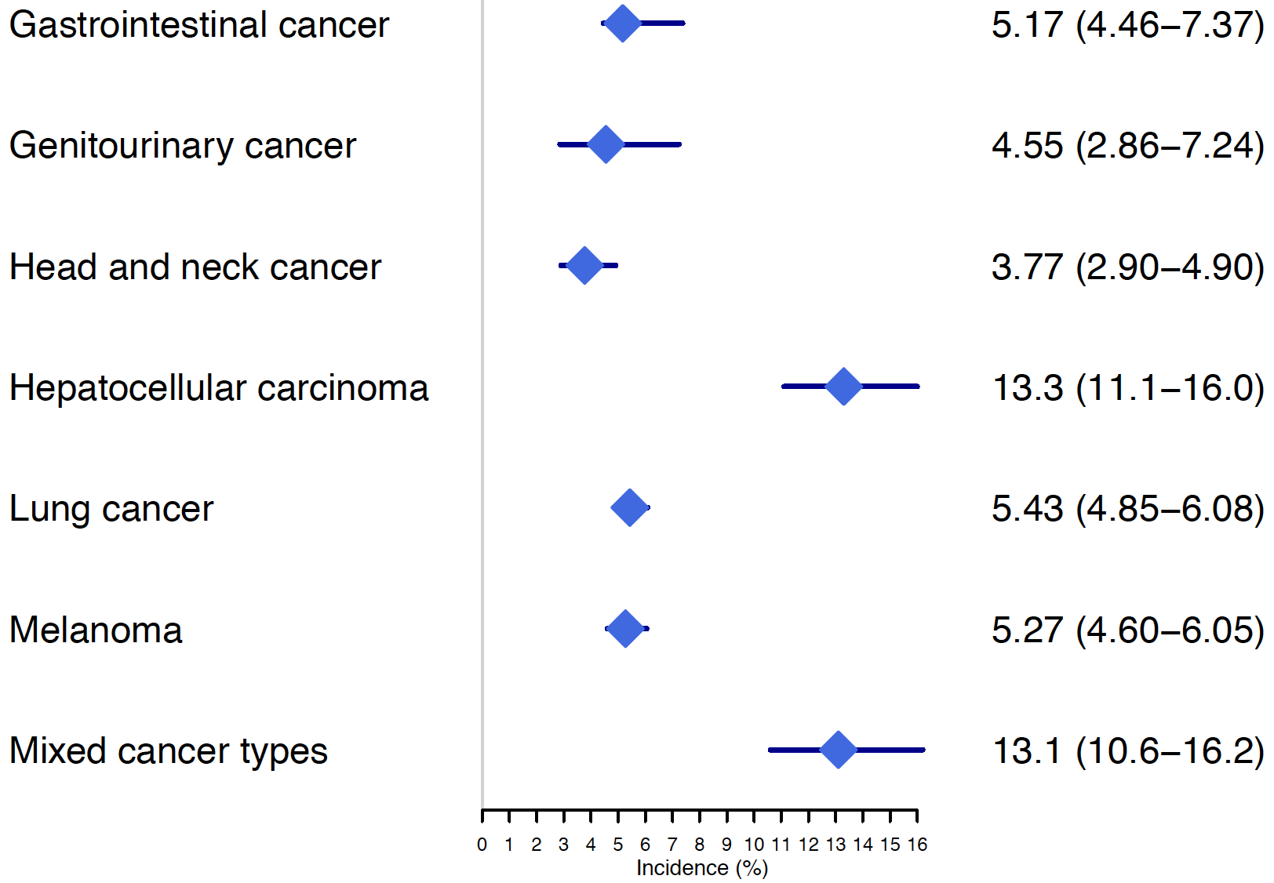
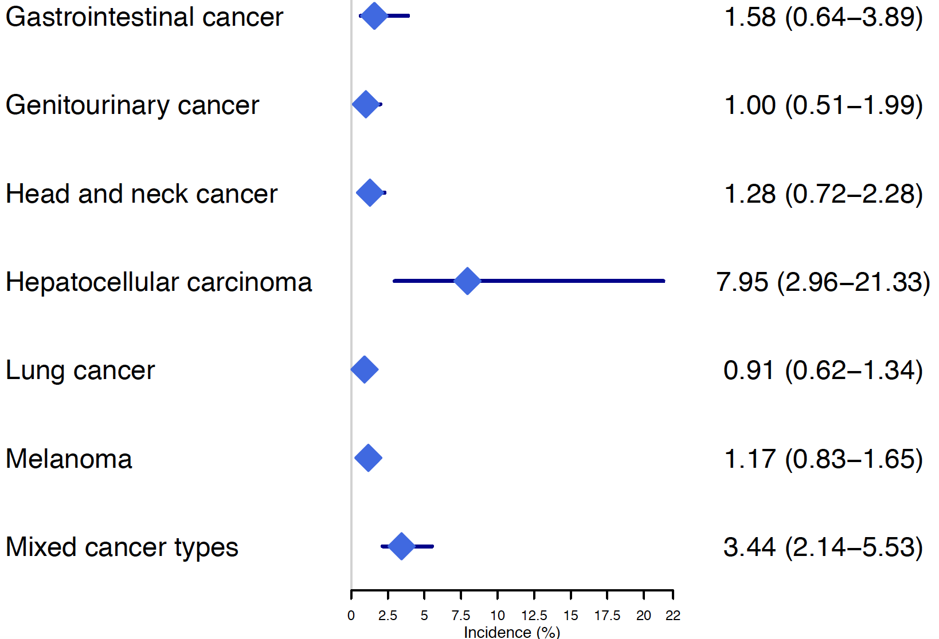
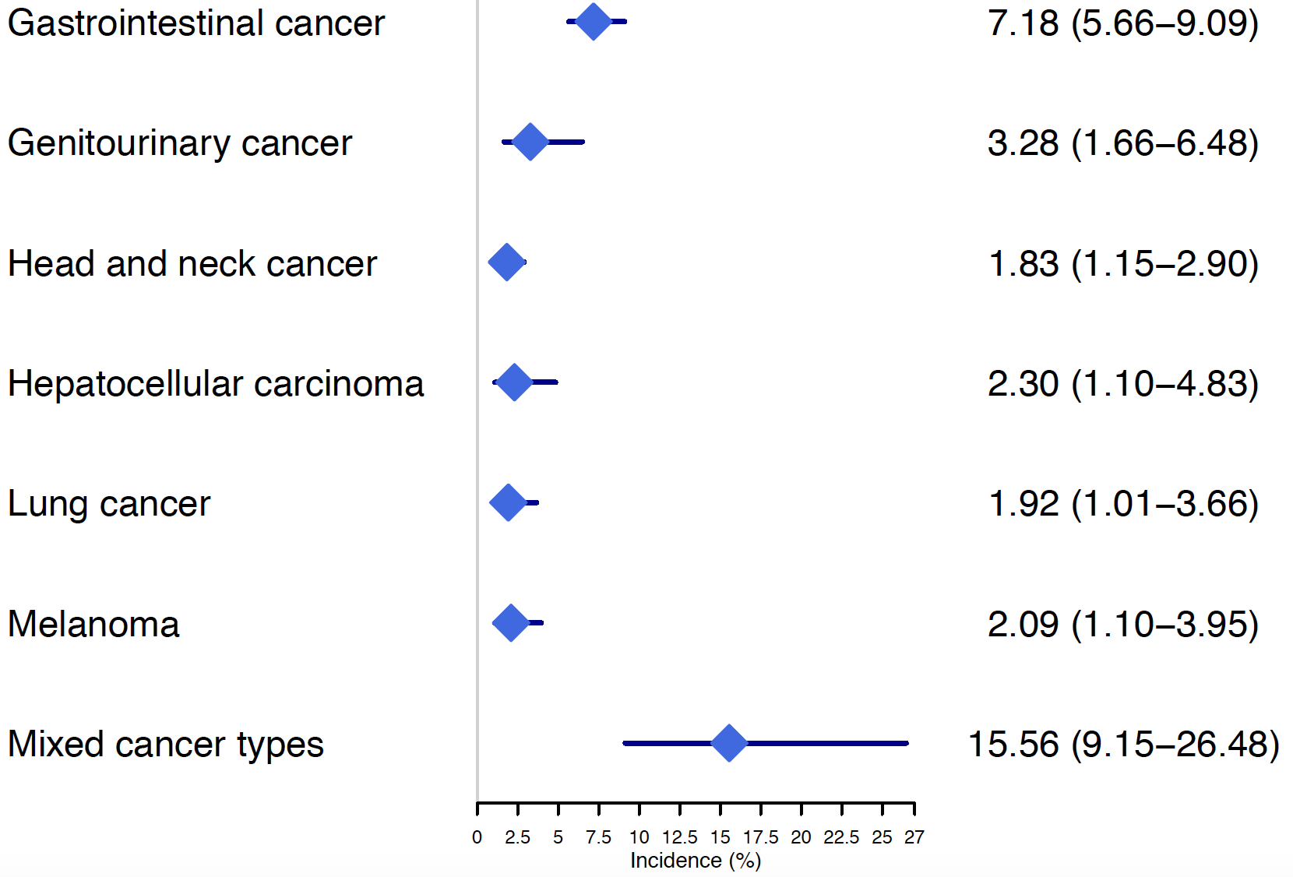
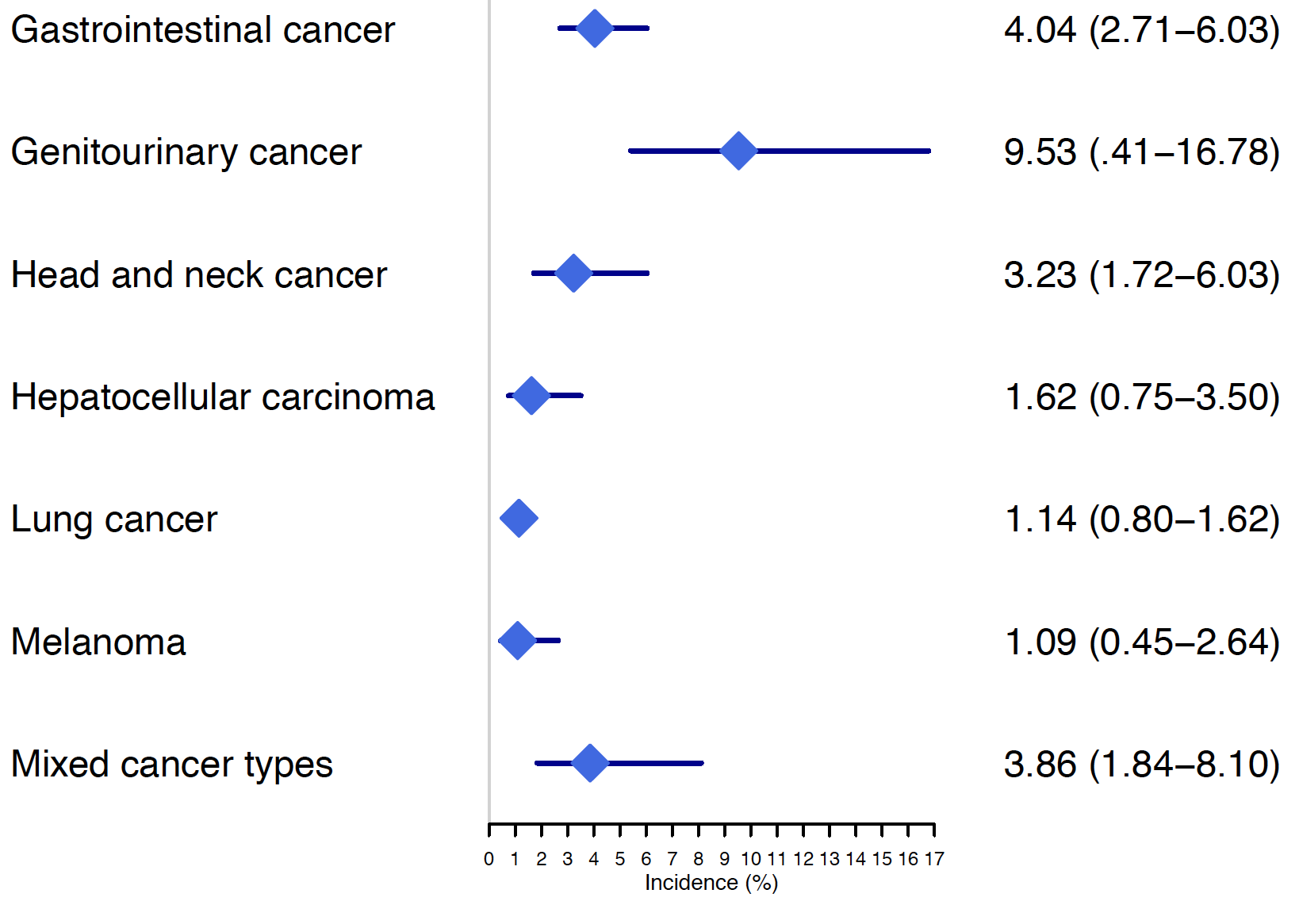
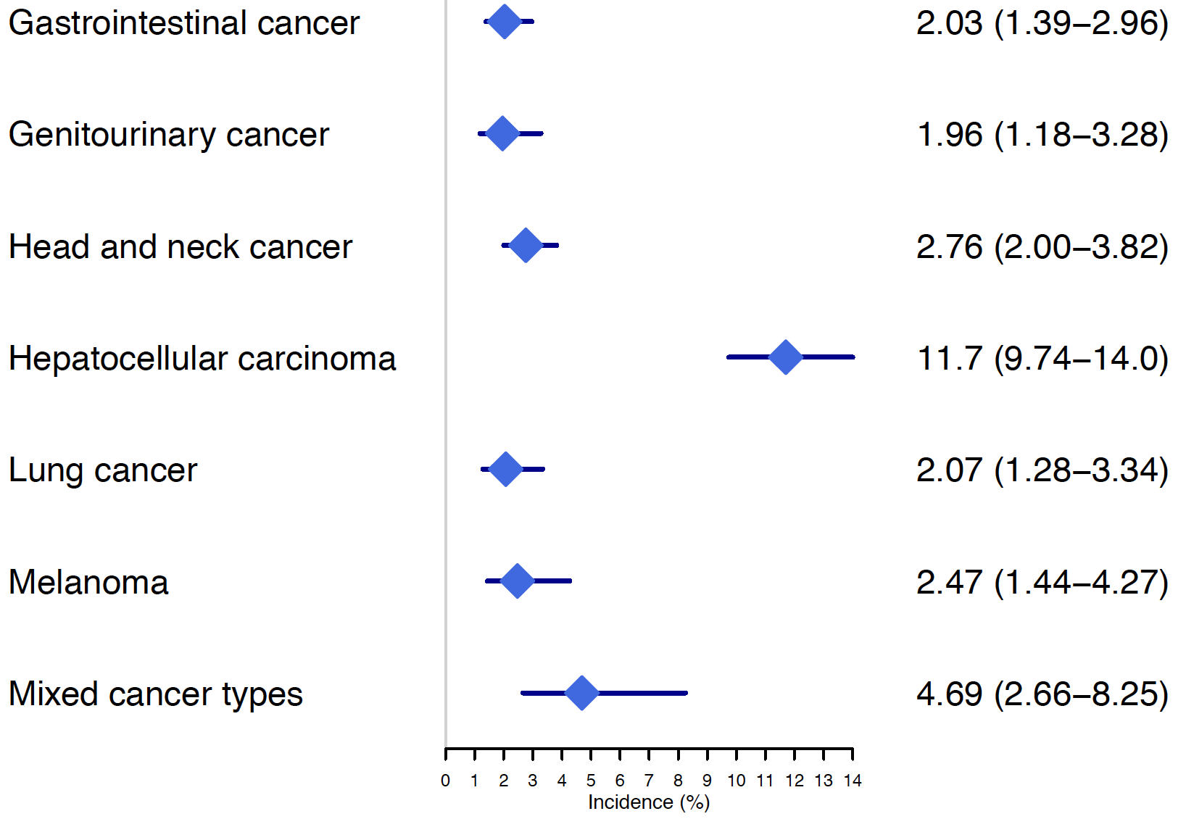
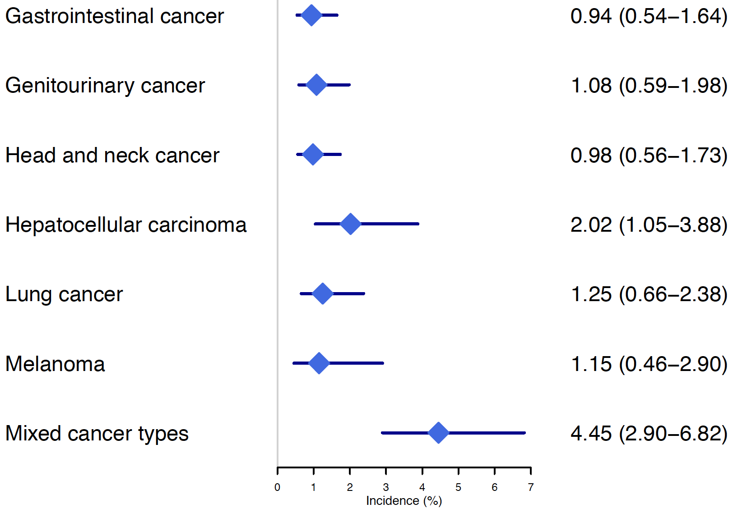
S3A
S3B
S3C
S3D
ALT
AST
Bilirubin
ALP
Type of Cancer Incidence (95% CI)
Type of Cancer Incidence (95% CI)
Type of Cancer Incidence (95% CI)
Type of Cancer Incidence (95% CI)
Primary liver cancer
Primary liver cancer
Primary liver cancer
Primary liver cancer
S3E
S3F
S3G
GGT
Hepatobiliary disorder
Ir-hepatitis
Type of Cancer Incidence (95% CI)
Type of Cancer Incidence (95% CI)
Type of Cancer Incidence (95% CI)
Primary liver cancer
Primary liver cancer
Primary liver cancer
Supplemental Figure S3 Incidence of all-grade hepatotoxicity in primary live cancers vs. other cancer types

Slide 4
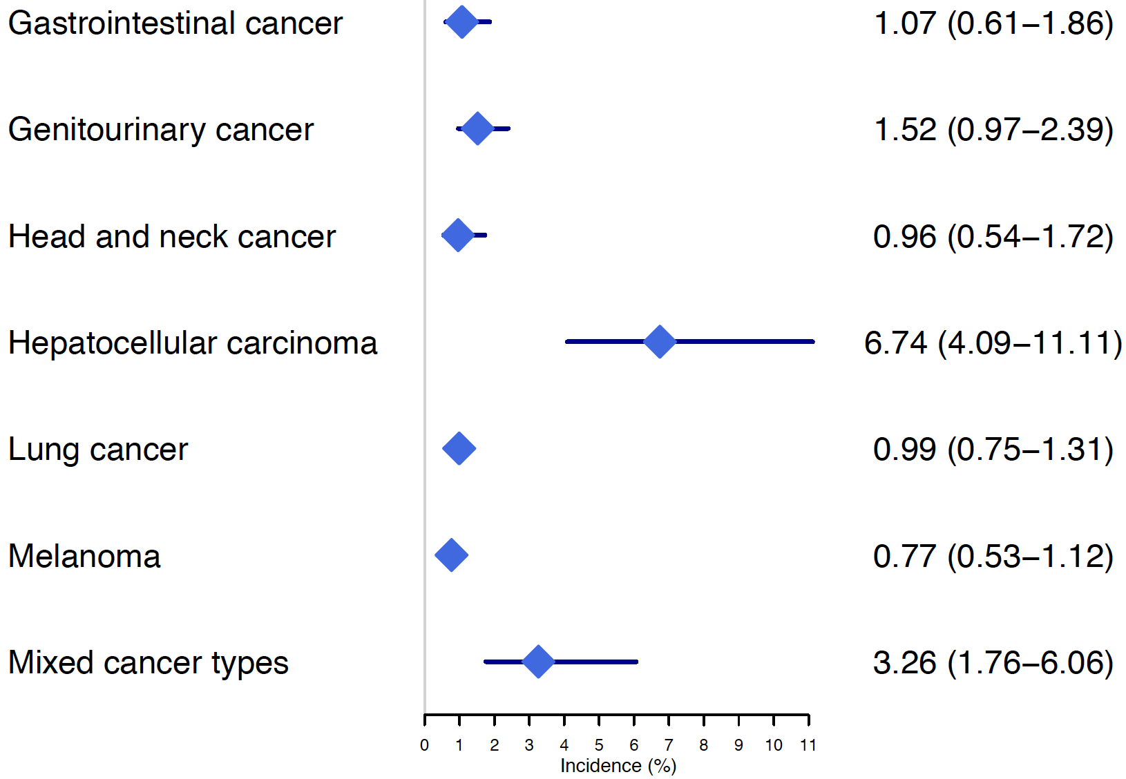
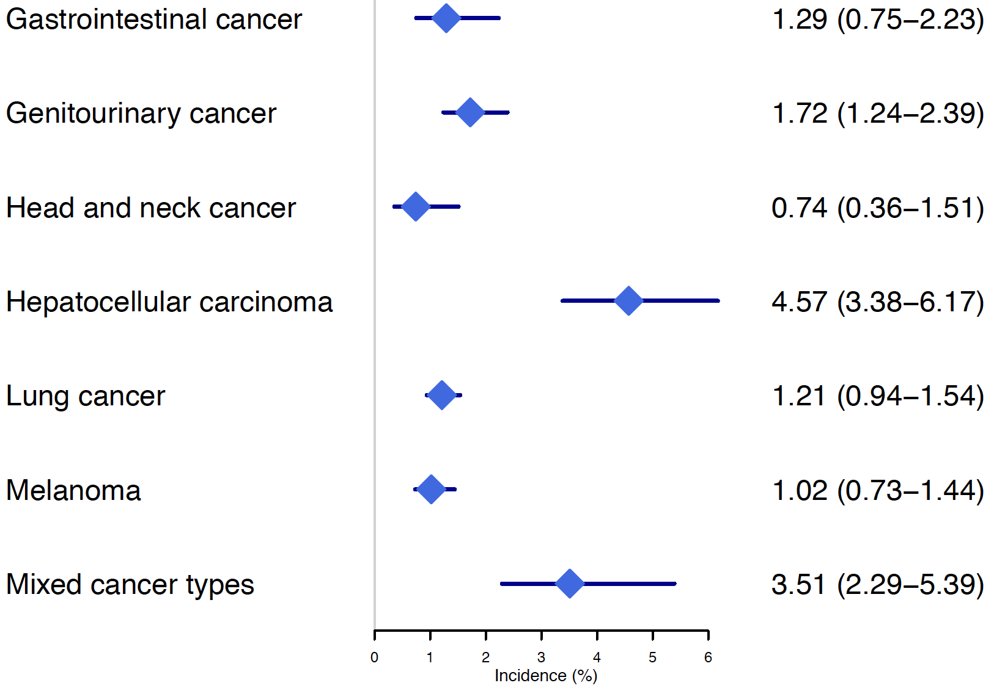
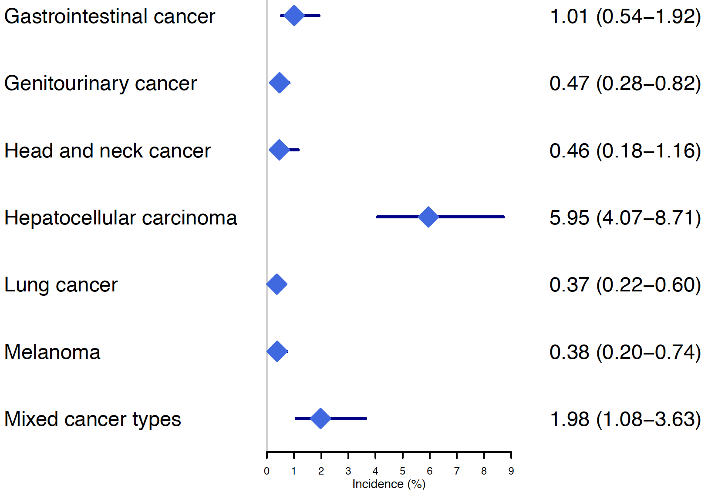
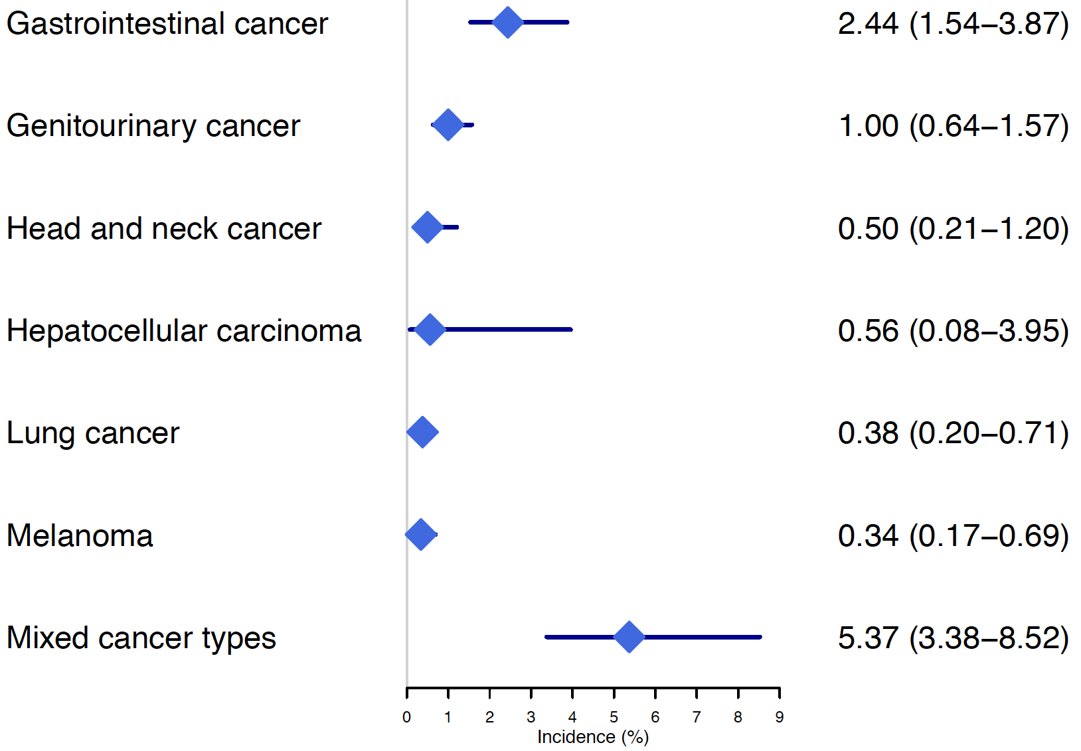
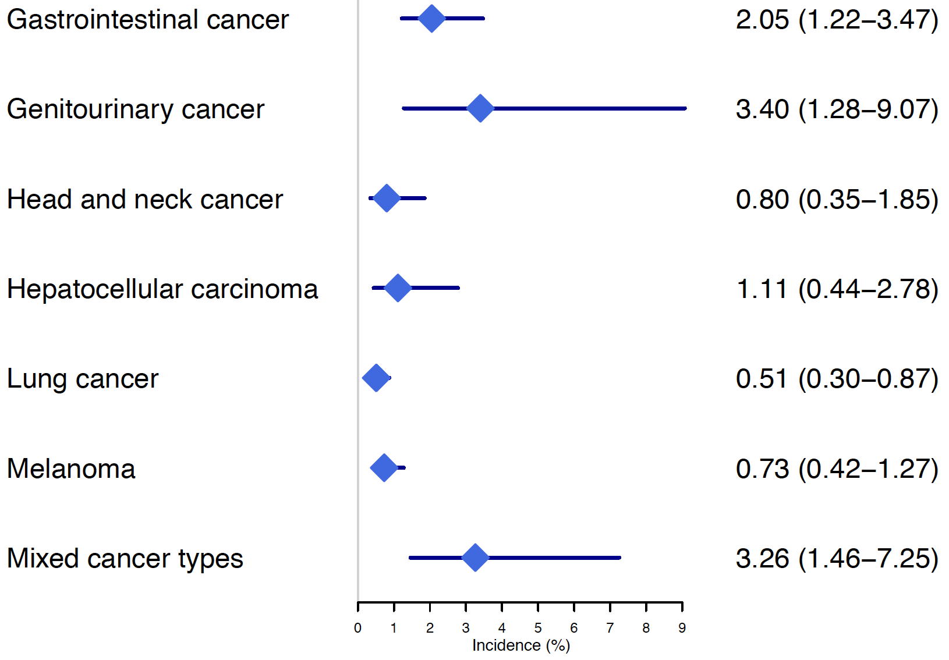
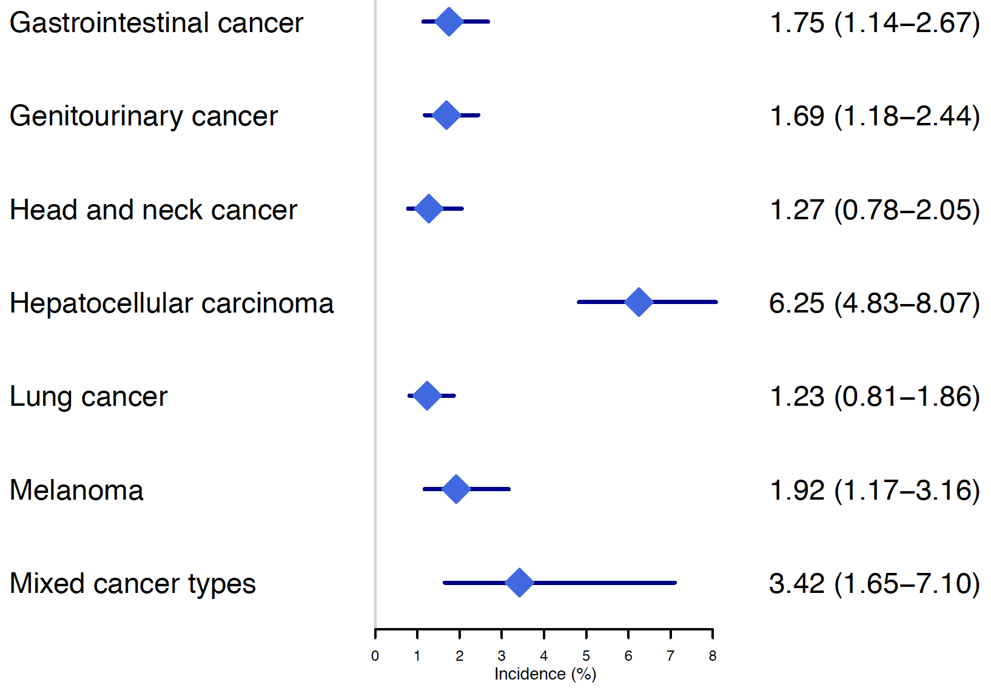
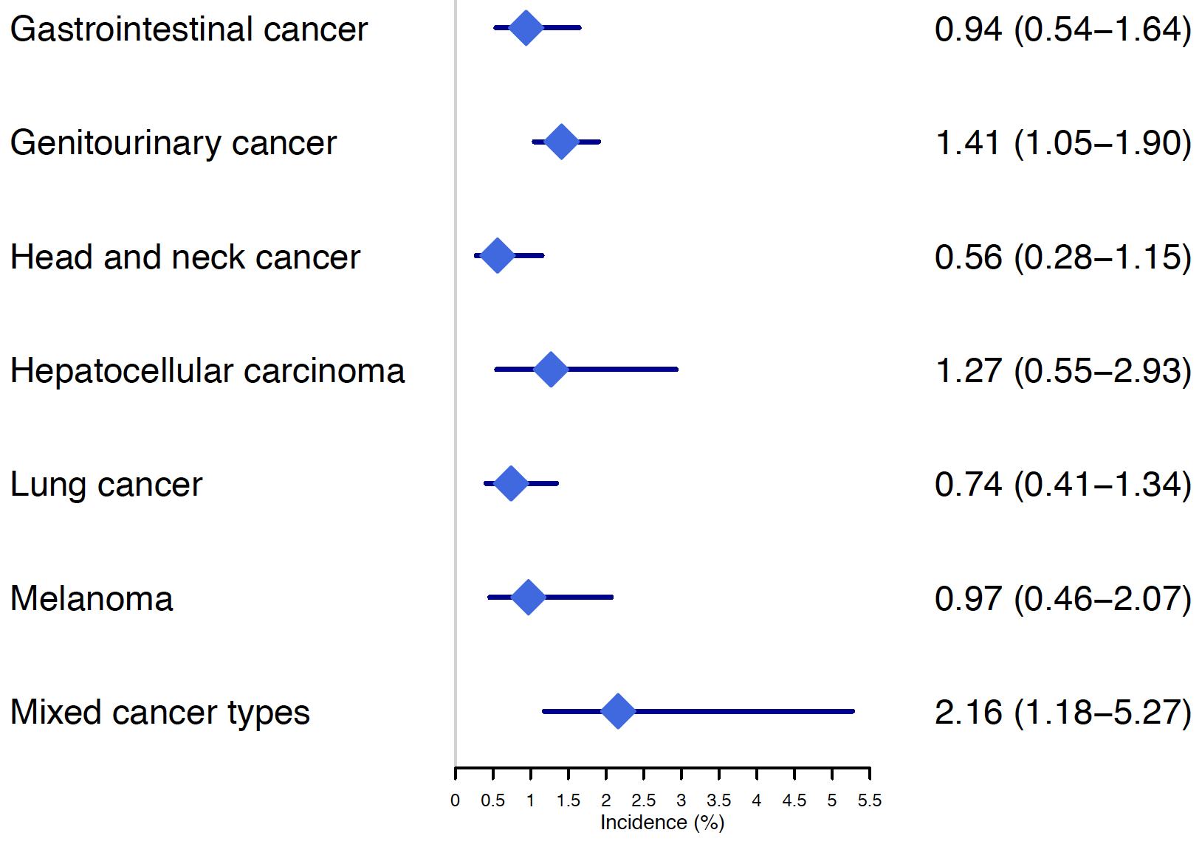
S4A
S4B
S4C
S4D
ALT
AST
Bilirubin
ALP
Type of Cancer Incidence (95% CI)
Type of Cancer Incidence (95% CI)
Type of Cancer Incidence (95% CI)
Type of Cancer Incidence (95% CI)
Primary liver cancer
Primary liver cancer
Primary liver cancer
Primary liver cancer
S4E
S4F
S4G
GGT
Nonspecific liver toxicity
Ir-hepatitis
Type of Cancer Incidence (95% CI)
Type of Cancer Incidence (95% CI)
Type of Cancer Incidence (95% CI)
Primary liver cancer
Primary liver cancer
Primary liver cancer
Supplemental Figure S4 Incidence of ≥ Grade 3 hepatotoxicity in primary live cancers vs. other cancer types

