Slide 1
Search terms and Boolean operators
((Aortic) OR (Mitral) OR (Aortic valve) OR (Mitral valve) OR (Heart valve) OR (Aortic prosthesis) OR (Mitral prosthesis) OR (Valve prosthesis) OR (Aortic bioprosthesis) OR (Mitral bioprosthesis) OR (Aortic valve replacement) OR (Mitral valve replacement) OR (valve replacement) OR (aortic valve surgery) OR (mitral valve surgery) OR (aortic valve repair) OR (mitral valve repair) OR (aortic valve reconstruction) OR (mitral valve reconstruction)) AND ((NOAC) OR (DOAC) OR (New oral anticoagulation) OR (Direct oral anticoagulation) OR (Non-vitamin K) OR (Non-vitamin k anticoagulation) OR (Non-vitamin k antagonist) OR (non-vitamin k antagonist oral anticoagulant) OR (Rivaroxaban) OR (Edoxaban) OR (Apixaban) OR (Dabigatran)).

Slide 2
Comparison of oral anticoagulants
Table S1
Anticoagulant | Mechanism of action | Absorption | Distribution | Plasma level, maximum | Elimination | Half-life | Approved indication | Dosing (AF only) | Dose modifications | Drug-drug and food interactions
Warfarin¹ | Vitamin K- antagonist | Completely orally | 99% protein bound | Variable | Metabolized by CYP450 isozymes, mostly CYP2C9 | ∼40 hours | Embolic risk-reduction in AF and cardiac valve replacement (biological and mechanical); prophylaxis and treatment of DVT/PE; risk reduction in certain high-risk patients following MI | Individualized INR | Various, based on INR | Inducers / inhibitors of CYP2C9, 1A2 or 3A4 Herbal medication and foods
Dabigatran² | Direct thrombin inhibitor | 3–7 % oral Bioavailability (Prodrug- Activation of prodrug by microsomes) | 35 % protein bound | ∼2 hours | Excretion 20% biliary and 80% renal | 12–18 hours (CrCl 30- ≥80 ml/min); 27 hours (CrCl 15–30 ml/min) | Embolic risk-reduction in nonvalvular AF; treatment and secondary prevention of DVT/PE | 150 mg BID CrCl>50 ml/min, 110 mg BID CrCl 30-50 ml/min, 75 mg BID CrCl 15–30 ml/min, No recommendation CrCl <15 ml/min | Renal impairment, P-glycoprotein inhibitor coadministration | P-glycoprotein Inhibitors / inducers
Apixaban³ | Direct factor Xa inhibitor (free and clot bound Xa in prothrombinase complex) | 50 % oral bioavailability | 87 % protein bound | 3-4 hours | 25 % metabolized by CYP3A4, 75 % excreted unchanged; 27 % in urine. | 12 hours | Embolic risk-reduction in nonvalvular AF | 5 mg BID, 2.5 mg BID if two of: age >80, body weight <60 kg, serum Cr >1.5 mg/dl | Renal impairment, age, body weight | Combined P-glycoprotein and CYP3A4 inhibitors / inducers
Edoxaban⁴ | Direct, reversible factor Xa inhibitor | ∼ 62 % oral bioavailability | 80 % protein bound | 1-2 hours | 50 % renal clearance, 50 % metabolism and biliary excretion | 10-14 hours | Embolic risk-reduction in nonvalvular AF; treatment and secondary prevention of DVT/PE | 60 mg od, 30 mg od if: CrCl 15-50 ml/min, body weight ≤ 60 kg, P-gp- inhibitor medication | Renal impairment, body weight, P-gp-inhibitor therapy | Combined P-glycoprotein and CYP3A4 inhibitors / inducers
Rivaroxaban⁵ | Direct factor Xa inhibitor (free and clot bound Xa in prothrombinase complex) | bioavailability dose dependent; 10 mg - 80 to 100 % orally bioavailable, 20 mg increases with food 39% to 76 % | 95–97 % protein bound | 2-4 hours | ∼50 % metabolized by CYP3A4/5 and CYP2J2; 2/3 excreted in urine, 1/3 in feces | 5–9 hours; 12–13 hours in elderly | Embolic risk-reduction in nonvalvular AF; treatment and secondary prevention of DVT/PE; prophylaxis of DVT/ PE after hip or knee arthroplasty | 20 mg od CrCl>50 ml/min, 15 mg od Cr Cl 15–50 ml/min | Renal impairment | Combined P-glycoprotein and CYP3A4 inhibitors / inducers
Table 1. Comparison of oral anticoagulants. BID = bis in die/twice a day, od = once daily, INR = International normalized ratio, DVT = Deep vein thrombosis, MI = Myocardial infarction, PE = Pulmonal arterial embolism
1. Forsberg P, DeSancho MT. Role of novel anticoagulants for patients with mechanical heart valves. Curr Atheroscler Rep 2014;16(11):448.
2. Stangier J, Clemens A. Pharmacology, pharmacokinetics, and pharmacodynamics of dabigatran etexilate, an oral direct thrombin inhibitor. Clin Appl Thromb Hemost 2009;15 Suppl 1:9S-16S.
3. Byon W, Garonzik S, Boyd RA, Frost CE. Apixaban: A Clinical Pharmacokinetic and Pharmacodynamic Review. Clin Pharmacokinet 2019;58(10):1265-1279.
4. Parasrampuria DA, Truitt KE. Pharmacokinetics and Pharmacodynamics of Edoxaban, a Non-Vitamin K Antagonist Oral Anticoagulant that Inhibits Clotting Factor Xa. Clin Pharmacokinet 2016;55(6):641-55.
5. Mueck W, Stampfuss J, Kubitza D, Becka M. Clinical pharmacokinetic and pharmacodynamic profile of rivaroxaban. Clin Pharmacokinet 2014;53(1):1-16.

Slide 3
Risk of bias summary
Figure S1
Supplementary Figure 1: Risk of bias tool assessment of included studies

Slide 4
Death from cardiovascular causes or thromboembolic events
– without valve repair
Figure S2
Supplementary Figure 2: Forest plot with pooled estimates regarding death from cardiovascular cause or thromboembolic events without valve repairs. DOAC = Direct oral anticoagulation, VKA = Vitamin-K antagonist, M-H = Mantel-Haenszel, CI = Confidence interval

Slide 5
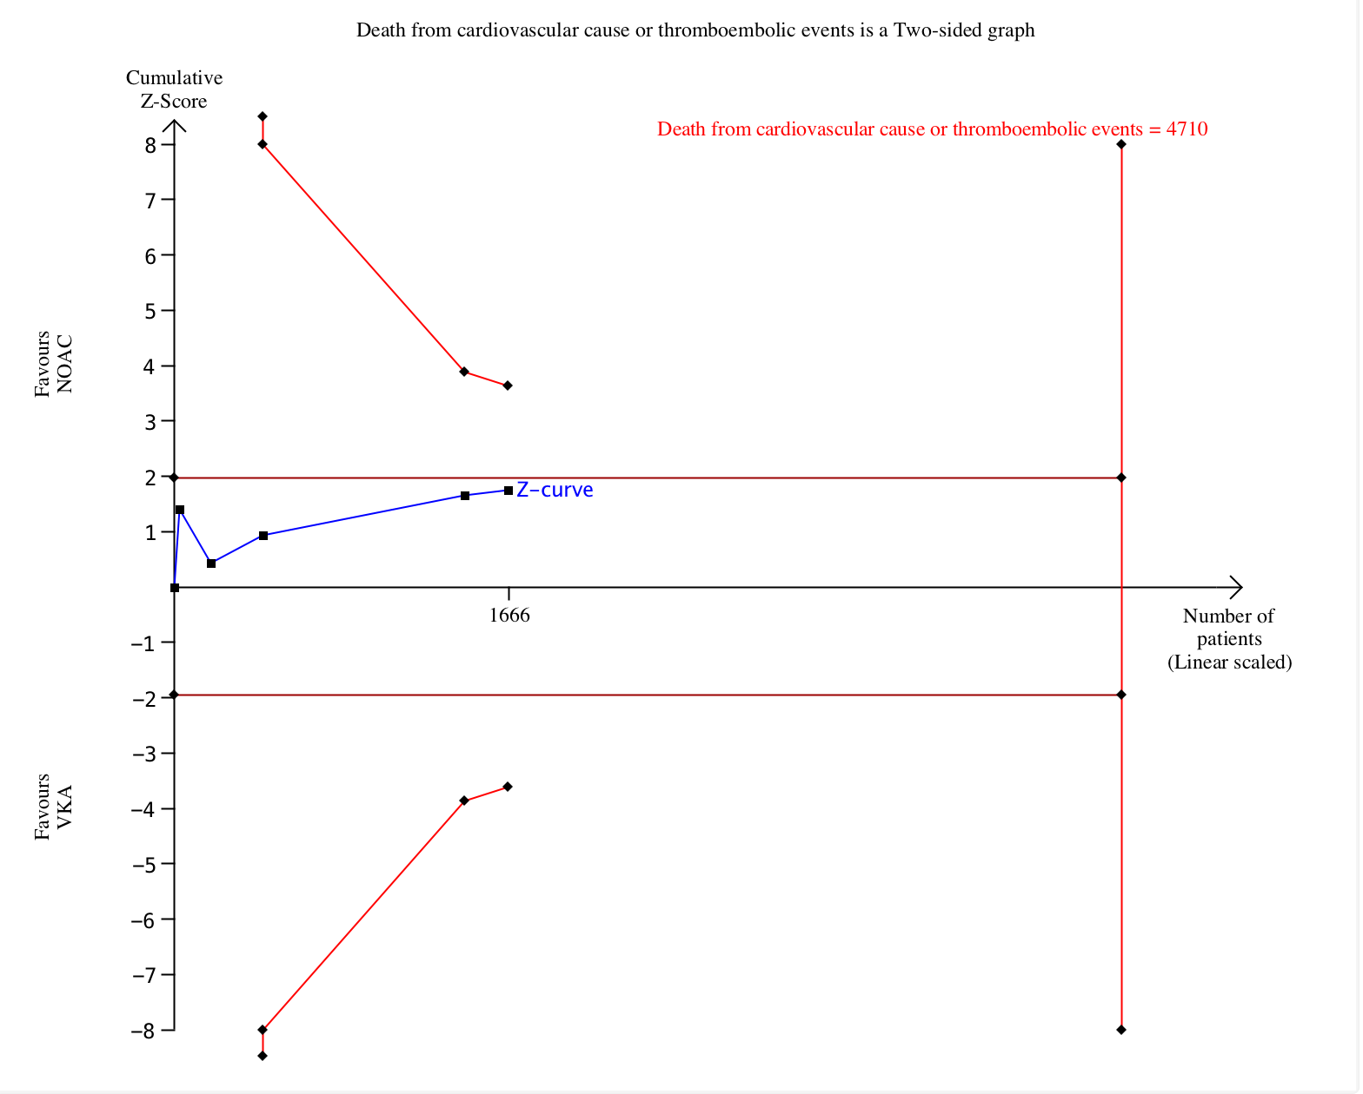
Death from cardiovascular causes or thromboembolic events - TSA
Figure S3
Supplementary Figure 3: Trial sequential analysis for death from cardiovascular cause or thromboembolic events. Required sample size and alpha spending boundaries were adjusted to the heterogeneity of the meta-analysis

Slide 6
Major bleeding – without valve repair
Figure S4
Supplementary Figure 4: Forest plot with pooled estimates regarding major bleeding without valve repairs. DOAC = Direct oral anticoagulation, VKA = Vitamin-K antagonist, M-H = Mantel-Haenszel, CI = Confidence interval

Slide 7
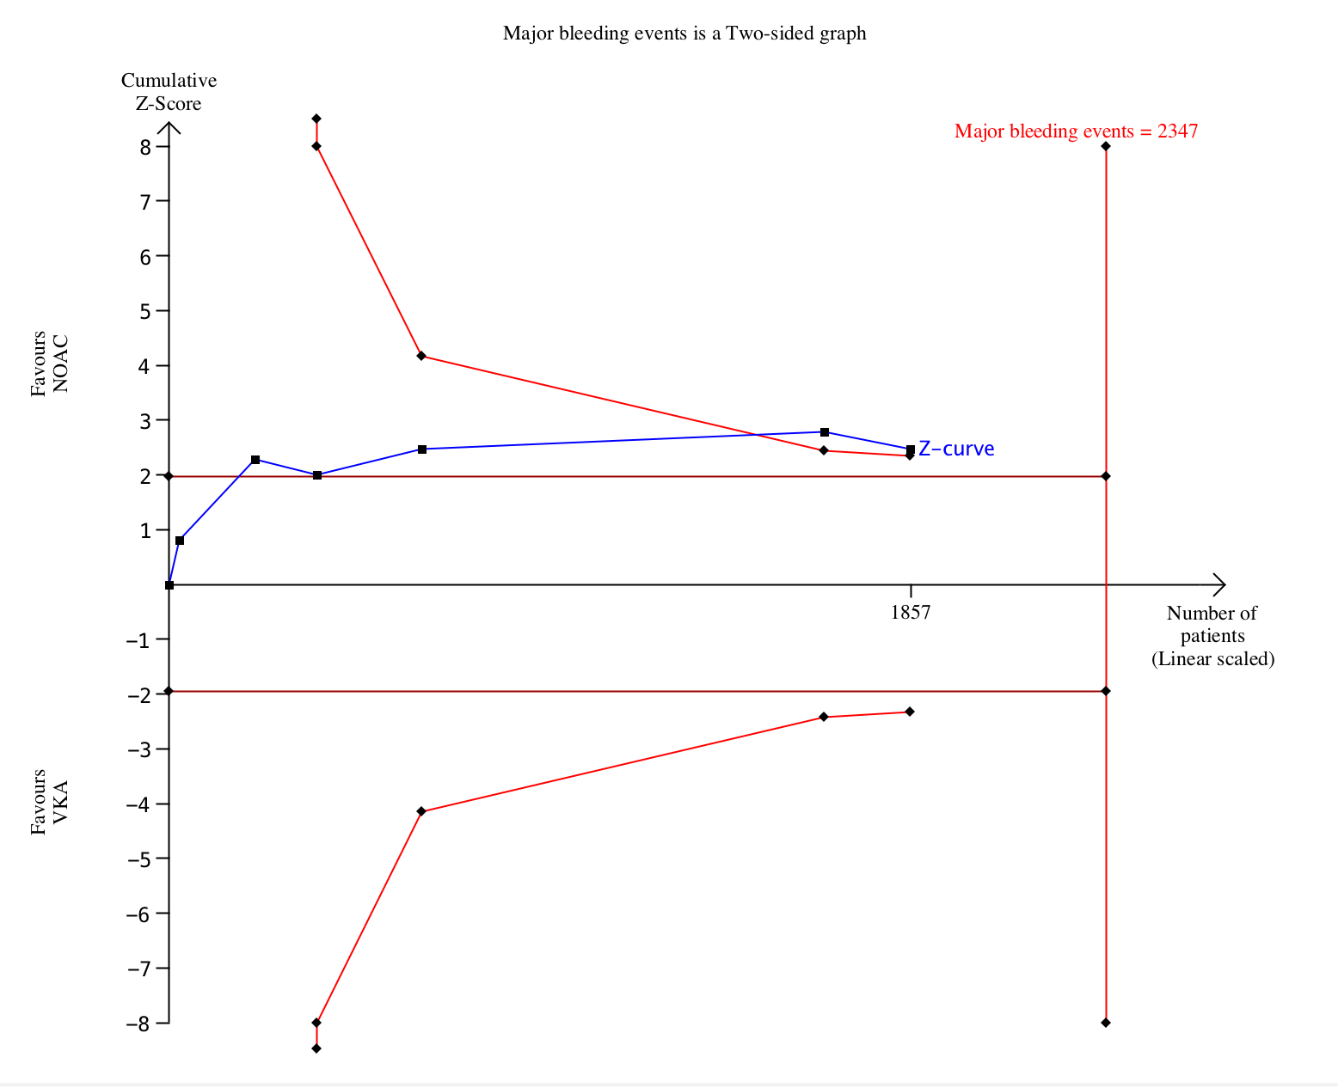
Major bleeding – TSA
Figure S5
Supplementary Figure 5: Trial sequential analysis for major bleeding. Required sample size and alpha spending boundaries were adjusted to the heterogeneity of the meta-analysis

Slide 8
Thromboembolic stroke or systemic embolism
– without valve repair
Figure S6
Supplementary Figure 6: Forest plot with pooled estimates regarding thromboembolic stroke or systemic embolism without valve repairs. DOAC = Direct oral anticoagulation, VKA = Vitamin-K antagonist, M-H = Mantel-Haenszel, CI = Confidence interval

Slide 9
Intracranial bleeding or haemorrhagic stroke
Figure S7
Supplementary Figure 7: Forest plot with pooled estimates regarding intracranial bleeding or hemorrhagic stroke. DOAC = Direct oral anticoagulation, VKA = Vitamin-K antagonist, M-H = Mantel-Haenszel, CI = Confidence interval

Slide 10
Intracranial bleeding or haemorrhagic stroke
– without valve repair
Figure S8
Supplementary Figure 8: Forest plot with pooled estimates regarding intracranial bleeding or hemorrhagic stroke without valve repairs. DOAC = Direct oral anticoagulation, VKA = Vitamin-K antagonist, M-H = Mantel-Haenszel, CI = Confidence interval

Slide 11
Any bleeding
Figure S9
Supplementary Figure 9: Forest plot with pooled estimates regarding any bleeding events (major + minor bleeding). DOAC = Direct oral anticoagulation, VKA = Vitamin-K antagonist, M-H = Mantel-Haenszel, CI = Confidence interval

Slide 12
Any bleeding – without valve repair
Figure S10
Supplementary Figure 10: Forest plot with pooled estimates regarding any bleeding events (major + minor bleeding) without valve repairs. DOAC = Direct oral anticoagulation, VKA = Vitamin-K antagonist, M-H = Mantel-Haenszel, CI = Confidence interval

Slide 13
All cause mortality
Figure S11
Supplementary Figure 11: Forest plot with pooled estimates regarding all cause mortality. DOAC = Direct oral anticoagulation, VKA = Vitamin-K antagonist, M-H = Mantel-Haenszel, CI = Confidence interval

Slide 14
All cause mortality – without valve repair
Figure S12
Supplementary Figure 12: Forest plot with pooled estimates regarding all cause mortality without valve repair. DOAC = Direct oral anticoagulation, VKA = Vitamin-K antagonist, M-H = Mantel-Haenszel, CI = Confidence interval

Slide 15
Cardiovascular mortality
Figure S13
Supplementary Figure 13: Forest plot with pooled estimates regarding cardiovascular mortality. DOAC = Direct oral anticoagulation, VKA = Vitamin-K antagonist, M-H = Mantel-Haenszel, CI = Confidence interval

Slide 16
Cardiovascular mortality – without valve repair
Figure S14
Supplementary Figure 14: Forest plot with pooled estimates regarding cardiovascular mortality without valve repair. DOAC = Direct oral anticoagulation, VKA = Vitamin-K antagonist, M-H = Mantel-Haenszel, CI = Confidence interval

Slide 17
Death from cardiovascular causes or thromboembolic events + major bleeding
– without valve repair
Figure S15
Supplementary Figure 15: Forest plot with pooled estimates regarding death from cardiovascular cause or thromboembolic events and major bleeding without valve repairs. DOAC = Direct oral anticoagulation, VKA = Vitamin-K antagonist, M-H = Mantel-Haenszel, CI = Confidence interval

