Slide 1
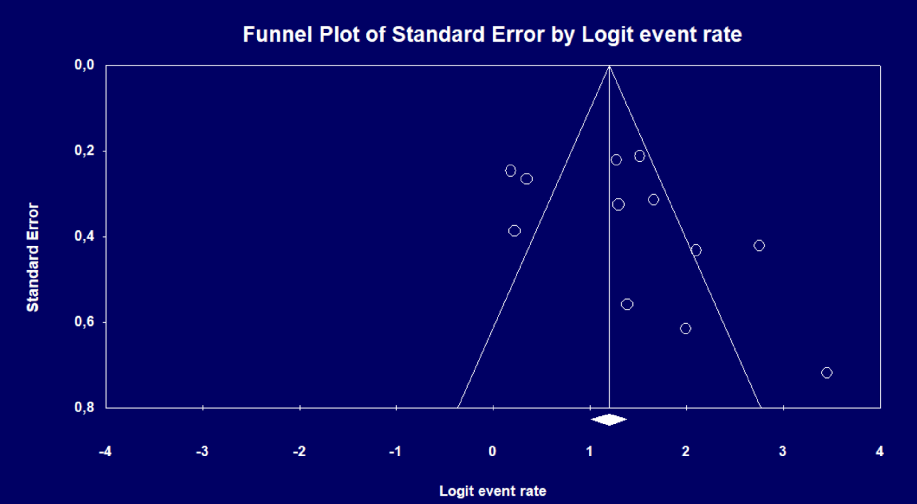
Publication bias for restaging
p<0.001

Slide 2
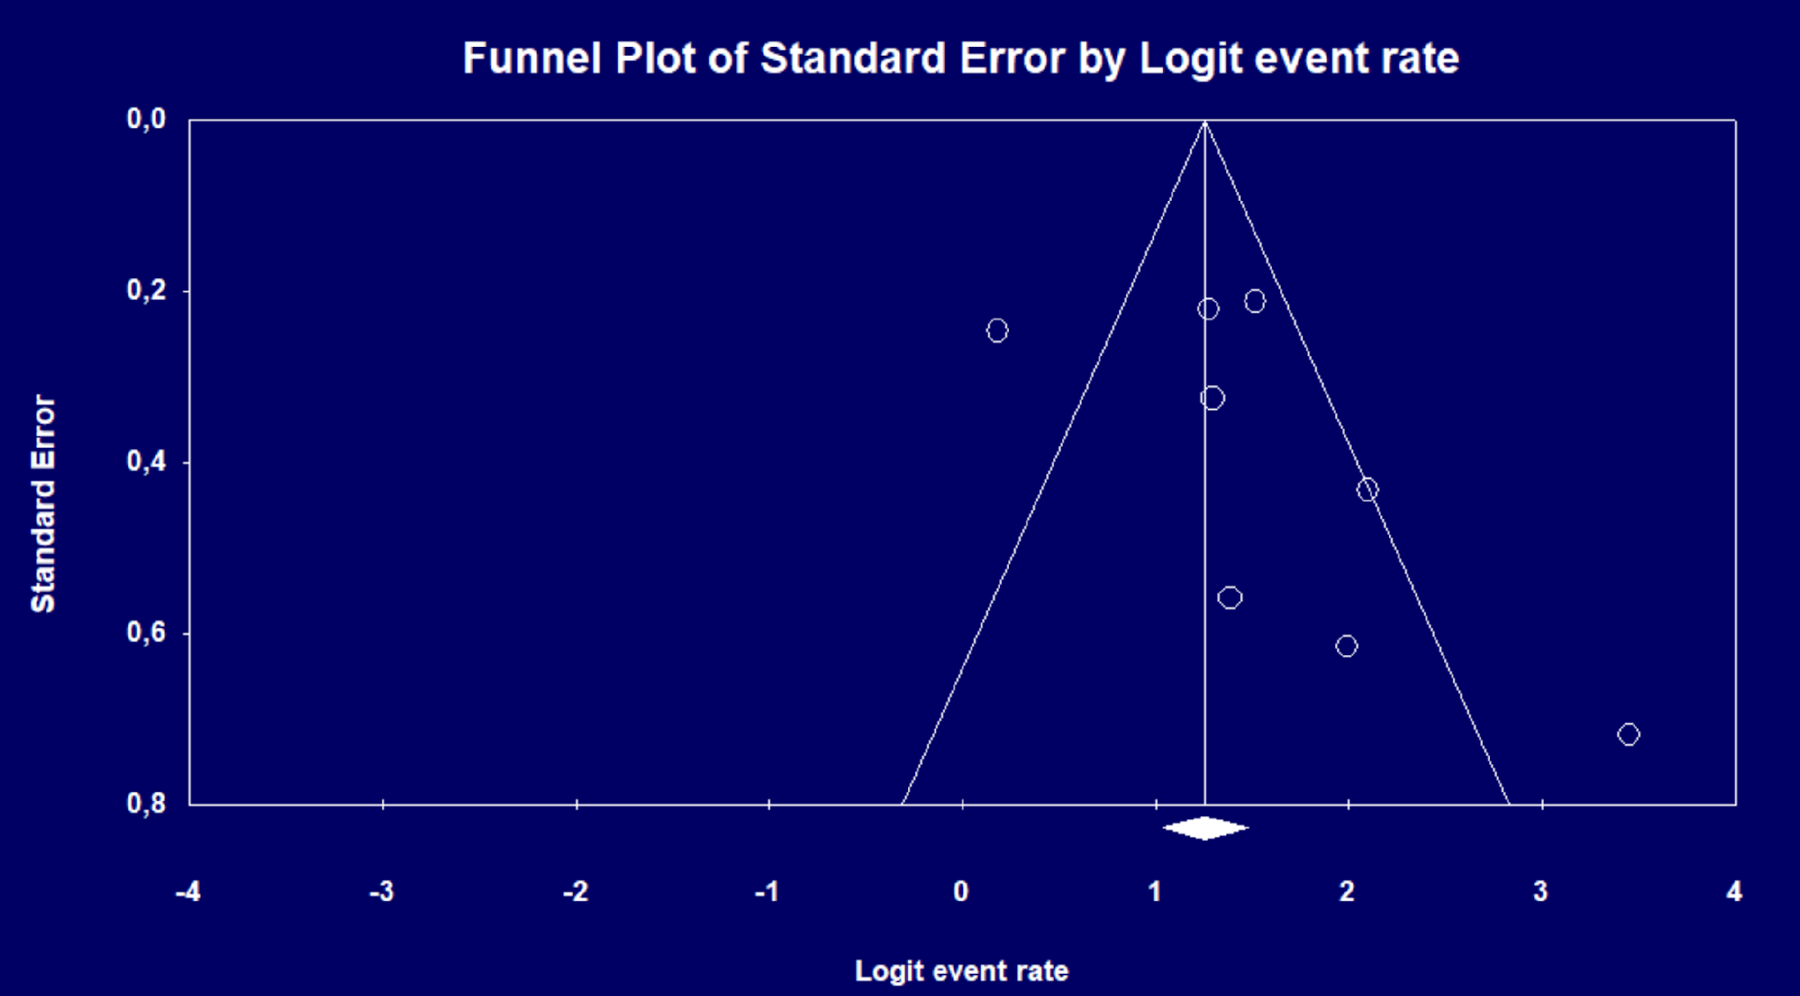
Publication bias for restaging
PSMA PET/MRI
p<0.001

Slide 3

Publication bias
for restaging
Choline PET/MRI
p<0.001

